Slide 2
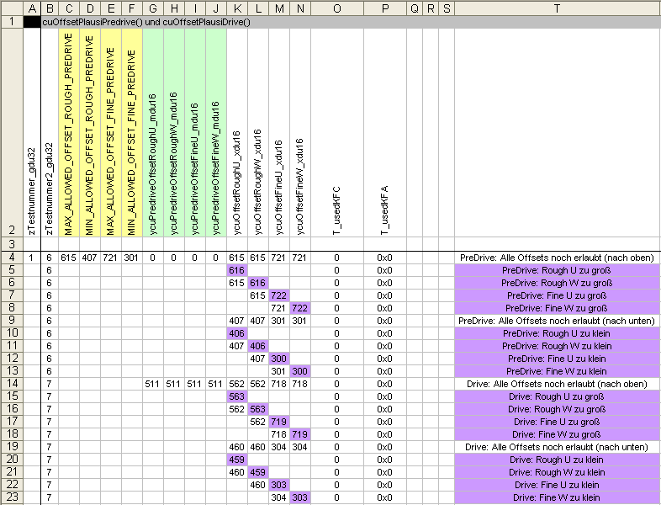
Example for Test Input (TI file)
Input variables
Output variables
Test case descriptions
Input values
Selection of function to test

Slide 3
Hints for Test Input (TI file)
Build reasonable groups of input and output variables
Build reasonable groups of test cases
Mark these groups with background colour
Don‘t write just „some“ test case description, better write an understandable description
If some test cases build a sequence (e.g. ramping up one value) one description is enough (mark this sequence with colour)
Give reasonable default values for input and output values.
Values are created according to following guideline:
Determination of input values for module testing
Mark „interesting“ cells with colour (e.g. cells who have direct influence on output values) (see example cells K5, L6 etc.)

Slide 4
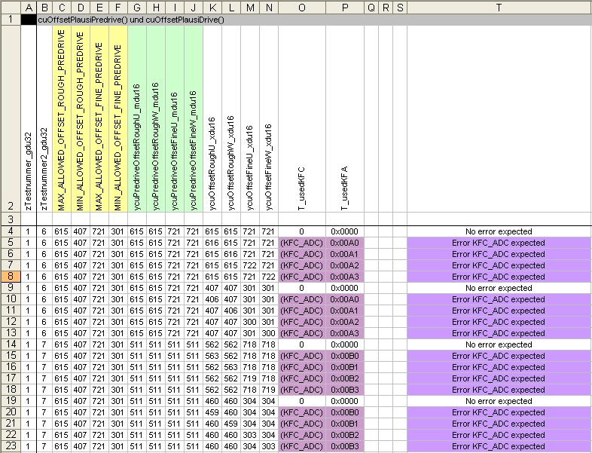
Example for Test Reference (TO file)
Expected output values
Descriptions of expected results

Slide 5
Hints for Test Reference (TO file)
Copy row with names of input and output variables (row number 2) from test input sheet (no need to write it manually)
Give concise descriptions of the expected results

Slide 6
Boundary-Value Analysis and Equivalence Partitioning
615 is max. allowed
One test with value 615 -> OK
One test with value 616 -> Error expected
301 is min. allowed
One test with value 301 -> OK
One test with value 300 -> Error expected

Slide 7
Hints for boundary-value analysis and
equivalence partitioning
Boundary-Value Analysis:
Test with one value below threshold (smallest distance possible)
Test with one value equal to threshold
Test with one value above threshold (smallest distance possible)
Equivalence Partitioning:
Build intervals of values
  E.g. value type is tSI8: equivalence classes may be (depends on function specification)
  [-128;-5] -> invalid value
  [-4;10] -> valid value
  [11;127] -> invalid value
Test with some values from each equivalence class (don‘t forget the boundary-value analysis)

