Slide 1

V - CAR
VCAR - UNIT TESTING
Pronounced as Fou-Car
E – Eingang - Input
V – Vorgang - Process
A – Ausgang - Exit/OP
Vcar – V (Process) car (Engine)
Unit Testing
Used for Testing Different Conditions
  – The code flow in a particular path resulting from the conditions
Strictly confidential | ESC2 | 07/02/2011 | By - Ashwin . Y | © Robert Bosch Engineering and Business Solutions Limited 2011. All rights reserved, also regarding any disposal, exploitation, reproduction, editing, distribution, as well as in the event of applications for industrial property rights.

Slide 2
Requirements of the ISO 26262 for unit testing
1. Define equivalence classes
2. A test specification for each testcase and teststep
3. A defined precondition for each testcase and teststep
4. Mention the equivalence class(es) used for each testcase and teststep
5. An expected behavior for each testcase

Slide 3
Basic Concept
VCAR - UNIT TESTING
BUILDING
by Running Target
( make VCAR CTC_FILE_ALL )
Gnucar.bat
( has reference to VCAR.exe and other tools used)
GENERATES
OUTPUT
(dat) → (_tr.dat)
-Values of the variables after executing a part of code
INPUT
(_ti.txt) → (txt)
-Input Variables and their values
VCAR
(testarossa.xls)
( GUI )
COMPARE
Reference / Expected Output
(_tr.odat) → (Odat)
Strictly confidential | ESC2 | 07/02/2011 | By - Ashwin . Y | © Robert Bosch Engineering and Business Solutions Limited 2011. All rights reserved, also regarding any disposal, exploitation, reproduction, editing, distribution, as well as in the event of applications for industrial property rights.

Slide 4
V-CAR Process
VCAR - UNIT TESTING
VCAR Testing involves :
Instrumentation of the Code for VCAR.
Compile the software and then generate the VCAR.exe using the target “make vcar_ctc “XFILE=‘COMPONENT NAME’ ”.
Initialising the local or global variables in the test header file present at the UnitTestSet subsystem for the corresponding component.
Create the VCAR files txt, cmo cmt, odat.
5. Load the txt file in testarossa.xls, then give the test inputs for the corresponding variables in it. Also fill the expected output in odat file.
6. Run the VCAR test.
7. Check for the output [dat file] in testarossa.xls
Strictly confidential | ESC2 | 07/02/2011 | By - Ashwin . Y | © Robert Bosch Engineering and Business Solutions Limited 2011. All rights reserved, also regarding any disposal, exploitation, reproduction, editing, distribution, as well as in the event of applications for industrial property rights.

Slide 5
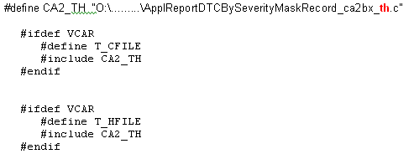
Test Header
VCAR - UNIT TESTING
    Each module will contain a test header with the name xxxxxxx_th.h. eg, ApplReportDTCBySeverityMaskRecord_ca2bx_cc.c will have a test header named ApplReportDTCBySeverityMaskRecord_ca2bx_th.c.
    The Test Header Contains certain pieces of code which is necessary for testing.
    These pieces of code are inserted at different places in the actual C code, and they help in testing the C code.
    To include the pieces of code at different places , This test header will be included conditionally when VCAR is defined.
Strictly confidential | ESC2 | 07/02/2011 | By - Ashwin . Y | © Robert Bosch Engineering and Business Solutions Limited 2011. All rights reserved, also regarding any disposal, exploitation, reproduction, editing, distribution, as well as in the event of applications for industrial property rights.

Slide 6
Test Header
The Test header has three sections:
The contents that go into the source file. This includes:
The contents that go before the first executable code in the file
The contents that go into the header file
The contents that go at the beginning and at the end of the function.
File Instrumentation
Function Instrumentation

Slide 7
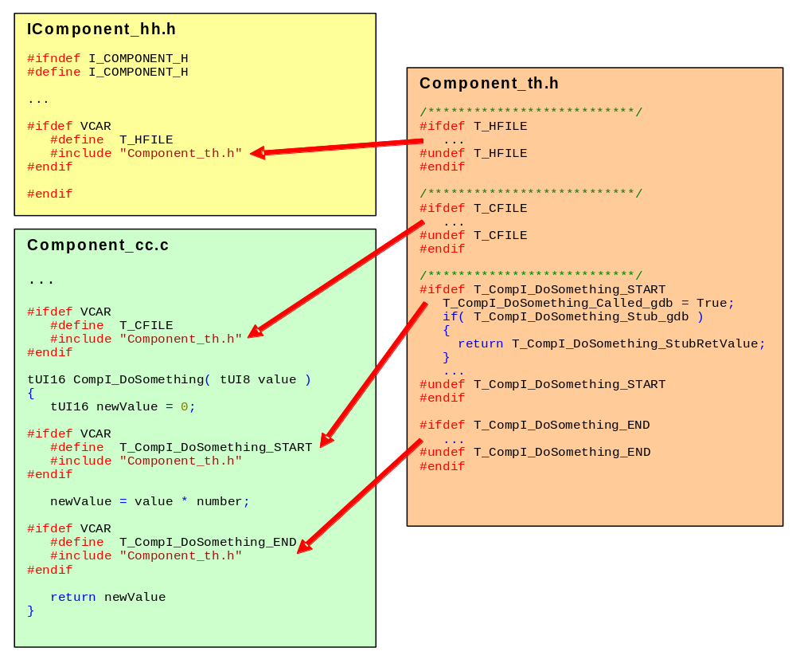
VCAR -
Strictly confidential | ESC2 | 07/02/2011 | By - Ashwin . Y | © Robert Bosch Engineering and Business Solutions Limited 2011. All rights reserved, also regarding any disposal, exploitation, reproduction, editing, distribution, as well as in the event of applications for industrial property rights.

Slide 8
VCAR -
CODE INSTRUMENTATION
Code instrumentation means inserting pieces of code into different locations in the actual code so as to enable testing.
There are 2 different kinds of Code Instrumentation
Function Instrumentation
File instrumentation
Strictly confidential | ESC2 | 07/02/2011 | By - Ashwin . Y | © Robert Bosch Engineering and Business Solutions Limited 2011. All rights reserved, also regarding any disposal, exploitation, reproduction, editing, distribution, as well as in the event of applications for industrial property rights.

Slide 9
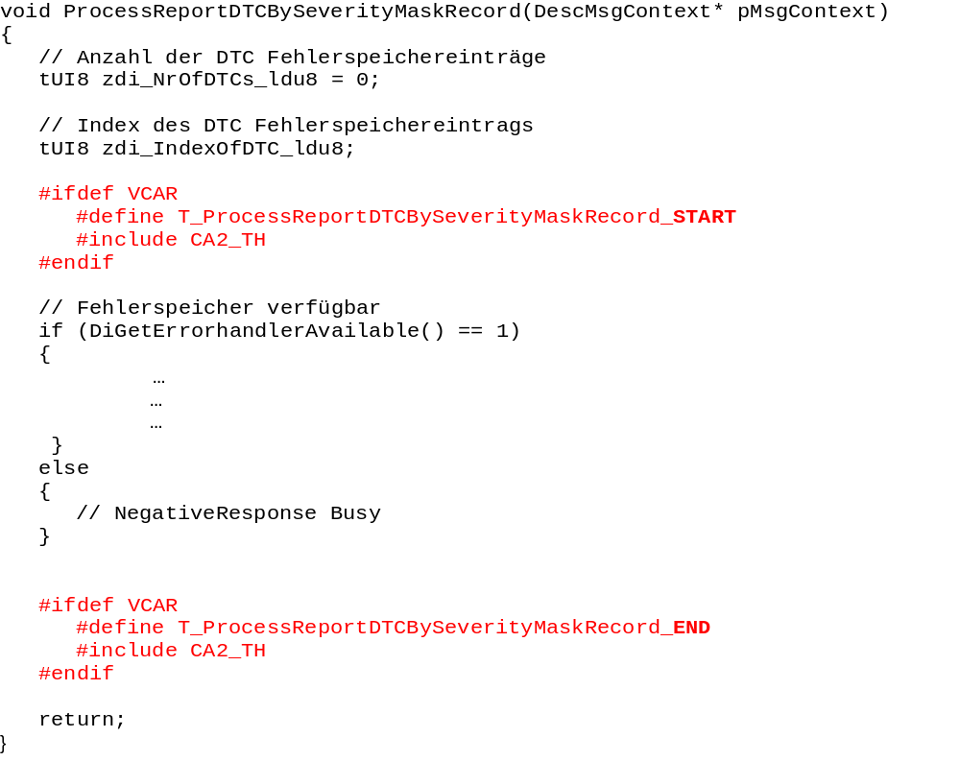
VCAR -
FUNCTION INSTRUMENTATION
Adding VCAR related pre-processor section at the function start and end.
PURPOSE:
To pass values into some local variables used within the function at the xxx_START of the function
And read the value of the local variable towards the xxx_END of the function
EXAMPLE : -->
Note: The ‘include’ at the function end should be added at every location the function can possibly return.
Strictly confidential | ESC2 | 07/02/2011 | By - Ashwin . Y | © Robert Bosch Engineering and Business Solutions Limited 2011. All rights reserved, also regarding any disposal, exploitation, reproduction, editing, distribution, as well as in the event of applications for industrial property rights.

Slide 10
FUNCTION INSTRUMENTATION
  Input variables that are structures and multidimentional arrays can be initialised by copying the data from test variables just before executing the function
  Test Header also provides stub(temporary) functions present in the current module, so that other modules can use these stubs.
These contents go into the starting of the function as below:
#if defined (T_ProcessReportDTCBySeverityMaskRecord_START)
/* indicate subroutine call */
zProcessReportDTCBySeverityMaskRecord_Calls_gdu8++;
/* do not execute subroutine in case of stubbing */
/* possibly give back a return parameter */
if (fProcessReportDTCBySeverityMaskRecord_Stub_gdb)
{
return;
}
#undef T_ProcessReportDTCBySeverityMaskRecord_START
#endif

Slide 11
VCAR -
FILE INSTRUMENTATION
1. Adding VCAR related pre-processor sections in the source file. This has to be added just before the first executable function starts.
#ifdef VCAR
#define T_CFILE
#include CA2_TH
#endif
2. Adding VCAR related pre-processor section in the source header file. This has to be added just before the first executable function starts.
#ifdef VCAR
#define T_HFILE
#include CA2_TH
#endif
PURPOSE:
Used to Stub Functions and declare test variables.
Functions : Functions that are a reference or call to hardware / Functions that we do not need to test are to be stubbed.
Variables : Variables that are an element of structure or Union and need to be tested are to be assigned to Test variables OR variables used for testing purpose.
Strictly confidential | ESC2 | 07/02/2011 | By - Ashwin . Y | © Robert Bosch Engineering and Business Solutions Limited 2011. All rights reserved, also regarding any disposal, exploitation, reproduction, editing, distribution, as well as in the event of applications for industrial property rights.

Slide 12
VCAR -
STUBS
A “Stub” is a dummy or a testable replacement for a function or a variable.
STUBBING A FUNCTION :
For Example : if there is a call to a function that handles a hardware functionality (for example a function to read temperature from a sensor) , but this function is not testable in an offline environment like a standalone computer or in your local compiler, then you STUB it ( or REPLACE it) with a dummy function , that does nothing or just increments a variable... say x.
So after you run you code , if you find that the variable x has been incremented , you know that the function(Temperature sensor function) has been called.
HOW to STUB:
Let us say that the temperature sensor function is “Read_TempSens()”
We stub it with a dummy variable “Test_ReadTemp” as shown below -
Int Test_ReadTemp;
#undef Read_TempSens()
#define Read_TempSens() Test_ReadTemp++
Strictly confidential | ESC2 | 07/02/2011 | By - Ashwin . Y | © Robert Bosch Engineering and Business Solutions Limited 2011. All rights reserved, also regarding any disposal, exploitation, reproduction, editing, distribution, as well as in the event of applications for industrial property rights.

Slide 13
VCAR -
TEST VARIABLES
VCAR can handle only global variables, static variables and one dimensional arrays. Anything that is other than these has to be handled in the test header using test variables.
For Example :
Assume a structure containing 2 elements Message.length , Message.period declared as shown.
Struct{
char length;
Int period;
} message;
If we want to read only the length of the message using VCAR ,Then we assign the element to Test variables as follows :-
Char Test_MessLength =0; // This line is put in File Instrumentation
message.length=Test_MessLength; //write the value to the Structure element
Test_MessLength=message.length; //Read the value of the Structure element
The declaration of a Test variable is done in File Instrumentation area , and assignment in either File instrumentation or Function Instrumentation area (START/END) depending on the need.
Strictly confidential | ESC2 | 07/02/2011 | By - Ashwin . Y | © Robert Bosch Engineering and Business Solutions Limited 2011. All rights reserved, also regarding any disposal, exploitation, reproduction, editing, distribution, as well as in the event of applications for industrial property rights.

Slide 14
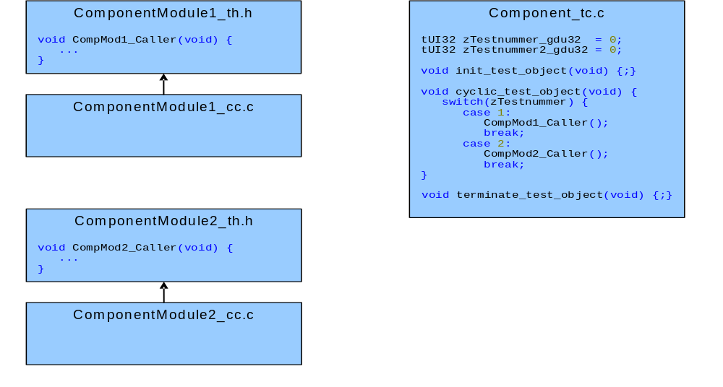
VCAR -
TEST Caller Files- They are used to call all the caller functions inside a C-file. Present in the UnitTestSet subsystem of the corresponding component.
Strictly confidential | ESC2 | 07/02/2011 | By - Ashwin . Y | © Robert Bosch Engineering and Business Solutions Limited 2011. All rights reserved, also regarding any disposal, exploitation, reproduction, editing, distribution, as well as in the event of applications for industrial property rights.

Slide 15
Process of testing and GUI
VCAR - UNIT TESTING
Run the make Target for VCAR
    Make vcar CTC_FILE_ALL
  Doing this Compiles the code with a macro VCAR defined.
  This includes some extra code into the actual code used for testing purpose, and then compiles the code.
  Then Generates gnucar.bat , which is used as an input in testarossa.
  NOTE : VCAR has its own compiler.
Open testarossa_4.xls
  Select the txt sheet to provide input for the VCAR module.
  Similarly fill the odat sheet which contains the expected Output for the input
  values in txt sheet.
Strictly confidential | ESC2 | 07/02/2011 | By - Ashwin . Y | © Robert Bosch Engineering and Business Solutions Limited 2011. All rights reserved, also regarding any disposal, exploitation, reproduction, editing, distribution, as well as in the event of applications for industrial property rights.

Slide 16
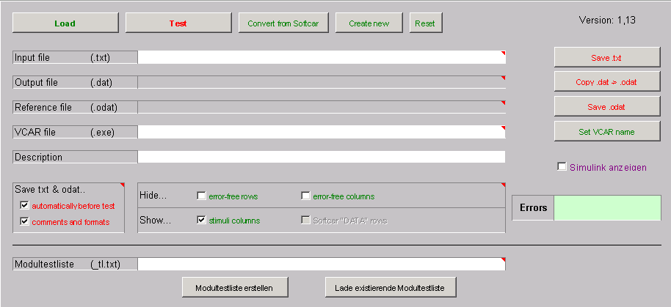
VCAR – GUI overview
Load the VCAR module to be tested
Test when Input and Output sheets are filled
Save options
Status of the errors
Description of the current VCAR module
Strictly confidential | ESC2 | 07/02/2011 | By - Ashwin . Y | © Robert Bosch Engineering and Business Solutions Limited 2011. All rights reserved, also regarding any disposal, exploitation, reproduction, editing, distribution, as well as in the event of applications for industrial property rights.

Slide 17
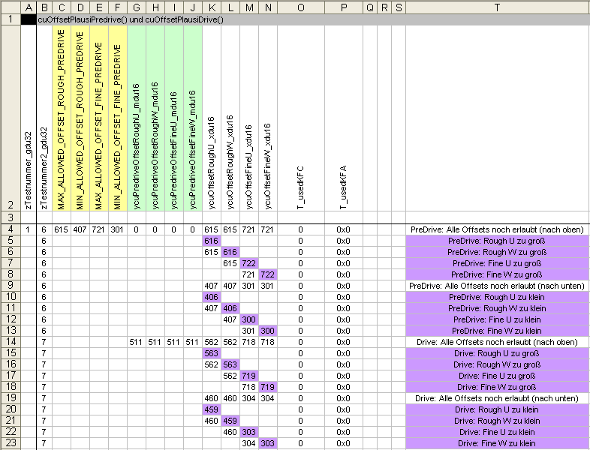
VCAR- Input sheet
Variables
Test Variables
Description
Input Values
Strictly confidential | ESC2 | 07/02/2011 | By - Ashwin . Y | © Robert Bosch Engineering and Business Solutions Limited 2011. All rights reserved, also regarding any disposal, exploitation, reproduction, editing, distribution, as well as in the event of applications for industrial property rights.

Slide 18
VCAR – Choosing the Input Values
Build reasonable groups of input and output variables
Build reasonable groups of test cases
Mark these groups with background colour
Don’t write just some“ test case”description, better write an understandable description
Give reasonable default values for input and output values.
Do not use insert any blank row or column between test cases / Variables
Strictly confidential | ESC2 | 07/02/2011 | By - Ashwin . Y | © Robert Bosch Engineering and Business Solutions Limited 2011. All rights reserved, also regarding any disposal, exploitation, reproduction, editing, distribution, as well as in the event of applications for industrial property rights.

Slide 19
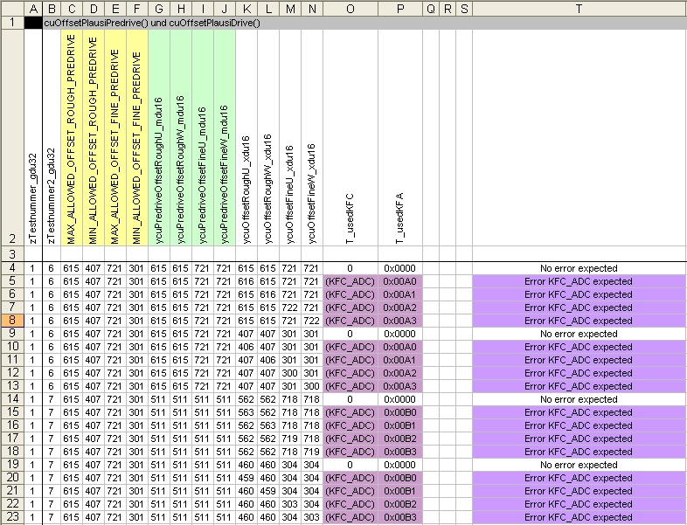
VCAR – Expected Output Sheet ( ODat )
Expected Output Values
Description for Expected Results
Strictly confidential | ESC2 | 07/02/2011 | By - Ashwin . Y | © Robert Bosch Engineering and Business Solutions Limited 2011. All rights reserved, also regarding any disposal, exploitation, reproduction, editing, distribution, as well as in the event of applications for industrial property rights.

Slide 20
VCAR – Output Values
Copy row with names of input and output variables (row number 2) from test input sheet (no need to write it manually)
Give concise descriptions of the expected results
Also the comments entered in Description
These Comments, formatting and colour data is automatically stored in 2 special files with extension .cmt and .cmo. They can be found in test set and correspond to the comments of Test input and Odat respectively.
2 other files that are necessary to be updated are the Testlist file with .tl extension ( used for VCAR) and the testlist.xml file which is used for Regression test.
Care has to be taken while filling and saving these files !
Strictly confidential | ESC2 | 07/02/2011 | By - Ashwin . Y | © Robert Bosch Engineering and Business Solutions Limited 2011. All rights reserved, also regarding any disposal, exploitation, reproduction, editing, distribution, as well as in the event of applications for industrial property rights.

Slide 21
Miscellaneous
With VCAR the aim should be to analyse complete code coverage and to test the logic of implementation.
We could also find dead code using VCAR test.

Slide 22
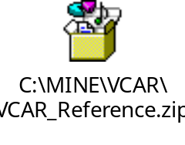

Reference Example
Please refer this example and go through the comments put along with the code , to get a better understanding.
Practice Task
Please create a Test header for the given C file , and also update the testmain.c file and test cases ( test Input and expected results –Odat) in the excell sheet accordingly. Use the reference for help.
NOTE : Do not edit in ppt.. Copy the Zip file, extract it and then do the Task

Slide 23
Thank You

