Slide 1
Distributed Systems Project Defense
Distributed Hash Computation System
David BOZON - M1 INFO
Khoa TRAN - M1 MOSIG

Slide 2
Table of content
Introduction
Architecture
Phase 1
Phase 2
Phase 3
Demonstration
Conclusion
Questions

Slide 3
Introduction
We all know how to compute a hash.
But can we invert it ?
Enter the Hash Machine.

Slide 4

Introduction
Hard to invert a hash
For most, two options are available
Bruteforce
  One ASCII character mean 94 possibilities
  n ASCII characters mean 94^{n} possibilities
  From 1 to n ASCII characters means
Dictionary attacks
  Narrow down the list of possibilities
  Huge file, still lot of computations

Slide 5
Architecture
Load Balancer (LB)
  Handle clients requests
Servers (S)
  Distribute the work (parts of a big dictionary)
Clients (C)
  Do the computations

Slide 6
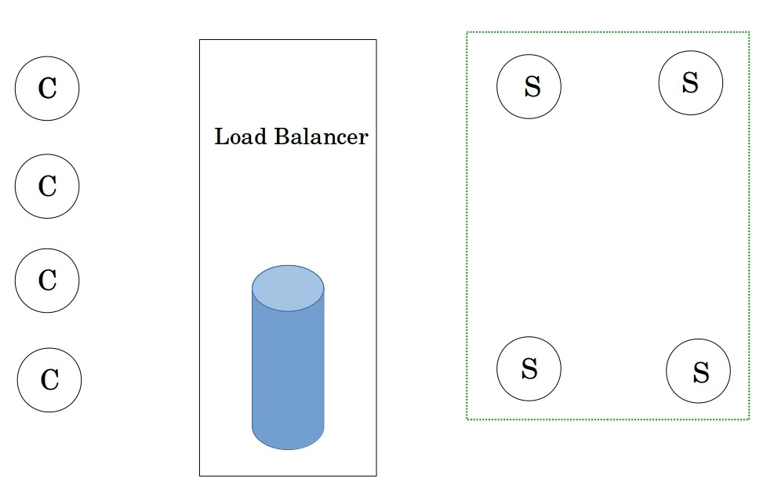
Architecture

Slide 7
Phase 1 - Bootstrap
Servers are launched
  Connect to the LB
  Get a part of the dictionary
Load Balancer is started
  Divide the dictionary
  Set up a queue for the servers to get their parts
  Also get hash to find

Slide 8
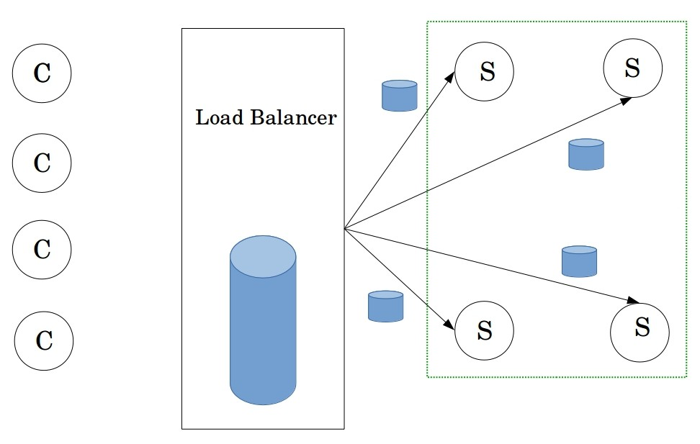
Phase 1 - Bootstrap

Slide 9
Phase 2 - Compute
Load Balancer wait for clients
Clients request chunk of dictionary
  Will compute hashes
Servers send smaller chunks
Clients start computing hashes
  Request more work if they are done
  Send the result if it’s found

Slide 10
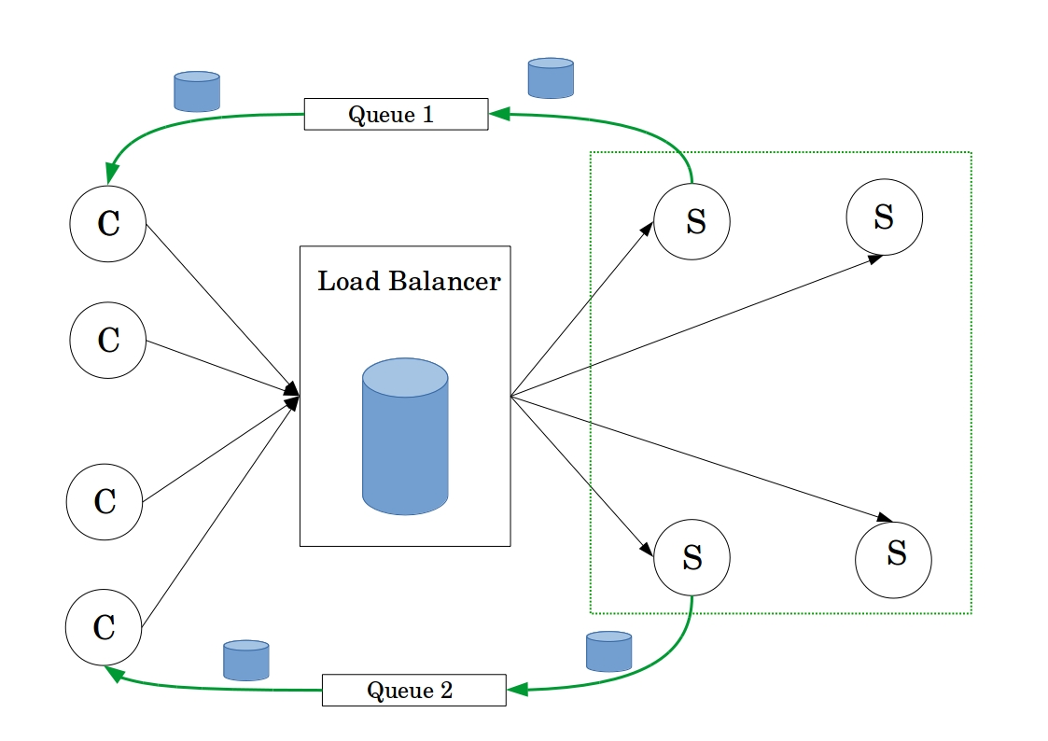
Phase 2 - Compute

Slide 11
Phase 3 - Terminate
A client find the result
  Abort computation on the remaining clients
  The other servers are notified
  Output the hash back to the user
No one find the result
  Client are informed that there is no work left

Slide 12
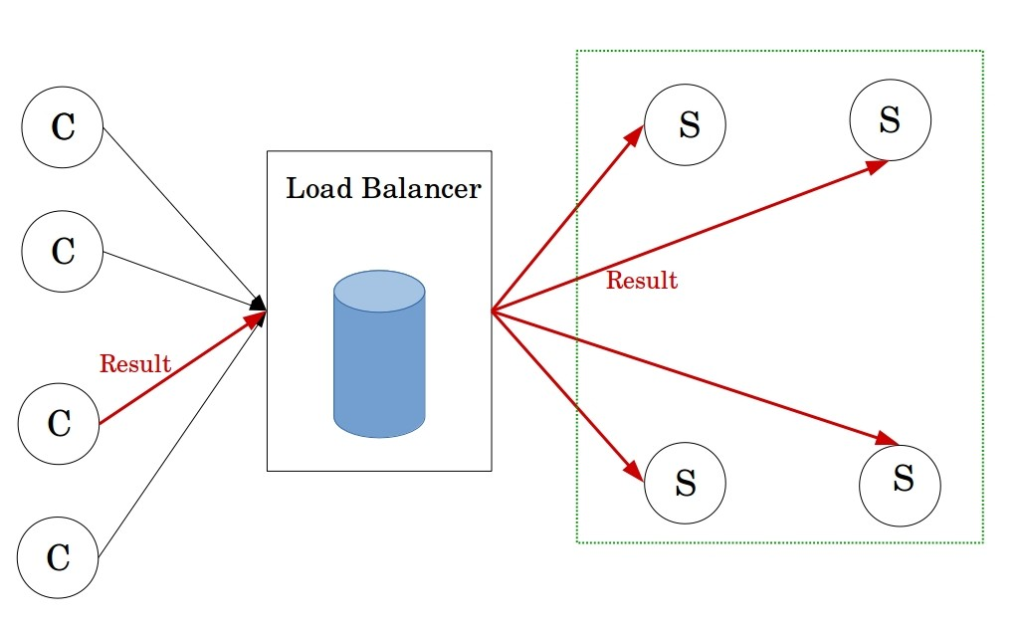
Phase 3 - Terminate

Slide 13
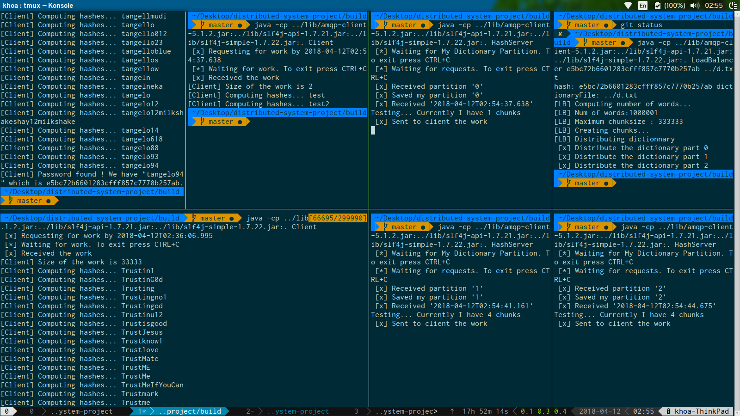
Demo

Slide 14
Conclusion
Was an interesting project
Much, much more time was needed
C++ would have fitted more
  Performance required for computations
Java was faster for implementation

Slide 15
Thanks you for your attention
Do you have any questions ?

