Slide 1
Chapter 6
Company-Centric B2B
and E-Procurement

Slide 2
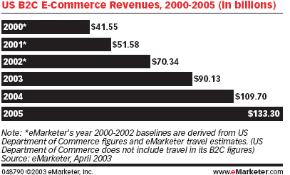
US B2C Market Size

Slide 3
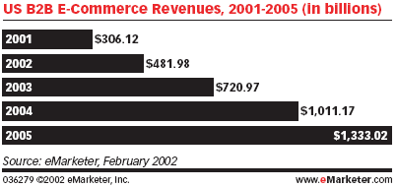
US B2B Market Size

Slide 4
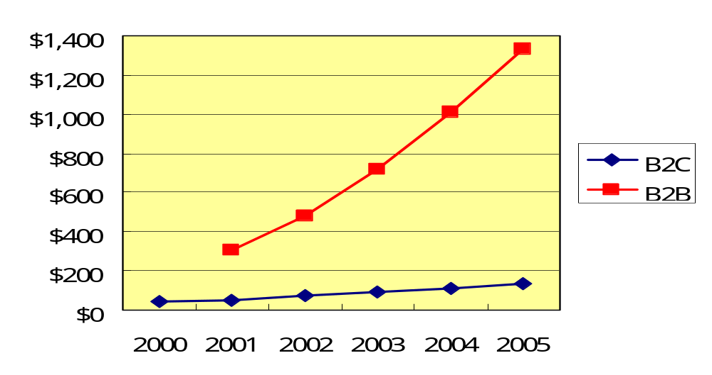
US EC Market Growth
Billion US$
Sources： eMarketer, February 2002Source: eMarketer, April 2003

Slide 5
General Motors’
B2B Initiatives
The Problem
  Because the automotive industry is very competitive, GM is always looking for ways to improve its effectiveness
  GM expects to custom-build the majority of its cars by 2005
  The company hopes to use the system to save billions of dollars by reducing its inventory of finished cars
    (why inventory??)

Slide 6
General Motors’
B2B Initiatives (cont.)
  GM sells custom-designed cars online through its dealers’ sites avoiding channel conflict (think about Dell vs. HP)
  This collaboration requires sharing information with dealers and suppliers
  Operational problems
    disposing of manufacturing machines that are no longer sufficiently productive
    procurement of commodity products

Slide 7
General Motors’
B2B Initiatives (cont.)
The Solution
  GM established an extranet infrastructure called ANX (Automotive Network eXchange)
  ANX has evolved into the consortium exchange covisint.com supported by other automakers

Slide 8
General Motors’
B2B Initiatives (cont.)
Capital assets problem
  GM implemented its own electronic market from which forward auctions are conducted
Resource procurement problem
  GM automated the bidding process using reverse auctions on its e-procurement site

Slide 9
General Motors’
B2B Initiatives (cont.)
The Results
  Within just 89 minutes after the first forward auction opened, eight stamping presses were sold for $1.8 million
  Off-line method, a similar item would have sold for less than half of its online price, and the process would have taken 4 to 6 weeks

Slide 10
General Motors’
B2B Initiatives (cont.)
  Online reverse auction prices are significantly lower than the prices the company had been paying for the same items previously negotiated by manual tendering
  Administrative costs per order have been reduced by 40%
  Most GM dealers and thousands of GM’s suppliers are connected on a common extranet platform

Slide 11
General Motors’
B2B Initiatives (cont.)
What can we learn…
  Involvement of a large company in three EC activities:
    connecting with dealers and suppliers through an extranet
    electronically auctioning used equipment to customers
    conducting purchasing via electronic bidding

Slide 12
General Motors’
B2B Initiatives (cont.)
  B2B transactions
    Company can be a seller, offering goods or services to many corporate buyers
    Company can be a buyer, seeking goods or services from many corporate sellers (suppliers)
  A company can
    employ auctions
    use electronic catalogs
    use other market mechanisms

Slide 13
Business activities
Material Flow
Cash Flow
Business Flow
Information Flow

Slide 14


Business activities ₂
Information Flow: Information processing, Catalogs, Order Processing
Business Flow: Promotion, Price negotiation, encumbrance, Transfer of Ownership
Buyer
Seller
Cash Flow: Payment, Financing, Risk management
Material Flow: Physical movement of goods, Physical ownership

Slide 15
Coupling OR uncoupling ?
Coupling OR uncoupling?
Value networks:
  tight coupling with up-stream and down-stream
Dynamic market:
  E-Marketplaces
What are the market forces underlying these development?
  Vertical vs. Horizontal visibilities
  Special designed parts vs. Commodities

Slide 16
Procurement:
Market and Product Characteristics
Product Characteristics
 | Low Price | High Price
Many small transactions | A (MRO) | B eProcurement
Few Big transactions | C | D Negotiations by Lawyers
Transaction Chars.
MRO: Maintenance, Repair and Operations

Slide 17
Governance Mechanisms
Specificity of Investments
 | General | Mixed | Specific
Some times
Frequent | 市場
Transaction Frequency
Fixed Networks
Market

Slide 18
Fixed networks vs Markets
Internal Value Chain
Dynamic Market
Industrial Value Network

Slide 19
Fixed networks vs Markets
 | Value Network | Dynamic Market
Relationships | Values added thru internal relationships | Values added thru external relationships
Time Span | Long term | Short term
Commitment | High | Low
Investment per Relationship | High | Low
Number of Relationship | Few | Many

Slide 20
Dynamic Market
Dynamic Specification, quantity and quality
Dynamic Supply and demand → Price fluctuations
Dynamic Pricing
Electronic Market and Electronic Marketplaces

Slide 21
Fixed value network Supply Chain
Virtual Hierarchy
Characteristics
  Low transaction costs
  Low agency costs
High
Agency Cost
Hierarchy | Undesirable
Best of both World | Market
Low
Transaction Cost
High

Slide 22
Fixed value network Supply Chain
Virtual Hierarchy
  Low transaction costs
  Low agency costs
High
Hierarchy | Undesirable
Best of both World | Market
Agency Cost
Low
Transaction Cost
High

Slide 23
This book treats B2B EC as eMarketPlaces

Slide 24
Concepts, Characteristics, and Models of B2B EC
Basic B2B concepts
  Business-to-business e-commerce (B2B EC): Transactions between businesses conducted electronically over the Internet, extranets, intranets, or private networks; also known as eB2B (electronic B2B) or just B2B

Slide 25
Concepts, Characteristics, and Models of B2B EC (cont.)
B2B characteristics
  Parties to the transaction
    Online intermediary: An online third party that brokers a transaction online between a buyer and a seller; can be virtual or click-and-mortar

Slide 26
Concepts, Characteristics, and Models of B2B EC (cont.)
  Types of transactions
    Spot buying: The purchase of goods and services as they are needed, usually at prevailing market prices
    Strategic sourcing: Purchases involving long-term contracts that are usually based on private negotiations between sellers and buyers

Slide 27
B2B Characteristics (cont.)
Types of materials
  Direct materials: Materials used in the production of a product (e.g., steel in a car or paper in a book)
  Indirect materials: Materials used to support production (e.g., office supplies or light bulbs)
  MROs (maintenance, repairs, and operations): Indirect materials used in activities that support production

Slide 28
Concepts, Characteristics, and Models of B2B EC (cont.)
  Direction of trade
    Vertical marketplaces: Markets that deal with one industry or industry segment (e.g., steel, chemicals)
    Horizontal marketplaces: Markets that concentrate on a service, material, or a product that is used in all types of industries (e.g., office supplies, PCs)

Slide 29
Concepts, Characteristics, and Models of B2B EC (cont.)
Basic B2B transaction types
  Sell-side
    One seller to many buyers
  Buy-side
    One buyer from many sellers
  Exchanges
    Many sellers to many buyers
  Collaborative commerce
    Communication and sharing of information, design, and planning among business partners

Slide 30
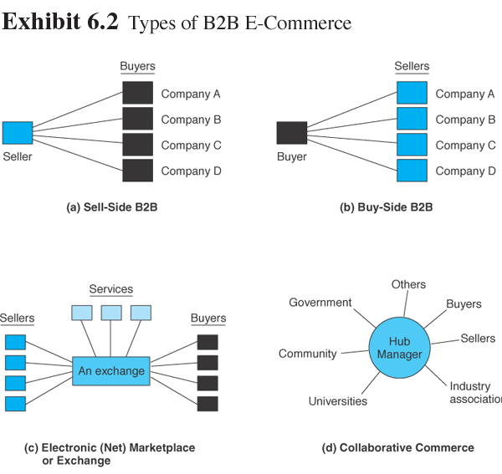
Concepts, Characteristics, and Models of B2B EC (cont.)

Slide 31
Concepts, Characteristics, and Models of B2B EC (cont.)
  One-to-many and many-to-one: company-centric transactions
    Company-centric EC: E-commerce that focuses on a single company’s buying needs (many-to-one, or buy-side) or selling needs (one-to-many, or sell-side)
    Private e-marketplaces: Markets in which the individual sell-side or buy side company has complete control over participation in the selling or buying transaction

Slide 32
Concepts, Characteristics, and Models of B2B EC (cont.)
  Many-to-many: exchanges
    Exchanges (trading communities or trading exchanges): Many-to-many e-marketplaces, usually owned and run by a third party or a consortium, in which many buyers and many sellers meet electronically to trade with each other; also called trading communities or trading exchanges
    Public e-marketplaces: Third-party exchanges that are open to all interested parties (sellers and buyers)

Slide 33
Concepts, Characteristics, and Models of B2B EC (cont.)
  Collaborative commerce
    Communication, design, planning, and information sharing among business partners

Slide 34
Concepts, Characteristics, and Models of B2B EC (cont.)
Supply chain relationships in B2B
  Supply chain process consists of a number of interrelated subprocesses and roles
    acquisition of materials from suppliers
    processing of a product or service
    packaging it and moving it to distributors and retailers
    purchase of a product by the end consumer

Slide 35
Concepts, Characteristics, and Models of B2B EC (cont.)
B2B private e-marketplace provides a company with high supply chain power and high capabilities for online interactions
Joining a public e-marketplace provides a business with high buying and selling capabilities, but will result in low supply chain power
Companies that choose an intermediary to do their buying and selling will be low on both supply chain power and buying/selling capabilities

Slide 36
Concepts, Characteristics, and Models of B2B EC (cont.)
Virtual services industries in B2B
  Travel services
  Real estate
  Financial services
  Online stock trading
  Online financing
  Other online services

Slide 37
Concepts, Characteristics, and Models of B2B EC (cont.)
Benefits of B2B
  Eliminates paper and reduces administrative costs.
  Expedites cycle time
  Lowers search costs and time for buyers
  Increases productivity of employees dealing with buying and/or selling
  Reduces errors and improves quality of services.
  Reduces inventory levels and costs
  Increases production flexibility, permitting just-in-time delivery
  Facilitates mass customization
  Increases opportunities for collaboration

Slide 38
One-to-Many:
Sell-Side Marketplaces
Sell-side e-marketplace: A Web-based marketplace in which one company sells to many business buyers from e-catalogs or auctions, frequently over an extranet
Three major direct sales methods:
  selling from electronic catalogs
  selling via forward auctions
  one-to-one selling

Slide 39
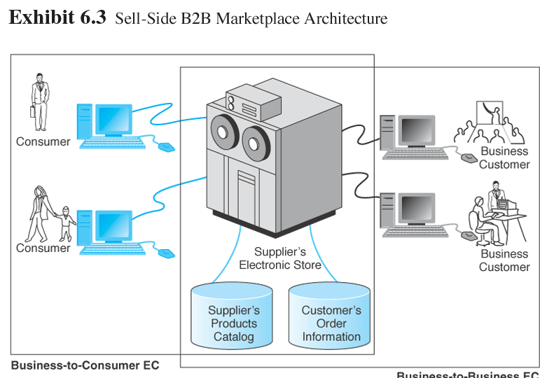
One-to-Many:
Sell-Side Marketplaces (cont.)

Slide 40
One-to-Many:
Sell-Side Marketplaces (cont.)
B2B sellers
  click-and-mortar manufacturers or intermediaries, usually distributors or wholesalers
Customer service
  online sellers can provide sophisticated customer services

Slide 41
One-to-Many:
Sell-Side Marketplaces (cont.)
Configuration and customization
  customize products
  get price quotes
  submit orders

Slide 42
One-to-Many:
Sell-Side Marketplaces (cont.)
Major benefits of direct sales are:
  Lower order-processing costs and less paperwork
  A faster ordering cycle
  Fewer errors in ordering and product configuration
  Lower search costs of products for buyers
  Lower search costs of finding buyers for sellers
  Sellers can advertise and communicate online
  Lower logistics costs
  Ability to offer different catalogs and prices to different customers

Slide 43

Selling via Auctions
Using auctions on the sell side
  Revenue generation
  Cost savings
  Increased page views
  Member acquisition and retention

Slide 44
Selling via Auctions (cont.)
Selling from the company’s own site
  The company will have to pay for infrastructure and operate and maintain the auction site
  If then company already has an electronic marketplace for selling from e-catalogs, the additional cost may not be too high

Slide 45
Selling via Auctions (cont.)
Using intermediaries
  An intermediary may conduct private auctions for a seller, either from the intermediary’s or the seller’s site
  A company may choose to conduct auctions in a public marketplace, using a third-party hosting company

Slide 46
Using Intermediaries in Auctions (cont.)
  Benefits of using intermediaries
    no additional resources are required
    auction set up to show the branding (company name) of the merchant rather than the intermediary’s name
    intermediary does the work of:
      controlling data on Web traffic, page views, and member registration
      setting all the auction parameters (transaction fee structure, user interface, and reports)
      integrating the information flow and logistics

Slide 47
Sell-Side Cases
Direct sales: Cisco Systems
  World’s leading producer of routers, switches, and network interconnection services
  Cisco’s portal began with technical support for customers and developed into one of the world’s largest direct sales EC sites

Slide 48
Sell-Side Cases (cont.)
  Customer service
    Applications offered:
      software downloads
      defect tracking
      technical advice
    85% of customer service inquiries and 95% of software updates are delivered online
  Online ordering by customers
    Provides online pricing and configuration tools to customers
    98% are now placed through Cisco Connection Online (CCO)
  Order status

Slide 49
Sell-Side Cases (cont.)
Benefits
  Reduced operating costs for order taking
  Enhanced technical support and customer service
  Reduced technical support staff cost
  Reduced software distribution costs
  Faster service

Slide 50
Sell-Side Cases (cont.)
Sales through an intermediary: Marshall Industries (now Avnet.com)
  large distributor of electronics components
  known for its innovative use of information technologies and the Web

Slide 51
Sell-Side Cases (cont.)
Marshall Industries EC initiatives
  MarshallNet
    intranet that supports salespeople in the field via wireless devices and portable PCs
  Marshall on the Internet (portal)
    B2B portal for customers that offers information, ordering, and tracking capabilities
  Strategic European Internet
    strategic partner in Europe that offers MarshallNet in 17 languages

Slide 52
Sell-Side Cases (cont.)
Marshal Industries
  Electronic Design Center
    online configuration tool; provides technical specifications; offers simulation capabilities for making virtual components
  PartnerNet
    customized Web pages for major customers and suppliers
  NetSeminar Education and News Portal
    online training tool; brings suppliers and customers together for live interactions

Slide 53
Sell-Side Cases (cont.)
B2B intermediary: Boeing’s parts marketplace
  World’s largest maker of airplanes for commercial and military customers
  Major goal of Boeing’s intermediary parts market, called PART is supporting customers’ maintenance needs as a customer service

Slide 54
Sell-Side Cases (cont.)
  Online strategy is to provide a single point of online access through which airlines (buyers) and the maintenance and parts providers (suppliers) can access data about the parts they need
  Began using traditional EDI

Slide 55
Sell-Side Cases (cont.)
  1996, Boeing introduced its PART page on the Internet
  Customers around the world could
    check parts availability and pricing
    order parts
    track order status
  Less than a year later, about 50 percent of Boeing’s customers used PART for parts orders and customer service inquiries

Slide 56
Sell-Side Cases (cont.)
  Boeing OnLine Data (BOLD) enables mechanics and technicians at the airport to access the technical manuals they need for repairs
  These manuals are now available in digital form, and mechanics and technicians can access them via wireline or wireless devices

Slide 57
One-from-Many: Buy-Side Marketplaces and E-Procurement
Buy-side e-marketplace: A corporate-based acquisition site that uses reverse auctions, negotiations, group purchasing, or any other e-procurement method

Slide 58
One-from-Many: Buy-Side
Marketplaces and E-Procurement (cont.)
Procurement methods
  Buy from manufacturers, wholesalers, or retailers from their catalogs, and possibly by negotiation
  Buy from the catalog of an intermediary that aggregates sellers’ catalogs or buy at industrial malls
  Buy from an internal buyer’s catalog in which company-approved vendors’ catalogs, including agreed upon prices, are aggregated

Slide 59
One-from-Many: Buy-Side Marketplaces and E-Procurement (cont.)
  Conduct bidding or tendering (a reverse auction) in a system where suppliers compete against each other
  Buy at private or public auction sites in which the organization participates as one of the buyers
  Join a group-purchasing system that aggregates participants’ demand, creating a large volume
  Collaborate with suppliers to share information about sales and inventory, so as to reduce inventory and stock-outs and enhance just-in-time delivery

Slide 60
One-from-Many: Buy-Side Marketplaces and E-Procurement (cont.)
Inefficiencies in traditional procurement management
  Procurement management: The coordination of all the activities relating to purchasing goods and services needed to accomplish the mission of an organization
  Maverick buying: Unplanned purchases of items needed quickly, often at non-pre-negotiated, higher prices

Slide 61
One-from-Many: Buy-Side
Marketplaces and E-Procurement (cont.)
e-procurement: The electronic acquisition of goods and services for organizations

Slide 62
Benefits of E-Procurement
Benefits of e-procurement
  Increasing the productivity of purchasing agents
  Lowering purchase prices through product standardization and consolidation of purchases
  Improving information flow and management

Slide 63
Benefits of E-Procurement (cont.)
  Minimizing the purchases made from noncontract vendors. Improving the payment process
  Establishing efficient, collaborative supplier relations
  Ensuring delivery on time, every time
  Reducing the skill requirements and training needs of purchasing agents
  Reducing the number of suppliers
  Streamlining the purchasing process, making it simple and fast

Slide 64
Benefits of E-Procurement (cont.)
  Reducing the administrative processing cost per order
  Improved sourcing
  Integrating the procurement process with budgetary control in an efficient and effective way
  Minimizing human errors in the buying or shipping process
  Monitoring and regulating buying behavior

Slide 65
Implementing E-Procurement
Implementing e-procurement—major e-procurement implementation issues
  Fitting e-procurement into the company EC strategy
  Reviewing and changing the procurement process itself
  Providing interfaces between
  e-procurement with integrated enterprisewide information systems such as ERP or supply chain management (SCM)

Slide 66
Implementing E-Procurement (cont.)
  Coordinating the buyer’s information system with that of the sellers; sellers have many potential buyers
  Consolidating the number of regular suppliers to a minimum and assuring integration with their information systems, and if possible with their business processes

Slide 67
Buy-Side E-Marketplaces: Reverse Auctions
One of the major methods of e-procurement is through reverse auctions (tendering or bidding model)
  request for quote (RFQ): The “invitation” to participate in a tendering (bidding) system
The reverse auction method is the most common model for large MRO purchases as it provides considerable savings

Slide 68
Reverse Auctions (cont.)
Conducting reverse auctions
  Thousands of companies use the reverse auction model
  They may be administered from a company’s Web site or from an intermediary’s site
  The bidding process may last a day or more
  Bidders may bid only once, but bidders can usually view the lowest bid and rebid several times

Slide 69
Reverse Auctions
A Pioneer: General Electric’s TPN
Procurement revolution at GE—Trading Process Network (TPN) Post
  With this online system, the sourcing department received the requisitions electronically from its internal customers and sent off a bid package to suppliers around the world via the Internet
  The system automatically pulled the correct drawings and attached them to the electronic requisition forms

Slide 70
Reverse Auctions
A Pioneer: General Electric’s TPN (cont.)
  Benefits of TPN
    labor involved in the procurement process declined by 30%
    cut by 50% staff involved in the procurement process and redeployed those workers into other jobs
    reduced the number of days to complete a contract by half
    invoices were automatically reconciled with purchase orders
    procurement departments around the world were able to share information about their best suppliers

Slide 71
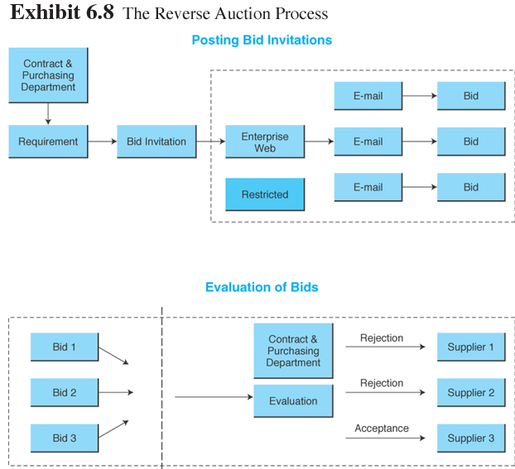
Reverse Auction:
The Process

Slide 72
Reverse Auctions
A Pioneer: General Electric’s TPN (cont.)
  GXS Express Marketplaces is an expanded system that makes it a public posting place for other buyers
    Suppliers gain instant access to global buyers
    Dramatically improve the productivity of their bidding and sales activities
    Increased sales volume
    Expanded market reach and ability to find new buyers
    Lower administration costs
    Shorter requisition cycle time
    Improved sales staff productivity
    Streamlined bidding process

Slide 73
Other E-Procurement Methods
Internal marketplace: The aggregated catalogs of all approved suppliers combined into a single internal electronic catalog

Slide 74
Internal Marketplace (cont.)
  Benefits of internal marketplaces
    corporate buyers quickly find what they want, check availability and delivery times, and complete an electronic requisition form
    reduce number of regular suppliers
    easy financial controls

Slide 75
Internal Marketplace: Desktop Purchasing
Desktop purchasing: Direct purchasing from internal marketplaces without the approval of supervisors and without intervention of a procurement department
Desktop purchasing systems: Software that automates and supports purchasing operations for nonpurchasing professionals and casual end users

Slide 76
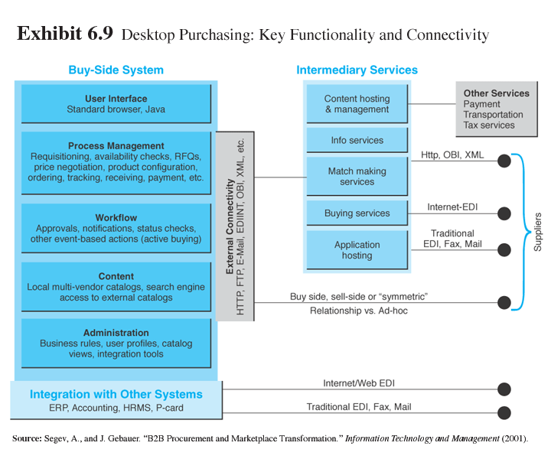
Other E-Procurement
Methods (cont.)

Slide 77
Other E-Procurement
Methods (cont.)
Industrial malls
  Distributors that aggregate products from hundreds or thousands of suppliers in one place
    Horizontal—carrying MRO (nonproduction) materials for use in a variety of industries
    Vertical—carrying products used by one industry but at various segments of the supply chain

Slide 78
Other E-Procurement
Methods (cont.)
E-auctions
  sellers are increasingly motivated to sell surpluses and even regular products via auctions
  e-auctions provide an opportunity to buyers to find inexpensive or unique items fairly quickly

Slide 79
Other E-Procurement
Methods (cont.)
Group purchasing: The aggregation of orders from several buyers into volume purchases so that better prices can be negotiated

Slide 80
Other E-Procurement
Methods (cont.)
  Internal aggregation—companywide orders are aggregated using the Web and replenished automatically
  External aggregation—provide SMEs with better prices, selection, and services by aggregating demand online and then either negotiating with suppliers or conducting reverse auctions

Slide 81
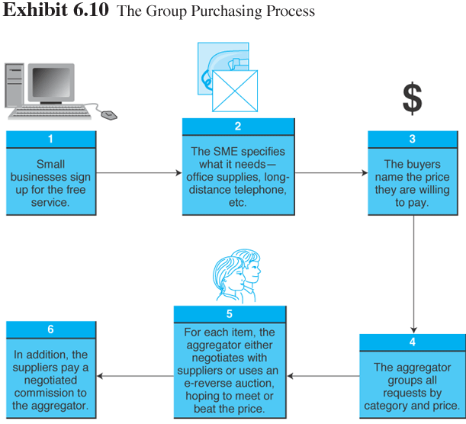
Other E-Procurement
Methods (cont.)

Slide 82
Other E-Procurement
Methods (cont.)
Purchasing direct goods
  E-purchasing direct goods allows buyers to:
    get them faster
    reduce the unit cost
    reduce inventories
    avoid shortages of materials
    expedite their own production processes

Slide 83
Other E-Procurement
Methods (cont.)
Electronic bartering
  Bartering exchange: An intermediary that links parties in a barter; a company submits its surplus to the exchange and receives points of credit, which can be used to buy the items that the company needs from other exchange participants

Slide 84
Infrastructure for B2B
Major infrastructures needed for B2B marketplaces
  Telecommunications networks and protocols
  Server(s) for hosting the databases and the applications
  Software for various activities for executing the sell-side activities, buy-side activities, PRM, and building a storefront
  Security for hardware and software

Slide 85
Other E-Procurement
Methods (cont.)
Electronic data interchange (EDI): The electronic transfer of specially formatted standard business documents, such as bills, orders, and confirmations sent between business partners

Slide 86
Other E-Procurement
Methods (cont.)
Value-added networks (VANs): Private, third-party managed networks that add communications services and security to existing common carriers; used to implement traditional EDI systems

Slide 87
Other E-Procurement
Methods (cont.)
Web-based
EDI Services
Internet-based (Web) EDI: EDI that runs on the Internet and is widely accessible to most companies, including SMEs

Slide 88
Other E-Procurement
Methods (cont.)
Integration
  Integration with existing internal infrastructure and applications
    EC applications of any kind need to be connected to the existing internal information systems
  Integration with business partners
    EC can be integrated more easily with internal systems than with external ones

Slide 89
Other E-Procurement
Methods (cont.)
The role of standards and XML in B2B integration
  XML (eXtensible Markup Language): Standard (and its variants) used to improve compatibility between the disparate systems of business partners by defining the meaning of data in business documents

Slide 90
Other E-Procurement
Methods (cont.)
  XML can overcome EDI barriers for three reasons:
    XML is a flexible language, therefore it expands the rigid ranges of EDI
    Message content can be easily read and understood by people using standard browsers
    XML-based technologies require less-specialized skills

Slide 91
Other E-Procurement
Methods (cont.)
Web services: An architecture enabling assembly of distributed applications from software services and tying them together

Slide 92
Managerial Issues
Can we justify the cost of B2B applications?
Which vendor(s) should we select?
Which B2B model(s) should we use?
Should we restructure our procurement system?

Slide 93
Managerial Issues (cont.)
What restructuring will be required for the shift to e-procurement?
What integration would be useful?
What are the ethical issues in B2B?
Will there be massive disintermediation?

Slide 94
Summary
The B2B field: EC activities between businesses
The major B2B models: sell-side; buy-side; trade exchanges; collaborative commerce
The characteristics of sell-side marketplaces: online direct sale by one seller to many buyers

Slide 95
Summary (cont.)
Sell-side intermediaries: provide value-added services to manufacturers and business customers
The characteristics of buy-side marketplaces and e-procurement: expedite purchasing, save on item and administrative costs, and gain better control over the purchasing process.

Slide 96
Summary (cont.)
B2B reverse auctions: tendering system used by buyers to collect bids electronically from suppliers
B2B aggregation and group purchasing: increasing the exposure and the bargaining power of companies can be done by aggregating either the buyers or the sellers.

Slide 97
Summary (cont.)
Infrastructure and standards in B2B: networks and protocols, multiple servers, application software, and security.
Web-based EDI, XML, and Web services: connectivity of B2B is facilitated by Web services.

