Slide 1
Airflow
Apache Airflow http://airflow.apache.org/
Airflow Document Go to [Concepts Document]
Some concepts:
DAG: directed acyclic graphs, using Python codes (tập hợp tất cả các tasks cần làm)
Task/Operator : Mô tả những task cần thực hiện:
DummyOperator
BashOperator
…

Slide 2
Airflow (Build)
Building Airflow Server using Docker:
Basic : https://github.com/trandungchien1982/airflow/tree/feature/basic%2F01_basic_example
Complex (multi-tasks): https://github.com/trandungchien1982/airflow/tree/feature/01_basic%2F02_loop_tasks

Slide 3
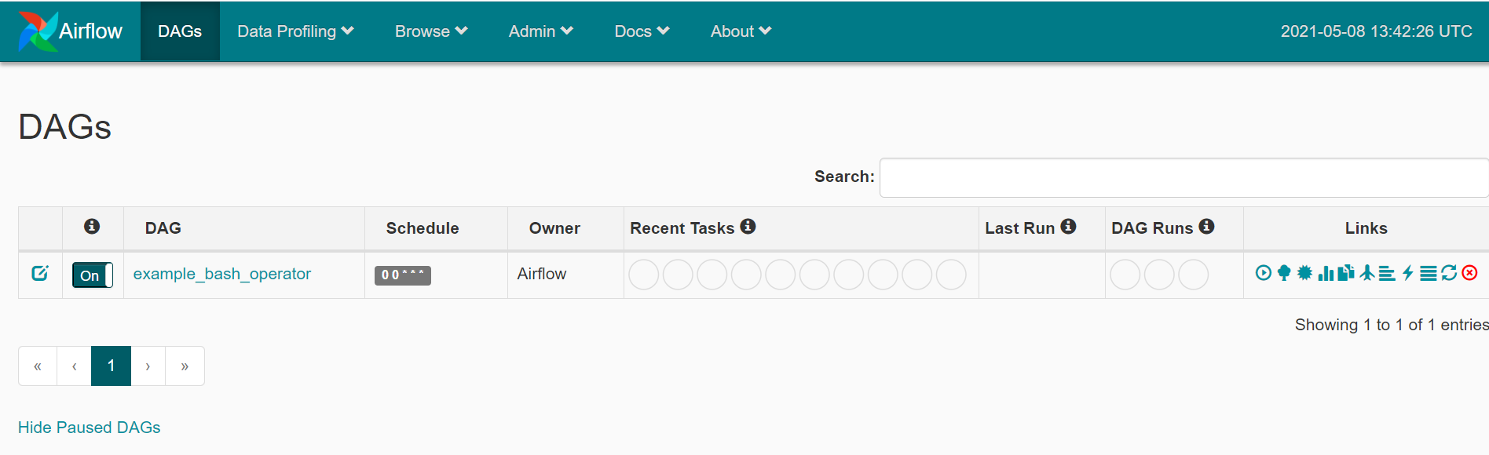
Airflow (List DAGs)

Slide 4
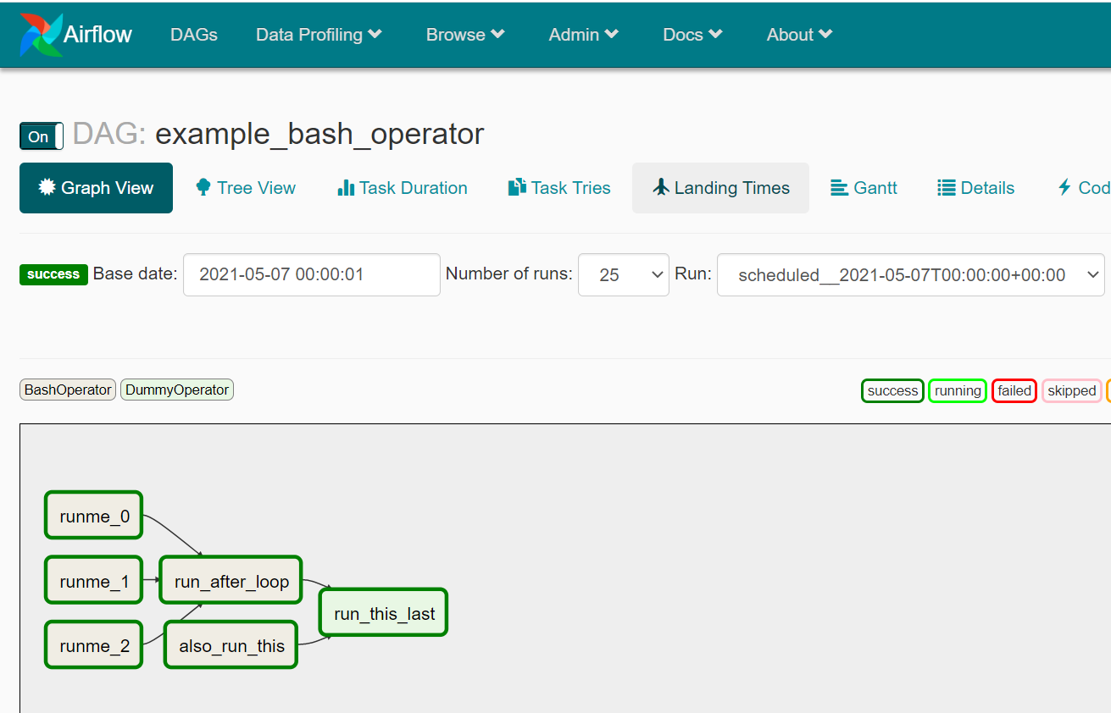
Airflow (DAG - Graph View)

Slide 5
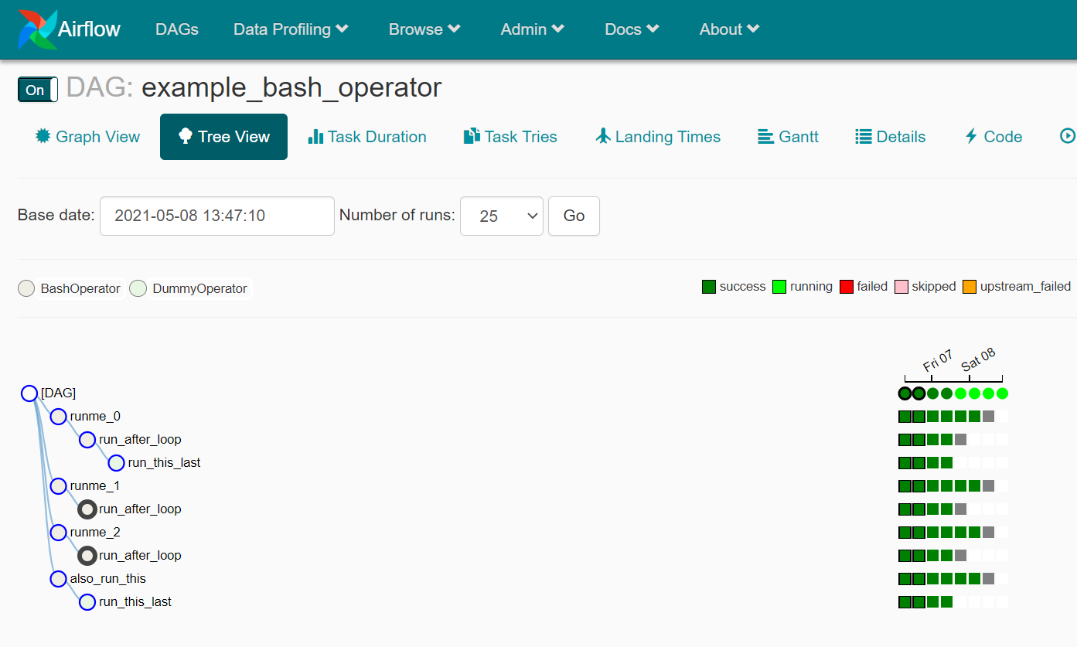
Airflow (DAG - Tree View)

Slide 6
Airflow (interaction with others)
Additional Functionality :
Hooks : Interfaces to external platforms and databases like S3, MySQL, Postgres… (built-in inside Python codes). Go to [List Hooks]
Connections: Create connections to external services and then we can use it in Python codes. Go to [Manage Connections]

Slide 7
Airflow (Resource References)
https://hocdata.com/chuong-3-tools-frameworks/apache-airflow
https://blog.duyet.net/tag/airflow
https://github.com/jghoman/awesome-apache-airflow

