Slide 1
P1
Navmesh Pathfinding

Slide 2

Given image
(0, 0)
(x, y)

Slide 3
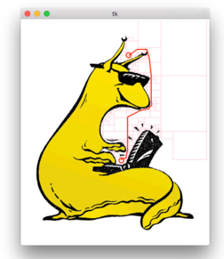
Output using bidirectional A* search

Slide 4
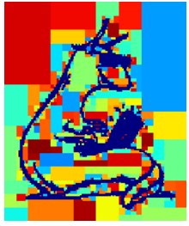
How the boxes look like…
(x1, y1)
A dictionary with key
‘boxes’ and ‘adj’
‘boxes’ : (x1, x2, y1, y2)
‘adj’ : (box2, box3, ….)
(x2, y2)

