Slide 1
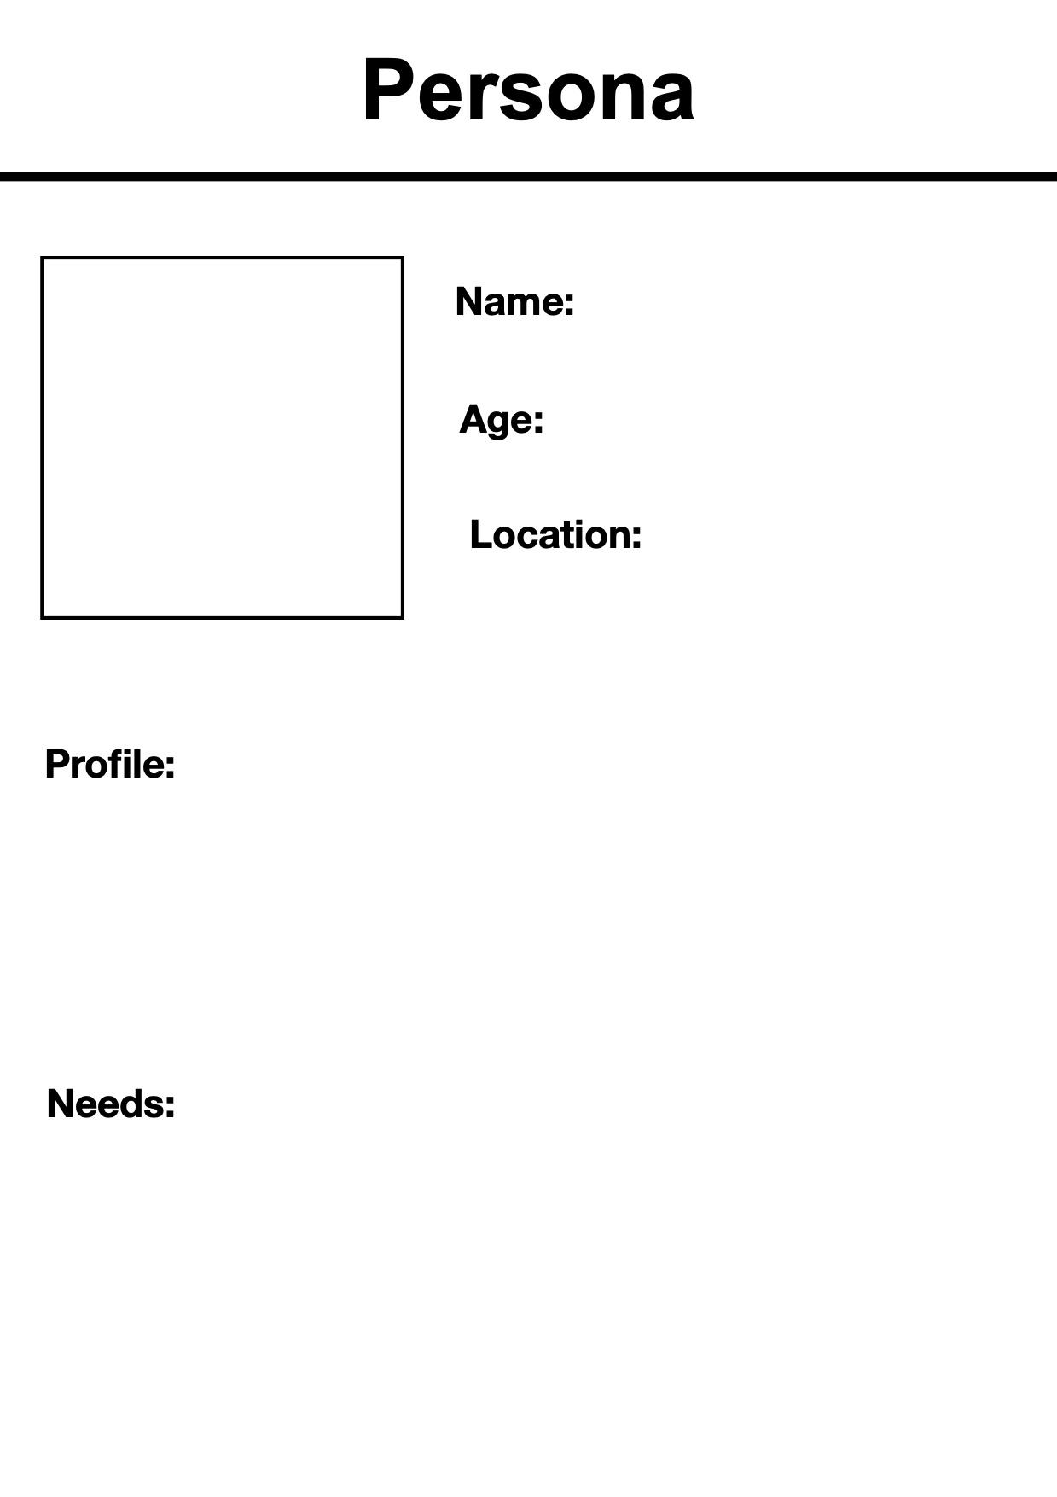
Lucas Kai
33
Downtown, Oshawa
Lucas Kai is an international Master’s student from Italy. He has a Bachelor’s in Computer Science but no Canadian work experience. Tech-savvy, active on LinkedIn, and worried about competing with both AI and experienced workers. Lives frugally, uses Durham Transit, and networks constantly at campus events.
Needs hands-on AI skills training and co-op/internship opportunities to gain Canadian experience. Needs affordable upskilling resources, mentorship from industry professionals, and clear pathways to tech jobs in Durham/GTA that value AI literacy over just experience.

