Slide 1
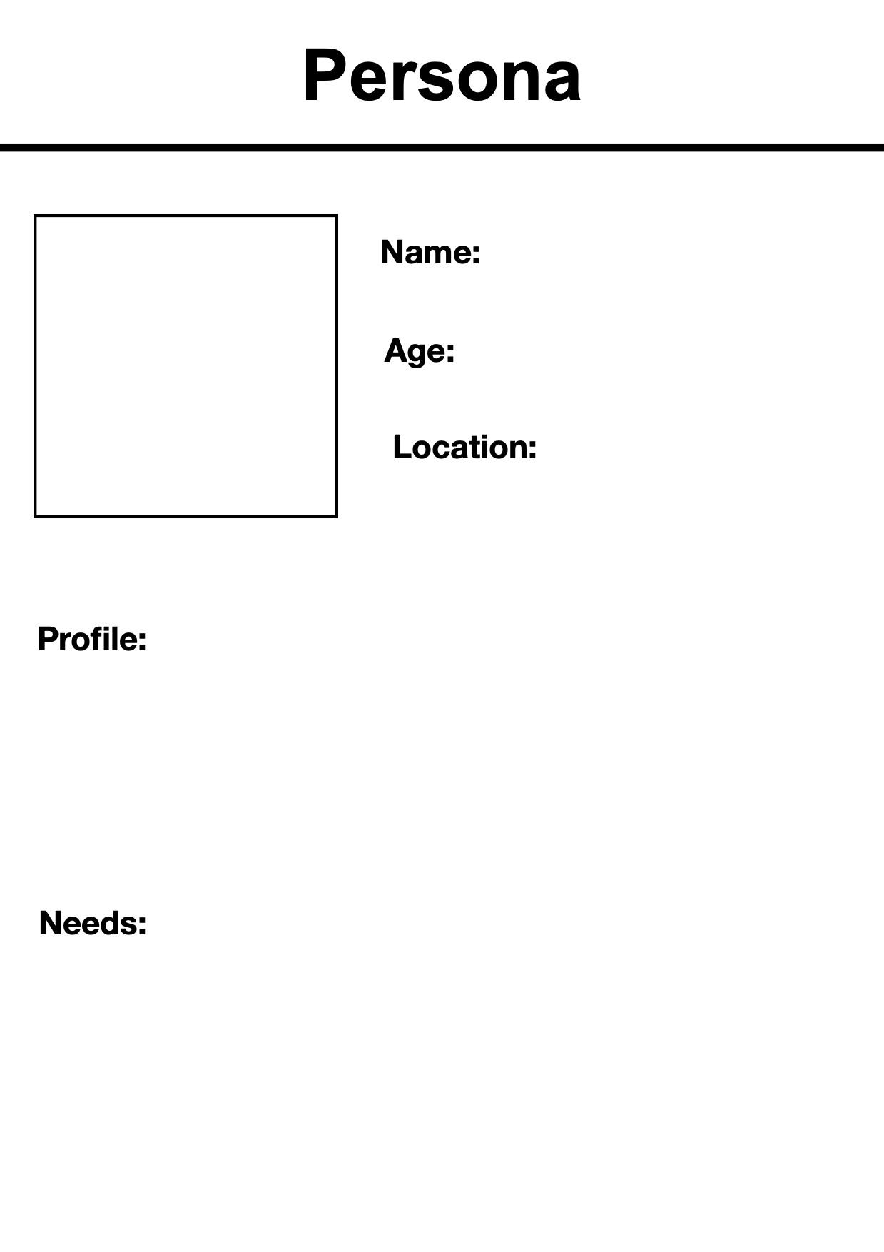
Marcus Thompson
23
Apartment in Oshawa (renting, lives with roommates)
Marcus is a Canadian-born recent graduate with a Bachelor’s in Business Management. He graduated last spring, worked part-time retail during school, but those entry-level corporate jobs he expected post-grad don’t seem to exist anymore. He’s seen AI tools do tasks he thought would be his first job duties
Marcus needs entry-level positions that actually hire entry-level workers, not “2-3 years experience required” postings. He’s desperate for skills training that makes him competitive against AI automation. Needs mentorship on how to position himself as someone who can leverage AI rather than compete with it. Also needs affordable upskilling options

