Slide 1
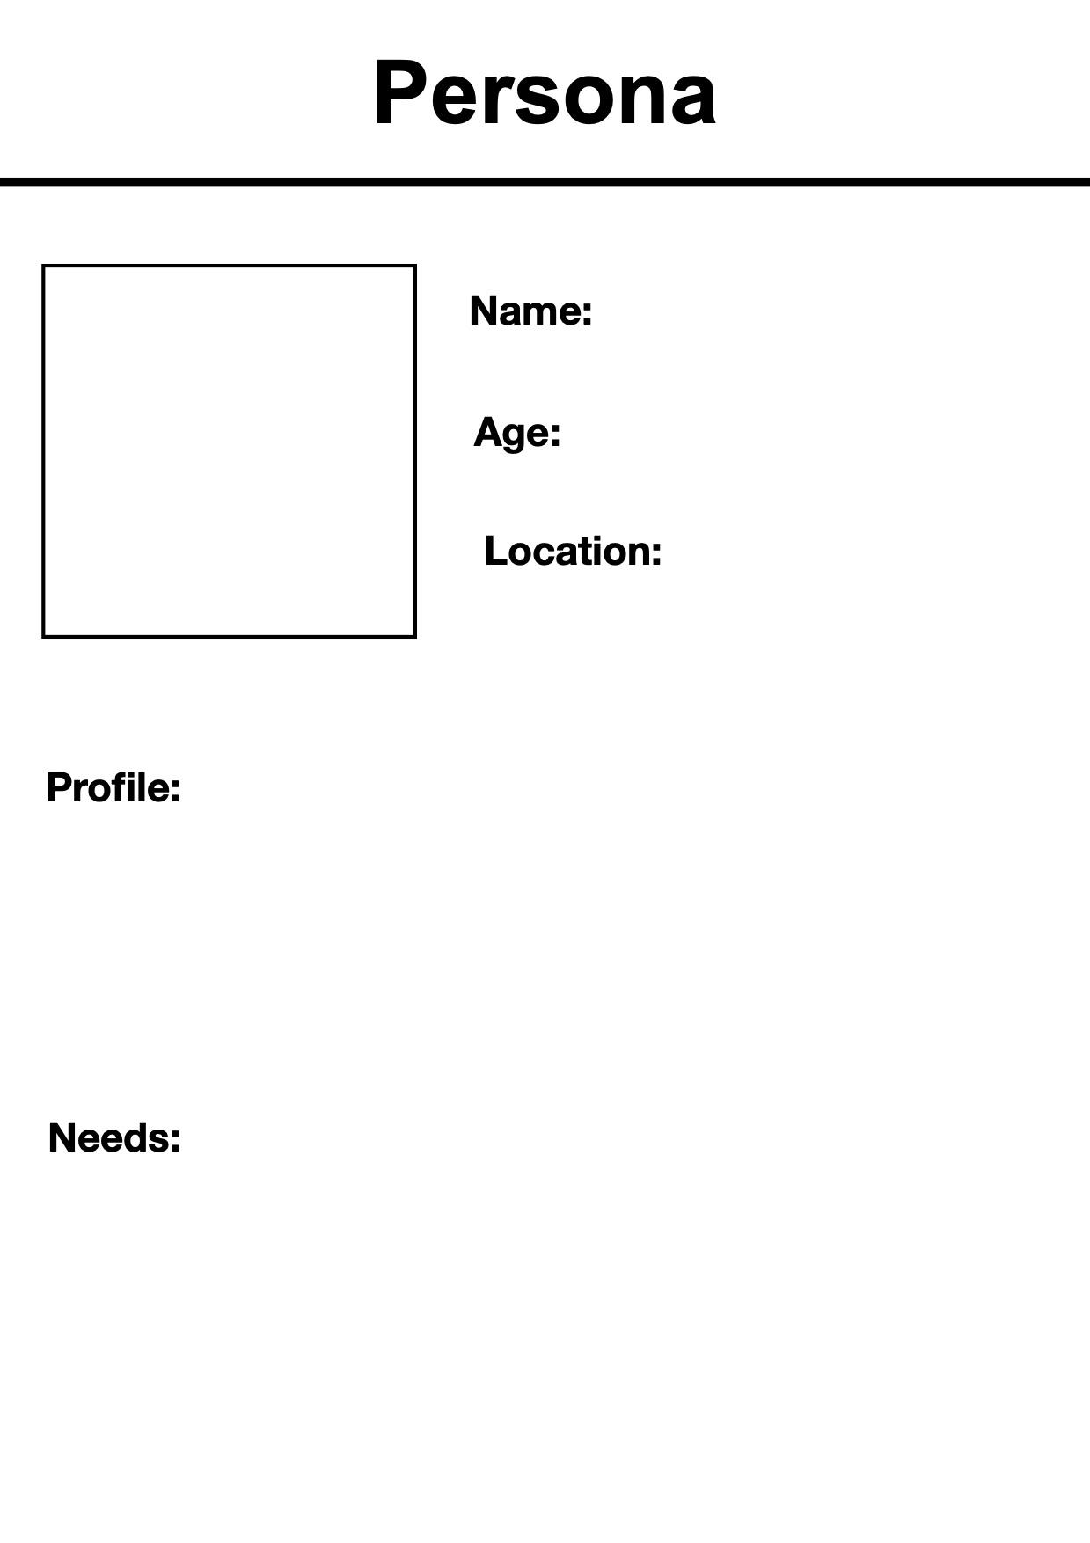
Priya Sharma
24
Durham Region
Priya is an HR from TD Bank, who is facing recruiting challenges.
Her company is in partnership with universities within the region for potential candidates the coming Summer 2026.

