Slide 1
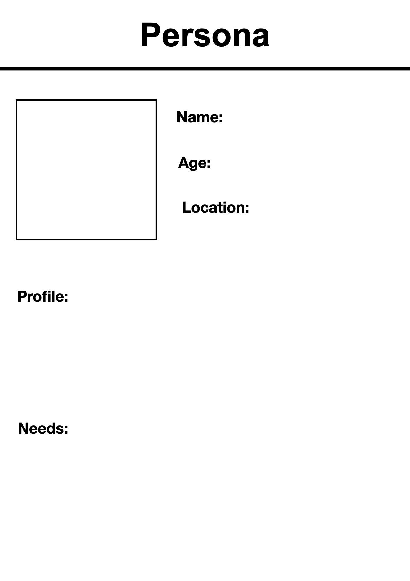
David Brown
46
Durham Region
David was a tech expert at Bell and recently he got laid off due to the company’s implementation of new technology, new brand Ateko.
David needs to find another job so he can support his family of 4.

