Slide 1

REVIEWS WITH SENTIMENT ANALYSIS

Slide 2





Why?
● Understand the intent behind the language
● Respond to customers’ complaints with better solutions

Slide 3
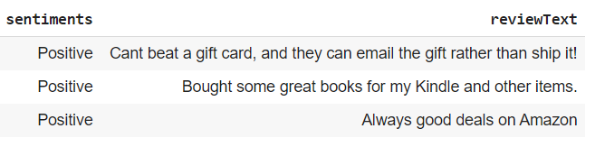


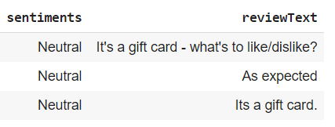

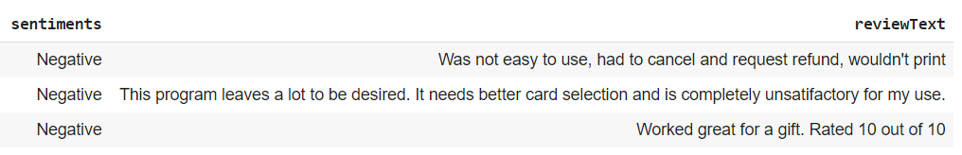


Slide 4
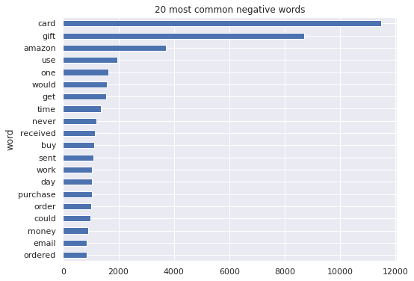
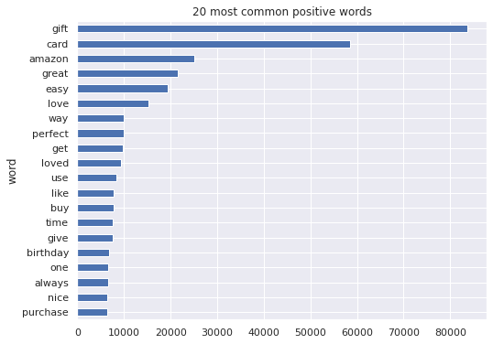
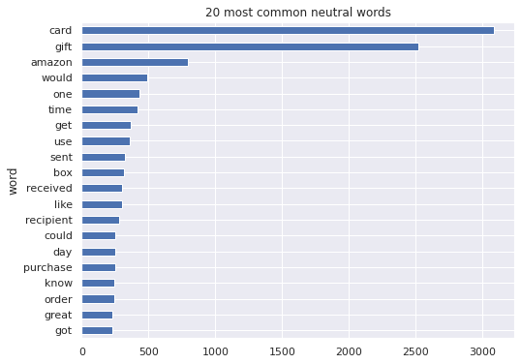
Most common words frequency

Slide 5
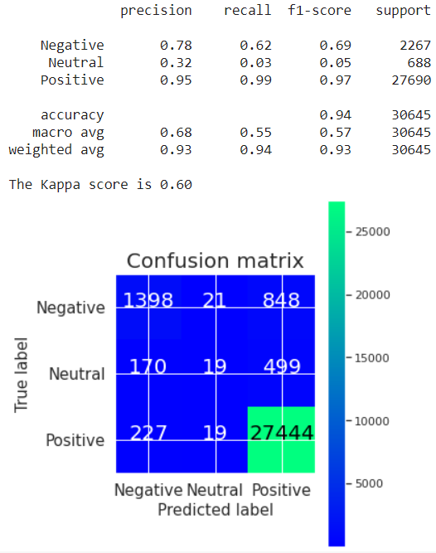
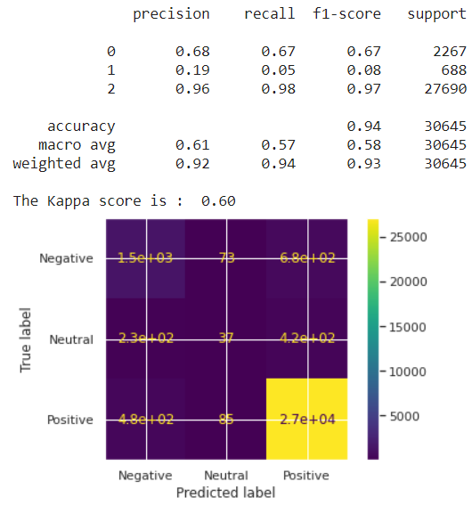
Best models on clean data
N-grams
Logistic Regression with Unigrams
Convolutional Neural Network
Keras

Slide 6
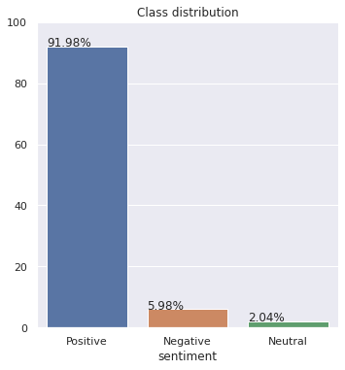
Class Imbalance!!!

Slide 7
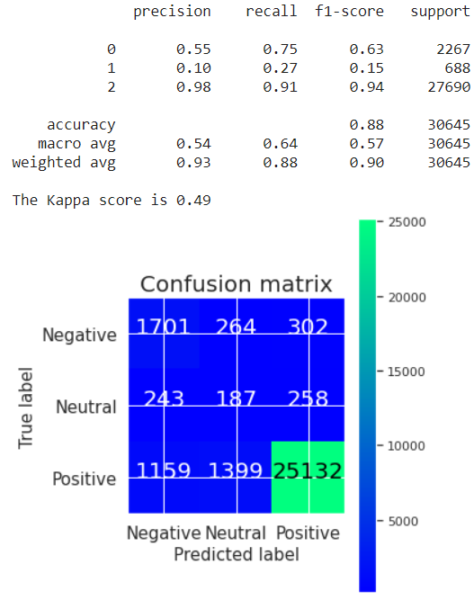
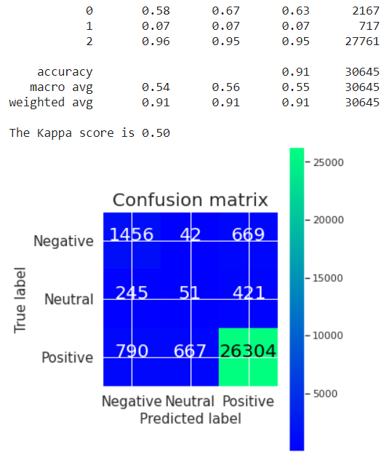
Improving the model
Using class balancing
Using Grid Search for Random Forest
SMOTE-Random Forest- Bigram

Slide 8


The best model is …
Logistic Regression with Unigrams

Slide 9
● Select a wider range of parameters for Random Forest Grid Search
● Using hyperparameter to optimize Convolutional Neural Network model
● Another validation dataset
For further improvements

