Slide 1
ComPlex Environment Multi Barcode & qr code reader
30th October, 2023

Slide 2
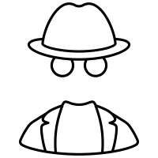

MEET OUR TEAM
Nguyễn Đức Vượng
Nguyễn Thanh Nam
Mentor
Mentor
Trần Thị Hằng

Slide 3
01
Background
02
Problem
03
Solution
04
Result
05
Conclusion

Slide 4
01
Background

Slide 5

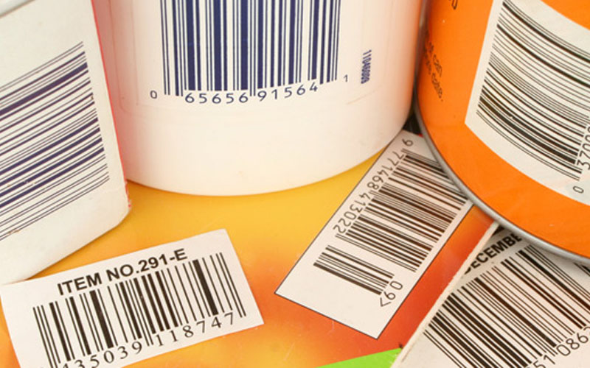

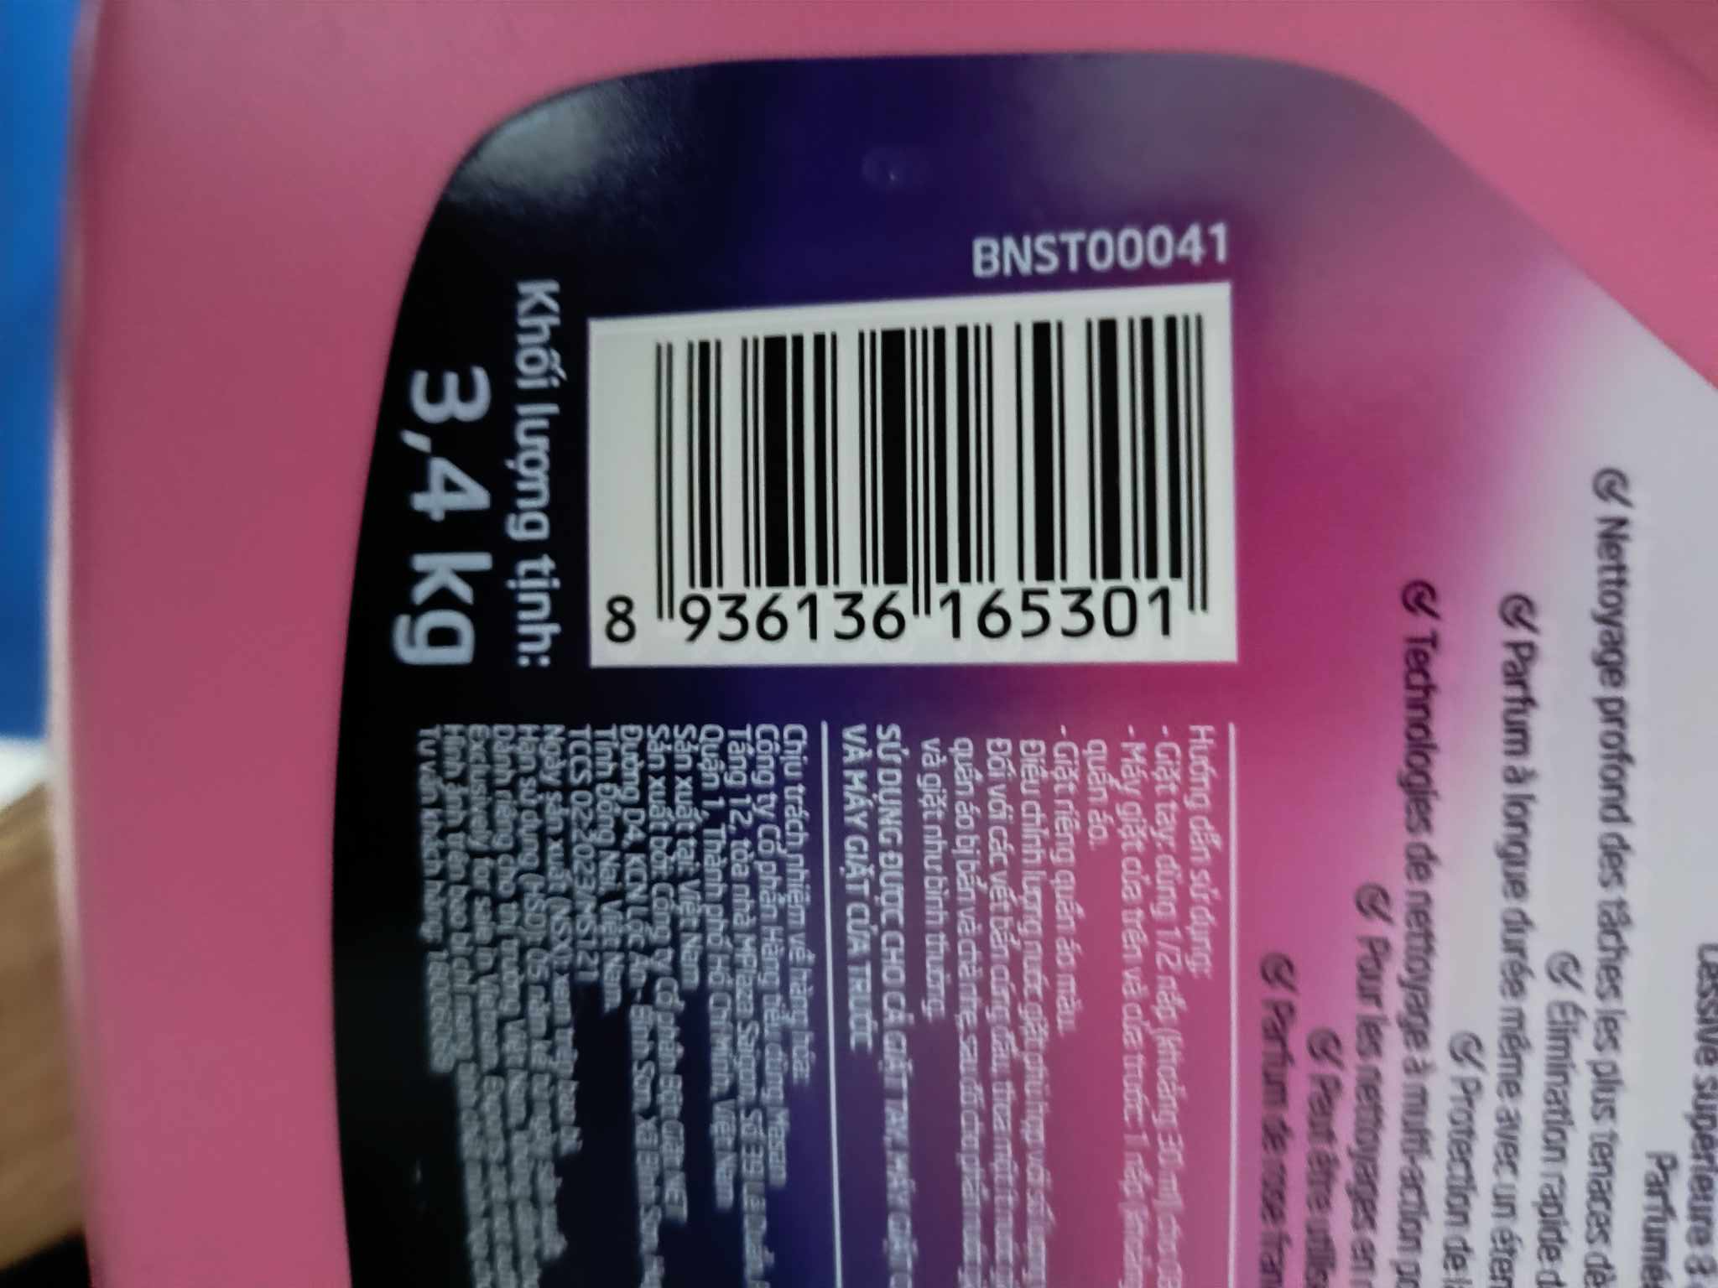
01
Background

Slide 6
02
Problem

Slide 7
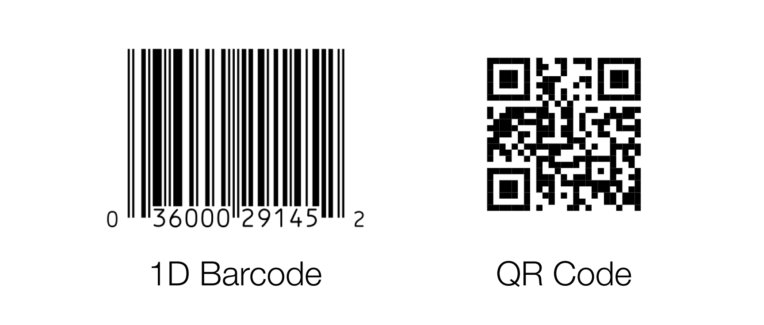
02
Problem
Barcode is an optical representation of data in the form of parallel lines or geometric patterns. It is used for efficient and accurate data entry, identification, and tracking in various industries.
QR code (Quick response code): is a two-dimensional barcode that contains information encoded in a pattern of black and white squares.

Slide 8
02
Problem
Complex environment
- Imbalanced Light
- Angle of view
- Deformed barcode
- Printing quality
- Camera issues

Slide 9
03
Solution

Slide 10
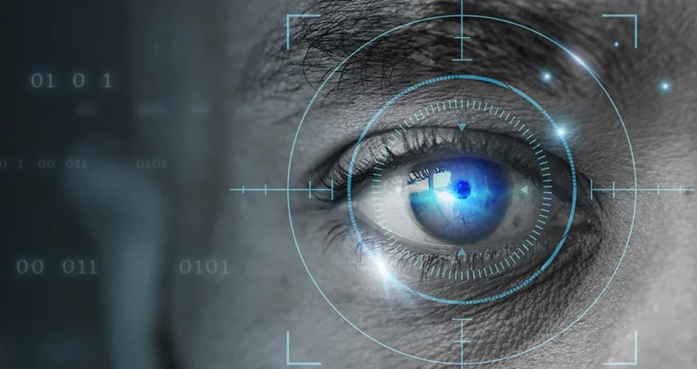
03
Solution
01
02
03
Preprocessing
Detect
Decode
Utilizing various techniques to process and enhance the image quality.
Detecting and bounding the positions that are likely to be QR codes or barcodes the most.
Additional processing for the library to be able to decode

Slide 11
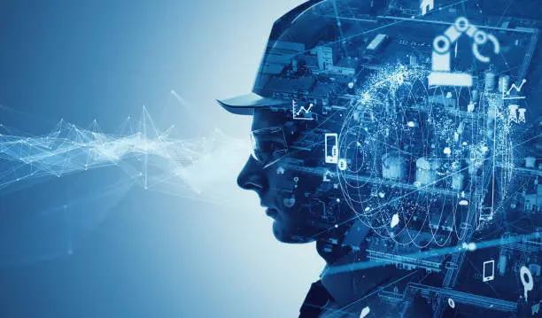
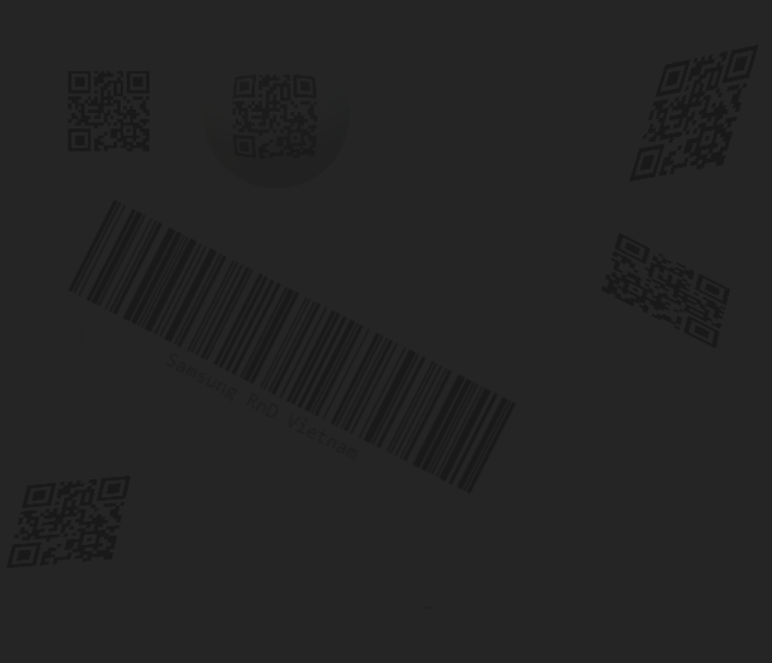
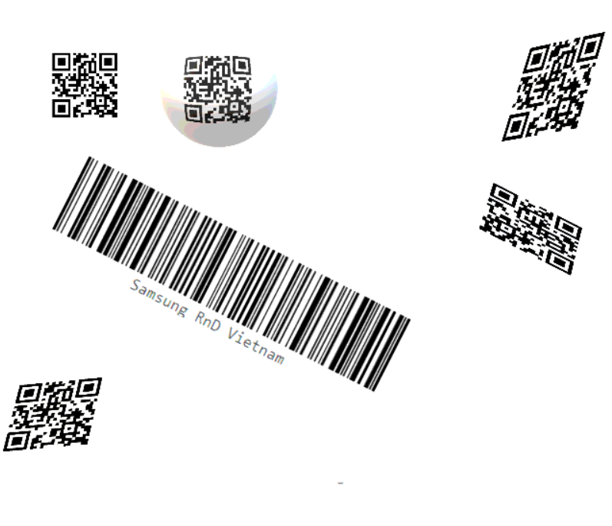
Brightness equalization
is a technique used in image processing to adjust the distribution of pixel intensities in an image. The goal is to enhance the overall contrast and improve the visibility of details in the image.

Slide 12
03
Solution
01
02
03
Preprocessing
Detect
Decode
Utilizing various techniques to process and enhance the image quality.
Detecting and bounding the positions that are likely to be QR codes or barcodes the most.
Additional processing for the library to be able to decode

Slide 13

Detect QR code
Feature matching
is a fundamental technique to find corresponding features or points between multiple images.
Feature Extraction
Feature Description
Feature Matching

Slide 14
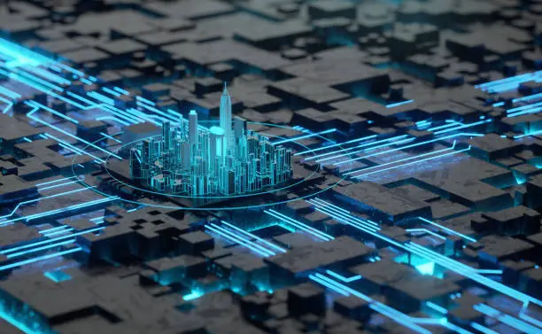
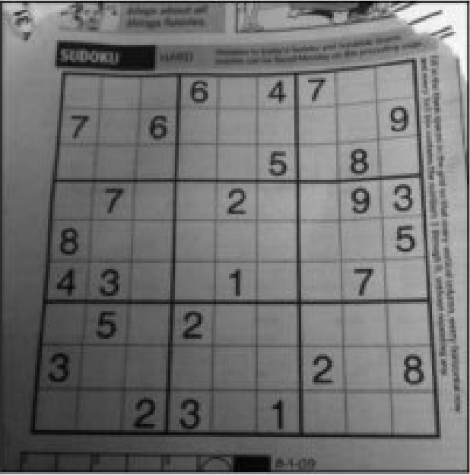
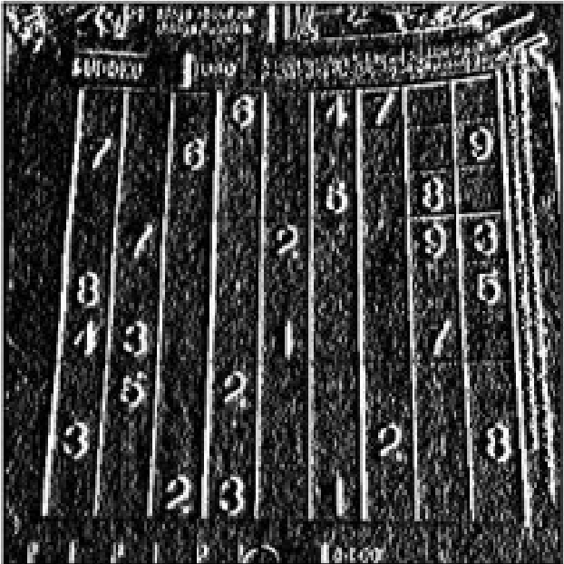
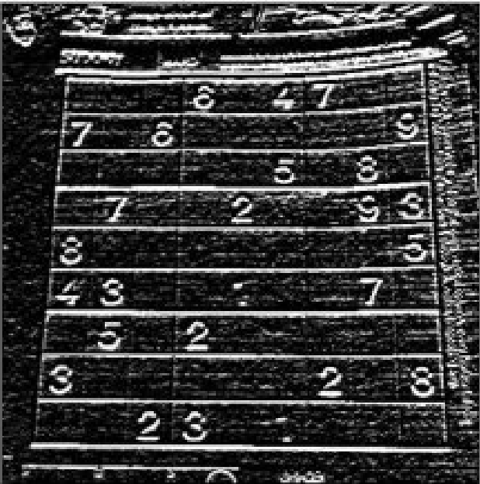
Detect Barcode
Gradient
used to represent the change in slope or difference in intensity of pixels in an image. Gradients are commonly used to find edges, contours, and other important features in an image.

Slide 15
03
Solution
01
02
03
Preprocessing
Detect
Decode
Utilizing various techniques to process and enhance the image quality.
Detecting and bounding the positions that are likely to be QR codes or barcodes the most.
Additional processing for the library to be able to decode

Slide 16

Decode

Slide 17
04
Result

Slide 19
05
Conclusion

Slide 22
THANK YOU

