Slide 1
Procurement Process
Organization Structure & Master Data
Tran Trung Hieu

Slide 2
Over view
Requirement determination
Source determination
Payment
Procurement process
Invoice Verification
Vendor selection
Goods receipt
Order processing

Slide 3



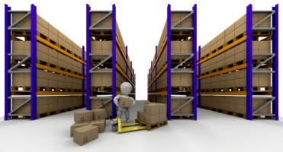

1. Requirement determination
Where do requirements come from?
From another process
Fulfillment process
Production process
Inventory and warehouse management process
Material Planning process
…
From organization operation
Purchase requisition
Back

Slide 4
2. Source determination
Purchase requisition
Requests for quotation
Quotations
Source list
Back

Slide 5






3. Vendor selection
X 123
Delivery time
Quantity
select in delivery time criteria
select in price criteria
select in quantity criteria
Price
Vendor A
Back
Vendor B

Slide 6
4. Order process
Back

Slide 7
5. Goods receipt
Back

Slide 8
6. Invoice Verification
Back

Slide 9
7. Payment
Back

Slide 10



9. SAP ERP
Client code
Client
Company
Company
Plant
Plant
Plant
Company code
Currency
Company name
Plant code
Plant name
Back

Slide 11
1. Create purchase requisition
Organizational data
Material master
Client
Company code
Receiving plant
Purchasing group
Purchase requisition
Material description
Material group
Valuation price
Purchasing info records
User input
Info record number
Vendor number
Item category
Account assignment category
Material number
Quantity
Dates
Receiving plant
Vendor master
Vendor number

Slide 12
2. Create Purchase order
Transaction documents
Requisition
Request for quotation
Quotation
Master data
Material
Vendor
Conditions
Contracts and agreements
Purchasing info record
Purchase order
User input
Verify data
Header
Items
Purchase order number
Purchase order data
Payment items
Vendor
Currency
Material
Order quantity
Delivery date
Price
Back

