Slide 1
Procurement Process
ORGANIZATION STRUCTURE & MASTER DATA
Tran Trung Hieu

Slide 2
Over view
Requirement determination
Source determination
Payment
Procurement process
Invoice Verification
Vendor selection
Goods receipt
Order processing

Slide 3



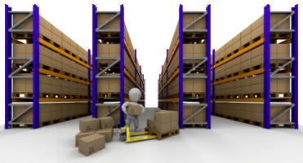

1. Requirement determination
Determination of requirementis is the phase in which the purchasing department is informed about the requirement of items or services. A requisition is an internal document
Where do requirements come from?
From another process
From organization operation
Fulfillment process
Purchase requisition
Production process
Inventory and warehouse management process
Material Planning process

Slide 4
1. Requirement determination
Organizational data
Material master
Client
Company code
Receiving plant
Purchasing group
Purchase requisition
Material description
Material group
Valuation price
Purchasing info records
User input
Item category
Account assignment category
Material number
Quantity
Dates
Receiving plant
Info record number
Vendor number
Vendor master
Vendor number
Back

Slide 5
2. Source determination
Purchase requisition
Requests for quotation
Quotations
Source list
Source determination is the logical subdivision where it is determined what material or services are required, and which supplier can fulfill the requirements.
Back

Slide 6






3. Vendor selection
X 123
Delivery time
Quantity
select in delivery time criteria
select in price criteria
select in quantity criteria
Price
Vendor A
Back
Vendor B

Slide 7
4. Order processing
Purchase requisition
Convert
Purchase order
Purchase order
Purchase order
Purchase requisition
Purchase requisition
Order processing is the phase when an order is created from requisition and it is approved and assigned to a supplier.

Slide 8
4. Order processing
Transaction documents
Master data
Requisition
Request for quotation
Quotation
Material
Vendor
Conditions
Contracts and agreements
Purchasing info record
Purchase order
User input
Verify data
Header
Items
Purchase order number
Purchase order data
Payment items
Vendor
Currency
Material
Order quantity
Delivery date
Price
Back

Slide 9
5. Goods receipt
Plant
Movement type
Valuation Class
Account Determination
Movement Type | Description | Accounting Effect
101 | GR goods receipt | Debit
102 | Reversal of GR | Credit
122 | RE return to vendor | Credit
123 | RE rtrn vendor rev. | Debit
Goods receipt is the phase in which the material is received by the company and its condition and quality are being inspected. In this phase, an invoice is received from the vendor (seller).
Back

Slide 10
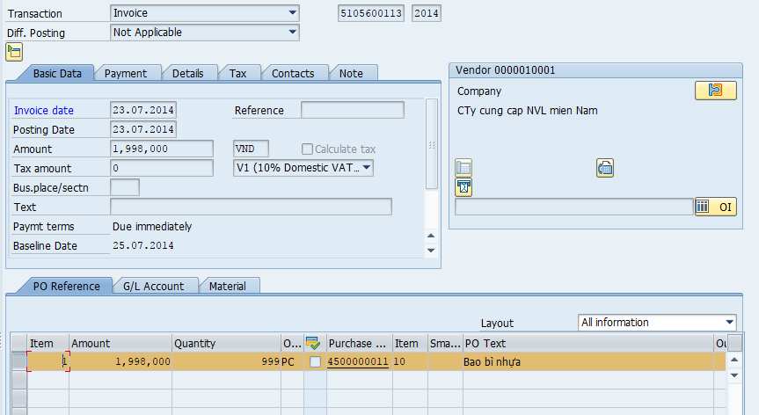
6. Invoice verification
User input
Company code
Purchase order number
Invoice date
Amount
…
Back
Invoice verification is the phase in which the vendor (seller) is paid from the company and reconciliation of the invoice and PO is accomplished.

Slide 11




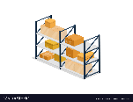
7. ORGANIZATION STRUCTURE
Client
Company
Company
Plant
Plant
Plant
Storage location
Storage location
Storage location
Storage location
Client code
Company code
Currency
Company name
Plant code
Plant name
Storage location code

Slide 12
7. ORGANIZATION STRUCTURE
Client code
Client
Company
Company
Plant
Plant
Plant
Storage location
Storage location
Company code
Currency
Company name
Plant code
Plant name
Storage location code
Purchasing organization

Slide 13
7. ORGANIZATION STRUCTURE
Client
Company
Company
Plant
Plant
Plant
Purchasing organization
Storage location
Client code
Company code
Currency
Company name
Plant code
Plant name
Purchasing organization

Slide 14
7. ORGANIZATION STRUCTURE
Client
Company
Company
Plant
Plant
Plant
Purchasing organization
Purchasing organization
Purchasing organization
Client code
Company code
Currency
Company name
Plant code
Plant name

Slide 15
7. ORGANIZATION STRUCTURE
Purchasing organization
Strategic aspects of purchasing, such as negotiating contracts with vendors
Purchasing group
Purchasing group
Carry out the day-to-day purchasing activities
Planning, creating purchase requisitions, requesting quotations from vendors, and creating and monitoring purchase orders.
Serves as the main point of contact with vendors.

Slide 16
8. Master Data
Data
Master data
Transactional data
Material
Source List
Vendor
Purchase Info record

Slide 17
8. Master Data
Data
Master data
Transactional data
Material
Source List
Vendor
Purchase Info record

Slide 18
8. Master Data
Material master data
This is the enterprise main source of material-specific data. This data will include information on the materials that a company can procure, produce, store, or sell.
2 categories:
Main Data
Additional Data
4 characteristics:
Material types
Material group
Number Range
Material Master

Slide 19
8. Master Data
Data
Master data
Transactional data
Material
Source List
Vendor
Purchase Info record

Slide 20
8. Master Data
Vendor Master Data is the enterprise main source of vendor-specific data. It includes information on vendors from which a company can procure, or can sell.
Vendor
3 categories :
General Data
Accounting Data
Purchasing Data
3 characteristics:
Vendor Account Group
Number Range
Vendor Master

