Slide 1
Swift Day 15

Slide 2
Summary
NSOperation vs GCD
Networking
AFNetworking vs NSURLSession

Slide 3
Nsoperation
The base class for defining custom operation objects. Subclassing NSOperation gives you complete control over the implementation of your own operations, including the ability to alter the default way in which your operation executes and reports its status.

Slide 4
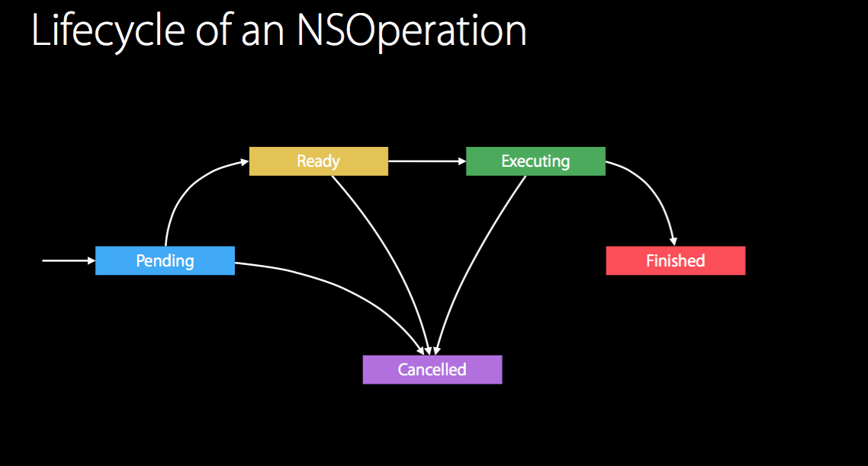

Slide 5
nsoperationqueue
NSOperationQueue regulates the concurrent execution of operations. It acts as a priority queue, such that operations are executed in a roughly First-In-First-Out manner, with higher-priority (NSOperation.queuePriority) ones getting to jump ahead of lower-priority ones. NSOperationQueue can also limit the maximum number of concurrent operations to be executed at any given moment, using the maxConcurrentOperationCount property.

Slide 6
states
ready: Returns true to indicate that the operation is ready to execute, or false if there are still unfinished initialization steps on which it is dependent.
executing: Returns true if the operation is currently working on its task, or false otherwise.
Finished: Returns true if the operation’s task finished execution successfully, or if the operation was cancelled. An NSOperationQueue does not dequeue an operation until finished changes to true, so it is critical to implement this correctly in subclasses to avoid deadlock.

Slide 7
NSOperationQueuePriority
public enum NSOperationQueuePriority : Int {
case VeryLow
case Low
case Normal
case High
case VeryHigh
}

Slide 8
Quality of Service
Quality of Service is a new concept in iOS 8 & OS X Yosemite that creates consistent, high-level semantics for scheduling system resources. APIs were introduced for both XPC and NSOperation that use this abstraction.
@available(iOS 8.0, OSX 10.10, *)
public enum NSQualityOfService : Int {
case UserInteractive
case UserInitiated
case Utility
case Background
case Default
}

Slide 9
.UserInteractive:UserInteractive QoS is used for work directly involved in providing an interactive UI such as processing events or drawing to the screen.
.UserInitiated: UserInitiated QoS is used for performing work that has been explicitly requested by the user and for which results must be immediately presented in order to allow for further user interaction. For example, loading an email after a user has selected it in a message list.
.Utility: Utility QoS is used for performing work which the user is unlikely to be immediately waiting for the results. This work may have been requested by the user or initiated automatically, does not prevent the user from further interaction, often operates at user-visible timescales and may have its progress indicated to the user by a non-modal progress indicator. This work will run in an energy-efficient manner, in deference to higher QoS work when resources are constrained. For example, periodic content updates or bulk file operations such as media import.
.Background: Background QoS is used for work that is not user initiated or visible. In general, a user is unaware that this work is even happening and it will run in the most efficient manner while giving the most deference to higher QoS work. For example, pre-fetching content, search indexing, backups, and syncing of data with external systems.
.Default: Default QoS indicates the absence of QoS information. Whenever possible QoS information will be inferred from other sources. If such inference is not possible, a QoS between UserInitiated and Utility will be used.

Slide 10
let backgroundOperation = NSOperation()
backgroundOperation.queuePriority = .Low
backgroundOperation.qualityOfService = .Background
let operationQueue = NSOperationQueue.mainQueue()
operationQueue.addOperation(backgroundOperation)

Slide 11
Dependencies
Depending on the complexity of an application, it may make sense to divide up large tasks into a series of composable sub-tasks. This can be done with NSOperation dependencies.
let networkingOperation: NSOperation = ...
let resizingOperation: NSOperation = ...
resizingOperation.addDependency(networkingOperation)
let operationQueue = NSOperationQueue.mainQueue()
operationQueue.addOperations([networkingOperation, resizingOperation], waitUntilFinished: false)

Slide 12
completionBlock
let operation = NSOperation()
operation.completionBlock = {
print("Completed")
}
NSOperationQueue.mainQueue().addOperation(operation)

Slide 13
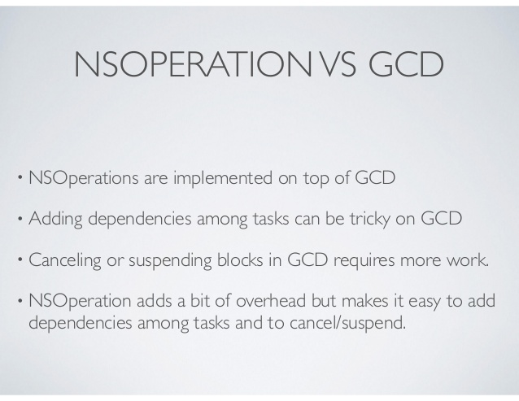

Slide 14
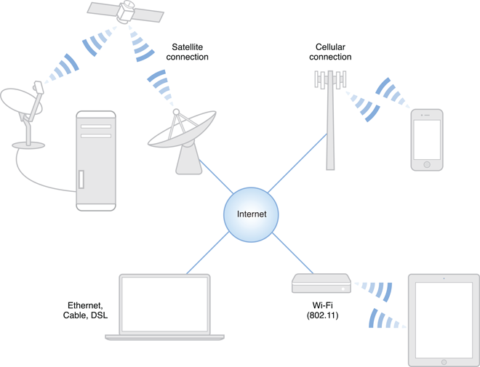
networking
Performing HTTP/HTTPS requests, such as GET and POST requests
Establishing a connection to a remote host, with or without encryption or authentication
Listening for incoming connections
Sending and receiving data with connectionless protocols
Publishing, browsing, and resolving network services with Bonjour
Link refer:
Apple Networking

Slide 15
Web api and NSURLConnection
Web api ?
An NSURLConnection object lets you load the contents of a URL by providing a URL request object. The interface for NSURLConnection is sparse, providing only the controls to start and cancel asynchronous loads of a URL request. You perform most of your configuration on the URL request object itself.

Slide 16
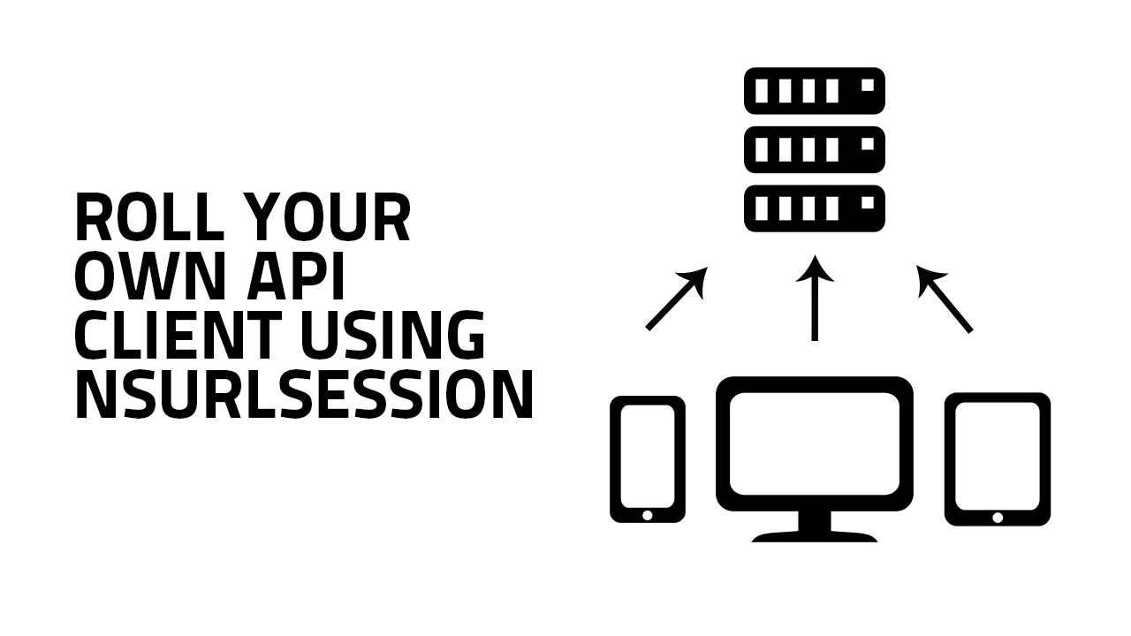
The NSURLSession class and related classes provide an API for downloading content. This API provides a rich set of delegate methods for supporting authentication and gives your app the ability to perform background downloads when your app is not running or, in iOS, while your app is suspended.
The NSURLSession class natively supports the data, file, ftp, http, and https URL schemes, with transparent support for proxy servers and SOCKS gateways, as configured in the user’s system preferences. You can also add support for your own custom networking protocols and URL schemes (for your app’s private use).

Slide 17
Background uploads and downloads: With just a configuration option when the NSURLSession is created, you get all the benefits of background networking. This helps with battery life, supports UIKit multitasking and uses the same delegate model as in-process transfers.
Ability to pause and resume networking operations: As you will see later, with the NSURLSession API any networking task can be paused, stopped, and restarted. No NSOperation sub-classing necessary.
Configurable container: Each NSURLSession is the configurable container for putting requests into. For example, if you need to set an HTTP header option you will only need to do this once and each request in the session will have the same configuration.
Subclassable and private storage: NSURLSession is subclassable and you can configure a session to use private storage on a per session basis. This allows you to have private storage objects outside of the global state.
Improved authentication handling: Authentication is done on a specific connection basis. When using NSURLConnection if an authentication challenge was issued, the challenge would come back for an arbitrary request, you wouldn’t know exactly what request was getting the challenge. WithNSURLSession, the delegate handles authentication.
Rich delegate model: NSURLConnection has some asynchronous block based methods, however a delegate cannot be used with them. When the request is made it either works or fails, even if authentication was needed. With NSURLSession you can have a hybrid approach, use the asynchronous block based methods and also setup a delegate to handle authentication.
Uploads and downloads through the file system: This encourages the separation of the data (file contents) from the metadata (the URL and settings).

Slide 18
https://www.objc.io/issues/5-ios7/from-nsurlconnection-to-nsurlsession/

Slide 19

afnetworking

Slide 20
NSURLSession vs NSURLConnection
NSString *londonWeatherUrl = @"http://api.openweathermap.org/data/2.5/weather?q=London,uk"; ==================NSURLConnnection using======================
NSURLRequest *request = [NSURLRequest requestWithURL: [NSURL URLWithString:londonWeatherUrl]]; [NSURLConnection sendAsynchronousRequest:request queue:[NSOperationQueue mainQueue] completionHandler:^(NSURLResponse *response, NSData *data, NSError *connectionError) { // handle response }]; ====================NSURLSession using========================
NSURLSession *session = [NSURLSession sharedSession]; [[session dataTaskWithURL:[NSURL URLWithString:londonWeatherUrl] completionHandler:^(NSData *data, NSURLResponse *response, NSError *error) { // handle response }] resume];

Slide 21
NSURLSession vs AFNetworking
NSURLRequest *request = [NSURLRequest requestWithURL: [NSURL URLWithString:londonWeatherUrl]];
AFJSONRequestOperation *operation = [AFJSONRequestOperation JSONRequestOperationWithRequest:request
success:^(NSURLRequest *request, NSHTTPURLResponse *response, id JSON) {
// handle response
}
failure:nil];
[operation start];

Slide 22
AFNetworking 2.0
https://github.com/AFNetworking/AFNetworking/wiki/AFNetworking-2.0-Migration-Guide

Slide 23
Big problem
AFNetworking 2.0 does not support Swift

Slide 24
Alamofire
Written by Mattt Thompson — August 4th, 2014
https://github.com/Alamofire/Alamofire
http://nshipster.com/alamofire/
http://www.raywenderlich.com/85080/beginning-alamofire-tutorial

