Slide 1


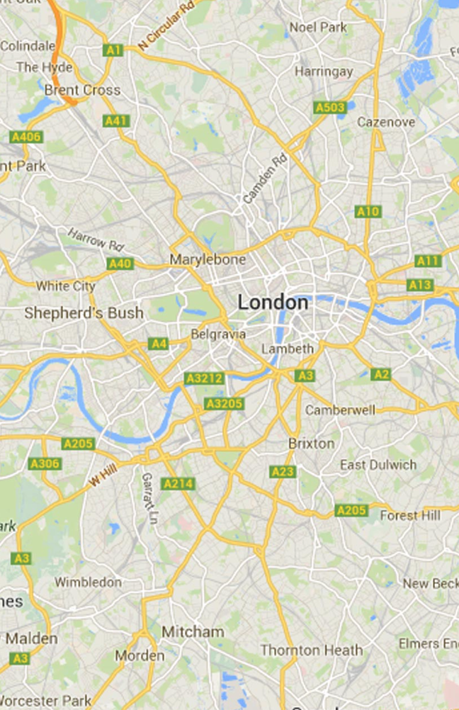


Slide 2

Ha noi

Slide 3
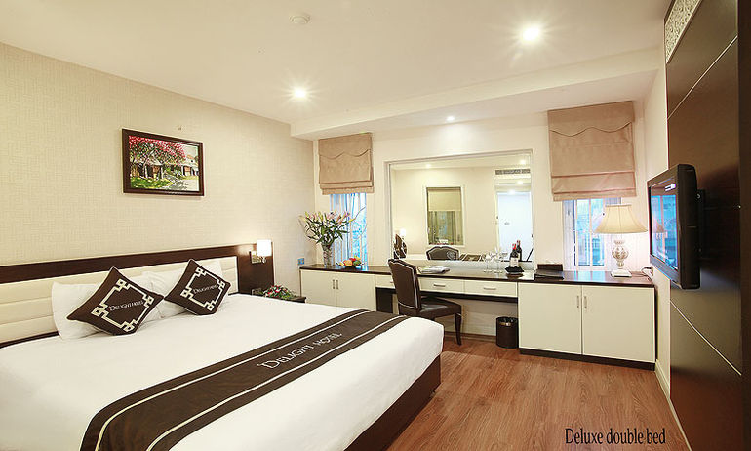
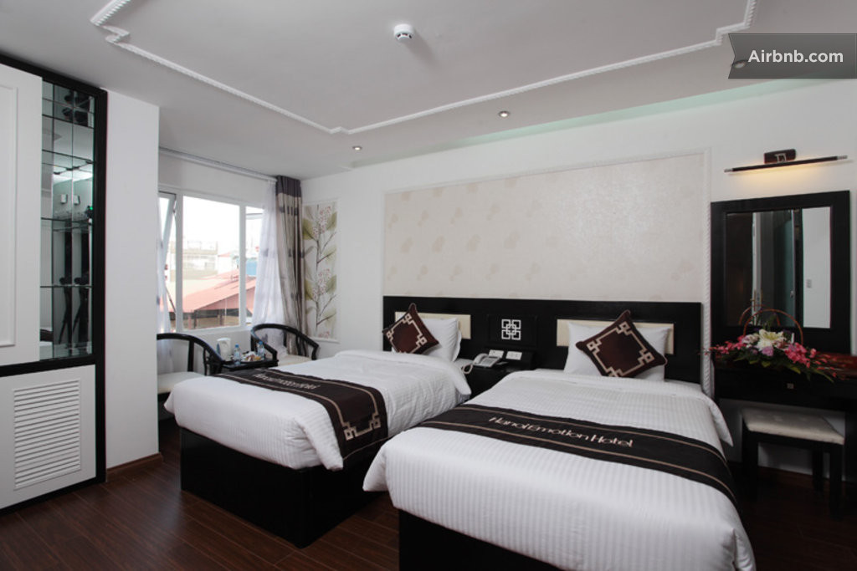

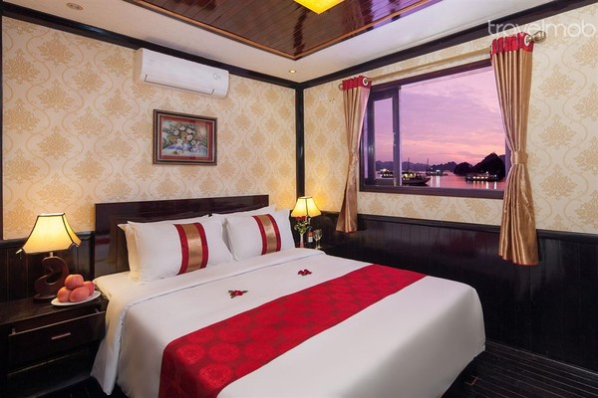
Halong Cruise
Price
Information
Emotion Hotel
Hanoi Delight Hotel
Notes:
ids = ( roo257351, air765852, air885820, tvmivJo3yPLN3f, air836277, air885805, air885831, roo75124, air2462399, air1652188, tvmK8kCIqseyka, air1181904, htw92073, air1533414 );

Slide 4
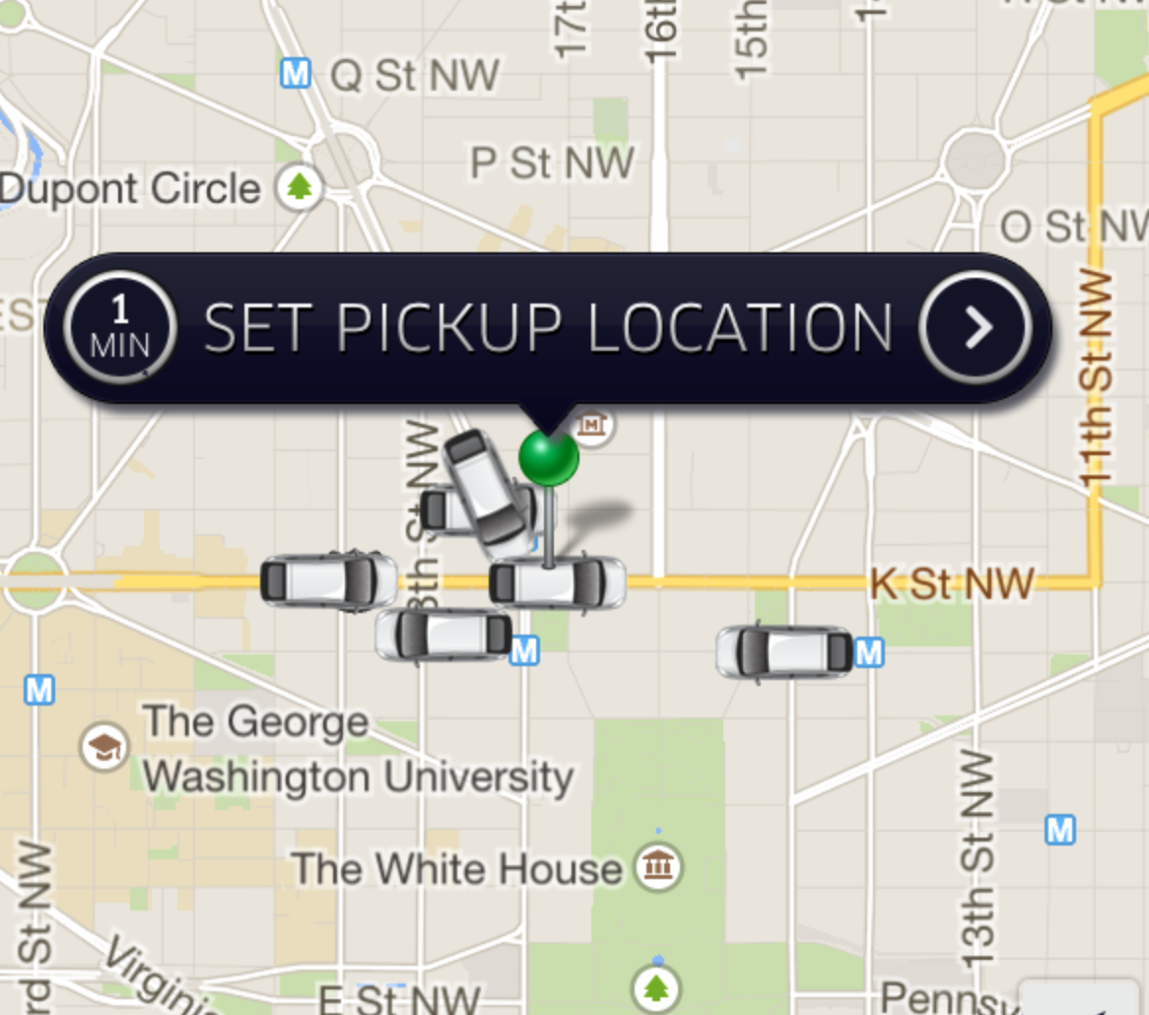

promotion code

Slide 5

Register Form
Price
Information
Notes:
reviews = { count = 4; entries = ({ date = 1422662400; name = Vincent; picture = "https://a2.muscache.com/ic/users/25209266/profile_pic/1419586160/original.jpg?interpolation=lanczos-none&crop=w:w;*,*&crop=h:h;*,*&resize=225:*&output-format=jpg&output-quality=70"; rating = "-1"; text = "C \U00e9tai bien\ nun accueil tr\ U00e8s agr\ U00e9able.\nUn logement plac\ U00e9 a cot\ U00e9 de la cath\ U00e9dral St Joseph, il y a des restaurent tout pr\ U00e9s.\nPetit b\ U00e9mol pour moi il y avait du bruit le matin.\n\ n "; }, { date = 1420070400; name = Rowan; picture = "https://a2.muscache.com/ic/users/23872032/profile_pic/1416274874/original.jpg?interpolation=lanczos-none&crop=w:w;*,*&crop=h:h;*,*&resize=225:*&output-format=jpg&output-quality=70"; rating = "-1"; text = "Great location for any activities around the old quarter. Warm welcoming host with lots of tour knowledge"; }, { date = 1383436800; name = Rafa; picture = "https://a0.muscache.com/ic/users/9126433/profile_pic/1380487231/original.jpg?interpolation=lanczos-none&crop=w:w;*,*&crop=h:h;*,*&resize=225:*&output-format=jpg&output-quality=70"; rating = "-1"; text = "It's an OK place to spend a night or two in the middle of busy Hanoi!\ n\ nBesides that, nice staff!Very helpful!"; }, { date = 1383177600; name = Jack; picture = "https://a1.muscache.com/ic/users/9638880/profile_pic/1382781402/original.jpg?interpolation=lanczos-none&crop=w:w;*,*&crop=h:h;*,*&resize=225:*&output-format=jpg&output-quality=70"; rating = "-1"; text = "We had such a fantastic experience at the Hanoi home hotel, the staff were lovely and so helpful with every question we had. We would highly recommend any backpackers to this hotel, it's very cheap and they have a good knowledge of the surrounding area, especially the cruises in ha long bay. Hanoi home stay really felt like a home away from home. Loved this place\n\nJack, Brits and Abbey"; }); rating = "3.5"; };

Slide 6


APCEPT!

Slide 7
