Slide 1

TRAN HOANG KHUONG
Automatic Image Captioning
Feb 26th, 2021

Slide 2
1
Introduction
2
Software stack
3
Model architecture
4
Training & Evaluation
5
Demo
6
Future works
7
Q & A

Slide 3

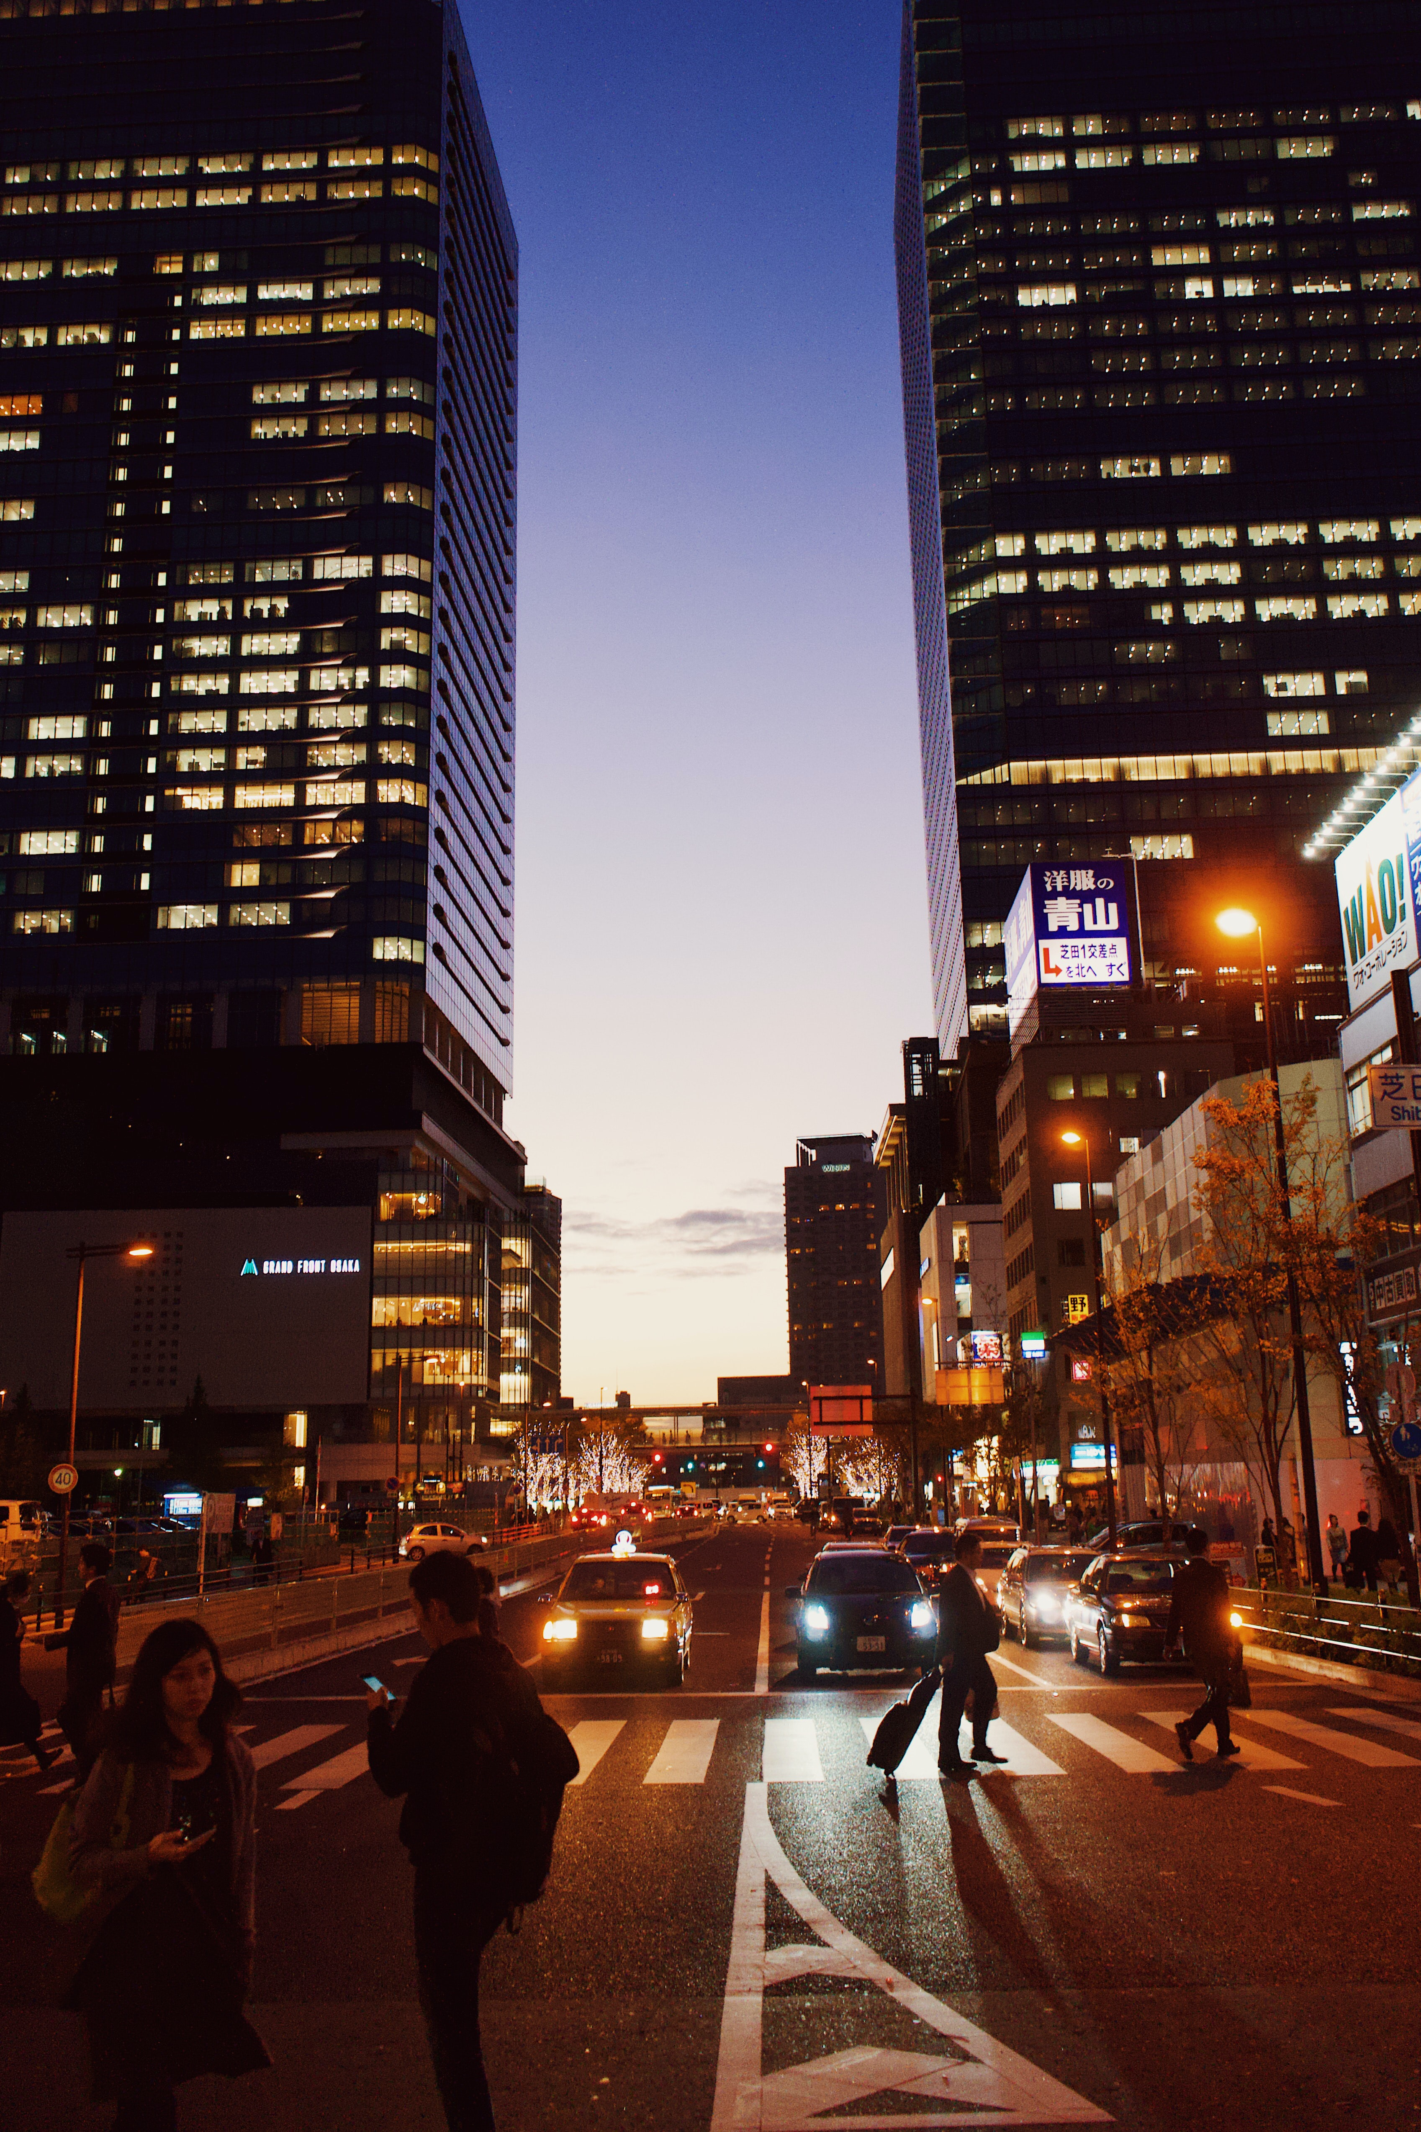
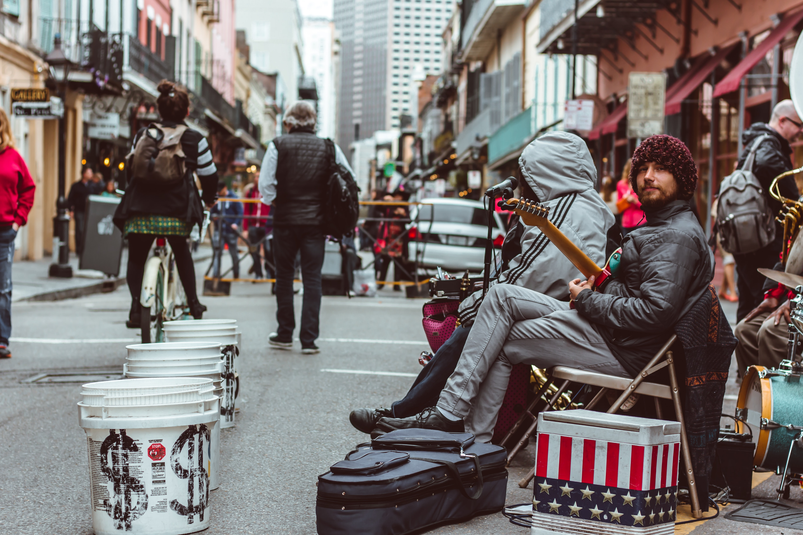
Try caption this yourself?

Slide 4



Automatic Image Captioning
Purpose
Business
Scope
Automatically generate captions for an
image/video: funny, comprehensive, informative, concise etc...
This is one of major research areas of
Microsoft/Google/FB
Business application: virtual assistant, hearing/ vision impaired aid, content generation
Develop an AIC for Vietnamese market
Notes:
Purpose
Specify the purpose and its intended audience.
⇒
1.2 Business Context
Provide an overview of the business organization sponsoring the development of the software application, including the mission statement and organizational objectives of the business unit.
⇒
1.3 Scope
Describe the scope of the software application to be produced. This section gives a brief description of the planned project and the purpose of the system to be built. Special emphasis is placed on the project’s deployment complexities and challenges.

Slide 5

Software stack
Backend
Frontend
Python, TensorFlow,
Pytorch, other python
libraries
Streamlit

Slide 6















Model architecture
Annotation vector 1
Annotation
weight
vectors
Image
English
caption
Vietnamese
caption
Annotation vector 2
Type title
Decoder
hidden
vectors
Annotation vector L
1
2
3
4
Translate
Image input
Encoder
Decoder

Slide 7
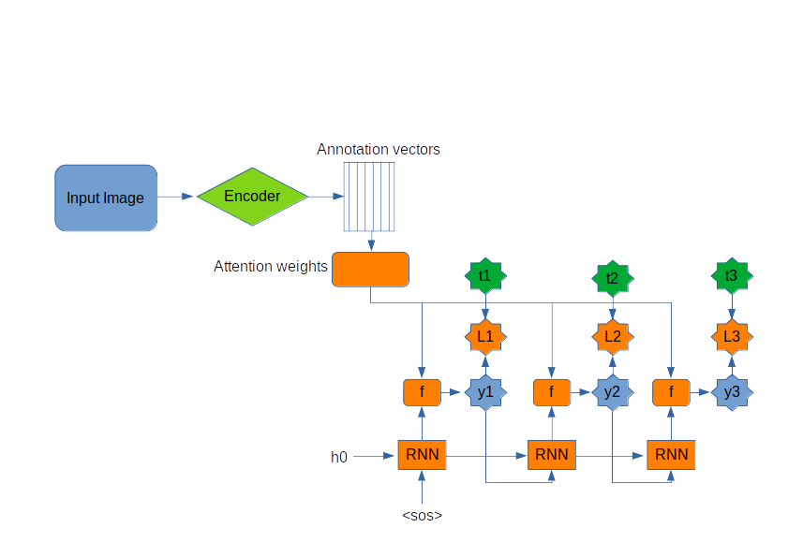
Model architecture (con’t)

Slide 8
Model architecture (final)
Image extractor: VGG16, InceptionV3, Resnet152
Decoder: RNN, LSTM, GRU
English - Vietnamese translation module using
Transformer (*)
(*) Used an available transformer code repo and train it myself

Slide 9
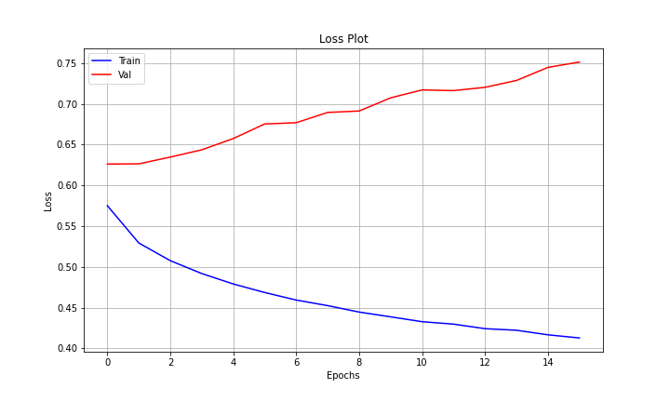
Training & Evaluation
Dataset:
Image: training 82783 & validation/ test: 40504
Captions: training 414113 & val 202654
Training
Local desktop with RTX3090: 10 hours for approx 25 epochs on entire dataset

Slide 10
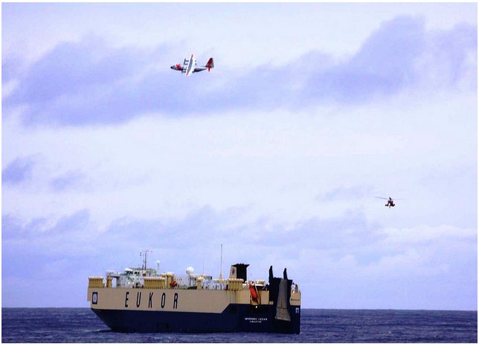
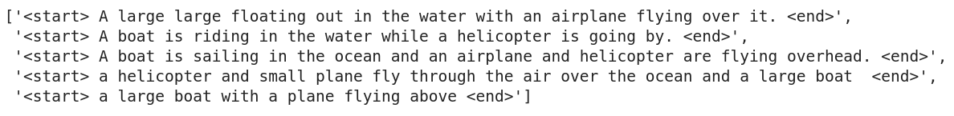
Example:

Slide 11


Validation BLEU score: n-gram words matching between predictions and references
Bleu-1
Bleu-2
Bleu-3
Bleu-4
Show-Attend-Tell paper
0.707
0.492
0.344
0.243
My model
0.32
0.202
0.11
0.00

Slide 12

DEMO TIME!

Slide 13
Future Work
Fine tune the model:
Beam search
Use different Attention
mechanisms
Use different image feature
extractors
Acquire background
knowledge
Deploy Automatic Image
Captioning app for
VNese market
Get the model working
Start
End
Conducted training to
obtain baseline
Improve language
translation
English-Vietnamese
Got a working prototype
And the journey begins here

Slide 14
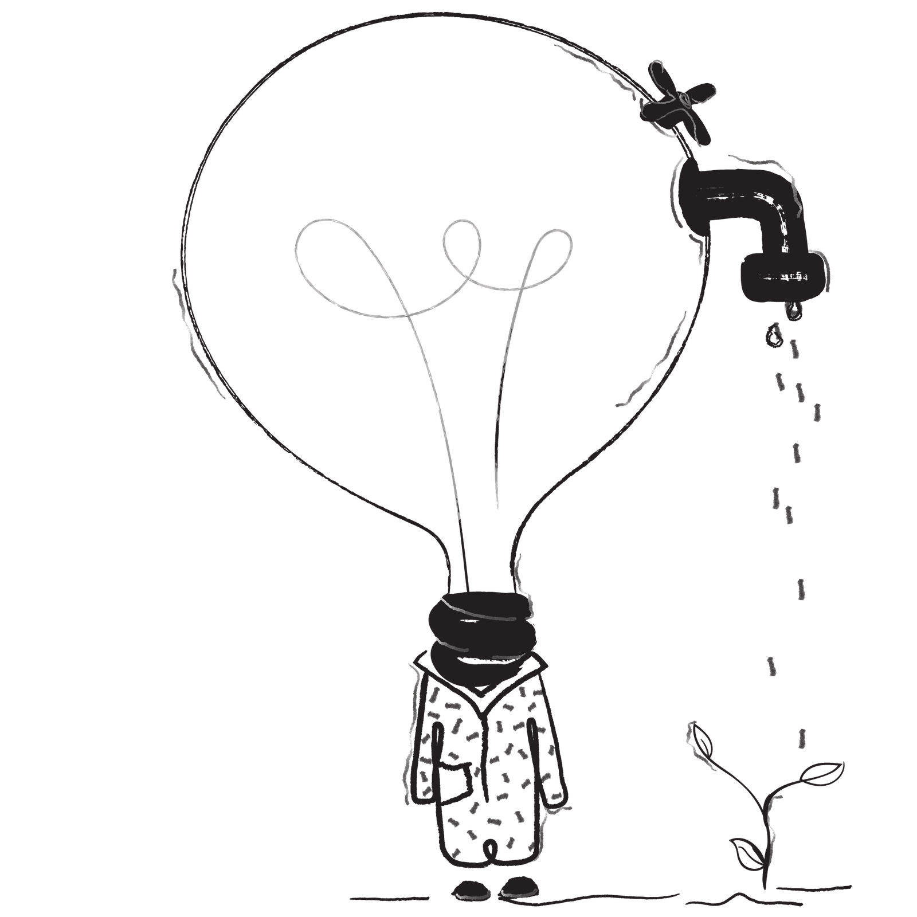
References
HTTPS://WWW.TENSORFLOW.ORG/TUTORIALS/TEXT/IMAGE_CAPTIONING
https://github.com/pbcquoc/transformer
Show, Attend and Tell paper: https://kelvinxu.github.io/projects/capgen.html
https://trungtran.io/2019/03/29/neural-machine-translation-with-attention-mechanism/
https://pravn.wordpress.com/2017/11/14/bahdanau-attention/
https://github.com/pkuccr/English-to-Vietnamese-NMT-Model
https://github.com/sgrvinod/a-PyTorch-Tutorial-to-Image-Captioning

Slide 15
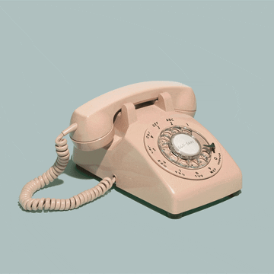
Questions?
Thank you for your attention!

