Slide 1

High Integrity Systems Project:
IoT - From the Microcontroller to the Cloud
Under the guidance of : Prof. Dr. Oliver Hahm
Team member:
Phuc Hoc Tran - 1235133
Jaime Sanchez Cotta - 1430488

Slide 2
Agenda
Introduction
Architecture
Grenoble Server Side
AwS Services
Challenges
Possible improvements
Demonstration
Outro

Slide 3
Kudos

Slide 4
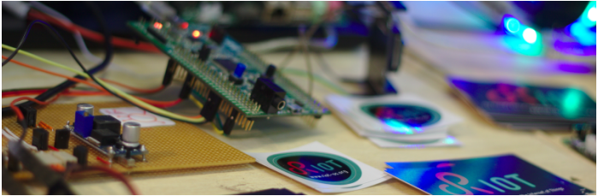
Introduction
Aim of the Project:
Send data from an IoT lab node to AwS cloud
Prerequisites:
RIOT application Fit IoT lab
Bash/shell knowledge C and Python programming skills
Fig 1:RIOT Internet of things

Slide 5
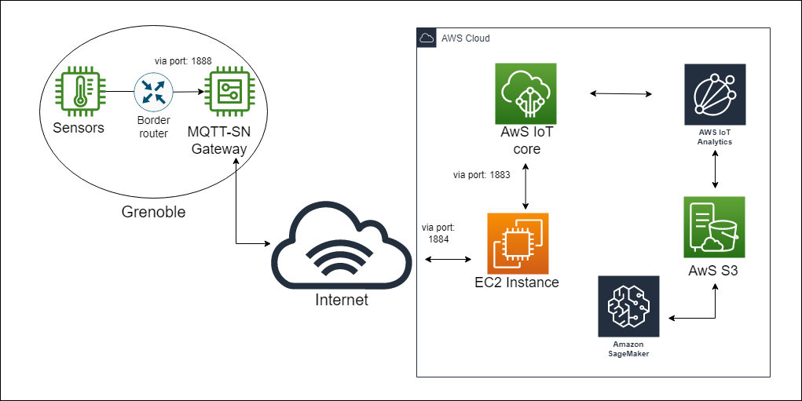
2. Architecture
Fig 2: Project Architecture

Slide 6
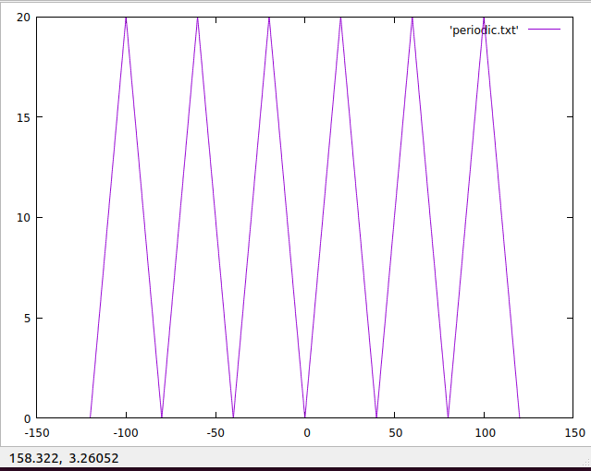
3. Grenoble Server Side - The Data Generator 3.1. The ones with tutorial and source code:
Border router: Enables the connection between nodes inside Grenoble (by assigning IP address to each node) and the Internet.
Sensors – Data Generator:
- Zigzag function
- Emulated values
Fig 3:Gnuplot from temperature sensor

Slide 7

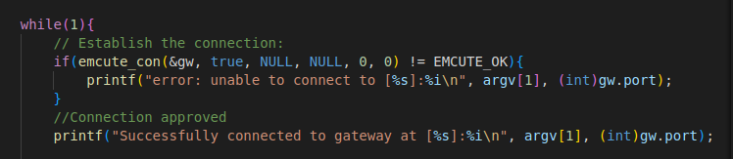
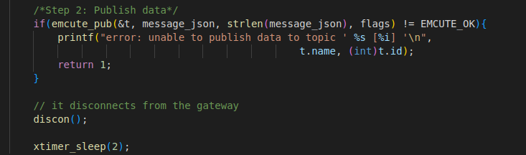
3.1. The ones with tutorial and source code:
Sensor – Data Publisher:
Run command:
Predefined topic attached:
Automatically connects to, sends message to, and disconnects from the Gateway/Broker:

Slide 8
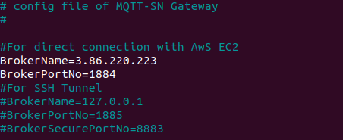
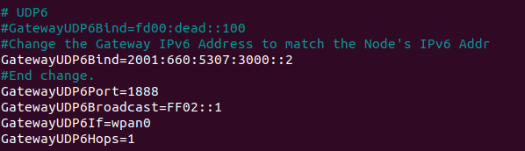
3.2. The one that is quite problematic
MQTT-SN Gateway.
On FiT/IoT Lab's node: "ip –6 –o addr show eth0" to obtain its IPv6 address.
Parameters need to be configured:
BrokerName
BrokerPortNo
GatewayUDP6Bind
GatewayUDP6Port
Gateway is built and run whilst on the node.
Fig 4.1: Paho Gateway config file: EC2 Broker Address Initialization
Fig 4.2: Paho Gateway config file: Gateway IP Address Initialization

Slide 9
4. AwS Services
AwS EC2 and AwS IoT Core – The Data Acquisition
AwS IoT Analytics and S3 – The Data Storage
AwS SageMaker – The Data Visualization
Fig 5: AwS Side

Slide 10
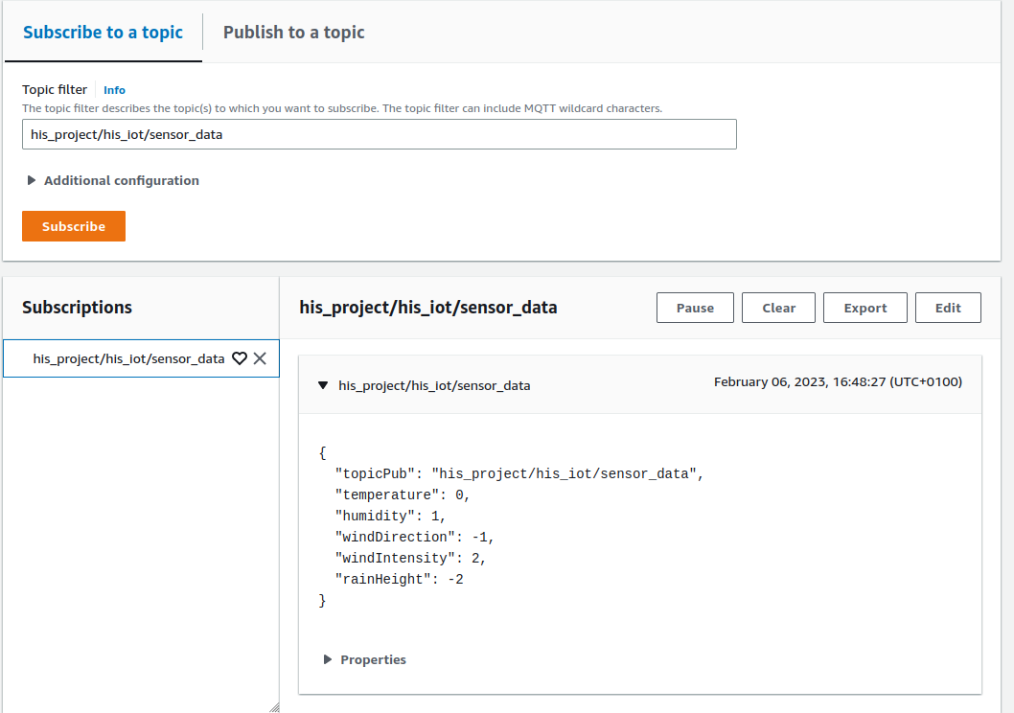
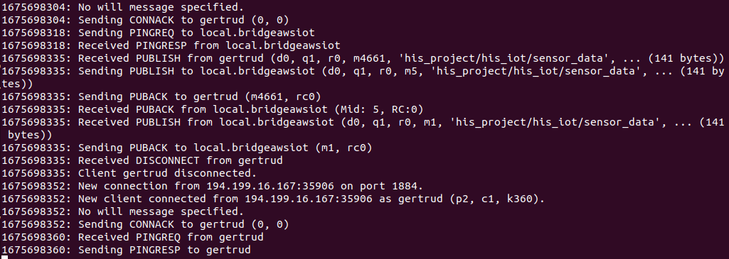
4.1 AwS EC2 and IoT Core – The Data Acquisition
Setup MQTT Brokers on EC2 and IoT Core.
Broker on EC2 acts as an entry point to AwS ecosystem.
Port 1884: Listens to all,
Port 1883: Connecting to AwS IoT Core.
Publishing messages from Grenoble to IoT Core via EC2 by using MQTT Bridge between AwS EC2 and AwS IoT Core.
Fig 6: EC2 Mosquitto Broker Output Log
Fig 7: IoT Core Broker subscribes to the topic and message received

Slide 11
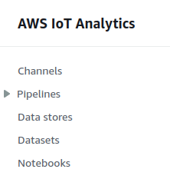
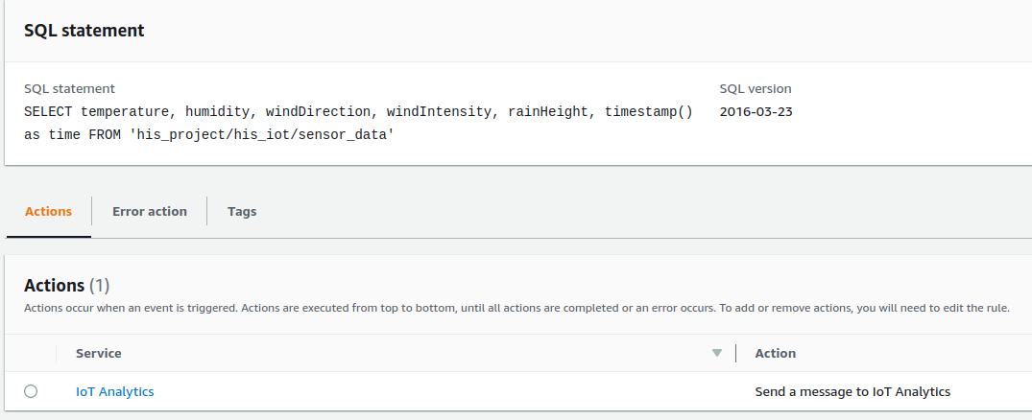
4.2 AwS IoT Analytics and S3 – The Data Storage
On AwS S3: Needs to create 3 different buckets for IoT Analytics-channels, -datastore, and –dataset.
On AwS IoT Analytics: Needs to create the Channel, Datastore, Pipeline, and Dataset (in this exact order). IoT Analytics dataset will query for new data every 1 minutes, but it comes with a cost that all previously saved message will be erased(Other AwS Service is recommended).
On AwS IoT Core: create Message Routing Rules to pipe the received messages via the IoT Analytics Channel to AwS S3.
AwS S3 Dataset Bucket folder structure: sensordatabucket-dataset/output.csv.
Fig 8: AwS IoT Analytics' service offerings
Fig 9: AwS IoT Core Message Routing Rule

Slide 12
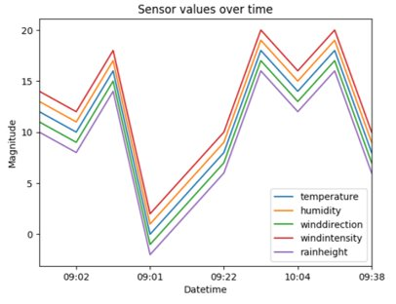
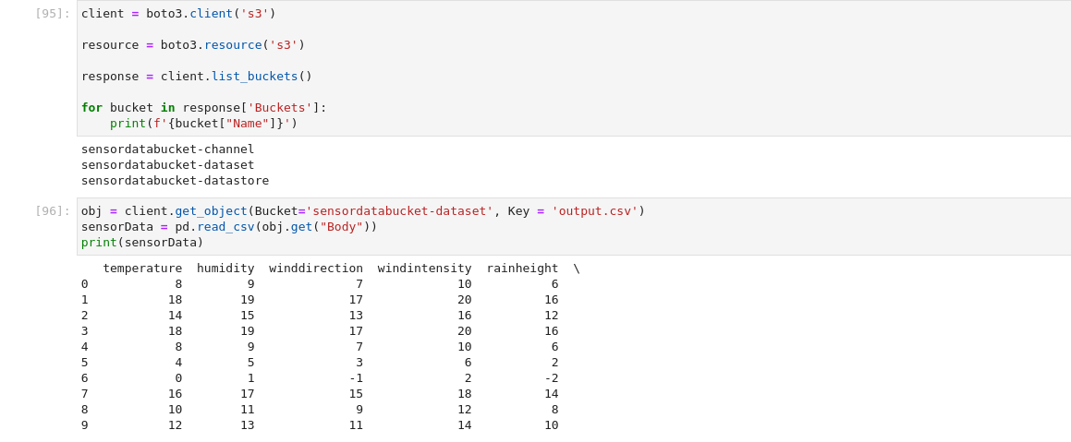
4.3 AwS SageMaker – The Data Visualization
Mainly use for building, training and deploying machine learning models ==> An obvious overkill "just" for data visualization.
A quick and dirty way to visualize and explore data.
Create a JupyterLab Notebook Instance and query the data from the earlier-created S3 dataset bucket.
More suitable to use with AwS Kinesis Firehose instead of the current architecture (real-time data streamline).
Fig 11: Sensor values plot on AwS SageMaker
Fig 10: A code snippet from JupyterLab – Reading data from S3 bucket

Slide 13
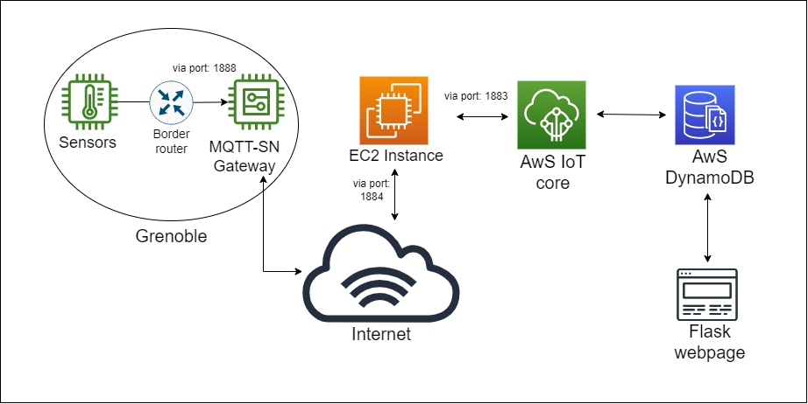
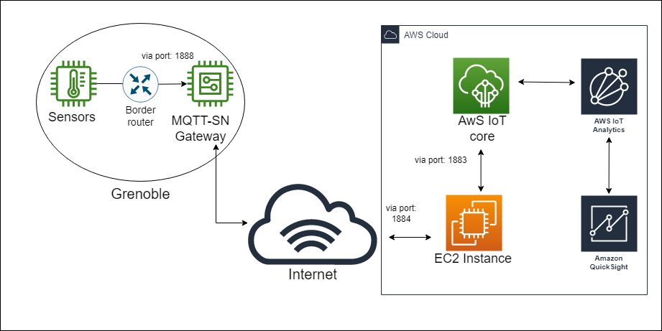
5. Challenges
Fig 12: Project Architecture: Initial Idea
Fig 13: Project Architecture: The "I thought this is gonna cut" Idea
Unable to create IAM Role

Slide 14
5. Challenges
Grenoble server is often unreliable (Need to reset a few times).
The usage of time.h library got interrupted by RIOT (RIOT triggers xtimer instead of using an RTC). ==> Unable to append the time when message was published to its content.
Paho latest version does not widely use. Typically, the new name convention caused confusion while going through the tutorials/online sources/Github closed issues, in which they all used the old one. ==> No choice but to use the old version, albeit the latest one offers much more improvement (building speed, more reliable, .etc).
Although all messages sent from Grenoble are received (and can be seen) on IoT Core. IoT Analytics is not cut out for streaming data. Messages were lost (because of incorrect rule setting, or possibly due to IoT Analytics setting) that only some messages are written into S3 dataset bucket.

Slide 15
6. Possible Improvements
An account with permission to create IAM Role. ==> Opens up the opportunity to use QuickSight with IoT Analytics or DynamDB with Flask webpage for visualization.
Another AwS Service tailored for real-time data streaming (Propose: AwS Kinesis Firehose opt with AwS Athena for instant querying).
FiT/IoT Lab's tutorials could be improved (replacing outdated commands (e.g. iotlab-ssh flash-m3 in the tutorial[1]) with the currently supported ones).
An actual board with real sensors.

Slide 16
7. Demonstration
Video Demo

Slide 17
8. Outro
Thank you very much for your attention.

