Slide 1



The 19th International Conference on Multi-disciplinary Trends in Artificial Intelligence
MIWAI 2026
NFTransUNet: A Neuro-Fuzzy Deep Learning
Model for Breast Tumor Segmentation in Big
Data Environment
Ho-Dat TRAN, Thuong-Cang PHAN, Ngoc-Thuan BUI,
Vinh-Phong NGUYEN, and Anh-Cang PHAN
10-12 October 2026

Slide 2
Challenges and Motivation
Ambiguous boundaries
Low contrast and gradual tissue transitions
Diverse appearances
Irregular contours and varying tumor sizes
Growing data volume
Accurate segmentation with faster, scalable training
2

Slide 3
Outline
01 Introduction
02 Related works
03 Proposed method
04 Experimental results
05 Conclusion
3

Slide 4
1. Introduction
Task and main contributions
Segment lesions
Input mammogram → pixel-level tumor mask
Refine representations
Learnable Gaussian rules at the encoder bottleneck
Evaluate broadly
Three backbones • two datasets • distributed training
4

Slide 5
2. Related works
Evolution of Medical Image Segmentation Models
Approach | Main strength | Medical segmentation benefit
U-Net / U-Net++ | Skip connections | Better spatial detail and boundaries
TransUNet | CNN + Transformer | Local and global feature modeling
Fuzzy models | Uncertainty modeling | Better handling of ambiguous lesions
Our approach | Neuro-fuzzy + Spark | Feature refinement and scalable training
5

Slide 6
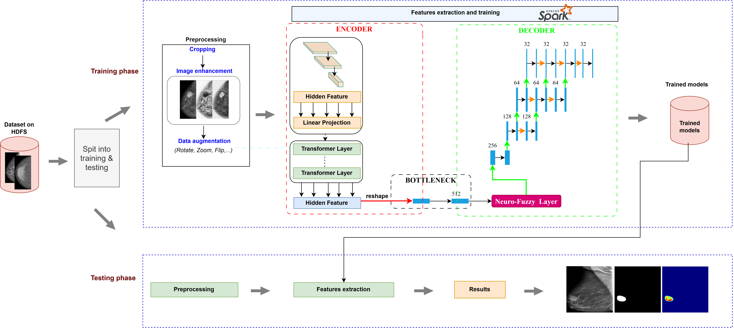
3. Proposed method
Fig.1 The proposed NFTransUNet pipeline for tumor segmentation on mammograms
in a big-data environment.
6

Slide 7
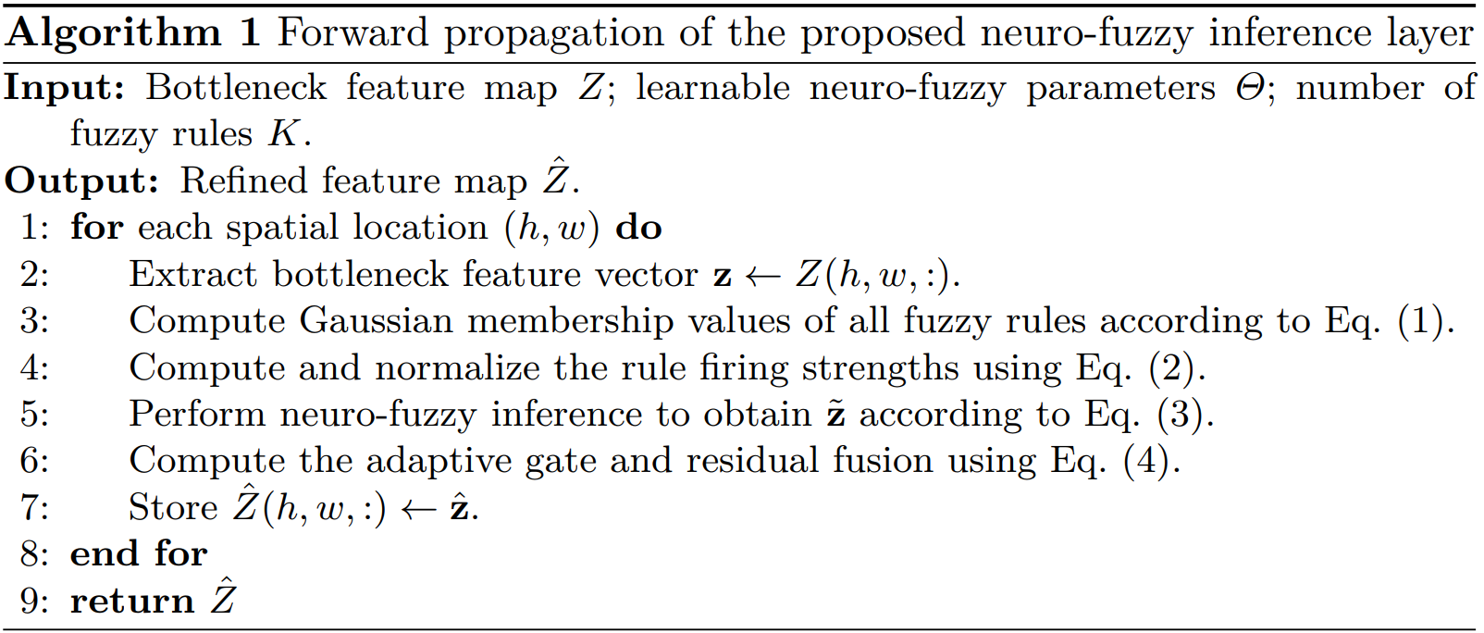
3. Proposed method
7

Slide 8
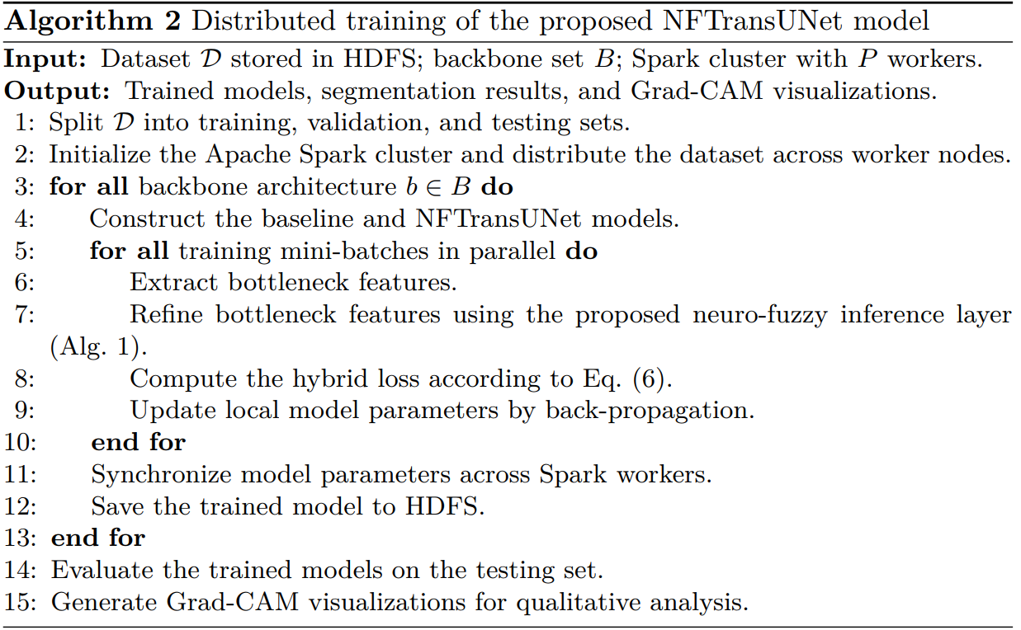
3. Proposed method
7

Slide 9
3. Proposed method
Table 1. Experimental scenarios and training parameters.
Sce | Model | Method | Epoch | LR | Batch size | Num rules
1 | U-Net | Baseline | 150 | 0.0001 | 8 | -
2 | U-Net | Neuro-fuzzy | 150 | 0.0001 | 8 | 4
3 | U-Net++ | Baseline | 150 | 0.0001 | 8 | -
4 | U-Net++ | Neuro-fuzzy | 150 | 0.0001 | 8 | 4
5 | TransUNet | Baseline | 150 | 0.0001 | 8 | -
6 | NFTransUNet | Proposed method | 150 | 0.0001 | 8 | 4
Compute: single node vs. Spark cluster with 12 workers
8

Slide 10
4. Experimental results
Table 2. The dataset used in the paper.
Dataset | Benign | Malignant | Normal | Total
VL-Bre | 1,108 | 1,260 | 1,992 | 4,360
VinDr-Mammo | 1,696 | 720 | 2,012 | 4,428
70% training / 15% validation / 15% testing
9

Slide 11
4. Experimental results
Table 3. Segmentation results on VL-Bre and VinDr-Mammo (%).
Model | VL-Bre |  | VinDr
 | IoU | Dice | IoU | Dice
U-Net | 86.00 | 91.50 | 84.90 | 91.00
U-Net + NF | 87.70 | 92.80 | 86.60 | 92.30
U-Net++ | 86.60 | 92.00 | 85.50 | 91.50
U-Net++ + NF | 88.20 | 93.10 | 87.10 | 92.60
TransUNet | 87.10 | 92.40 | 86.00 | 91.90
NFTransUNet | 88.90 | 93.50 | 87.60 | 93.00
11

Slide 12
4. Experimental results
Table 4. Statistical significance of the neuro-fuzzy improvements on the test set
Model | VL-Bre Dice | VinDr Dice | Pair t-test
U-Net | 91.5 ± 0.35 | 91.00 ± 0.42 | -
U-Net + NF | 92.80 ± 0.28 | 92.30 ± 0.31 | < 0.05
U-Net ++ | 92.00 ± 0.34 | 91.50 ± 0.39 | -
U-Net++ + NF | 93.10 ± 0.27 | 92.60 ± 0.29 | < 0.05
TransUNet | 92.40 ± 0.29 | 91.90 ± 0.38 | —
NFTransUNet | 93.50 ± 0.22 | 93.00 ± 0.25 | < 0.01
12

Slide 13
4. Experimental results
Table 5. Comparison table of experimental results with 1 node vs 12 nodes
NFTransUNet | VL-Bre | VinDr-Mammo
Time: 1 → 12 nodes | 26,300 → 3,190 s | 27,600 → 3,356 s
Speedup | 8.24× | 8.22×
Dice: 1 → 12 nodes | 93.50 → 91.00% | 93.00 → 91.15%
Dice reduction | 2.50 points | 1.85 points
13

Slide 14
4. Experimental results
Table 6. Assessment on the number of fuzzy rules K for NFTransUNet (test set, %).
Rules K | VL-Bre IoU | VL-Bre Dice | VinDr IoU | VinDr Dice
2 | 85.30 | 90.40 | 84.10 | 89.90
4 | 88.90 | 93.50 | 87.60 | 93.00
6 | 87.25 | 90.50 | 86.90 | 92.13
8 | 86.90 | 91.60 | 85.80 | 91.10
15

Slide 15
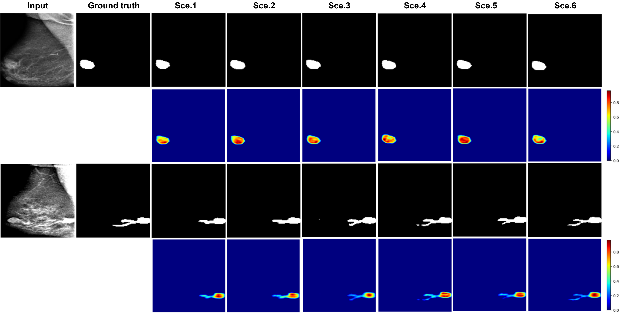
4. Experimental results
Fig.2. Segmentation and Grad-CAM results across all scenarios.
16

Slide 16
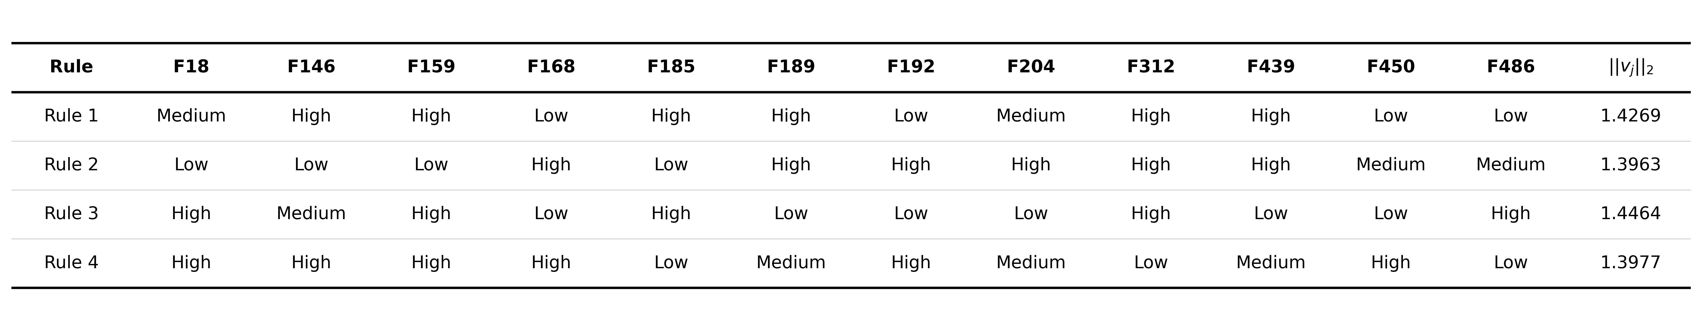
4. Experimental results
Table 7. Sample fuzzy rules learned by NFTransUNet (bottleneck channels F18–F486;
∥vj∥₂ is the L2-norm of the rule’s consequent vector)
17

Slide 17
5. Conclusion
This study proposes a learnable neuro-fuzzy inference layer integrated at the encoder bottleneck and evaluates it across three backbone architectures for mammographic tumor segmentation.
NFTransUNet achieved the best performance, with Dice scores of 93.5% on VL-Bre and 93.0% on VinDr-Mammo, while distributed training reduced computation time by approximately 6.7–8.7 with only a modest average Dice reduction of about 1.8 percentage points.
Future work will evaluate the framework on additional datasets and extend it to other mammographic lesions, particularly microcalcification detection and segmentation.
18

Slide 18
References
[1] Anari, S., Sadeghi, S., Sheikhi, G., Ranjbarzadeh, R., Bendechache, M.: Explainable attention based breast tumor segmentation using a combination of unet, resnet, densenet, and efficientnet models. Scientific Reports 15(1), 1027 (2025).
[2] Bray, F., Laversanne, M., Sung, H., Ferlay, J., Siegel, R.L., Soerjomataram, I., Jemal, A.: Global cancer statistics 2022: Globocan estimates of incidence and mortality worldwide for 36 cancers in 185 countries. CA: a cancer journal for clinicians 74(3), 229–263 (2024).
[3] Carriero, A., Groenhoff, L., Vologina, E., Basile, P., Albera, M.: Deep learning in breast cancer imaging: State of the art and recent advancements in early 2024. Diagnostics 14(8), 848 (2024)
[4] Chen, J., Lu, Y., Yu, Q., Luo, X., Adeli, E., Wang, Y., Lu, L., Yuille, A.L., Zhou, Y.: Transunet: Transformers make strong encoders for medical image segmentation. arXiv preprint arXiv:2102.04306 (2021)
[5] Pani, K., Chawla, I.: Fuzzy inception unet: bridging uncertainties in MRI for multimodal brain tumor segmentation. SN Computer Science 6(6), 621 (2025)
…
19

Slide 19

THANK YOU
FOR YOUR ATTENTION !

