Slide 1
Chapter 2. Memory Management
The main purpose of a computer system is to execute programs. These programs, together with the data they access, must be in main memory (at least partially) during execution.
Many memory-management schemes exist, reflecting various approaches, and the effectiveness of each algorithm depends on the situation.
Selection of a memory-management scheme for a system depends on many factors, especially on the hardware design of the system.

Slide 2
OBJECTIVES
  To provide a detailed description of various ways of organizing memory hardware.
  To discuss various memory-management techniques, including paging and segmentation.

Slide 3
Main Memory
  1.1.Background
  1.1.1. Basic hardware
  Main memory and the registers built into the processor itself are the only storage that the CPU can access directly.
  There are machine instructions that take memory addresses as arguments, but none that take disk addresses.
  Registers that are built into the CPU are generally accessible within one cycle of the CPU clock. Most CPUs can decode instructions and perform simple operations on register contents at the rate of one or more operations per clock tick.

Slide 4
  Memory access may take many cycles of the CPU clock to complete, in which case the processor normally needs to stall, since it does not have the data required to complete the instruction that it is executing.
  The remedy is to add fast memory between the CPU and main memory-A memory buffer used to accommodate a speed differential, called a cache
  Each process has a separate memory space and to ensure that the process can access only these legal addresses.

Slide 5
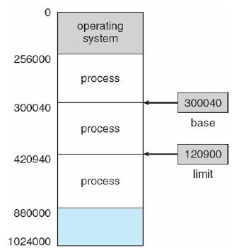
This protection by using two registers, usually a base and a limit
Figure 2.1. A base and a limit register define a logical address space.

Slide 6
  1.1.2. Address Binding
  Addresses in the source program are generally symbolic (such as count). A compiler will typically bind these symbolic addresses to relocatable addresses (such as “14 bytes from the beginning of this module'').
  The linkage editor or loader will in turn bind the relocatable addresses to absolute addresses (such as 74014).
  Classically, the binding of instructions and data to memory addresses can be done at any step along the way:

Slide 7
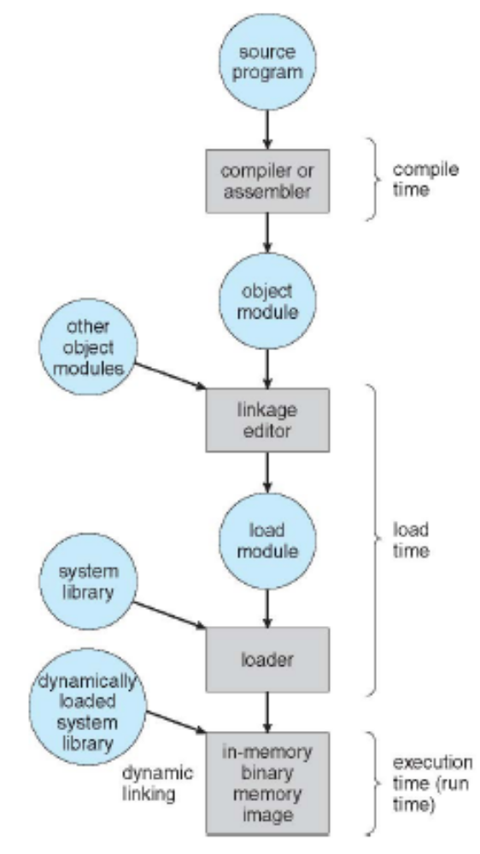
Figure 2.2. Multistep processing of a user program.

Slide 8
  Compile time. If you know at compile time where the process will reside in memory, then absolute code can be generated. For example, if you know that a user process will reside starting at location R, then the generated compiler code will start at that location and extend up from there. If, at some later time, the starting location changes, then it will be necessary to recompile this code. The MS-DOS .COM-format programs are bound at compile time.

Slide 9
  Load time. If it is not known at compile time where the process will reside in memory, then the compiler must generate relocatable code. In this case, final binding is delayed until load time. If the starting address changes, we need only reload the user code to incorporate this changed value (do not need to recompile this code)
  Execution time. If the process can be moved during its execution from one memory segment to another, then binding must be delayed until run time. Special hardware must be available for this scheme to work-MMU (memory management unit)

Slide 10
  1.1.3. Logical Versus Physical Address Space
  Logical address-virtual address: An address generated by the CPU.
  The set of all logical addresses generated by a program is a logical address space
  Physical address: An address seen by the memory unit.
  The set of all physical addresses corresponding to these logical addresses is a physical address space.
  The run-time mapping from virtual to physical addresses is done by a hardware device called the memory-management unit (MMU)

Slide 11
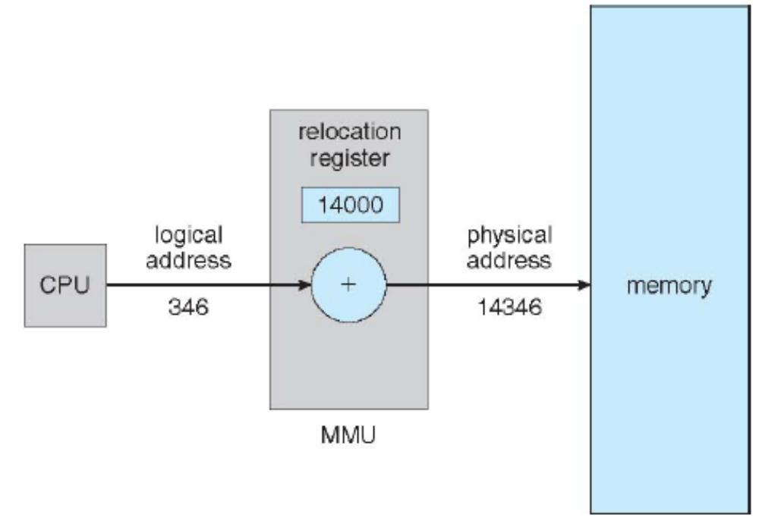
Figure 2.3. Dynamic relocation using a relocation register.

Slide 12
  The base register is now called a relocation register. The value in the relocation register is added to every address generated by a user process at the time it is sent to memory.
  For example, if the base is at 14000, then an attempt by the user to address location 0 is dynamically relocated to location 14000; an access to location 346 is mapped to location 14346.
  The user program deals with logical addresses. The memory-mapping hardware converts logical addresses into physical addresses.

Slide 13
We now have two different types of addresses: logical addresses (in the range 0 to max) and physical addresses (in the range R + 0 to R + max for a base value R).
The user generates only logical addresses and thinks that the process runs in locations 0 to max. The user program supplies logical addresses; these logical addresses must be mapped to physical addresses before they are used.

Slide 14
1.2. Swapping
  A process can be swapped temporarily out of memory to a backing store and then brought back into memory for continued execution.
    For example, assume a multiprogramming environment. When a quantum expires, the memory manager will start to swap out the process that just finished and to swap another process into the memory space that has been freed.
  Swapping requires a backing store. The backing store is commonly a fast disk. It must be large enough to accommodate copies of all memory images for all users, and it must provide direct access to these memory images.

Slide 15
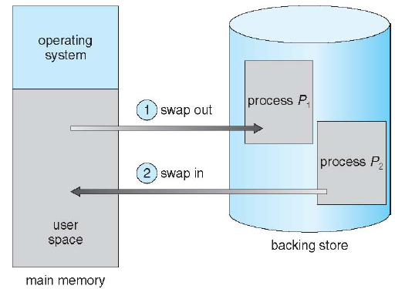
Figure 2.4. Swapping of two processes using a disk as a backing store.

Slide 16
  Normally, a process that is swapped out will be swapped back into the same memory space it occupied previously. This restriction is dictated by the method of address binding.
  If binding is done at assembly or load time, then the process cannot be easily moved to a different location.
  If execution-time binding is being used, however, then a process can be swapped into a different memory space, because the physical addresses are computed during execution time.

Slide 17
1.3. Contiguous Memory Allocation
  The main memory must accommodate both the operating system and the various user processes. OS therefore need to allocate the parts of the main memory in the most efficient way possible.
  1.3.1. Memory Mapping and Protection
  With relocation and limit registers, each logical address must be less than the limit register; the MMU maps the logical address dynamically by adding the value in the relocation register. This mapped address is sent to memory.

Slide 18
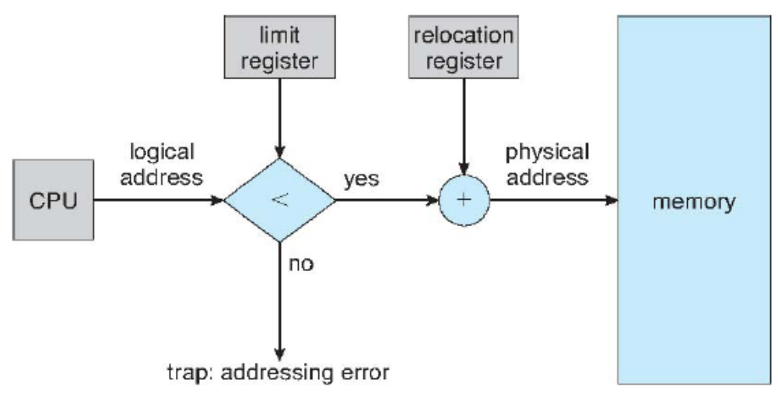
Figure 2.5. Hardware support for relocation and limit registers.

Slide 19
1.3.2. Memory Allocation
  (MFT-Multiprogramming with Fixed number of Tasks):
  One of the simplest methods for allocating memory is to divide memory into several fixed-sized partitions. Each partition may contain exactly one process. Thus, the degree of multiprogramming is bound by the number of partitions.
  In this multiplepartition method, when a partition is free, a process is selected from the input queue and is loaded into the free partition. When the process terminates, the partition becomes available for another process.

Slide 20
  MVT (Multiprogramming with a Variable number of Tasks or fixed-partition scheme:
  The operating system keeps a table indicating which parts of memory are available and which are occupied. Initially, all memory is available for user processes and is considered one large block of available memory, a hole.
  When a process arrives and needs memory, OS search for a hole large enough for this process. If find one, then allocate only as much memory as is needed, keeping the rest available to satisfy future requests

Slide 21
  As processes enter the system, they are put into an input queue.
  The operating system takes into account the memory requirements of each process and the amount of available memory space in determining which processes are allocated memory.
  When a process is allocated space, it is loaded into memory, and it can then compete for the CPU.
  When a process terminates, it releases its memory, which the operating system may then fill with another process from the input queue.

Slide 22
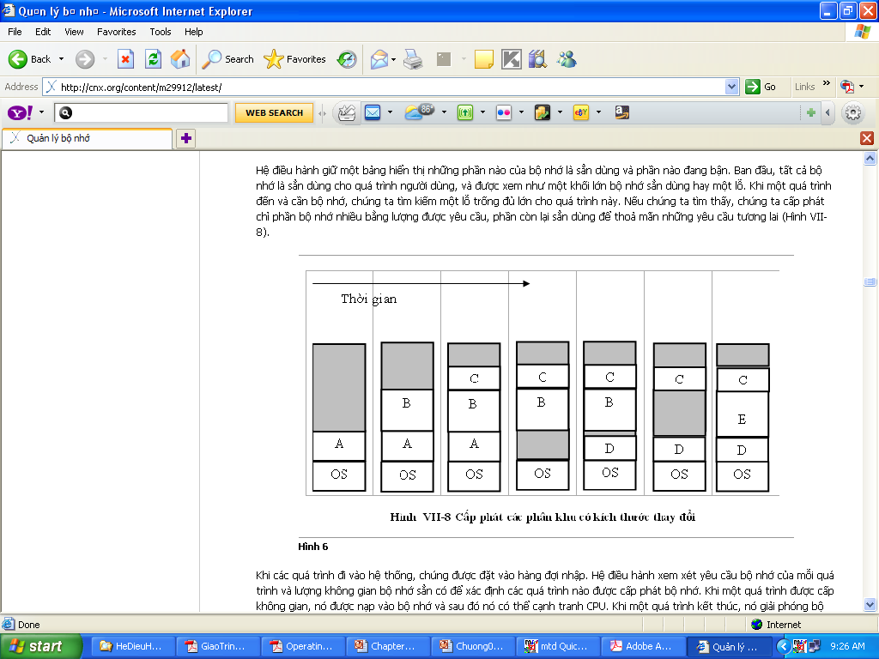
Time line
Figure 2.6. MVT memory allocation

Slide 23
How to satisfy a request of size n from a list of free holes. There are many solutions to this problem.
  First fit: Allocate the first hole that is big enough.
  Best fit: Allocate the smallest hole that is big enough.
  Worst fit: Allocate the largest hole.
Simulations have shown that both first fit and best fit are better than worst fit in terms of decreasing time and storage utilization. Neither first fit nor best fit is clearly better than the other in terms of storage utilization, but first fit is generally faster.

Slide 24
1.3.3. Fragmentation
  As processes are loaded and removed from memory, the free memory space is broken into little pieces.
  External fragmentation exists when there is enough total memory space to satisfy a request, but the available spaces are not contiguous; storage is fragmented into a large number of small holes.
  This fragmentation problem can be severe. In the worst case, we could have a block of free (or wasted) memory between every two processes.

Slide 25
  Both the first-fit and best-fit strategies for memory allocation suffer from external fragmentation.
  Memory fragmentation can be internal as well as external. If the memory allocated to a process may be larger than the requested memory. Then, the difference between these two numbers is internal fragmentation memory that is internal to a partition but is not being used.
  One solution to the problem of external fragmentation is compaction. The goal is to shuffle the memory contents so as to place all free memory together in one large block.

Slide 26
  Compaction is not always possible, however. If relocation is static and is done at assembly or load time, compaction cannot be done; compaction is possible only if relocation is dynamic and is done at execution time.
  Another possible solution to the external-fragmentation problem is to permit the logical address space of the processes to be noncontiguous, thus allowing a process to be allocated physical memory wherever the latter is available. Two complementary techniques achieve this solution: paging and segmentation

Slide 27
  1.4. Paging
  Paging is a memory-management scheme that permits the physical address space of a process to be noncontiguous.
  Paging avoids the considerable problem of fitting memory chunks of varying sizes onto the backing store; most memory-management schemes used before the introduction of paging suffered from this problem.
  Traditionally, support for paging has been handled by hardware. However, recent designs have implemented paging by closely integrating the hardware and operating system, especially on 64-bit microprocessors.

Slide 28
  1.4.1 Basic Method
  The basic method for implementing paging involves breaking physical memory into fixed-sized blocks called frames and breaking logical memory into blocks of the same size called pages.
  When a process is to be executed, its pages are loaded into any available memory frames from the backing store. The backing store is divided into fixed-sized blocks that are of the same size as the memory frames.

Slide 29
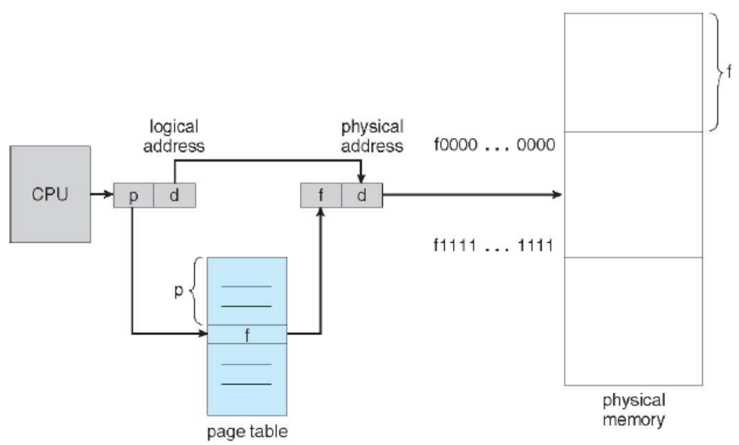
Figure 2.7. Paging hardware.

Slide 30
  Every address generated by the CPU is divided into two parts: a page number (p) and a page offset (d). The page number is used as an index into a page table. The page table contains the base address of each page in physical memory. This base address is combined with the page offset to define the physical memory address that is sent to the memory unit.
  The page size (like the frame size) is defined by the hardware. The size of a page is typically a power of 2, varying between 512 bytes and 16 MB per page, depending on the computer architecture.

Slide 31
If the size of logical address space is 2^{m} and a page size is 2^{n} addressing units (bytes or words), then the high-order m – n bits of a logical address designate the page number, and the n low-order bits designate the page offset.
Page number | Page offset
p | d
m-n | n
where p is an index into the page table and d is the displacement within the page.

Slide 32
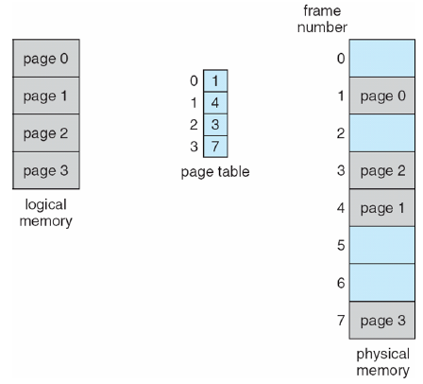
Figure 2.8. Paging model of logical and physical memory

Slide 33
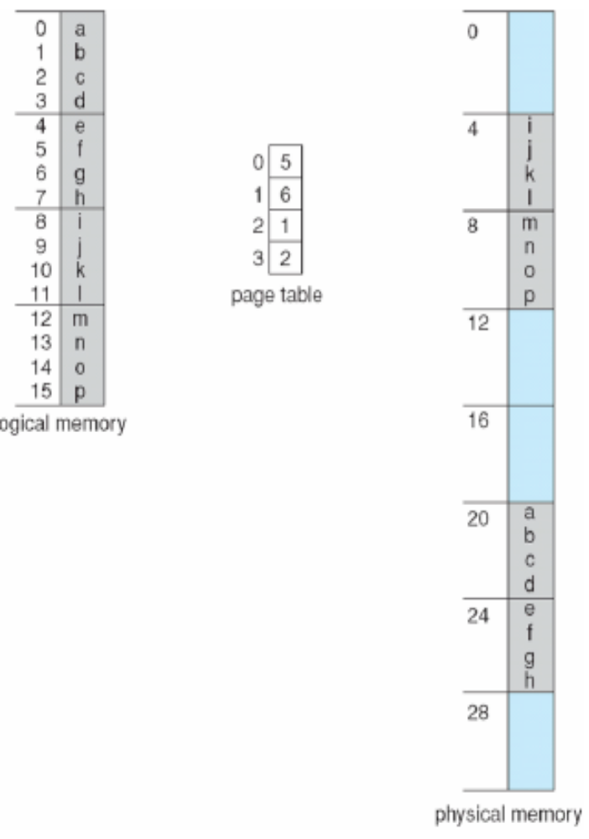
Example:Consider the memory in using a page size of 4 bytes and a physical memory of 32 bytes (8 frames).

Slide 34
Noticed that paging itself is a form of dynamic relocation. Every logical address is bound by the paging hardware to some physical address. Using paging is similar to using a table of base (or relocation) registers, one for each frame of memory.
When we use a paging scheme, we have no external fragmentation: Any free frame can be allocated to a process that needs it. However, we may have some internal fragmentation. Notice that frames are allocated as units.
Each operating system has its own methods for storing page tables. Most allocate a page table for each process. A pointer to the page table is stored with the other register values (like the instruction counter) in the process control block.

Slide 35
1.4.2. Protection
  Memory protection in a paged environment is accomplished by protection bits associated with each frame. Normally, these bits are kept in the page table.
  The operating system sets this bit for each page to allow or disallow access to the page.
  One additional bit is generally attached to each entry in the page table: a valid-invalid bit.

Slide 36
    When this bit is set to "valid," the associated page is in the process's logical address space and is thus a legal (or valid) page.
    When the bit is set to"invalid“, the page is not in the process's logical address space. Illegal addresses are trapped by use of the valid-invalid bit.
Example: Suppose that in a system with a 14-bit address space (0 to 16383), we have a program that should use only addresses 0 to 10468. Given a page size of 2 KB

Slide 37
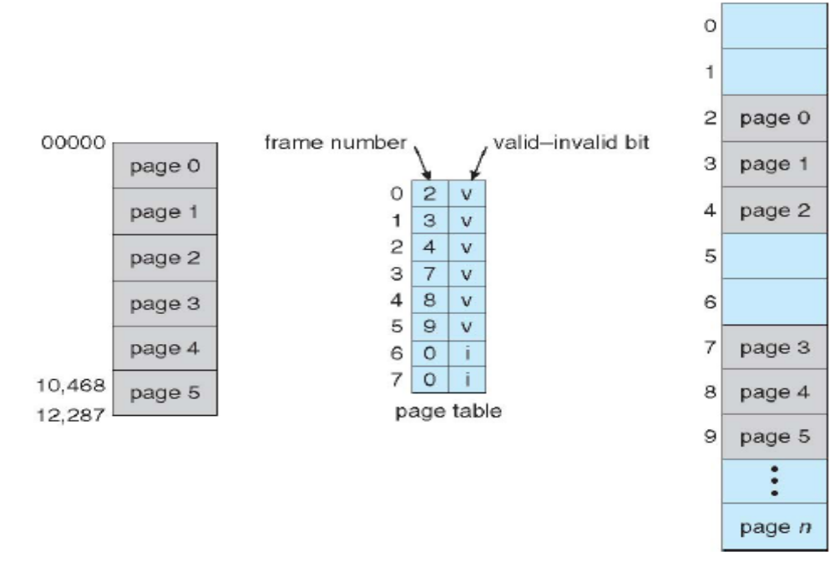

Slide 38
1.4.3. Shared Pages
  An advantage of paging is the possibility of sharing common code. This consideration is particularly important in a time-sharing environment.
    Consider a system that supports 40 users, each of whom executes a text editor. If the text editor consists of 150 KB of code and 50 KB of data space, we need 8,000 KB to support the 40 users.
  If the code is reentrant code (or pure code), however, it can be shared

Slide 39
Reentrant code is non-self-modifying code; it never changes during execution. Thus, two or more processes can execute the same code at the same time. Each process has its own copy of registers and data storage to hold the data for the process's execution. The data for two different processes will, of course, be different.
Only one copy of the editor need be kept in physical memory. Each user's page table maps onto the same physical copy of the editor, but data pages are mapped onto different frames. Thus, to support 40 users, we need only one copy of the editor (150 KB), plus 40 copies of the 50 KB of data space per user. The total space required is now 2,150 KB instead of 8,000 KB

Slide 40
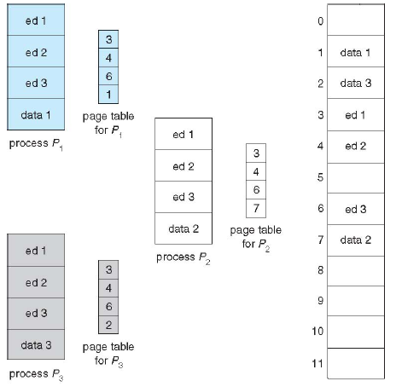
Figure 2.9 Sharing of code in a paging environment.

Slide 41
1.5. Structure of the Page Table
1.5.1. Hierarchical Paging
  Most modern computer systems support a large logical address space (2³² to 2⁶⁴). In such an environment, the page table itself becomes excessively large.
    For example, consider a system with a 32-bit logical address space. If the page size in such a system is 4 KB (2¹²), then a page table may consist of up to 1 million entries (2³²/2¹²).
  One simple solution to this problem is to divide the page table into smaller pieces.

Slide 42
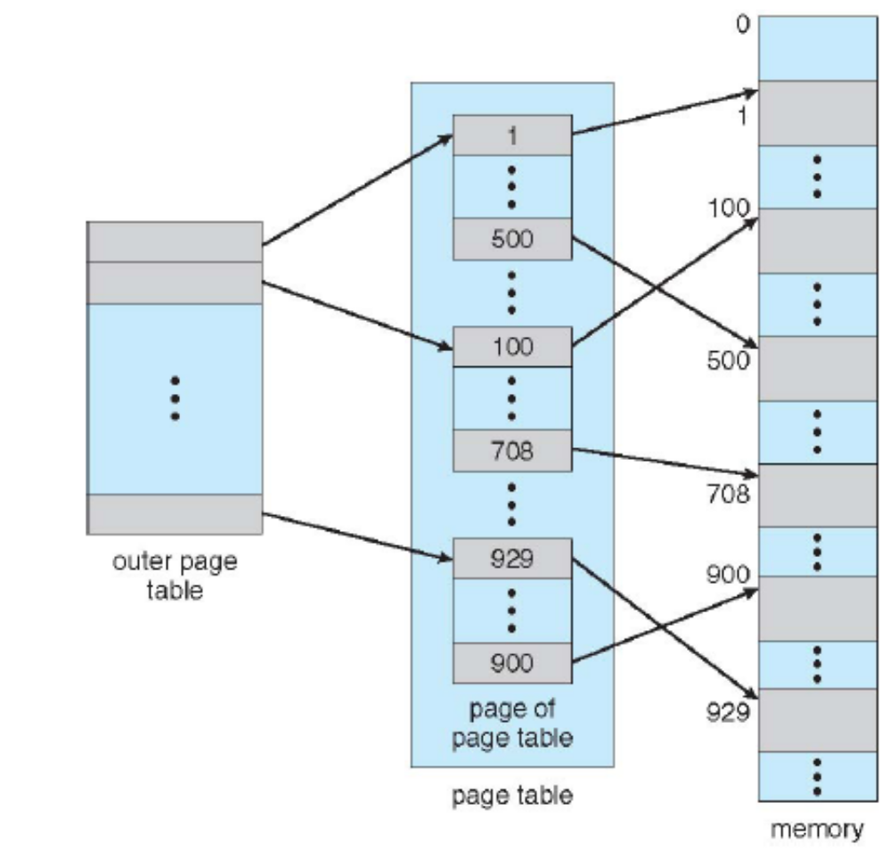
  One way is to use a two-level paging algorithm, in which the page table itself is also paged
Figure 2.10. A two-level page-table scheme.

Slide 43
  A logical address is divided into a page number consisting of 20 bits and a page offset consisting of 12 bits. Because we page the page table, the page number is further divided into a 10-bit page number and a 10-bit page offset. Thus, a logical address is as follows
page number
page offset
p1 | p2 | d
Where p1 is an index into the outer page table and p2 is the displacement within the page of the outer page table.

Slide 44
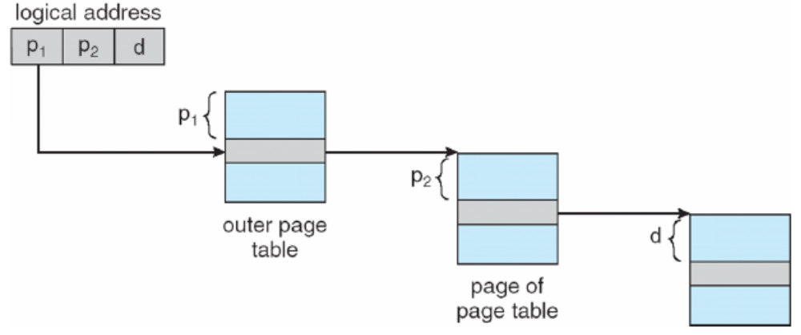
  The address-translation method for this architecture is as follow
Figure 2.11. Address translation for a two-level 32-bit paging architecture

Slide 45
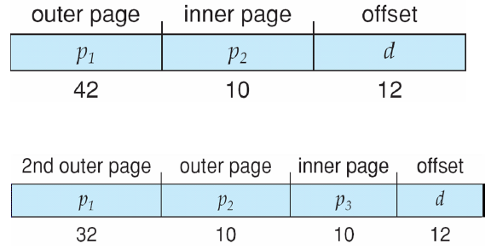
  Three-level paging

Slide 46
1.5.2. Hashed Page Tables
A common approach for handling address spaces larger than 32 bits is to use a hashed page table, with the hash value being the virtual page number.
Each entry in the hash table contains a linked list of elements that hash to the same location.
Each element consists of three fields:
  (1) the virtual page number
  (2) the value of the mapped page frame
  (3) a pointer to the next element in the linked list

Slide 47
  The algorithm works as follows
    The virtual page number in the virtual address is hashed into the hash table.
    The virtual page number is compared with field 1 in the first element in the linked list.
      If there is a match the corresponding page frame (field 2) is used to form the desired physical address.
      If there is no match, subsequent entries in the linked list are searched for a matching virtual page number.

Slide 48
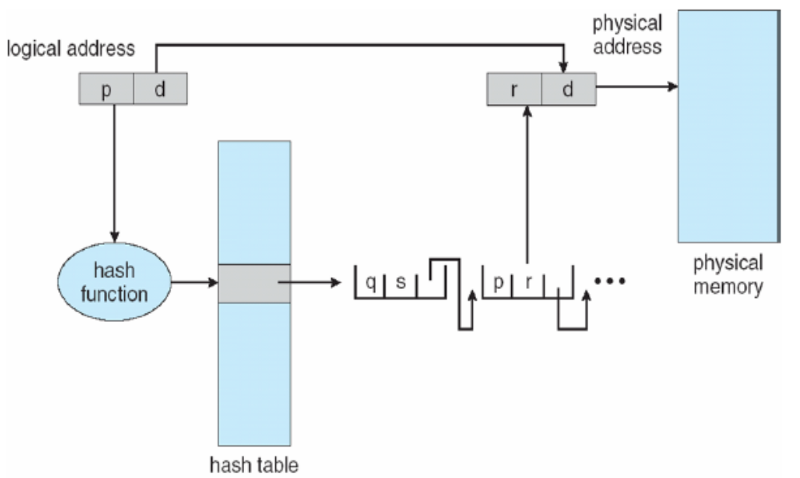
Figure 2.12. Hashed page table.

Slide 49
1.5.3. Inverted Page Tables
  Use an inverted page table to solve this problem that each page table may consist of millions of entries and these tables may consume large amounts of physical memory just to keep track of how other physical memory is being used.
  An inverted page table has one entry for each real page (or frame) of memory. Each entry consists of the virtual address of the page stored in that real memory location, with information about the process that owns that page.

Slide 50
  Thus, only one page table is in the system, and it has only one entry for each page of physical memory.
  A simplified version of the inverted page table used in the IBM RT.
    Each virtual address in the system consists of a triple <process-id, page-number, offset>.
    Each inverted page-table entry is a pair <process-id, page-number>
    When a memory reference occurs, the inverted page table is then searched for a match. If a match is found at entry i -then the physical address <i, offset> is generated.

Slide 51
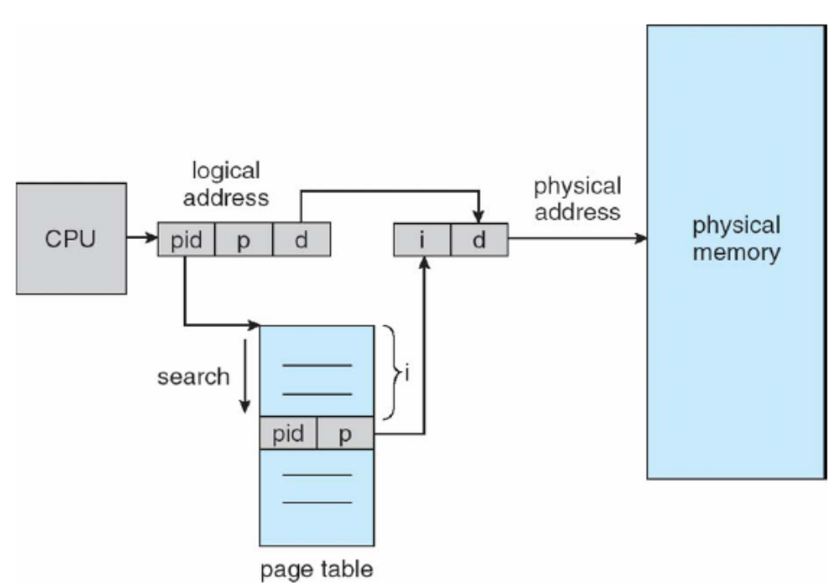
Figure 2.13. Inverted page table.

Slide 52
  1.6. Segmentation
  An important aspect of memory management that became unavoidable with paging is the separation of the user's view of memory and the actual physical memory.
  The user's view of memory is not the same as the actual physical memory.
  The user's view is mapped onto physical memory.
  This mapping allows differentiation between logical memory and physical memory.

Slide 53
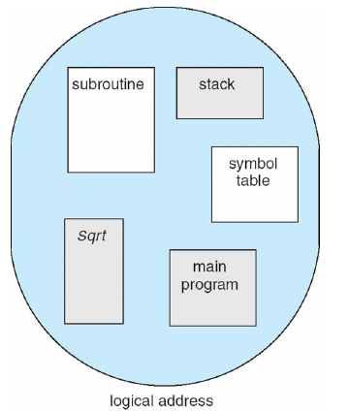
users prefer to view memory as a collection of variable-sized segments, with no necessary ordering among segments
Figure 2.14. User's view of a program.

Slide 54
1.6.1. Basic Method
  Segmentation is a memory-management scheme that supports this user view of memory. A logical address space is a collection of segments.
  Each segment has a name and a length. The addresses specify both the segment name and the offset within the segment.
  The user therefore specifies each address by two quantities: a segment name and an offset.

Slide 55
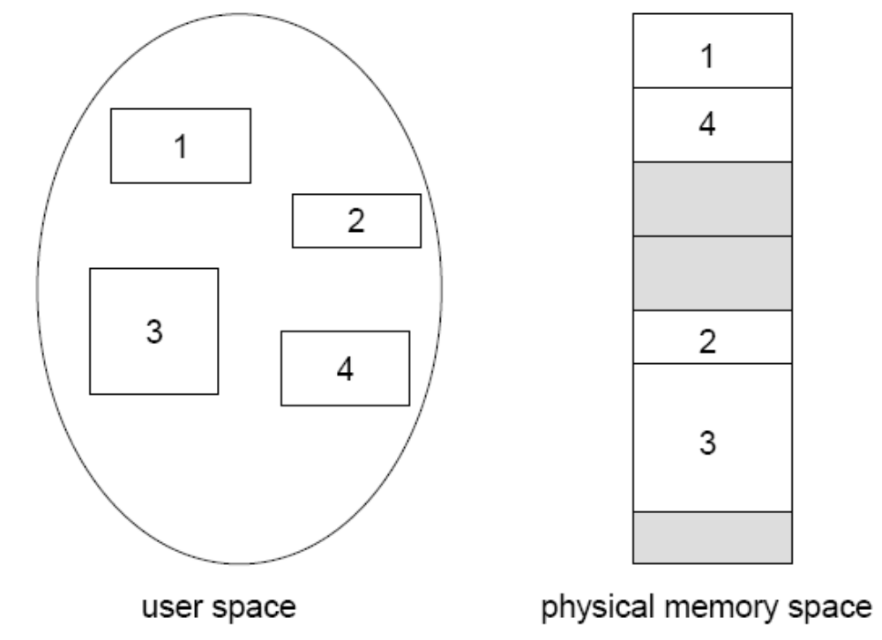
Figure 2.15. Logical view of Segmentation

Slide 56
  For simplicity of implementation, segments are numbered and are referred to by a segment number, rather than by a segment name. Thus, a logical address consists of a two tuple:
      < segment-number, offset >
  Normally, the user program is compiled, and the compiler automatically constructs segments reflecting the input program.

Slide 57
1.6.2. Hardware
  Although the user can now refer to objects in the program by a two-dimensional address, the actual physical memory is still, of course, a one-dimensional sequence of bytes. Thus, OS must define an implementation to map two dimensional user-defined addresses into one-dimensional physical addresses
  This mapping is effected by a segment table. Each entry in the segment table has a segment base and a segment limit. The segment base contains the starting physical address where the segment resides in memory, whereas the segment limit specifies the length of the segment

Slide 58
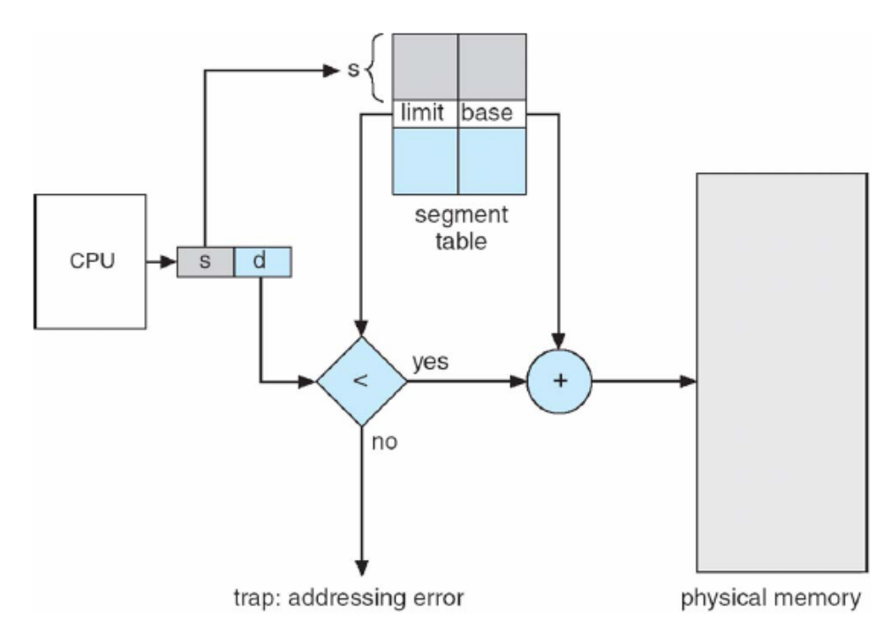
Figure 2.16. Segmentation hardware.

Slide 59
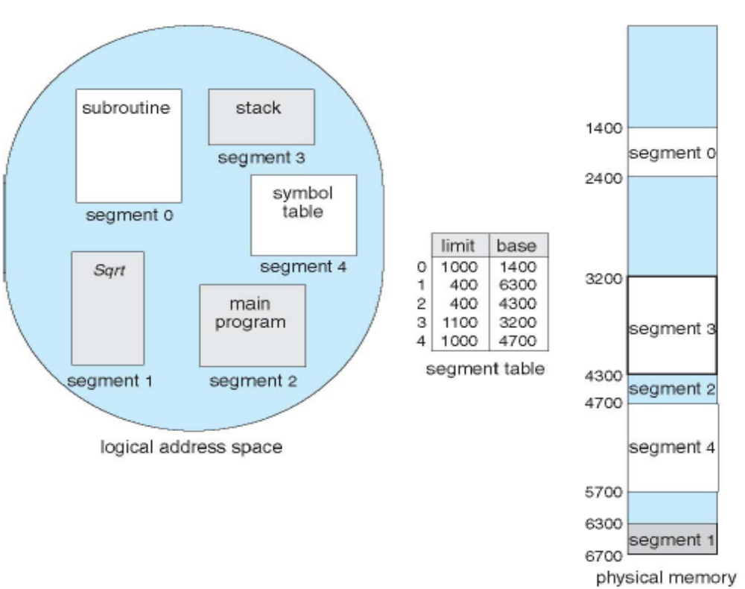
Example of Segmentation

Slide 60
Example:
1. Cho biết không gian địa chỉ logic có 16 trang (Page) và mỗi trang có 512 từ nhớ (byte) được ánh xạ vào bộ nhớ vật lý 128 khung trang (Frame) thì
  a. Địa chỉ luận lý có 13 bit và địa chỉ vật lý có 16 bit
  b. Địa chỉ luận lý có 16 bit và địa chỉ vật lý có 13 bit
  c. Địa chỉ luận lý có 9 bit và địa chỉ vật lý có 8 bit
  d. Tất cả a, b, c đều sai
2. Cho biết không gian địa chỉ logic có 8 trang (Page) và mỗi trang có 2048 từ nhớ (byte) được ánh xạ vào bộ nhớ vật lý 32 khung trang (Frame) thì
  a. Địa chỉ luận lý có 11 bit và địa chỉ vật lý có 5 bit
  b. Địa chỉ luận lý có 14 bit và địa chỉ vật lý có 16 bit
  c. Địa chỉ luận lý có 19 bit và địa chỉ vật lý có 5 bit
  d. Địa chỉ luận lý có 11 bit và địa chỉ vậy lý có 16 bit

Slide 61
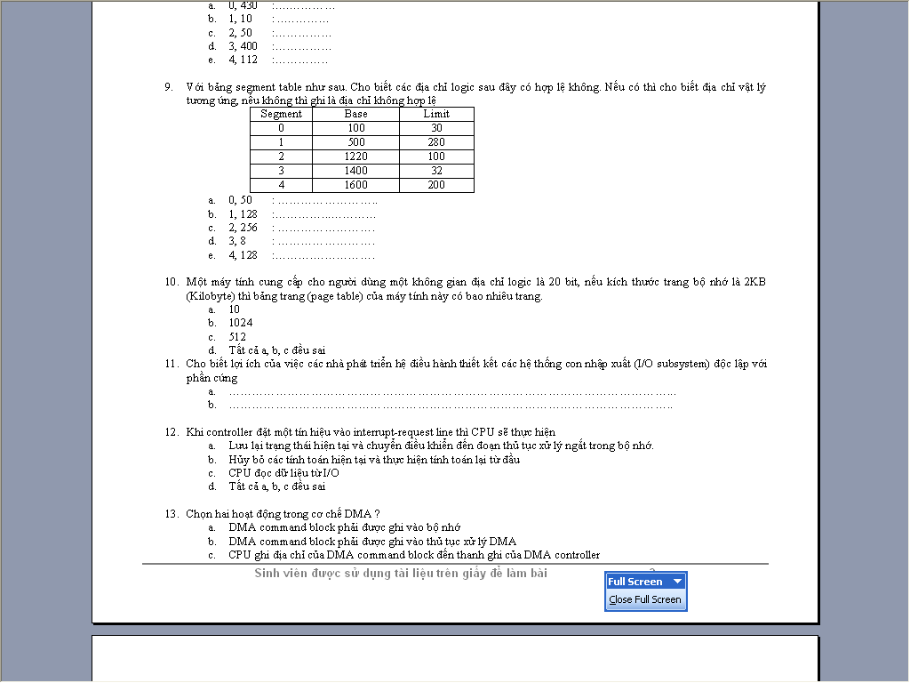

Slide 62
  2. Virtual Memory (Reference)
  2.1. Background
  2.2. Demand Paging
  2.3. Copy-on-Write
  2.4. Page Replacement
  2.5. Allocation of Frames
  2.6. Thrash
  2.7. Memory mapped Files
  2.8. Allocating Kernel Memory
  2.9. Other Considerations

Slide 63
2.1. Background
  Virtual memory–separation of user logical memory from physical memory.
    Only part of the program needs to be in memory for execution
    Logical address space can therefore be much larger than physicaladdress space
    Allows address spaces to be shared by several processes
    Allows for more efficient process creation
  Virtual memory can be implemented via:
    Demand paging
    Demand segmentation

Slide 64
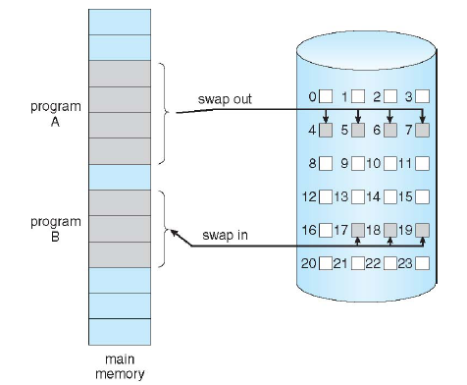
2.2. Demand Paging
Figure 2.1. Transfer of a paged memory to contiguous disk space.

Slide 65
2.3. Copy-on-Write
  Copy-on-Write (COW) allows both parent and child processes to initially sharethe same pages in memory
  COW allows more efficient process creation as only modified pages are copied
  Free pages are allocated from a pool of zeroed-out pages

Slide 66
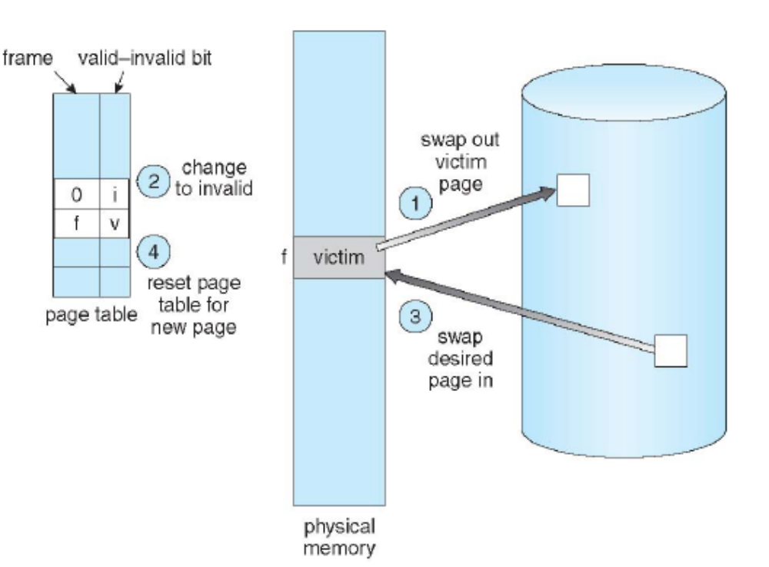
2.4. Page Replacement
Figure 2.2. Page replacement.

Slide 67
2.5. Allocation of Frames
  Each process needs minimumnumber of pages
  Example: IBM 370 –6 pages to handle SS MOVE instruction:
    instruction is 6 bytes, might span 2 pages
    pages to handle from
    2 pages to handle to
  Two major allocation schemes
    fixed allocation
    priority allocation

Slide 68
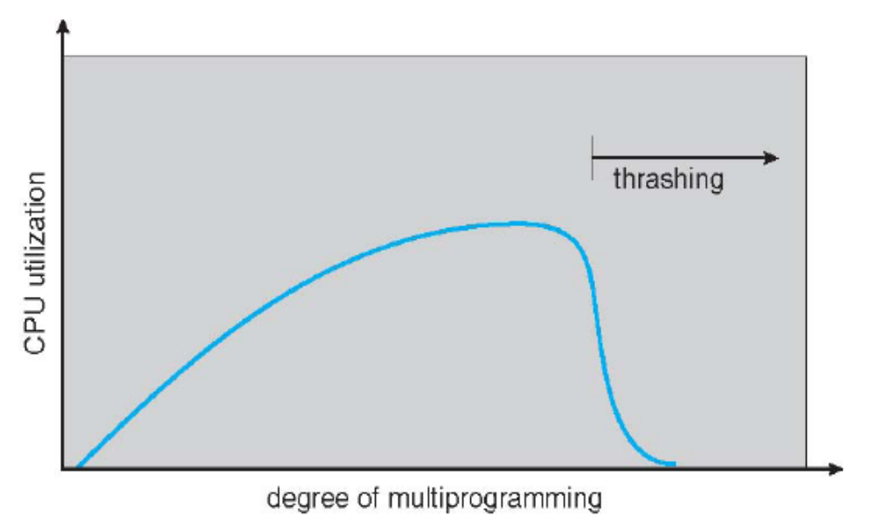
  2.6. Thrash
  Thrashing-a process is busy swapping pages in and out
Figure 2.3. Thrashing.

Slide 69
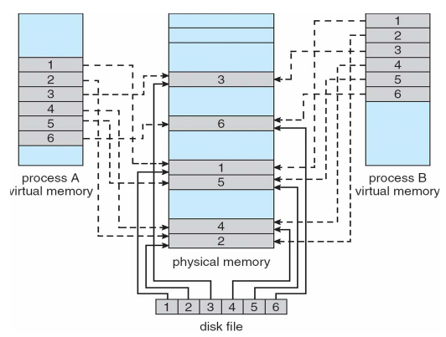
2.7. Memory mapped Files
Figure 2.4. Memory-mapped files.

Slide 70
2.8. Allocating Kernel Memory
  Treated differently from user memory
  Often allocated from a free-memory pool
    Kernel requests memory for structures of varying sizes
    Some kernel memory needs to be contiguous
  2.9. Other Considerations
  Reference: Silberschatz-Galvin-Gagne, Operating System Concepts, USA, 2005.(http://www.os-book.com)

