Slide 1
Chapter 8. IO Management
OBJECTIVES
• Explore the structure of an operating system's I/O subsystem.
• Discuss the principles of I/O hardware and its complexity.
• Provide details of the performance aspects of I/O hardware and software.

Slide 2
1. I/O System
1.1. Overview
  The control of devices connected to the computer is a major concern of operating-system designers.
  I/O devices vary so widely in their function and speed (consider a mouse, a hard disk, and a CD-ROM jukebox), varied methods are needed to control them.
  These methods form the I/O subsystem of the kernel, which separates the rest of the kernel from the complexities of managing I/O devices.

Slide 3
  The basic I/O hardware elements, such as ports, buses, and device controllers
  To encapsulate the details and oddities of different devices, the kernel of an operating system is structured to use device-driver modules.
  The device drivers present a uniform device access interface to the I/O subsystem, much as system calls provide a standard interface between the application and the operating system.

Slide 4
  1.2. I/O Hardware
  Computers operate a great many kinds of devices. Most fit into the general categories of storage devices (disks, tapes), transmission devices (network cards, modems), and human-interface devices (screen, keyboard, mouse).
  Despite the incredible variety of I/O devices, though, we need only a few concepts to understand how the devices are attached and how the software can control the hardware.
  The device communicates with the machine via a connection point (or port)—for example, a serial port.

Slide 5
  A bus is a set of wires and a rigidly defined protocol that specifies a set of messages that can be sent on the wires.
  A controller is a collection of electronics that can operate a port, a bus, or a device.
  How can the processor give commands and data to a controller to accomplish an I/O transfer? The short answer is that the controller has one or more registers for data and control signals. The processor communicates with the controller by reading and writing bit patterns in these registers.

Slide 6
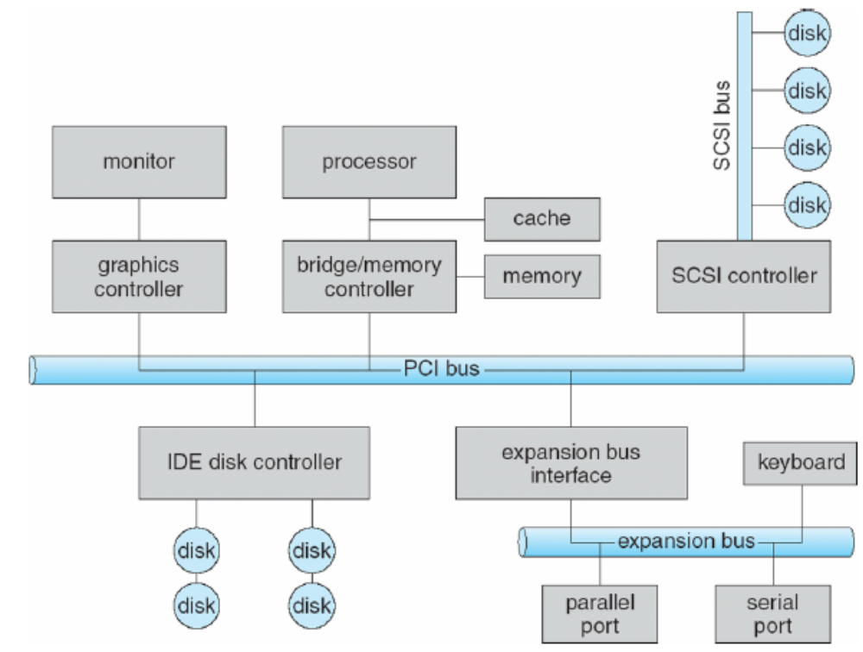
Figure 1.1. A typical PC bus structure.

Slide 7
  One way, this communication can occur is through the use of special I/O instructions that specify the transfer of a byte or word to an I/O port address. The I/O instruction triggers bus lines to select the proper device and to move bits into or out of a device register.
  Alternatively, the device controller can support memory-mapped I/O. In this case, the device-control registers are mapped into the address space of the processor. The CPU executes I/O requests using the standard data-transfer instructions to read and write the device-control registers.

Slide 8
Some systems use both techniques. For instance, PCs use I/O instructions to control some devices and memory-mapped I/O to control others. The graphics controller has I/O ports for basic control operations, but the controller has a large memory mapped region to hold screen contents. The process sends output to the screen by writing data into the memory-mapped region. The controller generates the screen image based on the contents of this memory. This technique is simple to use. Moreover, writing millions of bytes to the graphics memory is faster than issuing millions of I/O instructions.

Slide 9
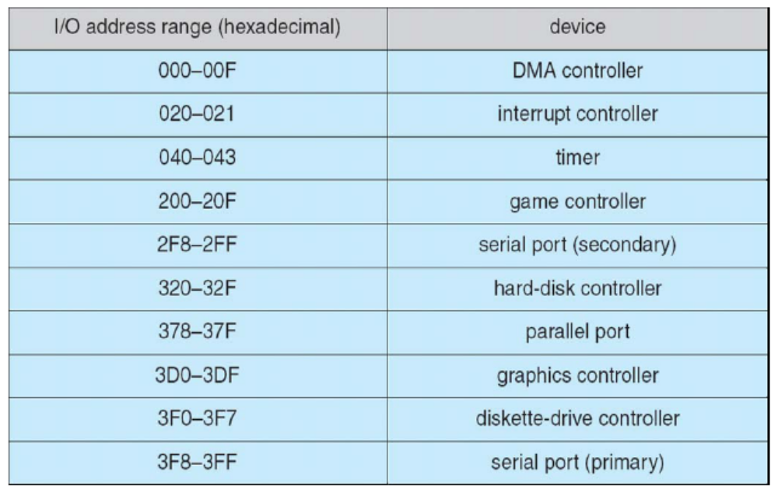
Figure 1.2. Device I/O port locations on PCs (partial).

Slide 10
An I/O port typically consists of four registers, called the (1) status, (2) control, (3) data-in, and (4) data-out registers.
  The data-in register is read by the host to get input.
  The data-out register is written by the host to send output.
  The status register contains bits that can be read by the host. These bits indicate states
  The control register can be written by the host to start a command or to change the mode of a device.
The data registers are typically 1 to 4 bytes in size.

Slide 11
1.2.1. Polling or Handshaking
The interaction between the host (CPU) and a controller
  The controller indicates its state through the busy bit in the status register (set a bit means to write a 1 into the bit and to clear a bit means to write a 0 into it.)
  The controller sets the busy bit when it is busy working and clears the busy bit when it is ready to accept the next command.
  The host signals its wishes via the command-ready bit in the command register. The host sets the command-ready bit when a command is available for the controller to execute.

Slide 12
  The host writes output through a port
  The host repeatedly reads the busy bit until that bit becomes clear.
  The host sets the write in the command register
  and writes a byte into the data-out register.
3. The host sets the command-ready bit.
4. When the controller notices that the command-ready bit is set, it sets the busy bit.
5. The controller reads the command register and sees the write command. It reads the data-out register to get the byte and does the I/O to the device.
6. The controller clears the command-ready bit, clears the error bit in the status register to indicate that the device I/O succeeded, and clears the busy bit to indicate that it is finished.

Slide 13
  In step 1, the host is busy-waiting or polling: It is in a loop, reading the status register over and over until the busy bit becomes clear, if the controller and device are fast, this method is a reasonable one. But if the wait may be long, the host should probably switch to another task.
  In many computer architectures, three CPU-instruction cycles are sufficient to poll a device: read a device register, logical-arid to extract a status bit, and branch if not zero. Clearly, the basic polling operation is efficient.

Slide 14
  But polling becomes inefficient when it is attempted repeatedly yet rarely finds a device to be ready for service, while other useful CPU processing remains undone.
  In such instances, it may be more efficient to arrange for the hardware controller to notify the CPU when the device becomes ready for service, rather than to require the CPU to poll repeatedly for an I/O completion.
  The hardware mechanism that enables a device to notify the CPU is called an interrupt.

Slide 15
1.2.2. Interrupts
  The CPU hardware has a wire called the interrupt-request line that the CPU senses after executing every instruction.
  When the CPU detects that a controller has asserted a signal on the interrupt request line, the CPU performs a state save and jumps to the interrupt handler routine at a fixed address in memory.
  The interrupt handler determines the cause of the interrupt, performs the necessary processing, performs a state restore, and return the CPU to the execution state prior to the interrupt.

Slide 16
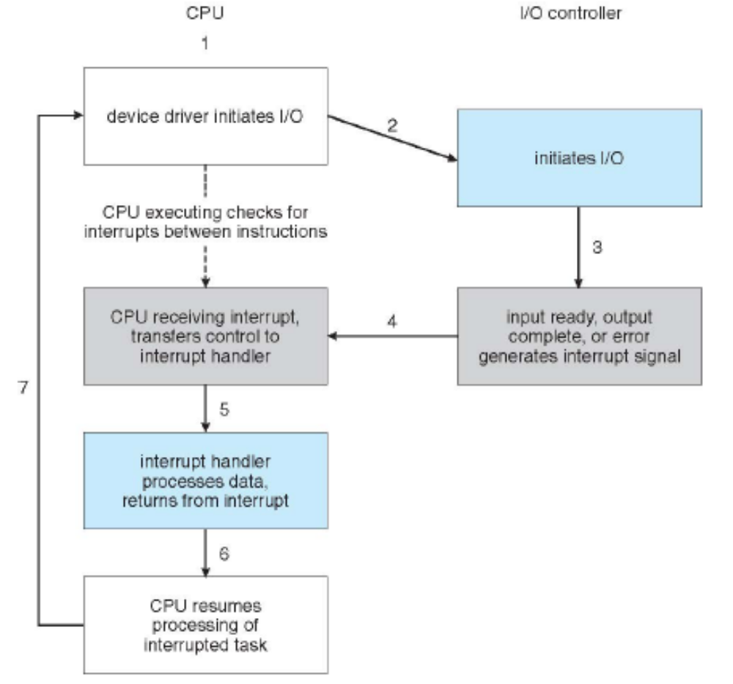
Figure 1.3 Interrupt-driven I/O cycle.

Slide 17
  In a modern operating system, however, we need more sophisticated, interrupt handling features.
  1. We need the ability to defer interrupt handling during critical processing.
  2. We need an efficient way to dispatch to the proper interrupt handler for a device without first polling all the devices to see which one raised the interrupt
  3. We need multilevel interrupts, so that the operating system can distinguish between high- and low-priority interrupts and can respond with the appropriate degree of urgency.

Slide 18
  In modern computer hardware, these three features are provided by the CPU and by the interrupt-controller hardware.
  Most CPUs have two interrupt request lines.
    One is the nonmaskable interrupt, which is used to signal various error conditions
    The second interrupt line is maskable: It can be turned off by the CPU
  The maskable interrupt is used by device controllers to request service.

Slide 19
  The interrupt mechanism accepts an address-a number that selects a specific interrupt-handling routine
  In most architectures, this address is an offset in a table called the interrupt vector. This vector contains the memory addresses of specialized interrupt handlers.
  The purpose of a vectored interrupt mechanism is to reduce the need for a single interrupt handler to search all possible sources of interrupts to determine which one needs service.

Slide 20
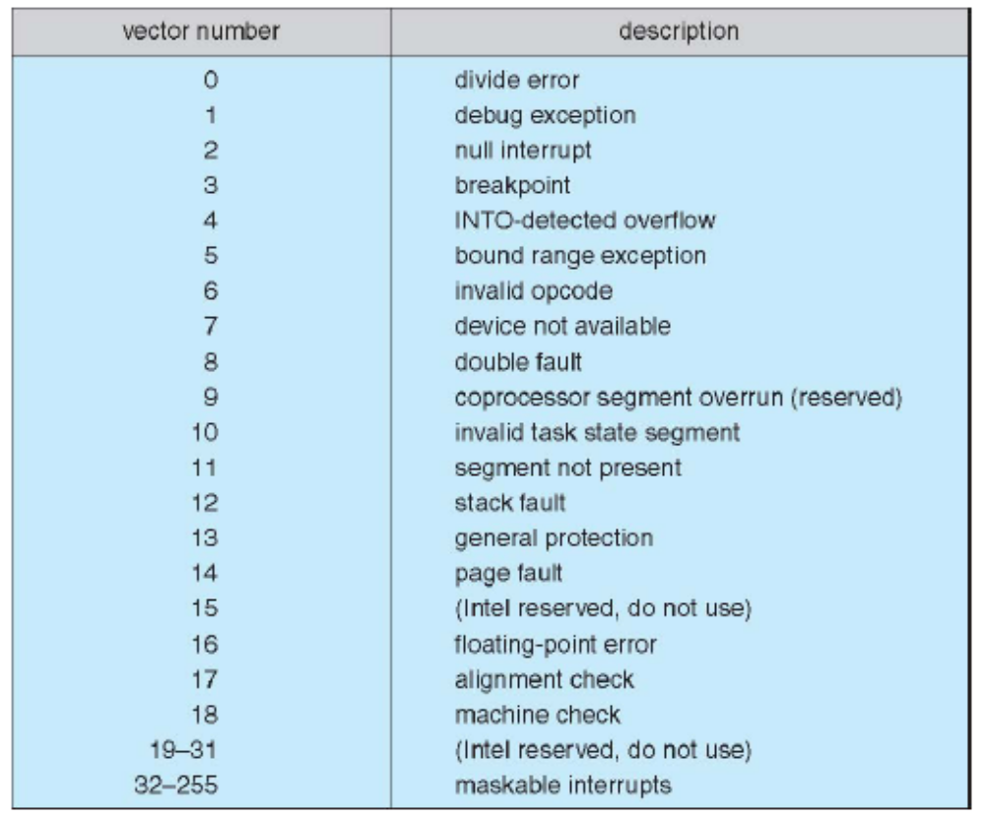
Figure 1.4. Intel Pentium processor event-vector table.

Slide 21
1.2.3. Direct Memory Access
  For a device that does large transfers, such as a disk drive, it seems wasteful to use an expensive main processor to watch status bits and to feed data into a controller register one byte at a time-a process termed programmed I/O (PIO).
  Many computers avoid burdening the main CPU with PIO by offloading some of this work to a special-purpose processor called a direct-memory-access (DMA) controller.

Slide 22
  To initiate a DMA transfer, the host writes a DMA command block into memory. This block contains a pointer to the source of a transfer, a pointer to the destination of the transfer, and a count of the number of bytes to be transferred.
  The CPU writes the address of this command block to the DMA controller, then goes on with other work. The DMA controller proceeds to operate the memory bus directly, placing addresses on the bus to perform transfers without the help of the main CPU.

Slide 23
  Handshaking between the DMA controller and the device controller: DMA-request and DMA-acknowledge.
  The device controller places a signal on the DMA-request wire when a word of data is available for transfer. This signal causes the DMA controller to seize the memory bus, to place the desired address on the memory-address wires, and to place a signal on the DMA-acknowledge wire.
  When the device controller receives the DMA-acknowledge signal, it transfers the word of data to memory and removes the DMA-request signal.

Slide 24
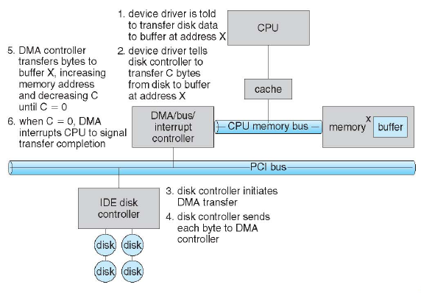
Figure 1.5. Steps in a DMA transfer.

Slide 25
1.3. Application I/O interface
  Like other complex software-engineering problems, the approach here involves abstraction, encapsulation, and software layering. Specifically we can abstract away the detailed differences in I/O devices by identifying a few general kinds.
  Each general kind is accessed through a standardized set of functions—an interface.
  The differences are encapsulated in kernel modules called device drivers that internally are custom-tailored to each device but that export one of the standard interfaces.

Slide 26
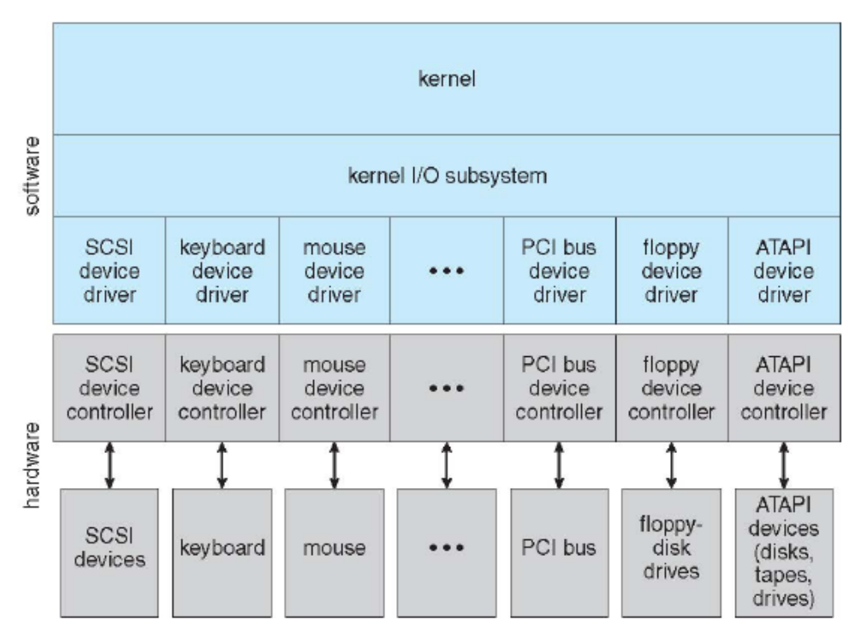
Figure 1.6. A kernel I/O structure.

Slide 27
  The purpose of the device-driver layer is to hide the differences among device controllers from the I/O subsystem of the kernel.
  Making the I/O subsystem independent of the hardware simplifies the job of the operating-system developer. It also benefits the hardware manufacturers.
    Design new devices to be compatible with an existing host controller interface.
    Write device drivers to interface the new hardware to popular operating systems.

Slide 28
  Devices vary on many dimensions
    Character-stream or block
    Sequential or random-access
    Synchronous or asynchronous
    Sharable or dedicated
    Speed of operation
    Read-write, read only, or write only

Slide 29
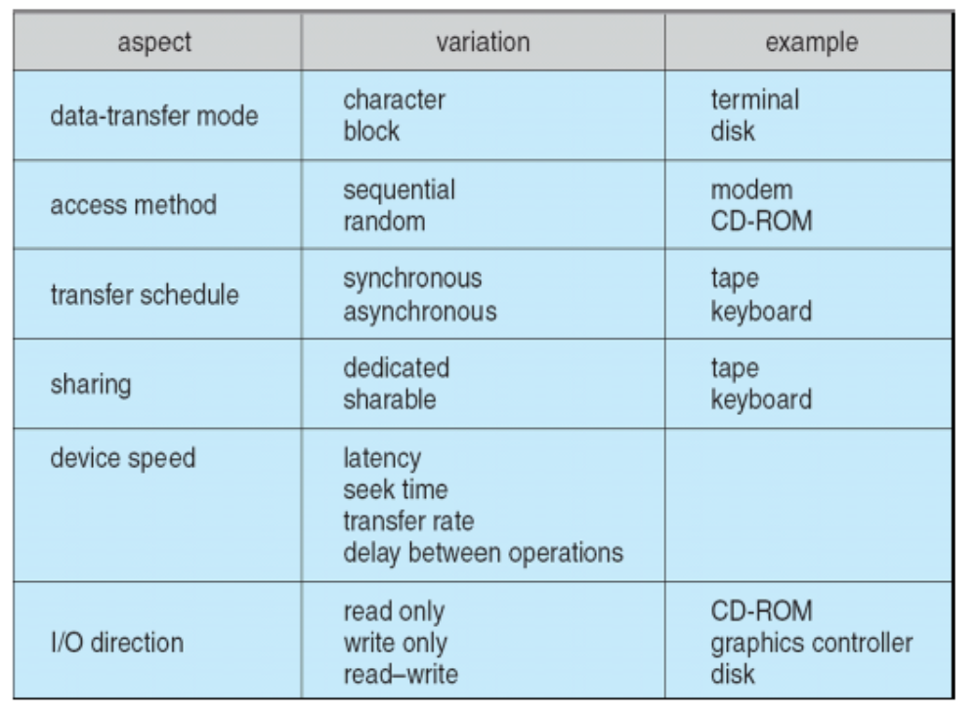
Figure 1.7. Characteristics of I/O devices.

Slide 30
1.3.1 Block and Character Devices
  Disk driver
  Commands include read(), write(), seek()
  The operating system itself, as well as special applications such as database management systems, may prefer to access a block device as a simple linear array of blocks. This mode of access is sometimes called raw I/O.
  Memory-mapped file access can be layered on top of block-device drivers.Rather than offering read and write operations, a memory-mapped interface provides access to disk storage via an array of bytes in main memory.

Slide 31
  Character devices include keyboards, mice, serial ports.
  The basic system calls in this interface enable an application to get() or put() one character.
  On top of this interface, libraries can be built that offer line-at-a-time access, with buffering and editing services.

Slide 32
1.3.2. Network Device
  Interface available in many operating systems is the network socket interface.
  The system calls in the socket interface enable an application to create a socket, to connect a local socket to a remote address listen for any remote application to plug into the local socket, and to send and receive packets over the connection.
  A call to select () returns information about which sockets have a packet waiting to be received and which sockets have room to accept a packet to be sent -> eliminates the polling and busy waiting that would otherwise be necessary for network I/O.

Slide 33
  1.3.3 Clocks and Timers
  Most computers have hardware clocks and timers that provide three basic functions:
    Give the current time.
    Give the elapsed time.
    Set a timer to trigger operation X at time T.
  The hardware to measure elapsed time and to trigger operations is called a programmable interval timer. It can be set to wait a certain amount of time and then generate an interrupt, and it can be set to do this once or to repeat the process to generate periodic interrupts.

Slide 34
1.3.4. Blocking and Nonblocking I/O
  When an application issues a blocking system call, the execution of the application is suspended. The application is moved from the operating system's run queue to a wait queue. After the system call completes, the application is moved back to the run queue, where it is eligible to resume execution, at which time it will receive the values returned by the system call.
  Most operating systems use blocking system calls for the application interface, because blocking application code is easier to understand than nonblocking application code

Slide 35
  Nonblocking-I/O call returns as much as available
    User interface, data copy (buffered I/O):receives keyboard and mouse input while processing and displaying data on the screen.
    Implemented via multi-threading
    Returns quickly with count of bytes read or written
  An example is a video application that reads frames from a file on disk while simultaneously decompressing and displaying the output on the display.

Slide 36
  An alternative to a nonblocking system call is an asynchronous system call.
    An asynchronous call returns immediately, without waiting for the I/O to complete. The application continues to execute its code.
    The completion of the I/O at some future time is communicated to the application, either through the setting of some variable in the address space of the application or through the triggering of a signal.

Slide 37
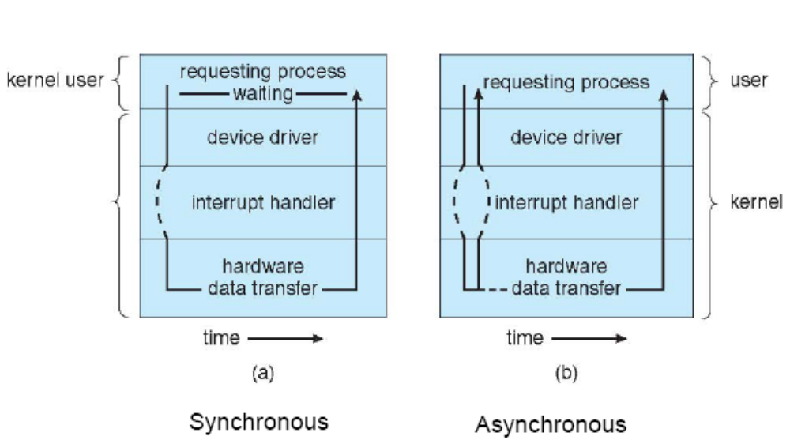
Figure 1.8 Two I/O methods:
(a) synchronous and (b) asynchronous.

Slide 38
  1.4 Kernel I/O Subsystem
  Kernels provide many services related to I/O. Several services—scheduling,buffering, caching, spooling and error handling are provided by the kernel's I/O subsystem and build on the hardware and device driver infrastructure.
  1.4.1. I/O Scheduling
  To schedule a set of I/O requests means to determine a good order in which to execute them.
  Operating-system developers implement scheduling by maintaining a wait queue of requests for each device.

Slide 39
  The I/O scheduler rearranges the order of the queue to improve the overall system efficiency and the average response time experienced by applications.
1.4.2 Buffering
  A buffer is a memory area that stores data while they are transferred between two devices or between a device and an application.
  Buffering is done for three reasons.
    To cope with device speed mismatch
    To cope with device transfer size mismatch
    To maintain “copy semantics”:copy data into kernel buffer before return control to the application

Slide 40
  1.4.3 Caching
  A cache is a region of fast memory that holds copies of data. Access to the cached copy is more efficient than access to the original.
  1.4.4 Spooling
  A spool is a buffer that holds output for a device If device can serve only one request at a time.Example: Printer.
  1.4.5 Error Handling
  Devices and I/O transfers can fail in many ways, either for transient reasons, as when a network becomes overloaded, or for "permanent" reasons, as when a disk controller becomes defective.

Slide 41
  Operating systems can often compensate effectively for transient failures. For instance, a disk read() failure results in a read() retry, and a network send() error results in a resend()
  Unfortunately, if an important component experiences a permanent failure, the operating system is unlikely to recover.
  As a general rule, an I/O system call will return one bit of information about the status of the call, signifying either success or failure.

Slide 42
2. Mass Storage Structure (Reference)
2.1. Overview Mass Storage Structure
2.2. Disk Structure
2.3. Disk Attachment
2.4. Disk Scheduling
2.5. Disk Management
2.6. RAID Structure
2.7. Stable Storage Implementation
2.8. Tertiary Storage Structure
  Reference: Silberschatz-Galvin-Gagne, Operating System Concepts, USA, 2005.(http://www.os-book.com)

