Slide 1
Chapter 9. FILE Management
OBJECTIVES
  To explain the function of file systems.
  To describe the interfaces to file systems.
  To discuss file-system design tradeoffs, including access methods, file sharing, file locking, and directory structures.
  To explore file-system protection

Slide 2
1. File System Interface
1.1. File concept
  A file is a named collection of related information that is recorded on secondary storage.
  From a user's perspective, a file is the smallest allotment of logical secondary storage
  Commonly, files represent programs (both source and object forms) and data.
  In general, a file is a sequence of bits, bytes, lines, or records, the meaning of which is defined by the file's creator and user.

Slide 3
1.1.1 File Attributes
  A file is named, for the convenience of its human users, and is referred to by its name.
  A file's attributes vary from one operating system to another but typically consist of these:
    Name–only information kept in human-readable form
    Identifier–unique tag (number) identifies file within file system
    Type–needed for systems that support different types
    Location–pointer to file location on device
    Size–current file size
    Protection–controls who can do reading, writing, executing
    Time, date, and user identification–data for protection, security, and usage monitoring

Slide 4
1.1.2 File Operations
  A file is an abstract data type.
  The basic file operations
    Creating a file:Two steps are necessary. First, space in the file system must be found for the file. Second, an entry for the new file must be made in the directory.
    Writing a file: A system call specifying both the name of the file and the information to be written to the file. Given the name of the file, the system searches the directory to find the file's location.

Slide 5
    Reading a file: A system call that specifies the name of the file and where (in memory) the next block of the file should be put.
    Repositioning within a file: The directory is searched for the appropriate entry, and the current-file-position pointer is repositioned to a given value.
    Deleting a file: OS search the directory for the named file and release all file space, so that it can be reused by other files, and erase the directory entry.

Slide 6
    Truncating a file: To allows all attributes to remain unchanged-except for file length be reset to length zero and its file space released.
    Open(Fi): search the directory structure on disk for entry Fi, and move the content of entry to memory.
    Close (Fi):move the content of entry Fi in memory to directory structure on disk.

Slide 7
    Some operating systems provide facilities for locking an open file (or sections of a file). File locks allow one process to lock a file and prevent other processes from gaining access to it.
    File locks are useful for files that are shared by several processes—for example, a system log file that can be accessed and modified by a number of processes in the system.

Slide 8
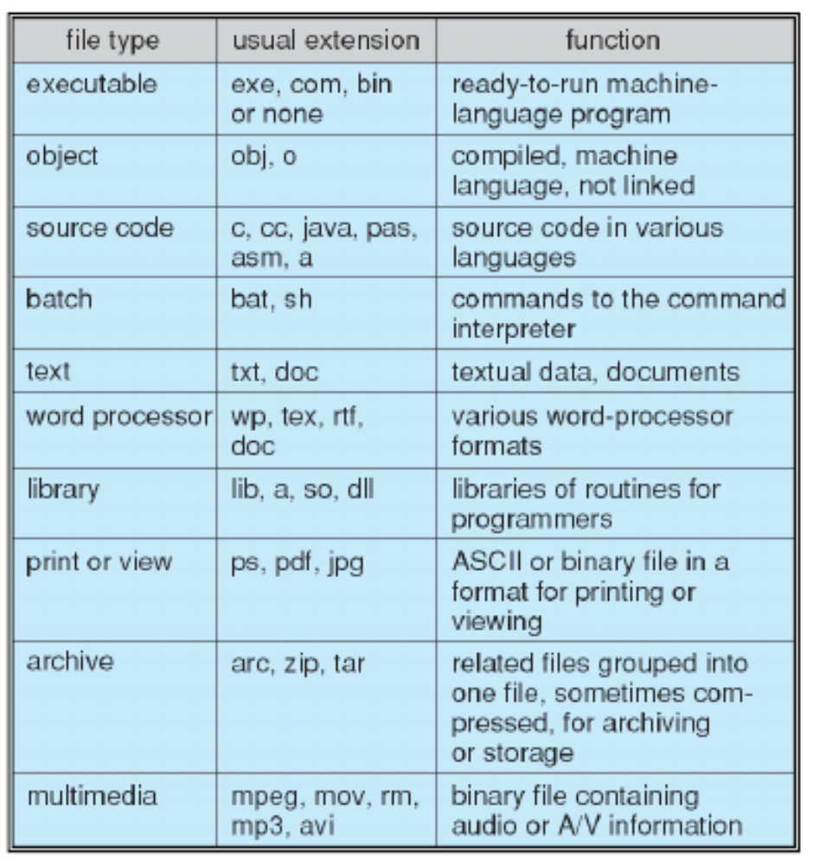
  Figure 10.2 Common file types.
Figure 1.1. Common file types.

Slide 9
1.2 Access Methods
1.2.1 Sequential Access
  A read operation-read next-reads the next portion of the file and automatically advances a file pointer, which tracks the I/O location.
  Similarly, the write operation-write next-appends to the end of the file and advances to the end of the newly written material (the new end of file).
  A file can be reset to the beginning, and on some systems, a program may be able to skip forward or backward n records for some integer n.
  Sequential access is based on a tape model of a file.

Slide 10
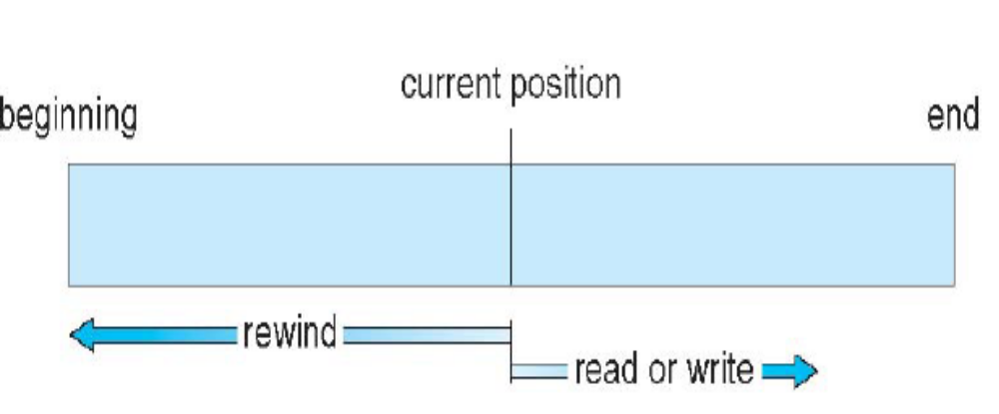
Figure 1.2. Sequential-access file.

Slide 11
1.2.2 Direct Access (or relative access)
  A file is made up of fixed length logical records that allow programs to read and write records rapidly in no particular order.
  The direct-access method is based on a disk model of a file, since disks allow random access to any file block.
  For the direct-access method, the file operations must be modified to include the block number as a parameter.
  we have read n and write n where n is the block number.

Slide 12
1.2.3 Other Access Methods
  Other access methods can be built on top of a direct-access method. These methods generally involve the construction of an index for the file.
  The index contains pointers to the various blocks.
  To find a record in the file, OS first search the index and then use the pointer to access the file directly and to find the desired record.

Slide 13
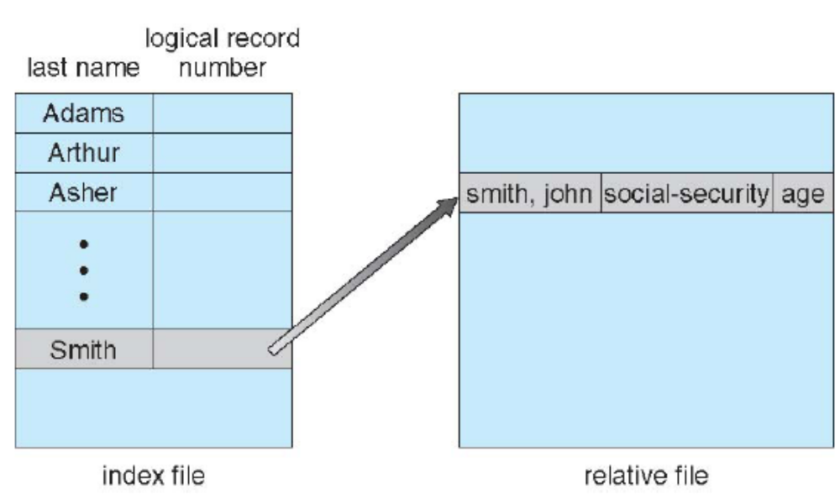
Figure 1.3. Example of index and relative files.

Slide 14
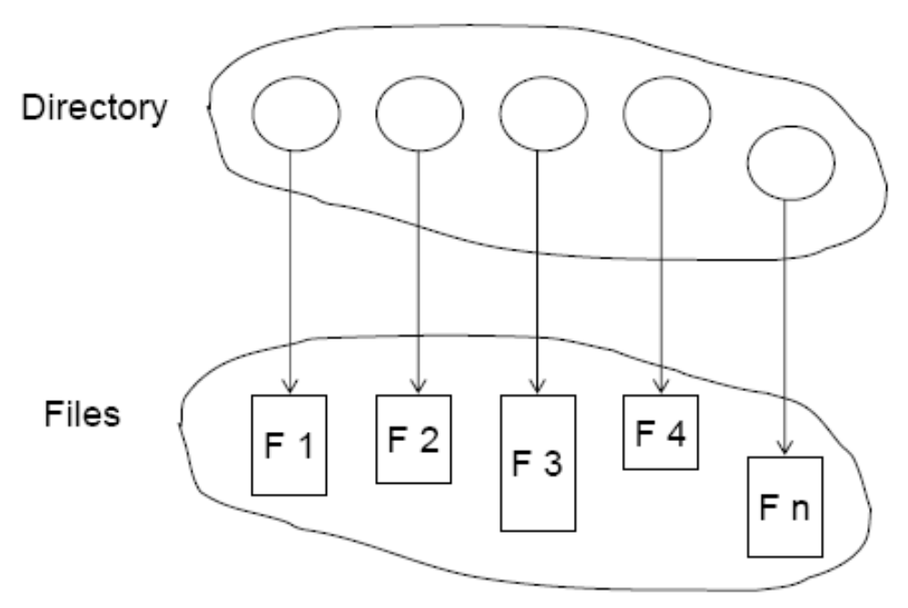
1.3. Directory Structure
  A collection of nodes containing information about all files.
  Both the directory structure and the files reside on disk

Slide 15
1.3.1. Storage Structure
  Disk can be subdivided into partitions or slices, or (in the IBM world) minidisks.
  Partition can be used raw (swap space) –without a file system, or formatted with a file system.
  A disk (or any storage device that is large enough) can be used in its entirety for a file system or place multiple file systems.
  Entity containing file system known as a volume
  Each volume containing file system also tracks that file system’s info in device directory or volume table of contents

Slide 16
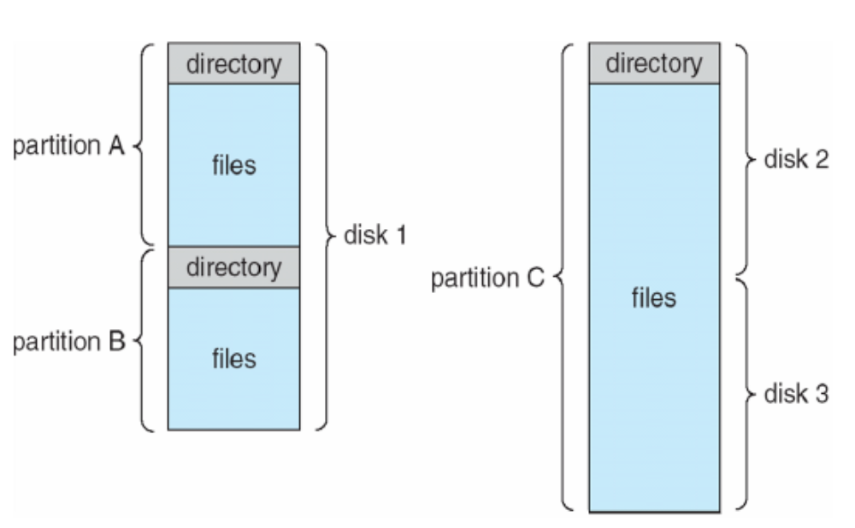
  The device directory (more commonly known simply as a directory) records information-such as name, location,size, and type-for all files on that volume.
Figure 1.4. A typical file-system organization.

Slide 17
1.3.2 Directory Overview
  The directory can be viewed as a symbol table that translates file names into their directory entries.
  The operations that are to be performed on a directory.
    Search for a file
    Create a file
    Delete a file
    List a directory
    Rename a file
    Traverse the file system

Slide 18
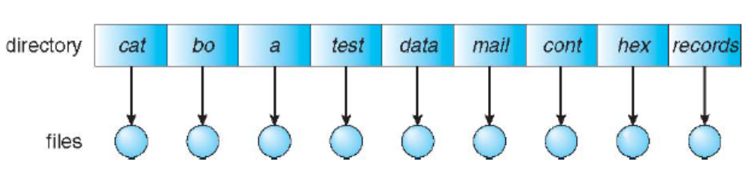
1.3.3 Single-Level Directory
  The simplest directory structure is the single-level directory. All files are contained in the same directory.
Figure 1.5. Single-level directory.
  A single-level directory has significant limitations, however, when the number of files increases or when the system has more than one user.

Slide 19
  1.3.4 Two-Level Directory
  A single-level directory often leads to confusion of file names among different users. The standard solution is to create a separate directory for each user.
  In the two-level directory structure, each user has his own user file directory (UFD). The UFDs have similar structures, but each lists only the files of a single user.
  When a user job starts or a user logs in, the system's master file directory (MFD) is searched. The MFD is indexed by user name or account number, and each entry points to the UFD for that user.

Slide 20
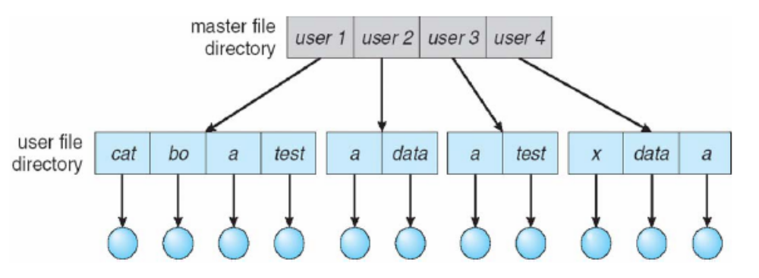
Figure 1.6. Two-level directory structure.

Slide 21
  When a user refers to a particular file, only his own UFD is searched.
  To create a file for a user, the operating system searches only that user's UFD to ascertain whether another file of that name exists.
  To delete a file, the operating system confines its search to the local UFD, thus it cannot accidentally delete another user's file that has the same name.
  A disadvantage when the users want to cooperate on some task and to access one another's files.

Slide 22
  If access is to be permitted, one user must have the ability to name a file in another user's directory.
  A two-level directory can be thought of as a tree, or an inverted tree, of height 2. The root of the tree is the MFD. Its direct descendants are the UFDs. The descendants of the UFDs are the files themselves.
  A user name and a file name define a path name.
  Example: /userb/test.

Slide 23
1.3.5 Tree-Structured Directories
  The natural generalization is to extend the directory structure to a tree of arbitrary height.
  This generalization allows users to create their own subdirectories and to organize their files accordingly.
  A tree is the most common directory structure. The tree has a root directory, and every file in the system has a unique path name.

Slide 24
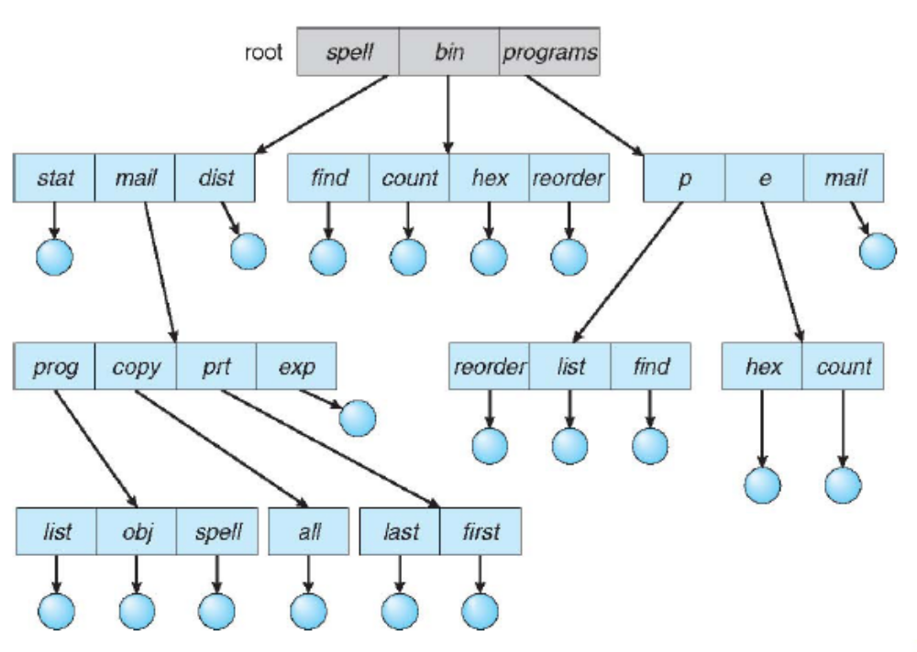
Figure 1.7. Tree-structured directory structure.

Slide 25
  A directory (or subdirectory) contains a set of files or subdirectories.
  A directory is simply another file, but it is treated in a special way.
  All directories have the same internal format. One bit in each directory entry defines the entry as a file (0) or as a subdirectory (1). Special system calls are used to create and delete directories.
  Path names can be of two types: absolute and relative.

Slide 26
1.3.6 Acyclic-Graph Directories
  Subdirectories and files can be shared.
  A shared directory or file will exist in the file system in two (or more) places at once.
  An acyclic graph is a graph with no cycles-allows directories to share subdirectories and files
  The same file or subdirectory may be in two different directories.

Slide 27
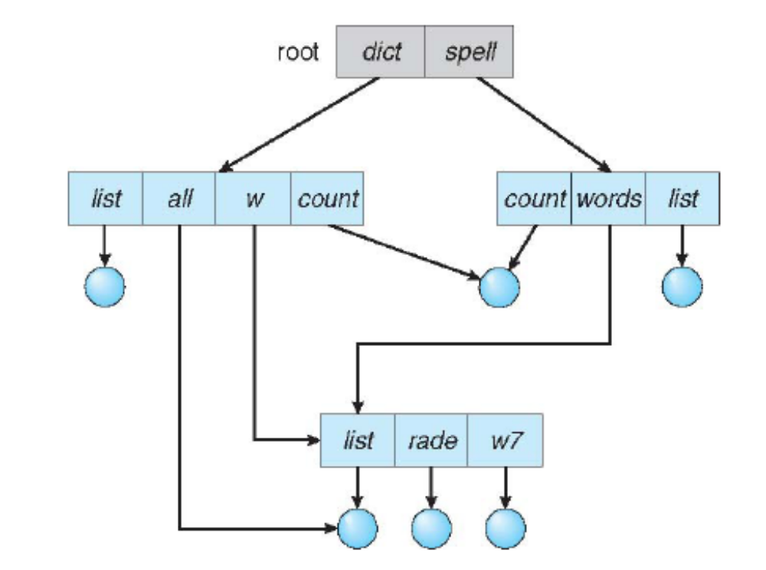
Figure 1.8. Acyclic-graph directory structure.

Slide 28
  Shared files and subdirectories can be implemented in several ways. A common way, exemplified by many of the UNIX systems, is to create a new directory entry called a link.
    A link is effectively a pointer to another file or subdirectory.
    When a reference to a file is made, OS search the directory.
      If the directory entry is marked as a link, then the name of the real file is included in the link information.
      Resolve the link by using that path name to locate the real file.

Slide 29
1.4. File-System Mounting
  A file system must be mounted before it can be available to processes on the system.
  The mount procedure is straightforward. The operating system is given the name of the device and the mount point-the location within the file structure where the file system is to be attached. Typically, a mount point is an empty directory.

Slide 30
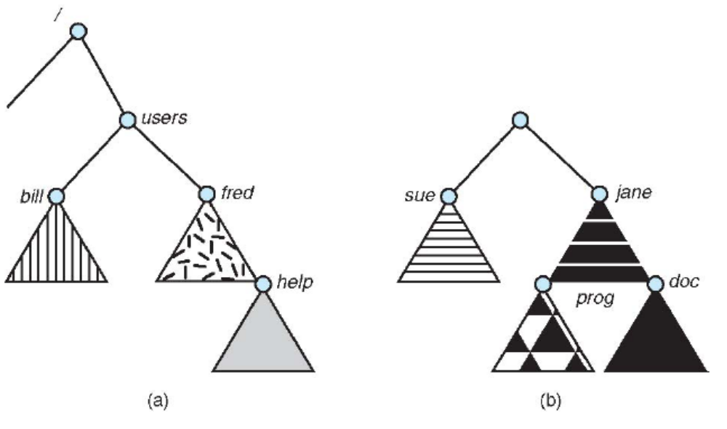
Figure 1.9. File system, (a) Existing system
(b) Unmounted volume.

Slide 31
1.5 File Sharing
1.5.1 Multiple Users
  When an operating system accommodates multiple users, the issues of file sharing, file naming, and file protection become preeminent.
  User IDs identify users, allowing permissions and protections to be per-user.
  Group IDs allow users to be in groups, permitting group access rights
  The owner is the user who can change attributes and grant access and who has the most control over the file.

Slide 32
  The owner and group IDs of a given file (or directory) are stored with the other file attributes.
  When a user requests an operation on a file
    The user ID can be compared with the owner attribute to determine if the requesting user is the owner of the file.
    Likewise, the group IDs can be compared. The result indicates which permissions are applicable.

Slide 33
1.5.2. Remote File Systems
Networking allows the sharing of resources spread
across a campus or even around the world. One obvious resource to share is data in the form of files.
  Via programs like FTP
  Using distributed file systems (DFS)
  Via the world wide web

Slide 34
  Client-server model allows clients to mount remote file systems from servers
    Server can serve multiple clients
    Client and user-on-client identification is insecure or complicated
    NFS is standard UNIX client-server file sharing protocol
    CIFS is standard Windows protocol
    Once the remote file system is mounted, file operation requests are sent on behalf of the user across the network to the server via the DFS (Distributed File System) protocol.

Slide 35
  Failure Modes
    Remote file systems add new failure modes, due to network failure, server failure
    Consider a client in the midst of using a remote file system. It has files open from the remote host. Suddenly, the remote file system is no longer reachable.
    The system can either terminate all operations to the lost server or delay operations until the server is again reachable.
    Most DFS protocols either enforce or allow delaying of file-system operations to remote hosts, with the hope that the remote host will become available again.

Slide 36
1.6. Protection
  1.6.1. Types of Access
  Protection mechanisms provide controlled access by limiting the types of file access.
  Several different types of operations may be controlled:
    Read
    Write
    Execute
    Append
    Delete
    List

Slide 37
  Other operations, such as renaming, copying, and editing the file, may also be controlled.
  Many protection mechanisms have been proposed. Each has advantages and disadvantages and must be appropriate for its intended application.
  1.6.2 Access Control
  The most common approach to the protection problem is to make access dependent on the identity of the user. Different users may need different types of access to a file or directory.

Slide 38
  The most general scheme to implement identity dependent access is to associate with each file and directory an access-control list (ACL) specifying user names and the types of access allowed for each user.
  The main problem with access lists is their length. If we want to allow everyone to read a file, we must list all users with read access.
    Constructing such a list may be a tedious and unrewarding task.
    The directory entry, previously of fixed size, now needs to be of variable size, resulting in more complicated space management.

Slide 39
  To condense the length of the access-control list, many systems recognize three classifications of users in connection with each file:
    Owner: The user who created the file is the owner.
    Group: A set of users who are sharing the file and need similar access is a group, or work group.
    Universe. All other users in the system constitute the universe.
  The most common recent approach is to combine access-control lists with the more general (and easier to implement) owner, group, and universe access-control.

Slide 40
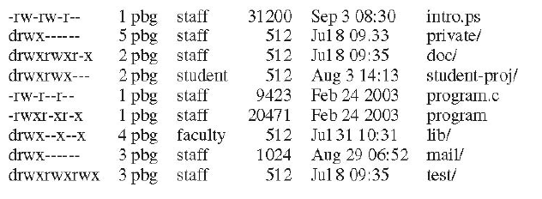
  Mode of access: read, write, execute
  Three classes of users
        RWX
      owner access 7 1 1 1
      group access 6 1 1 0
      public access 1 0 0 1
Figure 1.10. A sample UNIX directory access-control list

Slide 41
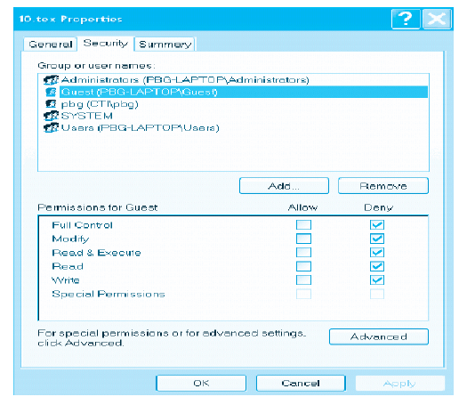
Figure 1.11. A sample Window XP access-control list

Slide 42
2. File System Implementation (Reference)
  2.1. File System Structure
  2.2. File System Implementation
  2.3. Directory Implementation
  2.4. Allocation Methods
  2.5. Free Space Management
  2.6. Efficiency and Performance
  2.7. Recovery
  2.8. Log Structured File Systems
  2.9. NFS
  Reference: Silberschatz-Galvin-Gagne, Operating System Concepts, USA, 2005.(http://www.os-book.com)

