Slide 1
Chapter 3. Process
OBJECTIVES
  To introduce the notion of a process - a program in execution, which forms the basis of all computation.
  To describe the various features of processes, including scheduling, creation and termination, and communication.
  To describe communication in client-server systems.

Slide 2
1. Process Concept
  An operating system executes a variety of programs:
    Batch system –jobs
    Time-shared systems –user programs or tasks
    A user may be able to run several programs at one time: a word processor, a web browser, and an e-mail package...
  Process is a program in execution; process execution must progress in sequential fashion

Slide 3
1.1. The Process
A process includes
  The current activity, as represented by the value of the program counter and the contents of the processor's registers.
  The stack, which contains temporary data (such as function parameters, return addresses, and local variables)
  A data section, which contains global variables.
  A process may also include a heap, which is memory that is dynamically allocated during process run time.

Slide 4
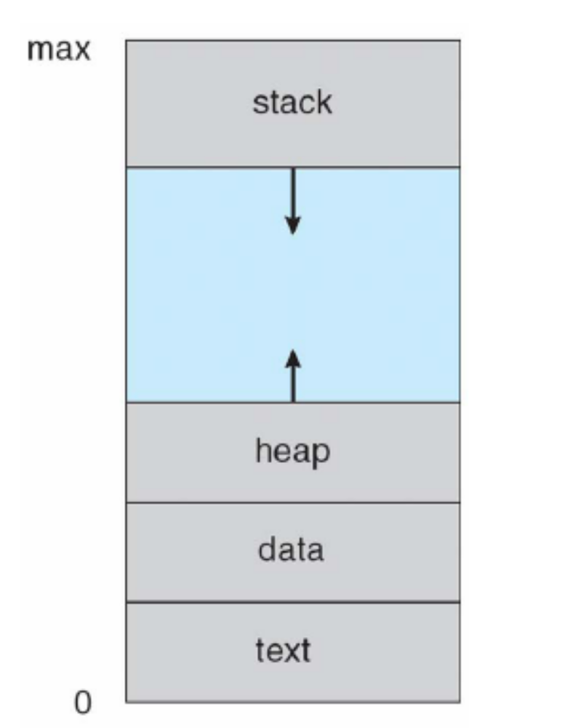
Figure 1. Process in memory.

Slide 5
1.2 Process State
  As a process executes, it changes state. Each process may be in one of the following states:
    New. The process is being created.
    Running. Instructions are being executed.
    Waiting. The process is waiting for some event to occur (such as an I/O completion or reception of a signal).
    Ready. The process is waiting to be assigned to a processor.
    Terminated. The process has finished execution.

Slide 6
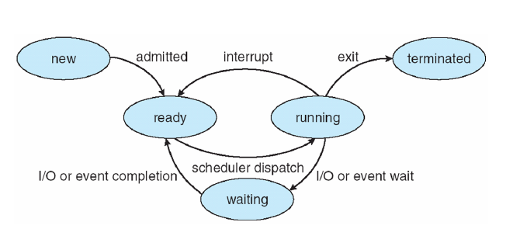
Figure 2. Diagram of process state.
It is important to realize that only one process can be running on any processor at any instant. Many processes may be ready.

Slide 7
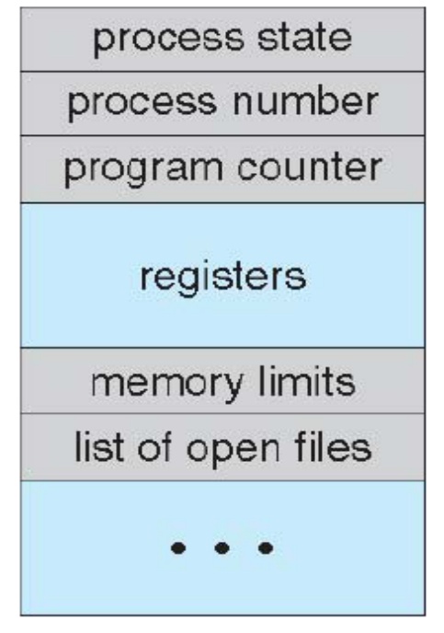
1.3 Process Control Block (PCB)
  Each process is represented in the operating system by a process control block (PCB)—also called a task control block.
Figure 3. Process control block (PCB).

Slide 8
  Process state. The state may be new, ready, running, waiting and halted.
  Program counter. The counter indicates the address of the next instruction to be executed for this process.
  CPU registers. The registers vary in number and type, depending on the computer architecture. They include accumulators, index registers, stack pointers, and general-purpose registers, plus any condition-code information.
  CPU-scheduling information. This information includes a process priority, pointers to scheduling queues, and any other scheduling parameters.

Slide 9
  Memory-management information. This information may include such information as the value of the base and limit registers, the page tables, or the segment tables, depending on the memory system used by the operating system.
  Accounting information. This information includes the amount of CPU and real time used, time limits, account numbers, job or process numbers, and so on.
  I/O status information. This information includes the list of I/O devices allocated to the process, a list of open files, and so on.

Slide 10
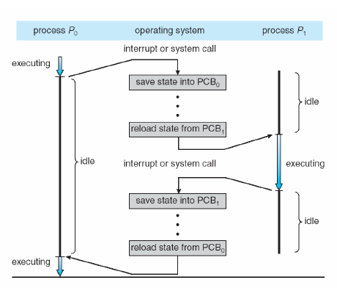
Figure 4. Diagram showing CPU switch from process to process.

Slide 11
2. Process Scheduling
  The objective of multiprogramming is to have some process running at all times, to maximize CPU utilization.
  The objective of time sharing is to switch the CPU among processes so frequently that users can interact with each program while it is running.
  To meet these objectives, the process scheduler selects an available process (possibly from a set of several available processes) for program execution on the CPU.

Slide 12
2.1. Scheduling Queues
  As processes enter the system, they are put into a job queue, which consists of all processes in the system.
  The processes that are residing in main memory and are ready and waiting to execute are kept on a list called the ready queue.
  The list of processes waiting for a particular I/O device is called a device queue. Each device has its own device queue.
  Processes migrate among the various queues

Slide 13
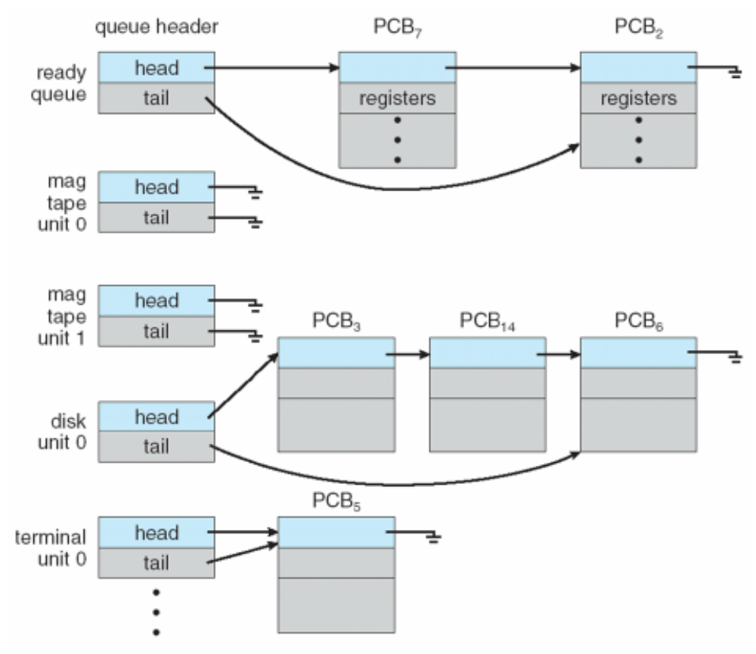
Figure 5. The ready queue and various I/O device queues.

Slide 14
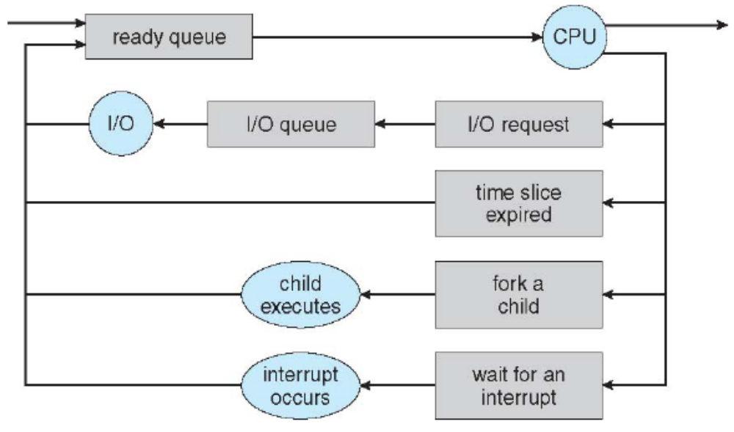
A common representation for a discussion of process scheduling is a queueing diagram.
Figure 6. Queueing-diagram representation of process scheduling.

Slide 15
  A new process is initially put in the ready queue. It waits there until it is selected for execution, or is dispatched. Once the process is allocated the CPU and is executing, one of several events could occur:
    The process could issue an I/O request and then be placed in an I/O queue.
    The process could create a new subprocess and wait for the subprocess's termination.
    The process could be removed forcibly from the CPU, as a result of an interrupt, and be put back in the ready queue.

Slide 16
2.2. Schedulers
  The selection process is carried out by the appropriate scheduler.
  Often, in a batch system, more processes are submitted than can be executed immediately. These processes are spooled to a mass-storage device (typically a disk), where they are kept for later execution.
  The long-term scheduler, or job scheduler, selects processes from this pool and loads them into memory for execution.
  The short-term scheduler, or CPU scheduler, selects from among the processes that are ready to execute and allocates the CPU to one of them.

Slide 17
  The primary distinction between these two schedulers lies in frequency of execution.
    The short-term scheduler must select a new process for the CPU frequently. A process may execute for only a few milliseconds before waiting for an I/O request (fast).
    The long-term scheduler executes much less frequently; minutes may separate the creation of one new process and the next (low).
  The long-term scheduler controls the degree of multiprogramming (the number of processes in memory).

Slide 18
  In general, most processes can be described as either I/O bound or CPU bound.
    An I/O-bound process is one that spends more of its time doing I/O than it spends doing computations.
    A CPU-bound process, in contrast, generates I/O requests infrequently, using more of its time doing computations.
  It is important that the long-term scheduler select a good process mix of I/O-bound and CPU-bound processes.

Slide 19
  On some systems, the long-term scheduler may be absent or minimal.
    For example, time-sharing systems such as UNIX and Microsoft Windows systems often have no long-term scheduler but simply put every new process in memory for the short-term scheduler.
    The stability of these systems depends either on a physical limitation (such as the number of available terminals) or on the self-adjusting nature of human users.
    If the performance declines to unacceptable levels on a multiuser system, some users will simply quit.

Slide 20
  Some operating systems, such as time-sharing systems, may introduce an additional, intermediate level of scheduling. This medium-term scheduler
    The key idea behind a medium-term scheduler is that sometimes it can be advantageous to remove processes from memory (and from active contention for the CPU) and thus reduce the degree of multiprogramming.
    Later, the process can be reintroduced into memory, and its execution can be continued where it left off. This scheme is called swapping. The process is swapped out, and is later swapped in.

Slide 21
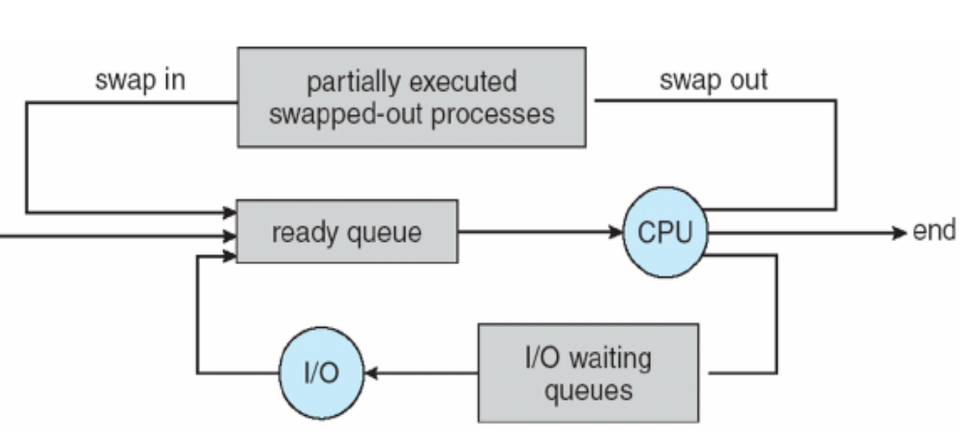
Figure 7. Addition of medium-term scheduling to the queueing diagram.

Slide 22
3. Operations on Processes
3.1 Process Creation
  Parent process create children processes, which, in turn create other processes, forming a tree of processes.
  Most operating systems (including UNIX and the Windows family of operating systems) identify processes according to a unique process identifier (or pid), which is typically an integer number.

Slide 23
  In general, a process will need certain resources (CPU time, memory, files, I/O devices) to accomplish its task. It maybe
    Parent and children share all resources
    Children share subset of parent’s resources
    Parent and child share no resources
  When a process creates a new process, two possibilities exist in terms of execution:
    The parent continues to execute concurrently with its children.
    The parent waits until some or all of its children have terminated.

Slide 24
  There are also two possibilities in terms of the address space of the new process:
    The child process is a duplicate of the parent process (it has the same program and data as the parent).
    The child process has a new program loaded into it.

Slide 25
3.2 Process Termination
  A process terminates when it finishes executing its final statement and asks the operating system to delete it by using the exit () system call.
    The process may return a status value to its parent process.
    All the resources of the process—including physical and virtual memory, open files, and I/O buffers-are deallocated by the operating system.

Slide 26
  A parent may terminate the execution of one of its children for a variety of reasons, such as these:
    Child has exceeded allocated resources
    Task assigned to child is no longer required
    The parent is exiting, and the operating system does not allow a child to continue if its parent terminates.
  Some systems, including VMS, do not allow a child to exist if its parent has terminated. In such systems, if a process terminates (either normally or abnormally), then all its children must also be terminated-cascading termination.

Slide 27
4. Interprocess Communication
  Processes within a system may be independent or cooperating
    A process is independent if it cannot affect or be affected by the other processes executing in the system. Any process that does not share data with any other process is independent.
    A process is cooperating if it can affect or be affected by the other processes executing in the system.

Slide 28
  There are several reasons for providing an environment that allows process cooperation:
    Information sharing. Since several users may be interested in the same piece of information (a shared file...)
    Computation speedup. If we want a particular task to run faster, we must break it into subtasks, each of which will be executing in parallel with the others.
    Modularity. To construct the system in a modular fashion- dividing the system functions into separate processes or threads.
    Convenience. User may work on many tasks at the same time.

Slide 29
  Cooperating processes require an interprocess communication (IPC) mechanism that will allow them to exchange data and information.
  There are two fundamental models of interprocess communication
    Shared memory: To allows maximum speed and convenience of communication, as it can be done at memory speeds when within a computer.
    Message passing: Useful for exchanging smaller amounts of data, because no conflicts need be avoided. Message passing is also easier to implement than is shared memory for intercomputer communication.

Slide 30
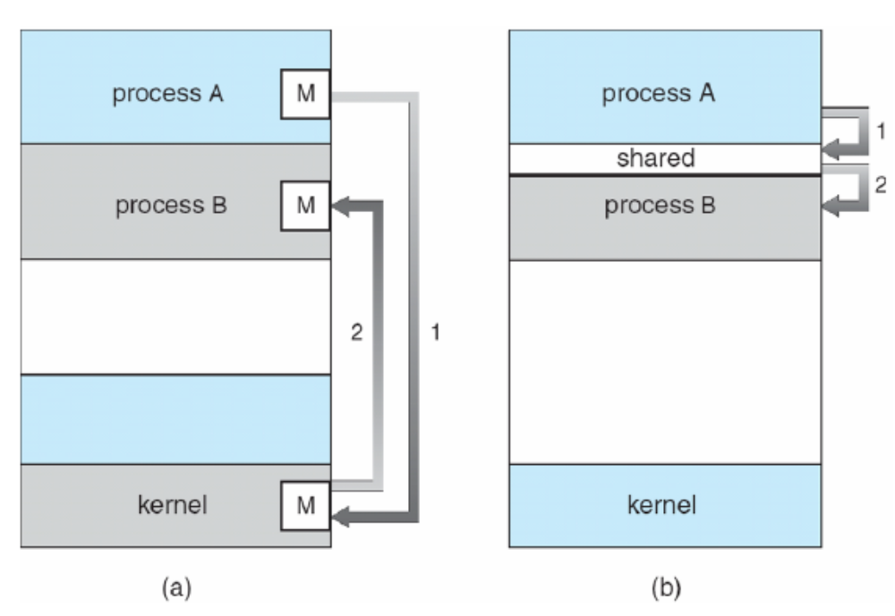
Figure 8. Communications models,
(a) Message passing, (b) Shared memory.

Slide 31
4.1. Shared-Memory Systems
  Interprocess communication using shared memory requires communicating processes to establish a region of shared memory.
  Other processes that wish to communicate using this shared-memory segment must attach it to their address space.
  Recall that, normally, the operating system tries to prevent one process from accessing another process's memory.

Slide 32
  Shared memory requires that two or more processes agree
    They can then exchange information by reading and writing data in the shared areas. The form of the data and the location are determined by these processes and are not under the operating system's control.
    The processes are also responsible for ensuring that they are not writing to the same location simultaneously.

Slide 33
  The producer-consumer problem, which is a common paradigm for cooperating processes. A producer process produces information that is consumed by a consumer process.
  To allow producer and consumer processes to run concurrently, OS must have available a buffer of items that can be filled by the producer and emptied by the consumer.
  A producer can produce one item while the consumer is consuming another item. The producer and consumer must be synchronized, so that the consumer does not try to consume an item that has not yet been produced.

Slide 34
  Two types of buffers can be used.
    The unbounded buffer places no practical limit on the size of the buffer. The consumer may have to wait for new items, the producer can always produce new items.
    The bounded buffer assumes a fixed buffer size. In this case, the consumer must wait if the buffer is empty, and the producer must wait if the buffer is full.

Slide 35
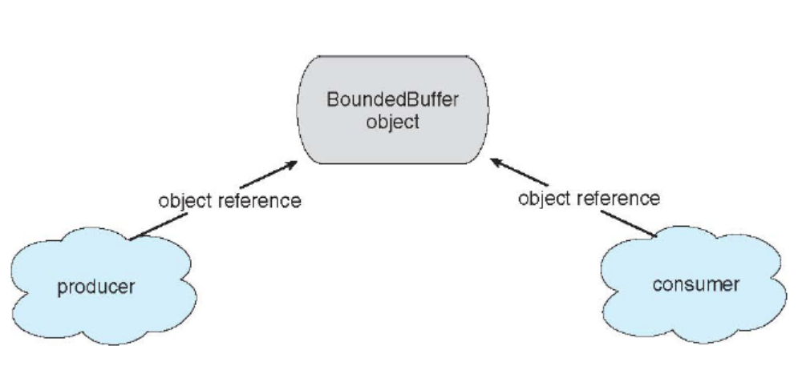
Figure 9. Simulating Shared Memory

Slide 36
4.2. Message-Passing Systems
  Message passing provides a mechanism to allow processes to communicate and to synchronize their actions without sharing the same address space.
  This mechanism is particularly useful in a distributed environment, where the communicating processes may reside on different computers connected by a network.
  A message-passing facility provides at least two operations:
    send(message): message size fixed or variable.
    receive(message)

Slide 37
  If processes P and Q want to communicate, they must send messages to and receive messages from each other; a communication link must exist between them.
  This link can be implemented in a variety of ways.
    Physical implementation (such as shared memory, hardware bus, or network)
    Logical implementation (logical properties)
      Direct or indirect communication
      Synchronous or asynchronous communication
      Automatic or explicit buffering

Slide 38
  Under direct communication, each process that wants to communicate must explicitly name the recipient or sender of the communication.
    send(P, message) –send a message to process P
    receive(Q, message) –receive a message from process Q
  Properties of communication link
    Links are established automatically
    A link is associated with exactly one pair of communicating processes
    Between each pair there exists exactly one link
    The link may be unidirectional, but is usually bi-directional

Slide 39
  With indirect communication, the messages are sent to and received from mailboxes, or ports. A mailbox can be viewed abstractly as an object into which messages can be placed by processes and from which messages can be removed.
  Operations
    create a new mailbox
    send and receive messages through mailbox
    destroy a mailbox

Slide 40
  Primitives are defined as:
    send(A, message) –send a message to mailbox A
    receive(A, message) –receive a message from mailbox A
  Properties of communication link
    Link established only if processes share a common mailbox
    A link may be associated with many processes
    Each pair of processes may share several communication links
    Link may be unidirectional or bi-directional

Slide 41
5. Communication in Client-Server Systems
5.1.Sockets
  A socket is defined as an endpoint for communication.
  A pair of processes communicating over a network employ a pair of sockets—one for each process.
  A socket is identified by an IP address concatenated with a port number.
  The server waits for incoming client requests by listening to a specified port. Once a request is received, the server accepts a connection from the client socket to complete the connection.

Slide 42
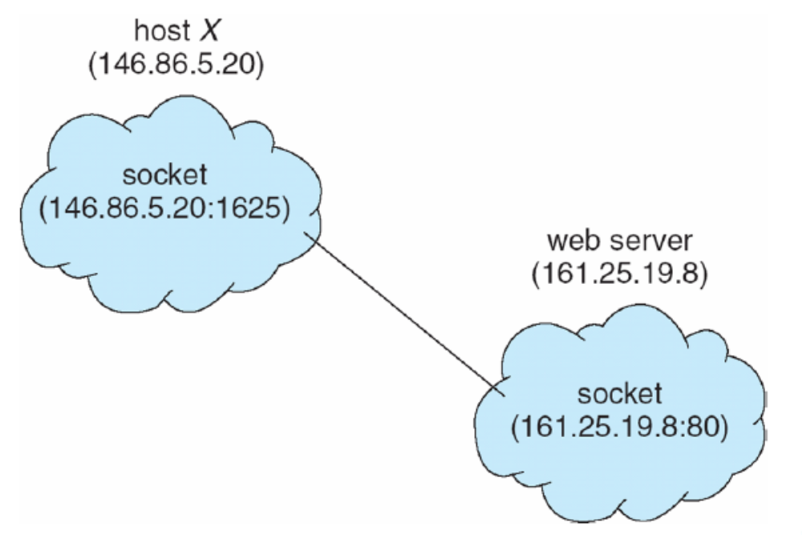
Figure 10. Communication using sockets.

Slide 43
5.2. Remote Procedure Calls (RPC)
  The RPC was designed as a way to abstract the procedure-call mechanism for use between systems with network connections.
  The semantics of RPCs allow a client to invoke a procedure on a remote host as it would invoke a procedure locally.
  The RPC system hides the details that allow communication to take place by providing a stub on the client side.
  Stubs–client-side proxy for the actual procedure on the server

Slide 44
  When the client invokes a remote procedure, the RPC system calls the appropriate stub, passing it the parameters provided to the remote procedure.
  This stub locates the port on the server and marshals the parameters. Parameter marshalling involves packaging the parameters into a form that can be transmitted over a network.
  A similar stub on the server side receives this message and invokes the procedure on the server. If necessary, return values are passed back to the client using the same technique.
  Reference: Silberschatz-Galvin-Gagne, Operating System Concepts, USA, 2005.(http://www.os-book.com)

