Slide 1
Chapter 7. CPU Scheduling
OBJECTIVES
  To introduce CPU scheduling, which is the basis for multiprogrammed operating systems
  To describe various CPU-scheduling algorithms.
  To discuss evaluation criteria for selecting a CPU-scheduling algorithm for a particular system.

Slide 2
7.1. Basic Concepts
  A process is executed until it must wait, typically for the completion of some I/O request. The CPU then just sits idle. This waiting time is wasted.
  The objective of multiprogramming is to have some process running at all times, to maximize CPU utilization. When one process has to wait, the operating system takes the CPU away from that process and gives the CPU to another process.
  Scheduling of this kind is a fundamental operating-system function.

Slide 3
7.1.1. CPU-I/O Burst Cycle
  The success of CPU scheduling depends on an observed property of processes:
    Process execution consists of a cycle of CPU execution and I/O wait.
    Processes alternate between these two states.
    Process execution begins with a CPU burst. That is followed by an I/O burst, which is followed by another CPU burst, then another I/O burst, and so on.
    Eventually, the final CPU burst ends with a system request to terminate execution

Slide 4
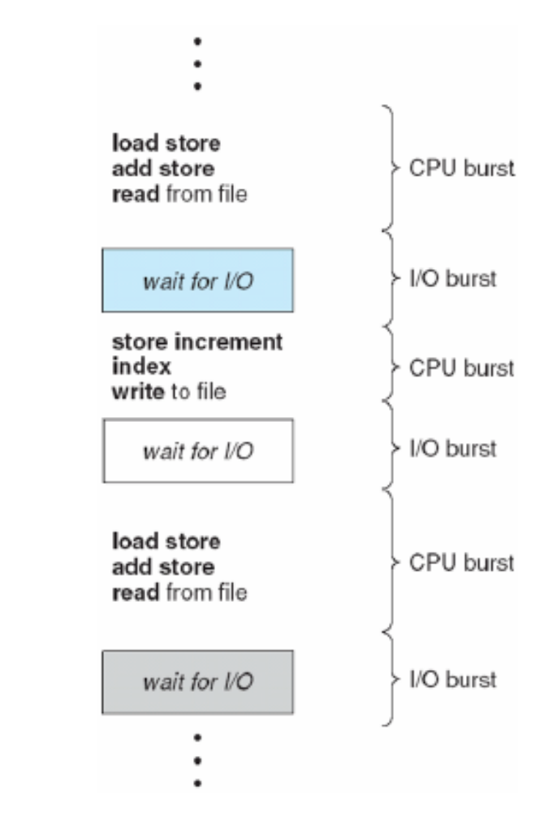
Figure 7.1. Alternating sequence of CPU and I/O bursts.

Slide 5
7.1.2. CPU Scheduler
  Whenever the CPU becomes idle, the operating system must select one of the processes in the ready queue to be executed.
  The selection process is carried out by the short-term scheduler (or CPU scheduler).
  CPU-scheduling decisions may take place under the following four circumstances:
    When a process switches from the running state to the waiting state (for example, as the result of an I/O request or an invocation of wait for the termination of one of the child processes)

Slide 6
    When a process switches from the running state to the ready state (for example, when an interrupt occurs)
    When a process switches from the waiting state to the ready state (for example, at completion of I/O).
    When a process terminates.
  When scheduling takes place only under circumstances 1 and 4, we say that the scheduling scheme is nonpreemptive or cooperative.
  2 and 3 is preemptive.

Slide 7
  Nonpreemptive scheduling
    Once the CPU has been allocated to a process, the process keeps the CPU until it releases the CPU either by terminating or by switching to the waiting state.
    This scheduling method was used by Microsoft Windows 3.x and Apple Macintosh.
    This scheduling is the only method that can be used on certain hardware platforms, because it does not require the special hardware

Slide 8
  Preemptive scheduling
    To incurs a cost associated with access to shared data that OS need new mechanisms to coordinate access to shared data.
    This method also affects the design of the operating-system kernel.
    This method was used by most versions of UNIX

Slide 9
7.1.3. Dispatcher
  The dispatcher is the module that gives control of the CPU to the process selected by the short-term scheduler. This function involves the following:
    Switching context
    Switching to user mode
    Jumping to the proper location in the user program to restart that program
  The dispatcher should be as fast as possible, since it is invoked during every process switch. The time it takes for the dispatcher to stop one process and start another running is known as the dispatch latency.

Slide 10
7.2. Scheduling Criteria
  Different CPU scheduling algorithms have different properties, and the choice of a particular algorithm may favor one class of processes over another.
  Many criteria have been suggested for comparing CPU scheduling algorithms. Which characteristics are used for comparison can make a substantial difference in which algorithm is judged to be best.
  The criteria include the following:

Slide 11
    CPU utilization. We want to keep the CPU as busy as possible. Conceptually, CPU utilization can range from 0 to 100 percent. In a real system, it should range from 40 percent (for a lightly loaded system) to 90 percent (for a heavily used system).
    Throughput. This measure of work is the number of processes that are completed per time unit.
    Turnaround time.The interval from the time of submission of a process to the time of completion. Turnaround time is the sum of the periods spent waiting to get into memory, waiting in the ready queue, executing on the CPU, and doing I/O.

Slide 12
    Waiting time. Amount of time (sum of the periods) that a process spent waiting in the ready queue.
    Response time. Amount of time it takes from when a request was submitted until the first response is produced (not the time it takes to output the response)
  It is desirable to maximize CPU utilization and throughput and to minimize turnaround time, waiting time, and response time.
  In most cases, we optimize the average measure. However, under some circumstances, it is desirable to optimize the minimum or maximum values rather than the average.

Slide 13
7.3. Scheduling Algorithms
7.3.1. First-Come, First-Served Scheduling- FCFS scheduling algorithm is nonpreemptive
  The process that requests the CPU first is allocated the CPU first.
  The implementation of the FCFS policy is easily managed with a FIFO queue. When a process enters the ready queue, its PCB is linked onto the tail of the queue.
  When the CPU is free, it is allocated to the process at the head of the queue. The running process is then removed from the queue.
  The average waiting time under the FCFS policy, however, is often quite long.

Slide 14
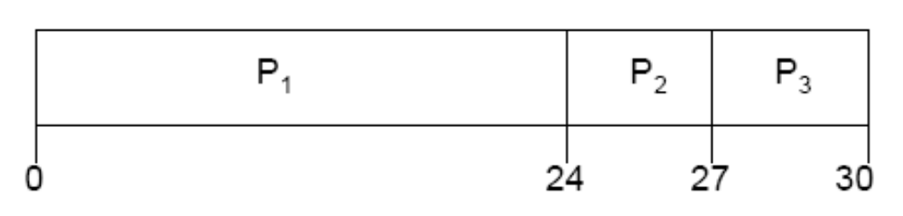
Example
        Process Burst Time
P1 24
P2 3
P3 3
  Suppose that the processes arrive in the order: P1, P2, P3
  The Gantt Chart for the schedule is:
Waiting time for P1= 0; P2= 24; P3 = 27
Average waiting time: (0 + 24 + 27)/3 = 17

Slide 15
7.3.2. Shortest-Job-First Scheduling-SJF
  This algorithm associates with each process the length of the process's next CPU burst. When the CPU is available, it is assigned to the process that has the smallest next CPU burst.
  If the next CPU bursts of two processes are the same, FCFS scheduling is used to break the tie.
  Note that a more appropriate term for this scheduling method would be the shortest-next-CPU-burst algorithm, because scheduling depends on the length of the next CPU burst of a process.

Slide 16
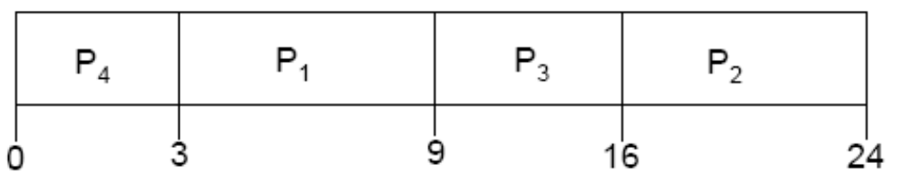
Example
Process Burst Time
    P1 6
P2 8
P3 7
    P4 3
  SJF scheduling chart
  Average waiting time = (3 + 16 + 9 + 0) / 4 = 7
  With FCFS scheduling scheme: 10.25

Slide 17
  The SJF scheduling algorithm is provably optimal, in that it gives the minimum average waiting time for a given set of processes.
  The real difficulty with the SJF algorithm is knowing the length of the next CPU request.
  There is no way to know the length of the next CPU burst.
  One approach is to try to approximate SJF scheduling. We may not know the length of the next CPU burst, but we may be able to predict its value.

Slide 18
  The next CPU burst is generally predicted as an exponential average of the measured lengths of previous CPU bursts.
    t_{n} = actual length of n^{th} CPU burst
    T_{n+1}= predict value for the next CPU burst
    a, 0 <=a <= 1
    T_{n+1} = at_{n} + (1-a)T_{n}
  If a=0
    T_{n+1} = T_{n} : Recent history does not count
  If a =1
    T_{n+1}= t_{n} :Only the actual last CPU burst counts

Slide 19
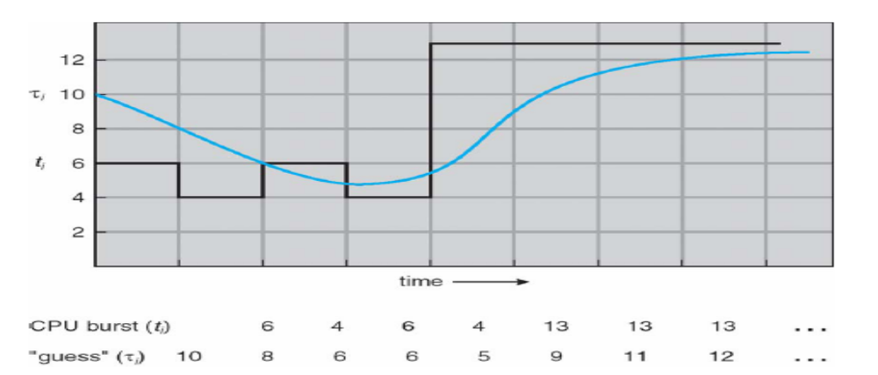
  If we expand the formula, we get:
    Tn+1 = aT_{n} + (1- a)at_{n-1}...
    + (1-a)^{j}at_{n-j}...
    + (1-a)^{n+1}T₀
  The initial T₀ can be defined as a constant or as an overall system average.
  Example: with a=1/2 and T₀=10
Figure 7.3. Prediction of the length of the next CPU burst.

Slide 20
  The SJF algorithm can be either preemptive or nonpreemptive. The choice arises when a new process arrives at the ready queue while a previous process is still executing.
    With preemptive SJF algorithm: If the next CPU burst of the newly arrived process to be shorter than what is left of the currently executing process then the new process will preempt the currently executing process.
    With nonpreemptive SJF algorithm: will allow the currently running process to finish its CPU burst.

Slide 21
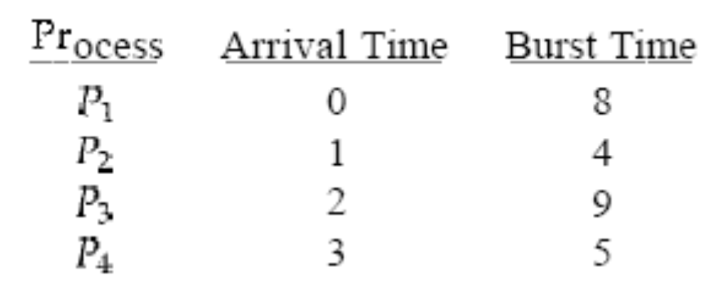
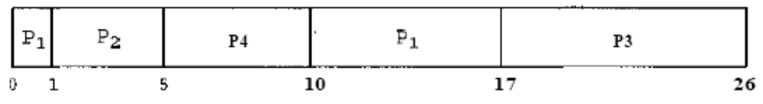
Example:
The resulting preemptive SJF schedule has the following Gantt chart:
The average waiting time for this example is ((10 - 1) + (1 - 1) + (17 - 2) + (5 - 3))/4 = 26/4 = 6.5
Nonpreemtive: waiting time is: (0 + (8 - 1) + (17 - 2) + (12 - 3))/4=7.75

Slide 22
7.3.3. Priority Scheduling
  A priority number (integer) is associated with each process.
  The CPU is allocated to the process with the highest priority (smallest integer ≡highest priority)
  Equal-priority processes are scheduled in FCFS order.
  An SJF algorithm is simply a priority algorithm where the priority (p) is the inverse of the (predicted) next CPU burst. The larger the CPU burst, the lower the priority, and vice versa.

Slide 23
  Priority scheduling can be either preemptive or nonpreemptive. When a process arrives at the ready queue, its priority is compared with the priority of the currently running process.
    A preemptive priority scheduling algorithm will preempt the CPU if the priority of the newly arrived process is higher than the priority of the currently running process.
    A nonpreemptive priority scheduling algorithm will simply put the new process at the head of the ready queue.

Slide 24
  A major problem with priority scheduling algorithms is indefinite blocking, or starvation: A priority scheduling algorithm can leave some low priority processes waiting indefinitely that means low priority processes may never execute.
  A solution to the problem of indefinite blockage of low-priority processes is aging: A technique of gradually increasing the priority of processes that wait in the system for a long time.
  For example, if priorities range from 127 (low) to 0 (high), OS could increase the priority of a waiting process by 1 every 15 minutes.

Slide 25
7.3.4. Round-Robin Scheduling-RR
  The round-robin (RR) scheduling algorithm is designed especially for timesharing systems.
  Each process gets a small unit of CPU time (time quantum), usually 10-100 milliseconds. After this time has elapsed, the process is preempted and added to the end of the ready queue.
  The ready queue as a FIFO queue of processes.
  New processes are added to the tail of the ready queue. The CPU scheduler picks the first process from the ready queue, sets a timer to interrupt after 1 time quantum, and dispatches the process.

Slide 26
  One of two things will then happen.
  The process may have a CPU burst of less than 1 time quantum. In this case, the process itself will release the CPU voluntarily. The scheduler will then proceed to the next process in the ready queue.
  If the CPU burst of the currently running process is longer than 1 time quantum
    The timer will go off and will cause an interrupt to the operating system.
    A context switch will be executed, and the process will be put at the tail of the ready queue.
    The CPU scheduler will then select the next process in the ready queue.

Slide 27
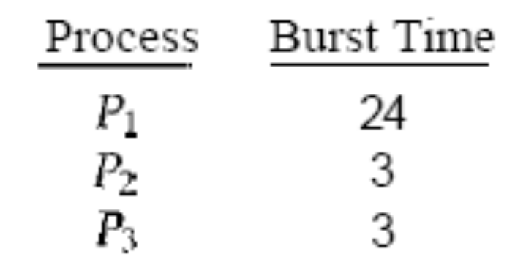
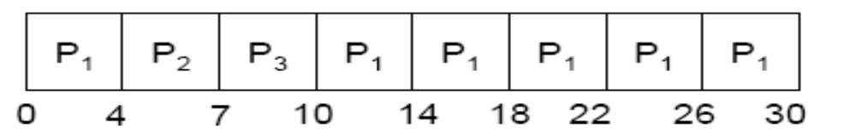
  Example:
  The Gantt chart is
  The average waiting time is 17/3 = 5.66 milliseconds.
  If a process's CPU burst exceeds 1 time quantum, that process is preempted and is put back in the ready queue. The RR scheduling algorithm is thus preemptive.

Slide 28
  If there are n processes in the ready queue and the time quantum is q, then each process gets 1/n of the CPU time in chunks of at most q time units.
  Each process must wait no longer than (n - 1)*q time units until its next time quantum.
  Typically, higher average turnaround than SJF, but better response

Slide 29
7.3.5. Multilevel Queue Scheduling
  A multilevel queue scheduling algorithm partitions the ready queue into several separate queues.
  The processes are permanently assigned to one queue, generally based on some property of the process, such as memory size, process priority, or process type.
  Each queue has its own scheduling algorithm
  A common division is made between
    foreground (interactive) processes
    background (batch) processes.

Slide 30
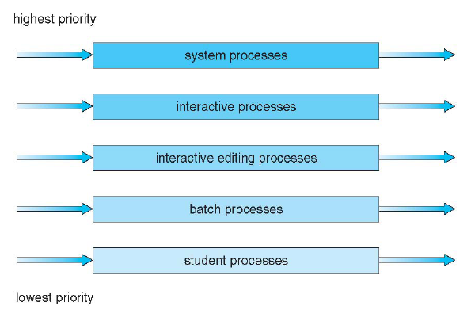
Figure 7.4. Multilevel queue scheduling.

Slide 31
  There must be scheduling among the queues. which is commonly implemented as fixed-priority preemptive scheduling.
    Each queue has absolute priority over lower-priority queues. For example-In Figure 7.4-No process in the batch queue could run unless the queues for system processes, interactive processes, and interactive editing processes were all empty
    Possibility of starvation.
  Another possibility is to time-slice among the queues. Example: 80% to foreground in RR and 20% to background in FCFS

Slide 32
7.3.6. Multilevel Feedback-Queue Scheduling
  The multilevel feedback-queue scheduling algorithm allows a process to move between queues.
    The idea is to separate processes according to the characteristics of their CPU bursts. If a process uses too much CPU time, it will be moved to a lower-priority queue.
    This scheme leaves I/O-bound and interactive processes in the higher-priority queues.
    A process that waits too long in a lower-priority queue may be moved to a higher-priority queue. This form of aging prevents starvation.

Slide 33
  In general, a multilevel feedback-queue scheduler is defined by the following parameters:
    The number of queues
    The scheduling algorithm for each queue
    The method used to determine when to upgrade a process to a higher priority queue
    The method used to determine when to demote a process to a lower priority queue
    The method used to determine which queue a process will enter when that process needs service

Slide 34
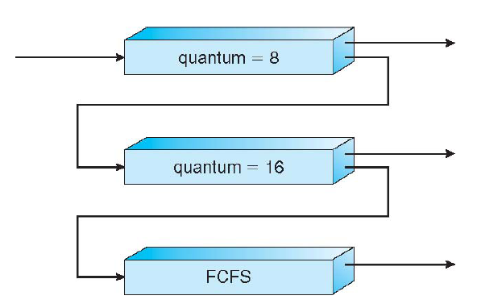
Example
Figure 7.5. Multilevel feedback queues.

Slide 35
  Three queues:
    Q0–RR with time quantum 8 milliseconds
    Q1–RR time quantum 16 milliseconds
    Q2–FCFS
  Scheduling
    A new job enters queue Q0 which is served FCFS. When it gains CPU, job receives 8 milliseconds. If it does not finish in 8 milliseconds, job is moved to queue Q1.
    At Q1 job is again served FCFS and receives 16 additional milliseconds. If it still does not complete, it is preempted and moved to queue Q2.

Slide 36
7.4. Multiple-Processor Scheduling
  If multiple CPUs are available, load sharing becomes possible; however, the scheduling problem becomes correspondingly more complex.
  Many possibilities have been tried; and as we saw with single processor CPU scheduling, there is no one best solution.
  Several concerns in multiprocessor scheduling.
    Homogeneous processors within a multiprocessor in terms of their functionality

Slide 37
    Asymmetric multiprocessing –only one processor accesses the system data structures, alleviating the need for data sharing.
    Symmetric multiprocessing (SMP) –each processor is self-scheduling, all processes in common ready queue, or each has its own private queue of ready processes
    Processor affinity –process has affinity for processor on which it is currently running
    Load balancing attempts to keep the workload evenly distributed across all processors in an SMP system.

Slide 38
7.5. Algorithm Evaluation
How do we select a CPU scheduling algorithm for a particular system?-The first problem is defining the criteria to be used in selecting an algorithm.
  Several criteria may include
    CPU utilization
    Response time
    Throughput
  Once the selection criteria have been defined, we want to evaluate the algorithms under consideration. We next describe the various evaluation methods we can use.

Slide 39
7.5.1. Deterministic Modeling
  One major class of evaluation methods is analytic evaluation.
  Analytic evaluation uses the given algorithm and the system workload to produce a formula or number that evaluates the performance of the algorithm for that workload.
  One type of analytic evaluation is deterministic modeling.
  This method takes a particular predetermined workload and defines the performance of each algorithm for that workload.

Slide 40
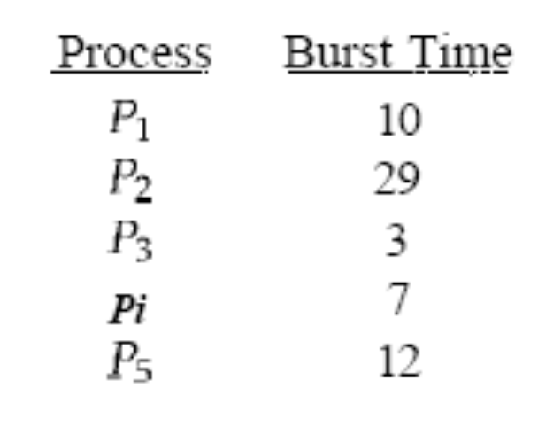
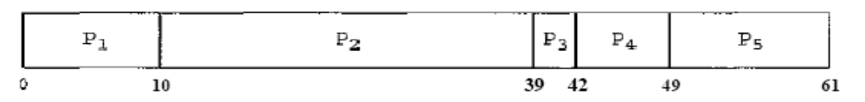
  Example: We have five processes arrive at time 0 and length of the CPU burst given in milliseconds:
For the FCFS algorithm, the average waiting time is (0 + 10 + 39 + 42 + 49)/5 = 28 milliseconds.

Slide 41
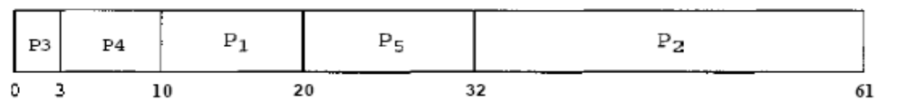
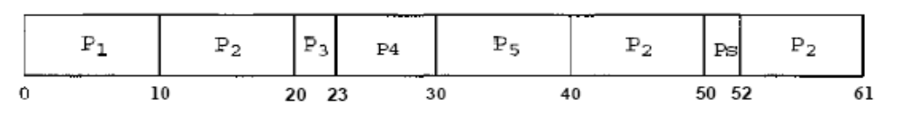
  With nonpreemptive SJF scheduling, the average waiting time is (10 + 32 + 0 + 3 + 20)/5 = 13 milliseconds.
With the RR algorithm, the average waiting time is (0 + 32 + 20 + 23 + 40)/5 = 23 milliseconds.

Slide 42
7.5.2. Queueing Models
  The computer system is described as a network of servers. Each server has a queue of waiting processes. The CPU is a server with its ready queue.
  Knowing arrival rates and service rates, we can compute utilization, average queue length, average wait time, and so on. This area of study is called queueing-network analysis.
  The queueing models are often only approximations of real systems, and the accuracy of the computed results may be questionable.

Slide 43
7.5.3. Simulations
  To get a more accurate evaluation of scheduling algorithms, we can use simulations.
  Running simulations involves programming a model of the computer system. Software data structures represent the major components of the system.
  The simulator has a variable representing a clock; as this variable's value is increased, the simulator modifies the system state to reflect the activities of the devices, the processes, and the scheduler.
  As the simulation executes, statistics that indicate algorithm performance.

Slide 44
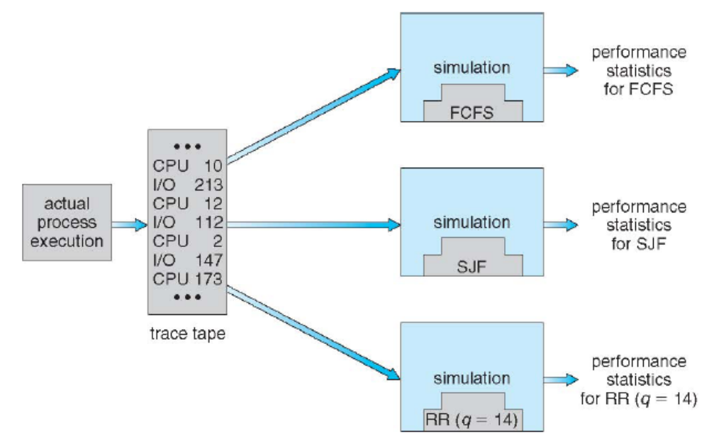
Figure 7.6. Evaluation of CPU schedulers by simulation.
Reference: Silberschatz-Galvin-Gagne, Operating System Concepts, USA, 2005.(http://www.os-book.com)

