Slide 1
Chapter 6. Process Synchronization
OBJECTIVES
We discuss various mechanisms to ensure the orderly execution of cooperating processes that share a logical address space, so that data consistency is maintained.
  To introduce the critical-section problem, whose solutions can be used to ensure the consistency of shared data.
  To present both software and hardware solutions of the critical-section problem

Slide 2
8.1. Background
  The bounded buffer can be used to enable processes to share memory. The following variables reside in a region of memory shared by the producer and consumer processes
  See 3.4.1-page 97
  #define BUFFER_SIZE 10
typedef struct{ . . .
} item;
item buffer[BUFFER_SIZE];
  int in = 0;
int out = 0;

Slide 3
  The shared buffer is implemented as a circular array with two logical pointers: in and out.
  The variable in points to the next free position in the buffer; out points to the first full position in the buffer.
  The buffer is empty when in == out
  The buffer is full when ((in+1)%BUFFER_SIZE) == out.
  The producer process has a local variable nextProduced in which the new item to be produced is stored.

Slide 4
  The consumer process has a local variable nextConsumed in which the item to be consumed is stored.
  The producer process.
while (true) {
/* produce an item in nextProduced */
while (((in + 1) % BUFFER_SIZE) == out)
; /* do nothing */
buffer[in] = nextProduced;
in = (in + 1) % BUFFER_SIZE;
}

Slide 5
  The consumer process.
while (true) {
while (in == out)
; //do nothing
nextConsumed = buffer[out];
out = (out + 1) % BUFFER_SIZE;
/* consume the item in nextConsumed */
}
    This is a model of a system consisting of cooperating sequential processes, all running asynchronously and possibly sharing data.
    This scheme allows at most BUFFER_SIZE-1 items in the buffer at the same time.

Slide 6
  Suppose we want to modify the algorithm to remedy this deficiency.
  One possibility is to add an integer variable counter
    initialized to 0.
    counter is incremented every time we add a new item to the buffer.
    counter is decremented every time we remove one item from the buffer.
  The code for the producer process and consumer process can be modified as follows:

Slide 7
while (true) {
/* produce an item in nextProduced */
while (counter == BUFFER_SIZE)
; /* do nothing */
buffer[in] = nextProduced;
in = (in + 1) % BUFFER-SIZE;
counter++;
}

Slide 8
while (true) {
while (counter == 0)
; /* do nothing */
nextConsumed = buffer [out];
out = (out + 1) % BUFFER_SIZE;
counter--;
/* consume the item in nextConsumed */
}
  Although both the producer and consumer routines are correct separately, they may not function correctly when executed concurrently.

Slide 9
  As an illustration, suppose that the value of the variable counter is currently 5 and that the producer and consumer processes execute the statements "counter++" and "counter--" concurrently.
    The value of the variable counter may be 4, 5, or 6.
    The only correct result, though, is counter=5, which is generated correctly if the producer and consumer execute separately.

Slide 10
count++ could be implemented as
register1 = count
register1 = register1+ 1
count = register1
count-- could be implemented as
register2 = count
register2 = register2-1
count = register2
Consider this execution interleaving with “count = 5”initially:
T0: producer execute register1 = count {register1 = 5}
T1: producer execute register1 = register1+ 1 {register1 = 6}
T2: consumer execute register2 = count {register2 = 5}
T3: consumer execute register2 = register2-1 {register2 = 4}
T4: producer execute count = register1 {count = 6 }
T5: consumer execute count = register2 {count = 4}

Slide 11
  This incorrect state because we allowed both processes to manipulate the variable counter concurrently.
  A situation like this, where several processes access and manipulate the same data concurrently and the outcome of the execution depends on the particular order in which the access takes place, is called a race condition.
  To guard against the race condition above, we need to ensure that only one process at a time can be manipulating the variable counter.
  To make such a guarantee, we require that the processes be synchronized in some way.

Slide 12
8.2. The Critical-Section Problem
  Consider a system consisting of n processes {P₀, P₁, ..., P_{n-1}}.
  Each process has a segment of code, called a critical section, in which the process may be changing common variables, updating a table, writing a file, and so on.
  Each process must request permission to enter its critical section. The section of code implementing this request is the entry section.
  The critical section may be followed by an exit section. The remaining code is the remainder section.

Slide 13
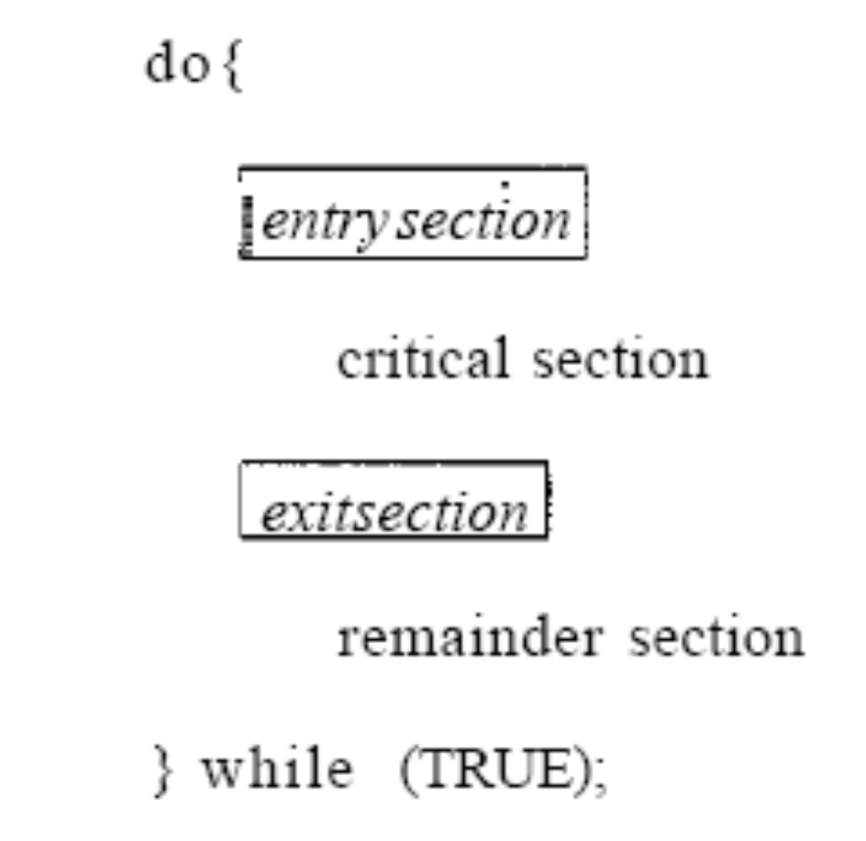
Figure 8.1. General structure of a typical process P,.

Slide 14
  A solution to the critical-section problem must satisfy the following three requirements:
  Mutual exclusion. If process P_{i} is executing in its critical section, then no other processes can be executing in their critical sections.
  Progress. If no process is executing in its critical section and some processes wish to enter their critical sections, then only those processes that are not executing in their remainder sections can participate in the decision on which will enter its critical section next, and this selection cannot be postponed indefinitely.
  Bounded waiting. There exists a bound, or limit, on the number of times that other processes are allowed to enter their critical sections after a process has made a request to enter its critical section and before that request is granted.

Slide 15
  Two general approaches are used to handle critical sections in operating systems:
    preemptive kernels
    nonpreemptive kernels.
  A preemptive kernel allows a process to be preempted while it is running in kernel mode.
  A nonpreemptive kernel does not allow a process running in kernel mode to be preempted; a kernel-mode process will run until it exits kernel mode, blocks, or voluntarily yields control of the CPU.
  A nonpreemptive kernel is essentially free from race conditions on kernel data structures.

Slide 16
  A preemptive kernel
    More suitable for real-time programming, as it will allow a real-time process to preempt a process currently running in the kernel.
    More responsive, since there is less risk that a kernel-mode process will run for an arbitrarily long period before relinquishing the processor to waiting processes.
  Nonpreemptive kernels: Windows 2000/XP and traditional UNIX kernel, prior to Linux 2.6.
  Preemptive kernels: release of the 2.6 kernel, Several commercial versions of UNIX including Solaris and IRIX.

Slide 17
8.3. Peterson's Solution
  Peterson's solution is restricted to two processes that alternate execution between their critical sections and remainder sections.
  The processes are P₀ and P₁.
  For convenience, when presenting P_{i}, we use P_{j} to denote the other process; j =1 - i.
  Peterson's solution requires two data items to be shared between the two processes:
    int turn;
  boolean flag [2] ;

Slide 18
  The variable turn indicates whose turn it is to enter its critical section.
    if turn == i, then process P_{i}; is allowed to execute in its critical section.
  The flag array is used to indicate if a process is ready to enter its critical section.
if flag[i] is true, this value indicates that P_{i} is ready to enter its critical section.

Slide 19
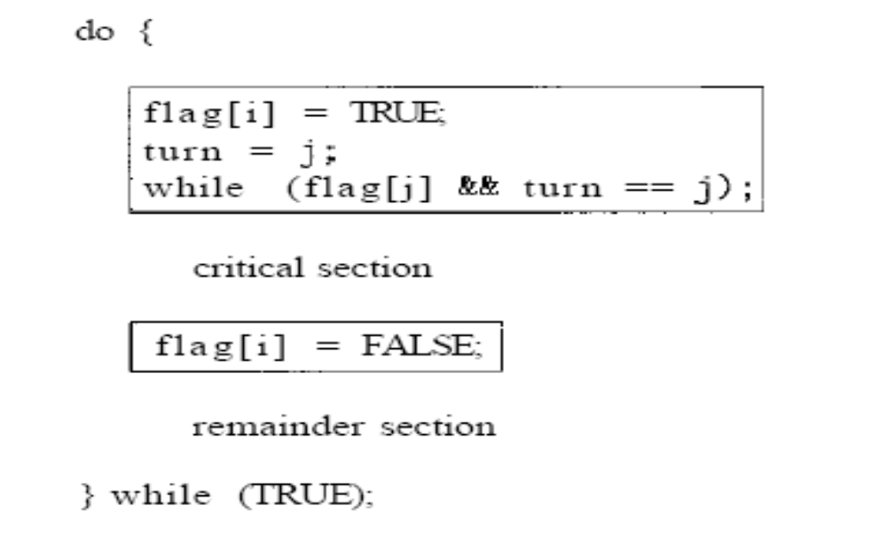
Figure 8.2. The structure of process P_{i} , in Peterson's solution.

Slide 20
8.4. Synchronization Hardware
  We can state that any solution to the critical section problem requires a simple tool-a lock.
  Race conditions are prevented by requiring that critical regions be protected by locks. That is, a process must acquire a lock before entering a critical section; it releases the lock when it exits the critical section

Slide 21
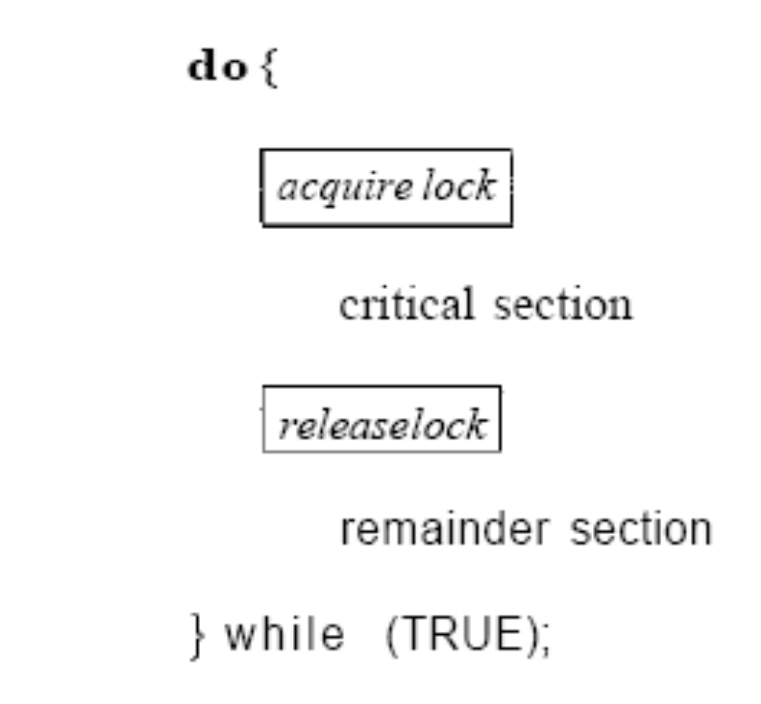
Figure 8.3. Solution to the critical-section problem using locks.

Slide 22
  The critical-section problem could be solved simply in a uniprocessor environment if we could prevent interrupts from occurring while a shared variable was being modified.
  To be sure that the current sequence of instructions would be allowed to execute in order without preemption.
    No other instructions would be run, so no unexpected modifications could be made to the shared variable.
    This is the approach taken by nonpreemptive kernels.

Slide 23
  Unfortunately, this solution is not as feasible in a multiprocessor environment.
    Disabling interrupts on a multiprocessor can be time consuming, as the message is passed to all the processors. This message passing delays entry into each critical section, and system efficiency decreases
  Modern machines provide special atomic hardware instructions
    Atomic = non-interruptable
    Either test memory word and set value
    Or swap contents of two memory words

Slide 24
8.5. Semaphores
  The various hardware-based solutions to the critical-section problem are complicated for application programmers to use.
  To overcome this difficulty, we can use a synchronization tool called a semaphore.
  A semaphore S is an integer variable
  To accessed only through two standard atomic operations: wait () and signal ()
        acquire() and release()
        Originally called P() and V()

Slide 25
  All the modifications to the integer value of the semaphore in the wait () and signal() operations must be executed indivisibly. That mean
    When one process modifies the semaphore value, no other process can simultaneously modify that same semaphore value.
    In the case of wait(S), the testing of the integer value of S (S <= 0), and its possible modification (S--) must also be executed without interruption.

Slide 26
  The definition of wait() is as follows:
wait(S) {
      while S <= 0
      ; // no-op
      S-- ;
  }
  The definition of signal () is as follows:
  signal(S) {
      S ++ ;
    }

Slide 27
8.5.1. Usage
  Operating systems often distinguish between counting and binary semaphores.
    The value of a counting semaphore can range over an unrestricted domain.
    The value of a binary semaphore can range only between 0 and 1.
  On some systems, binary semaphores are known as mutex locks, as they are locks that provide mutual exclusion.
  We can use binary semaphores to deal with the critical-section problem for multiple processes.

Slide 28
  The n processes share a semaphore, mutex, initialized to 1. Each process P_{i}, is organized as shown in Figure 8.4.
do {
waiting(mutex);
critical section;
signal(mutex);
remainder section;
}while (TRUE);
Figure 8.4. Mutual-exclusion implementation with semaphores.

Slide 29
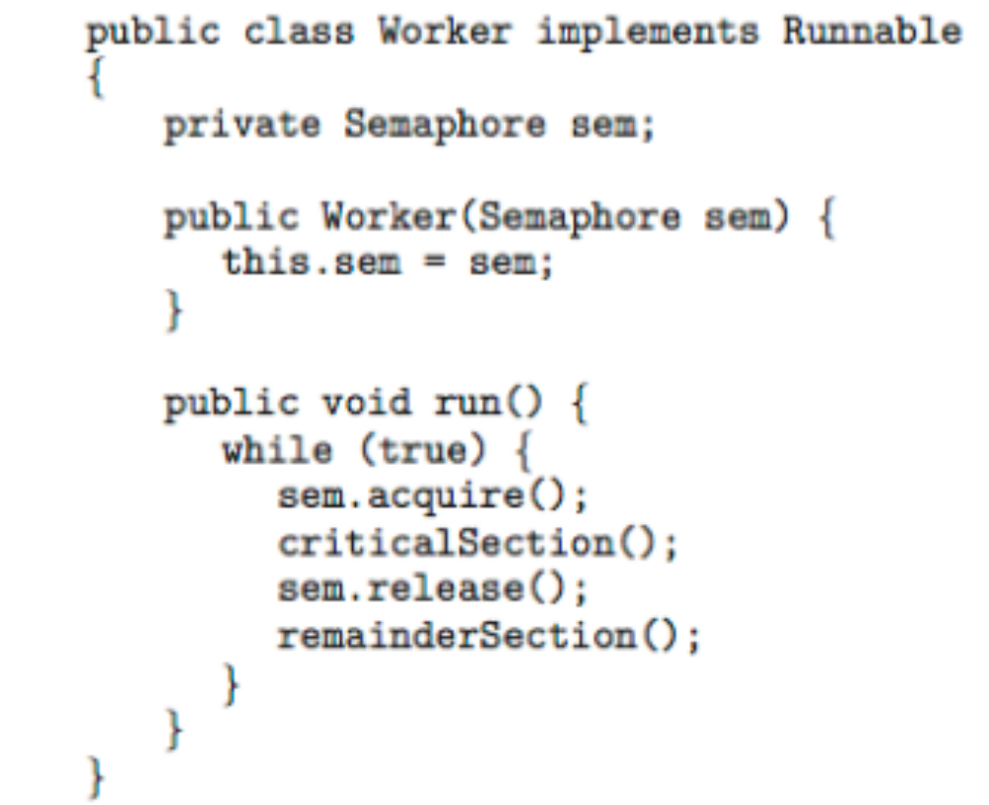

Slide 30
  We can also use semaphores to solve various synchronization problems.
  For example
    Consider two concurrently running processes: P1 with a statement S1 and P2 with a statement S2.
    Suppose we require that S2 be executed only after S1 has completed.
  We can implement this scheme readily by letting P1 and P2 share a common semaphore synch, initialized to 0.
    Insert {...S1; signal(synch);...} in process P1
    Insert {...wait(synch); S2;...} in process P2

Slide 31
8.5.2. Implementation
  The main disadvantage of the semaphore definition given here is that it requires busy waiting
    While a process is in its critical section, any other process that tries to enter its critical section must loop continuously in the entry code.
  Busy waiting wastes CPU cycles that some other process might be able to use productively.
  To overcome the need for busy waiting, we can modify the definition of the wait () and signal () semaphore operations.

Slide 32
  With each semaphore there is an associated waiting queue.
    When a process executes the wait () operation and finds that the semaphore value is not positive, it must wait. However, rather than engaging in busy waiting, the process can block itself.
    The block operation
      Places a process into a waiting queue associated with the semaphore
      The state of the process is switched to the waiting state.
      Then control is transferred to the CPU scheduler, which selects another process to execute.

Slide 33
    The wakeup () operation
      A process that is blocked, waiting on a semaphore S, should be restarted when some other process executes a signal() operation.
      To changes the process from the waiting state to the ready state. The process is then placed in the ready queue.
  To implement semaphores under this definition
    Each entry in a waiting queue has two data items:
      value (of type integer)
      pointer to next record in the list

Slide 34
  we define a semaphore
  typedef struct {
        int value;
struct process *list;
} semaphore;
  The wait () semaphore operation wait(semaphore *S) {
  S->value--;
        if (S->value < 0) {
      add this process to S->list;
block(); }
}

Slide 35
  The signal() semaphore operation
  signal(semaphore *S) {
S->value++;
if (S->value <= 0) {
remove a process P from S->list;
wakeup(P);}
}
  The list of waiting processes can be easily implemented by a link field in each process control block (PCB).
  One way to add and remove processes from the list in a way that ensures bounded waiting is to use a FIFO queue.

Slide 36
8.5.3. Deadlocks and Starvation
  The implementation of a semaphore with a waiting queue may result in a situation where two or more processes are waiting indefinitely for an event that can be caused only by one of the waiting processes.
  The event in question is the execution of a signal() operation.
  When such a state is reached, these processes are said to be deadlocked.

Slide 37
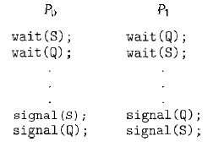
  Example: consider a system consisting of two processes, P₀ and P₁, each accessing two semaphores, S and Q, set to the value 1:
When P₀ executes wait(Q), it must wait until P₁ executes signal(Q). Similarly, when P₁ executes wait(S), it must wait until P₀ executes signal(S).

Slide 38
  Another problem related to deadlocks is indefinite blocking, or starvation, a situation in which processes wait indefinitely within the semaphore.
  Indefinite blocking may occur if we add and remove processes from the list associated with a semaphore in LIFO (last-in, first-out) order.
Reference: Silberschatz-Galvin-Gagne, Operating System Concepts, USA, 2005.(http://www.os-book.com)

