Slide 1
Chapter 7. Deadlock
OBJECTIVES
  A process requests resources; and if the resources are not available at that time, the process enters a waiting state.
  Sometimes, a waiting process is never again able to change state, because the resources it has requested are held by other waiting processes. This situation is called a deadlock.

Slide 2
  To develop a description of deadlocks, which prevent sets of concurrent processes from completing their tasks
  To present a number of different methods that an operating system can use for preventing or avoiding deadlocks in a computer system.

Slide 3
9.1. System Model
  A system consists of a finite number of resources to be distributed among a number of competing processes.
  The resources are partitioned into several types, each consisting of some number of identical instances.
  Memory space, CPU cycles, files, and I/O devices (such as printers and DVD drives) are examples of resource types.
  If a system has two CPUs, then the resource type CPU has two instances.

Slide 4
  If a process requests an instance of a resource type, the allocation of any instance of the type will satisfy the request.
  If it will not, then the instances are not identical, and the resource type classes have not been defined properly.
  A process must request a resource before using it and must release the resource after using it.
  A process may request as many resources as it requires to carry out its designated task. Obviously, the number of resources requested may not exceed the total number of resources available in the system.

Slide 5
  Under the normal mode of operation, a process may utilize a resource in only the following sequence:
    1. Request. If the request cannot be granted immediately (for example, if the resource is being used by another process), then the requesting process must wait until it can acquire the resource.
    2. Use. The process can operate on the resource (for example, if the resource is a printer, the process can print on the printer).
    3. Release. The process releases the resource.

Slide 6
  A set of processes is in a deadlock state when every process in the set is waiting for an event that can be caused only by another process in the set.
  The events with which we are mainly concerned here are resource acquisition and release.
  The resources maybe either physical resources (for example, printers, tape drives, memory space, and CPU cycles) or logical resources (for example, files, semaphores, and monitors).

Slide 7
  Example
  A system with three CD RW drives. Suppose each of three processes holds one of these CD RW drives. If each process now requests another drive, the three processes will be in a deadlock state.
  A system with one printer and one DVD drive. Suppose that process P₁ is holding the DVD and process P₂ is holding the printer. If P₁ requests the printer and P₂ requests the DVD drive, a deadlock occurs.

Slide 8
9.2. Deadlock Characterization
In a deadlock, processes never finish executing, and system resources are tied up, preventing other jobs from starting.
9.2.1. Necessary Conditions
A deadlock situation can arise if the following four conditions hold simultaneously in a system
1.Mutual exclusion. At least one resource must be held in a nonsharable mode; that is, only one process at a time can use the resource. If another process requests that resource, the requesting process must be delayed until the resource has been released.

Slide 9
  2.Hold and wait. A process must be holding at least one resource and waiting to acquire additional resources that are currently being held by other processes.
  3.No preemption. Resources cannot be preempted, that is, a resource can be released only voluntarily by the process holding it, after that process has completed its task.
  4.Circular wait. A set {P₀, P₁, ..., P_{n} } of waiting processes must exist such that P₀ is waiting for a resource held by P₁, P₁ is waiting for a resource held by P₂, ..., P_{n-1} is waiting for a resource held by P_{n} , and P_{n} is waiting for a resource held by P₀.

Slide 10
9.2.2. Resource-Allocation Graph
  Deadlocks can be described more precisely in terms of a directed graph called a system resource-allocation graph.
  This graph consists of a set of vertices V and a set of edges E.
  V is partitioned into two types:
    P= {P₁, P₂, …, P_{n}}, the set consisting of all the processes in the system
    R= {R₁, R₂, …, R_{m}}, the set consisting of all resource types in the system
  request edge - directed edge Pi →Rj
  assignment edge - directed edge Rj→Pi

Slide 11
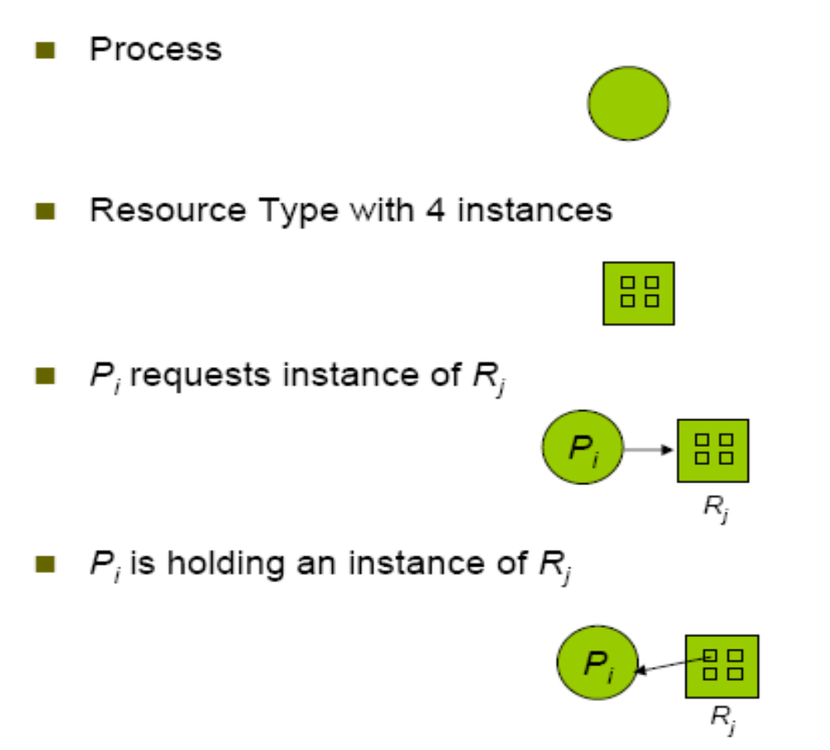

Slide 12
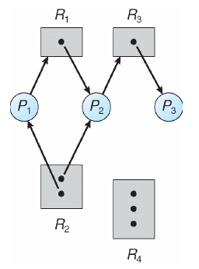
Example
The set P, R and E
  P ={P₁, P₂, P₃}
  R ={R₁, R₂, R₃, R₄}
E = {P1->R1, P2->R3, R1->P2, R2->P2,R2->P1, R3->P3}
Figure 9.1. Resource-allocation graph.

Slide 13
  Basic Facts
    If the graph contains no cycles, then no process in the system is deadlocked.
    If the graph does contain a cycle, then a deadlock may exist.
      If each resource type has exactly one instance, then a cycle implies that a deadlock has occurred. Each process involved in the cycle is deadlocked.
      If each resource type has several instances, then possibility of deadlock.

Slide 14
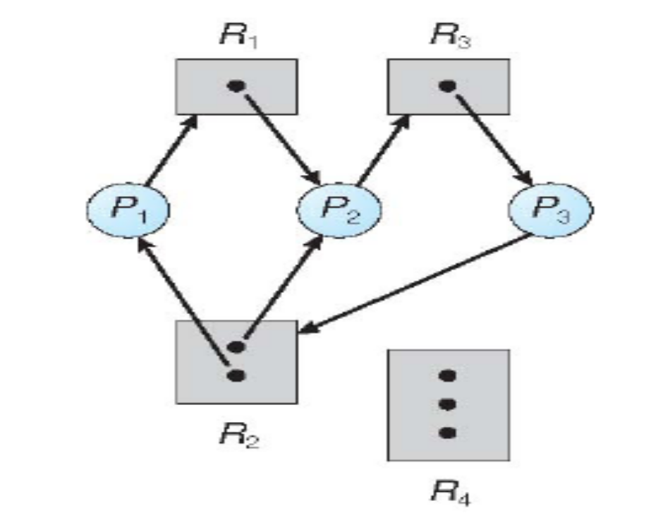
Two minimal cycles exist in the system:
P₁->R₁->P₂->R₃->P₃->R₂->P₁
P₂->R₃->P₃->R₂->P₂
Figure 9.2. Resource-allocation graph with a deadlock.
Processes P₁, P₂, and P₃ are deadlocked. Process P₂ is waiting for the resource R₃, which is held by process P₃. Process P₃ is waiting for either process P₁ or P₂ to release resource R₂.

Slide 15
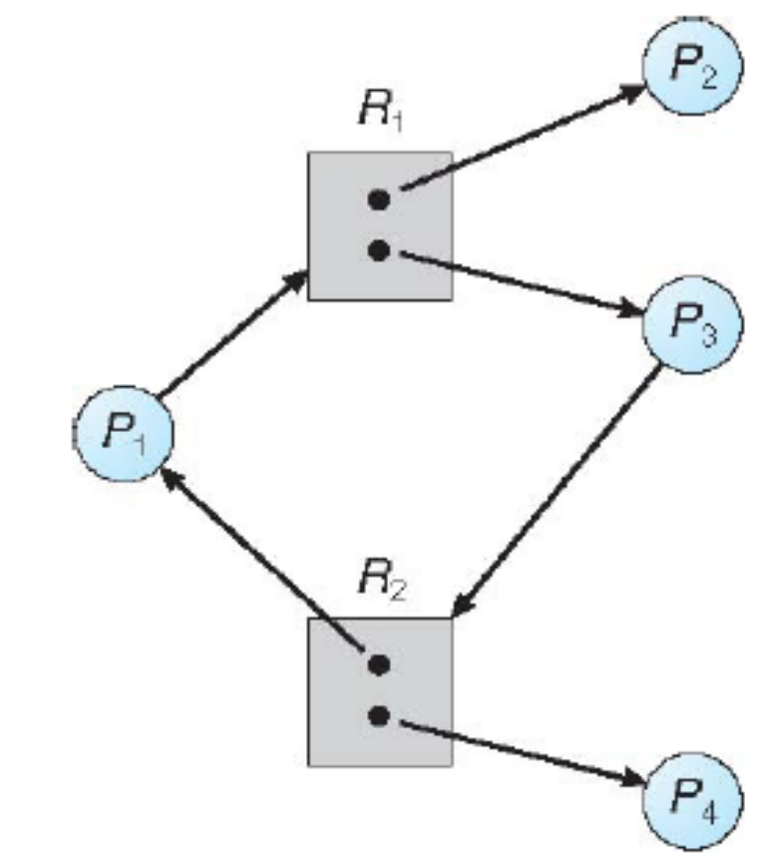
We also have a cycle
  P₁->R₁->P₃->R₂->P₁
However, there is no deadlock. Observe that process P₄ may release its instance of resource type R₂. That resource can then be allocated to P₃, breaking the cycle,
Figure 9.3. Resource-allocation graph with a cycle but no deadlock.

Slide 16
9.3. Methods for Handling Deadlocks
  Generally speaking, We (OS) can deal with the deadlock problem in one of three ways:
    We can use a protocol to prevent or avoid deadlocks, ensuring that the system will never enter a deadlock state.
    We can allow the system to enter a deadlock state, detect it, and recover.
    We can ignore the problem altogether and pretend that deadlocks never occur in the system.
  The third solution is the one used by most operating systems, including UNIX and Windows.

Slide 17
9.4. Deadlock Prevention
For a deadlock to occur, each of the four necessary conditions must hold. By ensuring that at least one of these conditions cannot hold, we can prevent the occurrence of a deadlock.

Slide 18
9.4.1. Mutual Exclusion
  The mutual-exclusion condition must hold for nonsharable resources.
  Sharable resources, in contrast, do not require mutually exclusive access and thus cannot be involved in a deadlock. A process never needs to wait for a sharable resource.
  In general, however, we cannot prevent deadlocks by denying the mutual-exclusion condition, because some resources are intrinsically nonsharable

Slide 19
9.4.2. Hold and Wait
  To ensure that the hold-and-wait condition never occurs in the system, we must guarantee that, whenever a process requests a resource, it does not hold any other resources.
  One protocol that can be used requires each process to request and be allocated all its resources before it begins execution.
  An alternative protocol allows a process to request resources only when it has none.
  Both these protocols have two main disadvantages.
    Resource utilization may be low.
    Starvation is possible.

Slide 20
9.4.3. No Preemption
  The third necessary condition for deadlocks is that there be no preemption of resources that have already been allocated.
  To ensure that this condition does not hold, we can use the following protocol.
    If a process is holding some resources and requests another resource that cannot be immediately allocated to it (that is, the process must wait), then all resources currently being held are preempted. In other words, these resources are implicitly released.
    The preempted resources are added to the list of resources for which the process is waiting.
    The process will be restarted only when it can regain its old resources, as well as the new ones that it is requesting.

Slide 21
9.4.4. Circular Wait
  The fourth and final condition for deadlocks is the circular-wait condition.
  One way to ensure that this condition never holds is to impose a total ordering of all resource types and to require that each process requests resources in an increasing order of enumeration.
  To illustrate
    R = {R₁,.., R_{i}, ..., R_{m}} set of resource types.
    F: R->N, where N is the set of natural numbers
    A process can initially request any number of instances of a resource R_{i}. After that, the process can request instances of resource type R_{j} if and only if F(R_{j}) > F(R_{i}).

Slide 22
9.5. Deadlock Avoidance
  An alternative method for avoiding deadlocks is to require additional information about how resources are to be requested.
  The simplest and most useful model requires that each process declare the maximum number of resources of each type that it may need.
  A deadlock-avoidance algorithm dynamically examines the resource-allocation state to ensure that a circular wait condition can never exist.
  The resource-allocation state is defined by the number of available and allocated resources and the maximum demands of the processes.

Slide 23
9.5.1. Safe State
  A state is safe if the system can allocate resources to each process (up to its maximum) in some order and still avoid a deadlock.
  System is in safe state if there exists a sequence <P₁, P₂, …, P_{n}> of all the processes is the systems such that for each P_{i}, the resources that P_{i} can still request can be satisfied by currently available resources + resources held by all the P_{j}, with j < i.

Slide 24
  That is:
    If P_{i} resource needs are not immediately available, then P_{i} can wait until all P_{j} have finished.
    When P_{j} is finished, P_{i} can obtain needed resources, execute, return allocated resources, and terminate.
    When P_{i} terminates, P_{i+1} can obtain its needed resources, and so on.

Slide 25
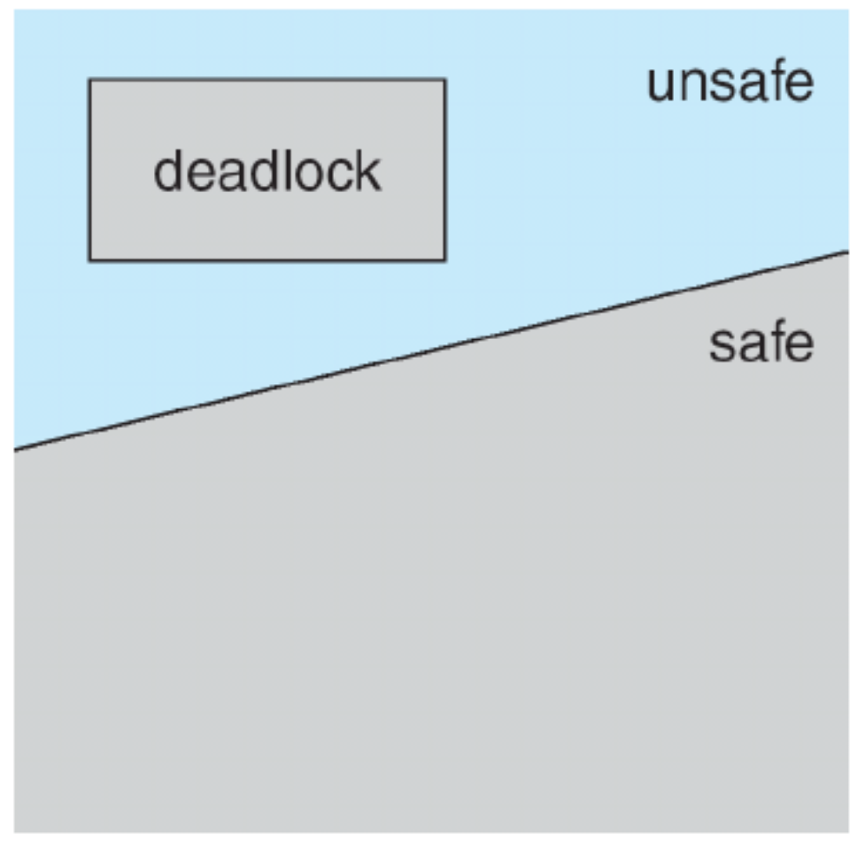
Figure 9.4. Safe, unsafe, and deadlock state spaces.
  A safe state is not a deadlocked state.
  Conversely, a deadlocked state is an unsafe state. Not all unsafe states are deadlocks, however, an unsafe state may lead to a deadlock.

Slide 26
9.5.2. Resource-Allocation-Graph Algorithm
  If we have a resource-allocation system with only one instance of each resource type, a variant of the resource-allocation graph can be used for deadlock avoidance.
  In addition to the request and assignment edges already described, we introduce a new type of edge, called a claim edge.
    A claim edge P_{i} -> R_{j} indicates that process P_{i} may request resource R_{j} at some time in the future. This edge resembles a request edge in direction but is represented in the graph by a dashed line.

Slide 27
    When process P_{i} requests resource R_{j}, the claim edge P_{i} -> R_{j} is converted to a request edge.
    Request edge converted to an assignment edge when the resource is allocated to the process.
    When a resource is released by a process, assignment edge reconverts to a claim edge
    Before process P_{i} starts executing, all its claim edges must already appear in the resource-allocation graph.

Slide 28
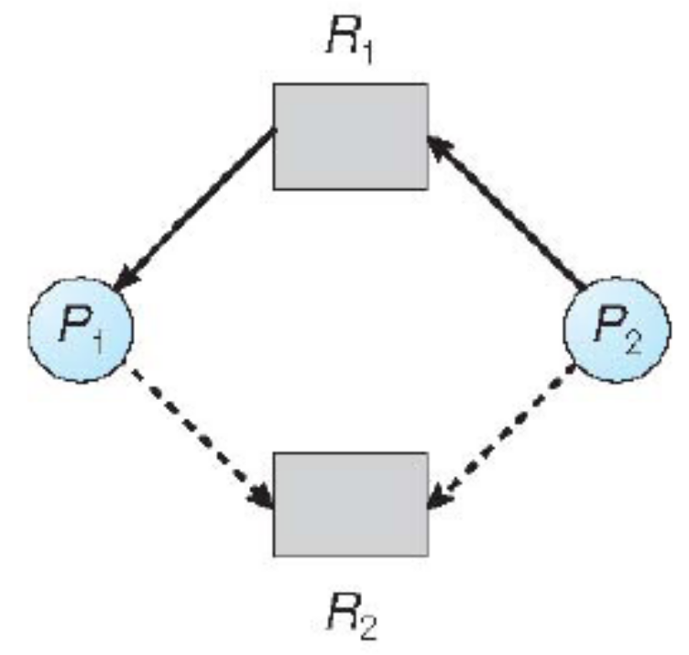
Figure 9.5. Resource-allocation graph for deadlock avoidance.
Suppose that process P_{i} requests resource R_{j}. The request can be granted only if converting the request edge P_{i} -> R_{j} to an assignment edge R_{j}-> P_{i} does not result in the formation of a cycle in the resource-allocation graph.

Slide 29
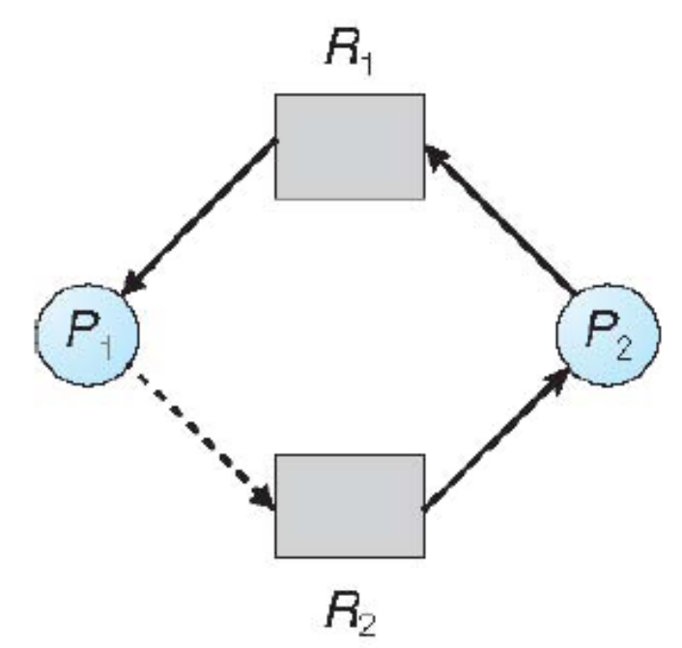
  If no cycle exists, then the allocation of the resource will leave the system in a safe state.
  If a cycle is found, then the allocation will put the system in an unsafe state. Therefore, process P_{i} will have to wait for its requests to be satisfied.
Figure 9.6. An unsafe state in a resource-allocation graph.

Slide 30
9.5.3. Banker's Algorithm
  Use the banker’s algorithm for multiple instances of a resource type.
  The name was chosen because the algorithm could be used in a banking system to ensure that the bank never allocated its available cash in such a way that it could no longer satisfy the needs of all its customers.
    When, a new process enters the system, it must declare the maximum number of instances of each resource type that it may need. This number may not exceed the total number of resources in the system.

Slide 31
    When a user requests a set of resources, the system must determine whether the allocation of these resources will leave the system in a safe state.
      If it will, the resources are allocated.
      otherwise, the process must wait until some other process releases enough resources.
    When a process gets all its resources it must return them in a finite amount of time

Slide 32
  Let n be the number of processes in the system and m be the number of resource types. We need the following data structures:
  Available:Vector of length m. If available[ j ]=k, there are k instances of resource type R_{j} available.
  Max: n x m matrix. If Max [i,j]=k, then process P_{i} may request at most k instances of resource type R_{j}
  Allocation: n x m matrix. If Allocation[i,j]=k then P_{i} is currently allocated k instances of R_{j}
  Need: n x m matrix. If Need[i,j]=k, then P_{i} may need k more instances of R_{j} to complete its task
    Need[i,j]= Max[i,j] –Allocation[i,j]

Slide 33
  Note
  Let X and Y be vectors of length n. We say that X<Y if and only if X[i]<Y[i] for all i = 1, 2, ..., n
  We can treat each row in the matrices Allocation and Need as vectors and refer to them as Allocation_{i} and Need_{i}.
  The vector Allocation_{i} specifies the resources currently allocated to process P_{i}; the vector Need_{i} specifies the additional resources that process P_{i} may still request to complete its task.

Slide 34
7.5.3.1. Safety Algorithm
We can now present the algorithm for finding out whether or not a system is in a safe state.
  Let Work and Finish be vectors of length m and n, respectively. Initialize:
    Work = Available
    Finish [i] =false for i= 0, 1, …, n-1
  2. Find an i such that both:
    Finish[i] = false
    Need_{i} ≤Work
  If no such i exists, go to step 4
3. Work= Work + Allocation_{i}
    Finish[i] =true
    go to step 2
  4. If Finish[i] == true for all i, then the system is in a safe state

Slide 35
7.5.3.2. Resource-Request Algorithm
Request_{i} is request vector for process P_{i}. If Request_{i}[j] = k then process P_{i} wants k instances of resource type R_{j}
  If Request_{i} ≤ Need_{i} go to step 2. Otherwise, raise error condition, since process has exceeded its maximum claim
  If Request_{i} ≤ Available, go to step 3. Otherwise P_{i} must wait, since resources are not available
  Pretend to allocate requested resources to P_{i} by modifying the state as follows:
    Available= Available –Request_{i} ;
    Allocation_{i}= Allocation_{i}+ Request_{i};
    Need_{i}=Need_{i}–Request_{i};
      If safe =>the resources are allocated to P_{i}
      If unsafe =>P_{i} must wait, and the old resource-allocation state is restored

Slide 36
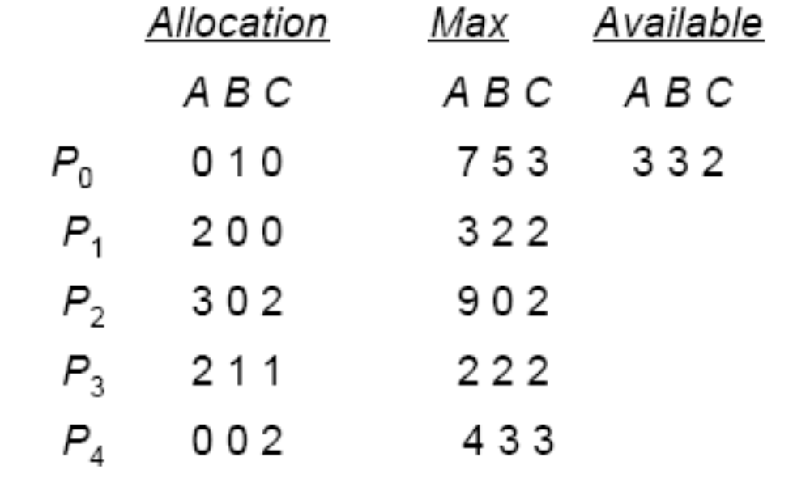
7.5.3.3. Example
  5 processes P₀ through P₄
  3 resource types:
A(10 instances), B(5instances), and C(7 instances)
  Snapshot at time T₀:

Slide 37
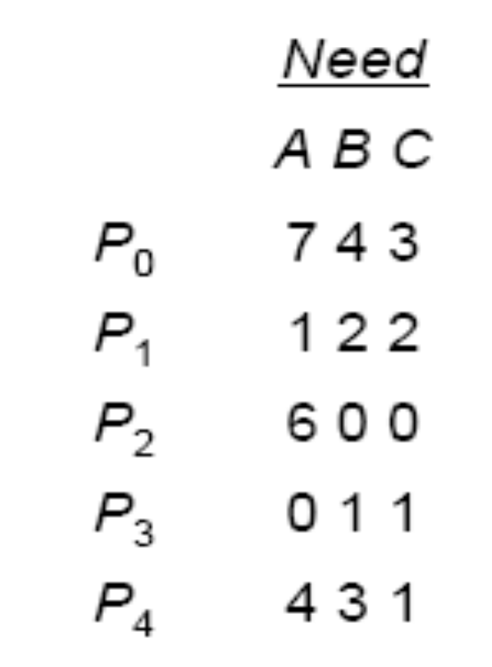
  The content of the matrix Need is defined to be Max - Allocation and is as follows:
The system is in a safe state since the sequence < P₁, P₃, P₄, P₂, P₀> satisfies safety criteria

Slide 38
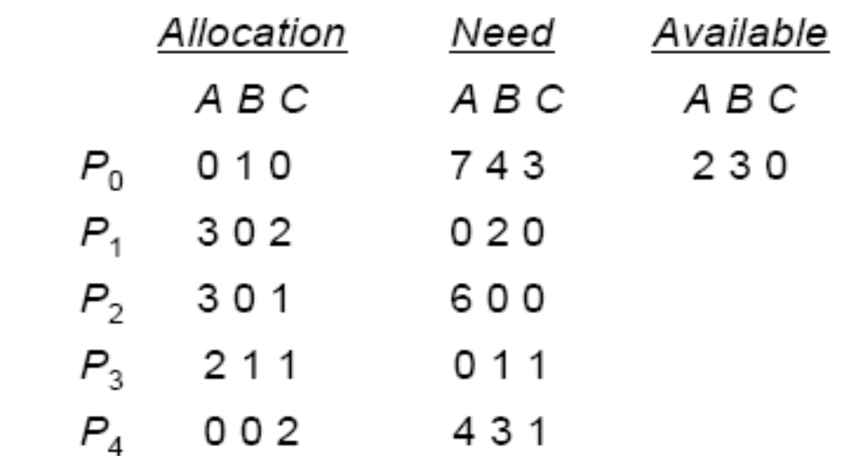
  P1 request (1,0,2) -Check that Request ≤ Available (that is, (1,0,2) ≤(3,3,2) => true)
Executing safety algorithm shows that sequence <P₁, P₃, P₄, P₀, P₂> satisfies safety requirement.
Request for (3,3,0) by P₄ cannot be granted-why?
Request for (0,2,0) by P₀ cannot be granted-why?

Slide 39
7.6. Deadlock Detection
If a system does not employ either a deadlock prevention or a deadlock avoidance algorithm, then a deadlock situation may occur. In this environment, the system must provide:
  An algorithm that examines the state of the system to determine whether a deadlock has occurred
  An algorithm to recover from the deadlock

Slide 40
7.6.1. Single Instance of Each Resource Type
  If all resources have only a single instance, then we can define a deadlock detection algorithm that uses a variant of the resource-allocation graph, called a wait-for graph.
  We obtain this graph from the resource-allocation graph by removing the resource nodes and collapsing the appropriate edges.

Slide 41
  Maintain wait-for graph
    Nodes are processes
    P_{i} ->P_{j} if P_{i} is waiting for P_{j} (to release a resource that P_{i} needs)
  Periodically invoke an algorithm that searches for a cycle in the graph. If there is a cycle, there exists a deadlock
  An algorithm to detect a cycle in a graph requires an order of n² operations, where n is the number of vertices in the graph
  Note
  An edge P_{i} -> P_{j} exists in a wait-for graph if and only if the corresponding resource allocation graph contains two edges P_{i} -> R_{q} and R_{q} -> P_{j} for some resource R_{q}

Slide 42
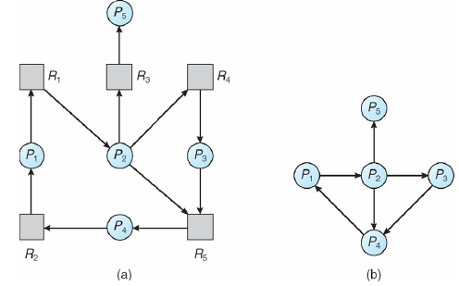
Figure 9.7 (a) Resource-allocation graph, (b) Corresponding wait-for graph.

Slide 43
7.6.2. Several Instances of a Resource Type
The algorithm employs several time-varying data structures that are similar to those used in the banker's algorithm.
  Available:A vector of length m indicates the number of available resources of each type.
  Allocation: A nxm matrix defines the number of resources of each type currently allocated to each process.
  Request:A nxm matrix indicates the current request of each process. If Request [ i j ] = k, then process P_{i} is requesting k more instances of resource type R_{j}.

Slide 44
  Let Work and Finish be vectors of length m and n, respectively Initialize:
    (a) Work= Available
    (b) For i= 1,2, …,n, if Allocation_{i} ≠ 0, then
  Finish[i] = false;otherwise, Finish[i] = true
2. Find an index i such that both:
    (a) Finish[i] == false
    (b) Request_{i} ≤ Work
  If no such i exists, go to step 4

Slide 45
  3. Work = Work+ Allocation_{i}
    Finish[i] = true
    go to step 2
4. If Finish[i] == false, for some i, 1 ≤ i ≤ n, then the system is in deadlock state. Moreover, if Finish[i] == false, then P_{i} is deadlocked
This algorithm requires an order of mxn² operations to detect whether the system is in a deadlocked state.

Slide 46
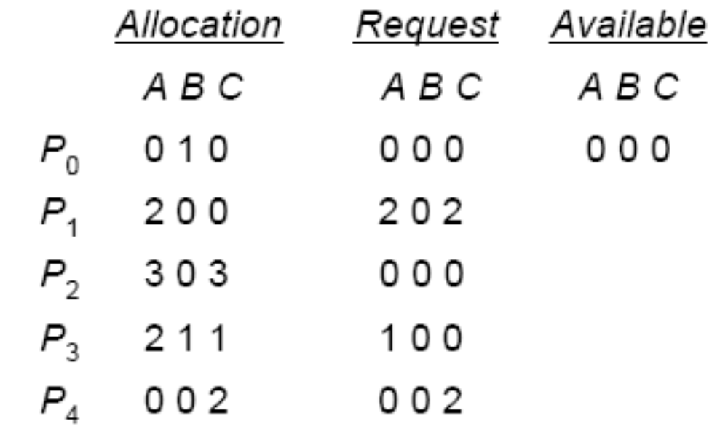
Example
  Five processes P₀ through P₄
  Three resource types
A(7 instances), B (2 instances), and C(6 instances)
  Snapshot at time T₀:

Slide 47
  We claim that the system is not in a deadlocked state. Indeed, if we execute our algorithm, we will find that the sequence <P₀, P₂, P₃, P₁, P₄> results in Finish[i] = true for all i.
  Suppose now that process P₂ makes one additional request for an instance of type C. The Request matrix is modified as follows:

Slide 48
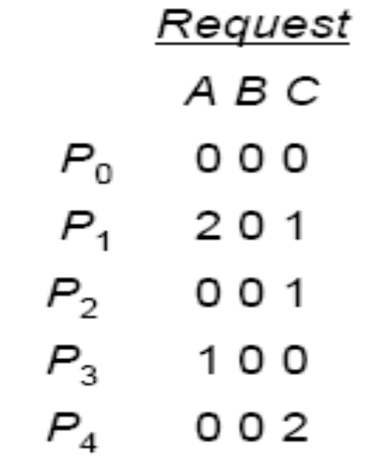
The system is now deadlocked.
  Although we can reclaim the resources held by process P₀, the number of available resources is not sufficient to fulfill the requests of the other processes.
  Thus, a deadlock exists, consisting of processes P₁, P₂, P₃, and P₄.

Slide 49
7.7. Recovery From Deadlock
There are two options for breaking a deadlock.
  One is simply to abort one or more processes to break the circular wait.
  The other is to preempt some resources from one or more of the deadlocked processes.

Slide 50
7.7.1. Process Termination
  Abort all deadlocked processes. This method clearly will break the deadlock cycle, but at great expense; the deadlocked processes may have computed for a long time, and the results of these partial computations must be discarded and probably will have to be recomputed later.
  Abort one process at a time until the deadlock cycle is eliminated. This method incurs considerable overhead, since, after each process is aborted, a deadlock-detection algorithm must be invoked to determine whether any processes are still deadlocked.

Slide 51
  In which order should we choose to abort?
    Priority of the process
    How long process has computed, and how much longer to completion
    Resources the process has used
    Resources process needs to complete
    How many processes will need to be terminated
    Is process interactive or batch?

Slide 52
7.7.2. Resource Preemption
  To eliminate deadlocks using resource preemption, we successively preempt some resources from processes and give these resources to other processes until the deadlock cycle is broken.
  If preemption is required to deal with deadlocks, then three issues need to be addressed:
    Selecting a victim –minimize cost
    Rollback –return to some safe state, restart process for that state
    Starvation –same process may always be picked as victim, include number of rollback in cost factor

Slide 53
  Reference: Silberschatz-Galvin-Gagne, Operating System Concepts, USA, 2005.(http://www.os-book.com)

