Slide 1

UiPath ICCA
ABEAM
DIGITAL TRANSFORMERS
Intelligent Customer Communication Automation
Submission to #UiPath #PowerUp 2019
@ABeam Consulting (Vietnam)

Slide 2

About UiPath ICCA
INTELIGENT CUSTOMER COMMUNICATION AUTOMATION
Automation First: smoothen the communication with customers.
Artificial Intelligence: using state-of-the art Language Understanding Intelligent Service (LUIS).
Salesforce Integration: facilitating Open Cases in Salesforce Lightning Platform.
Automatic Classification: new cases and existing cases in Salesforce.

Slide 3

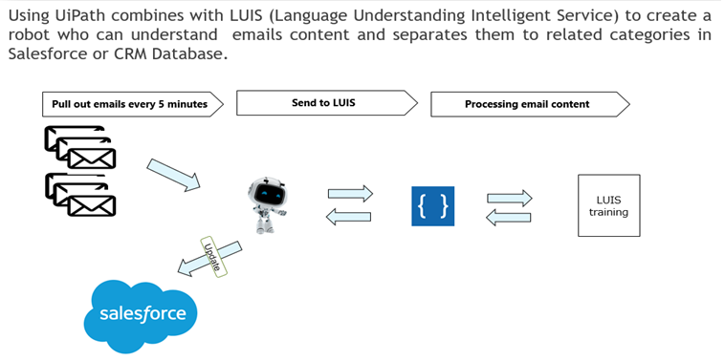
ICCA OVERVIEW
INTELIGENT CUSTOMER COMMUNICATION AUTOMATION

Slide 4
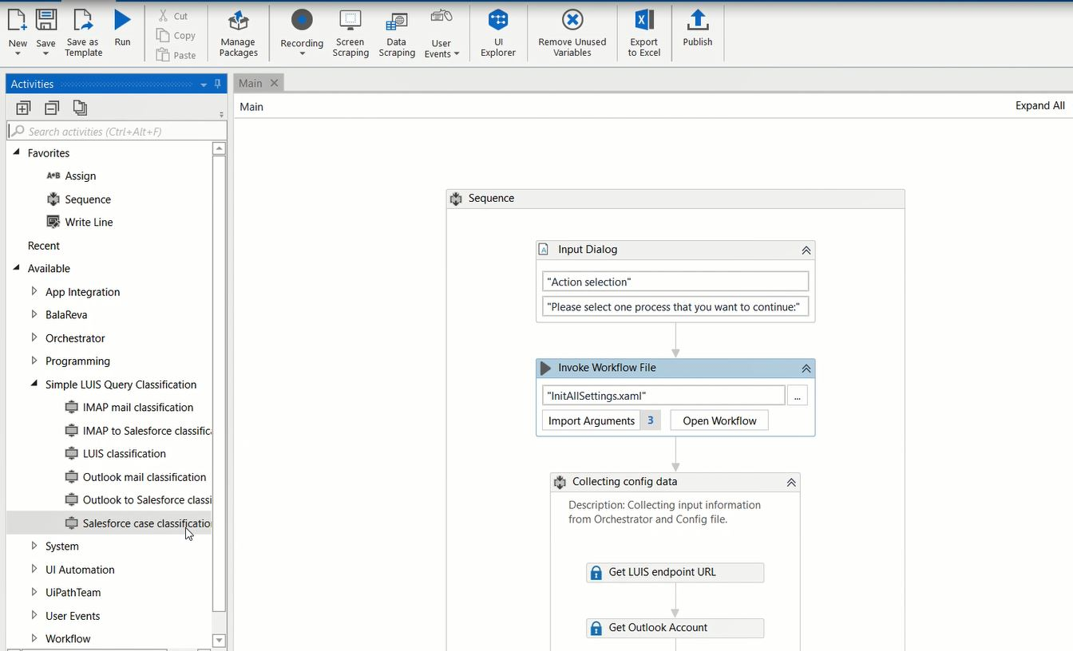
ICCA: UiPath Custom Activity (1/2)
Drag & Drop activity to classify the emails in the mailbox or the existing open cases in Salesforce Lightning Platform

Slide 5
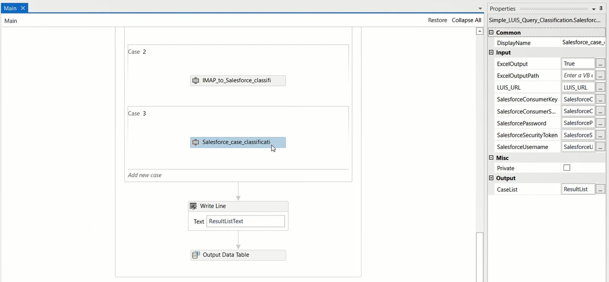
ICCA: UiPath Custom Activity (2/2)
Drag & Drop activity to classify the emails in the mailbox or the existing opened cases in Salesforce Lightning Platform
Configure the settings to connect to Salesforce Lightning Platform

Slide 6
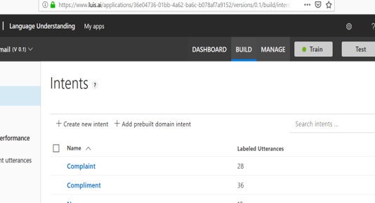
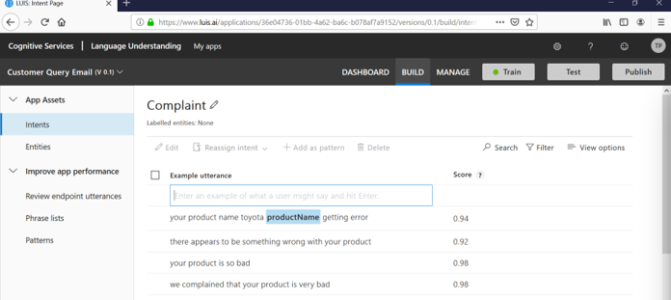
ICCA: Trained using Language Understanding Intelligent Services
The first step is by making a list of the intents that your application can resolve
After identifying the intents, then create sample utterances that LUIS needs to map to your intents.

Slide 7
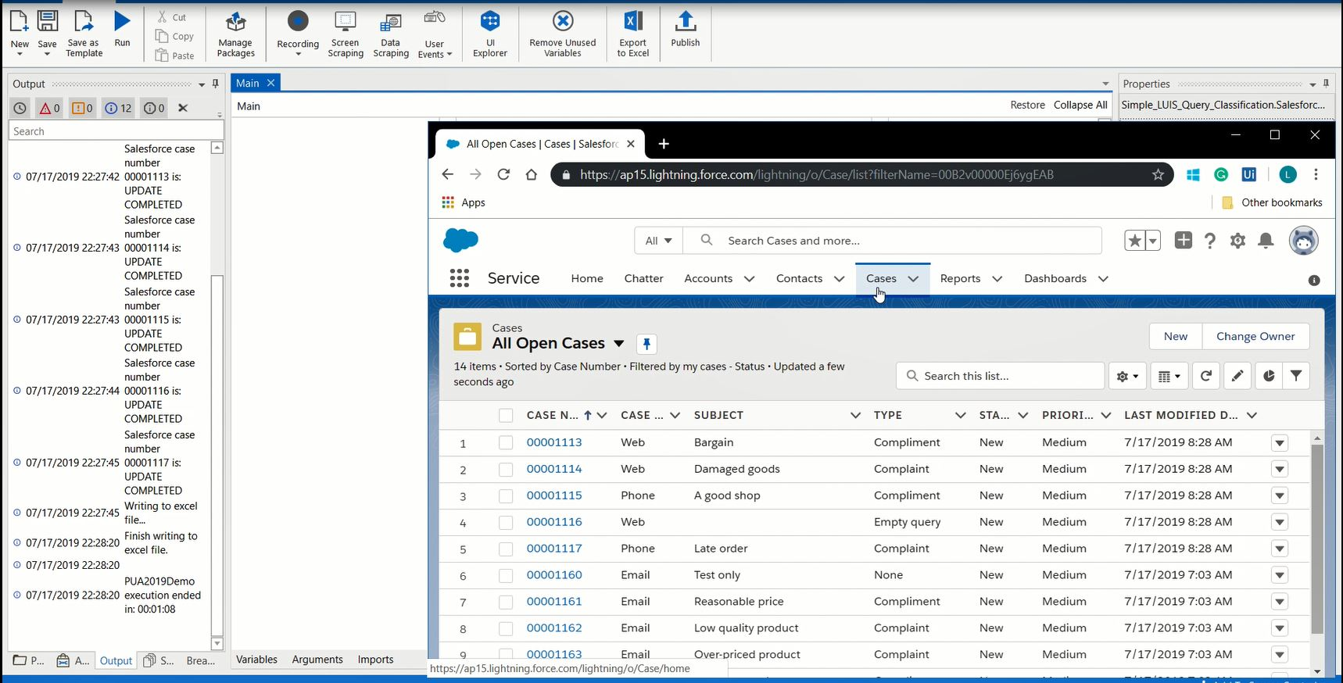
ICCA: UiPath Robot updated Salesforce Cases
After getting the response from the Language Understanding Service, the Robot will update the corresponding open cases in Salesforce Lightning Platform
Drag & Drop activity to classify the emails in the mailbox or the existing opened cases in Salesforce Lightning Platform
Configure the settings to connect to Salesforce Lightning Platform

Slide 8
ICCA FEATURES
INTELIGENT CUSTOMER COMMUNICATION AUTOMATION
CLASSIFY EMAIL & OPEN SALESFORCE CASES
CLASSIFY EXISTING SALESFORCE CASES
Connect to your company mailbox.
Get all the new emails and send requests to the LUIS.
Update the Type of the case in Salesforce Open Case: whether the customer sent a complaint that needs to handle with care or customer sent a compliment or question-related. Correctly categorize inquiries from the customers to help the Customer Service team to deliver better Customer Experiences.
Connect to the existing Open Cases in Salesforce Lightning Platform.
Send requests to LUIS to classify the cases.
Update the Type of the case in Salesforce Open Case: whether the customer sent a complaint that needs to handle with care or customer sent a compliment or question-related. Correctly categorize inquiries from the customers to help the Customer Service team to deliver better Customer Experiences.

Slide 9
ICCA - LUIS Integration Language Understanding Intelligent Service
INTELIGENT CUSTOMER COMMUNICATION AUTOMATION
Robot composes the request based on email subject & email text.
Robot sends the request to LUIS.
Robot gets back the response in which the email is classified into defined categories: Compliment, Complain, Generic or Question.
The Language Understanding Service can be further trained with additional data.

Slide 10
References
UiPath ICCA Source Code: https://github.com/leo-tran/ICCA/
UiPath PowerUp 2019 Challenge: https://uipath2019.devpost.com/
ABeam Consulting: https://www.abeam.com/
Language Understanding Service: https://www.luis.ai/
UiPath Salesforce Connector: https://go.uipath.com/component/connector-for-salesforce-lightning-platform/
@2019 ABeam Digital Transformation

Slide 11

UiPath ICCA: Customer Centric Automation Starts NOW!

Slide 12
Thank You.
ABeam
ABeam Consulting (Vietnam)
DIGITAL TRANSFORMERS
+84 28 3911 6345
dunguyen@abeam.com
https://www.abeam.com

