Slide 1

23g mentor-mentee
First presentation
Date: JUN 27, 2017
Mentor: ANH TRAN (0406)
Mentee: Tung vo (2013)
Rcar software solution 3 group
Renesas design Vietnam co., ltd

Slide 2
Agenda
Target & Current status
Analysis and solution
Training plan
Sumary

Slide 3
Agenda
Target & Current status
Analysis and Solution
Training plan
Sumary

Slide 4
1. TARGET & CURRENT STATUS (1/2)
Skill | Current status | Target | Current level | Target level
Software coding | - Basic knowledge of C, Shell script language. | - Understand structure and operation of RCar, RZ/G series. | 1 | 2
Development environment | - Basic knowledge about Qt, Yocto project, Gstreamer, Scripting. | - Understand operating system (Linux kernel, device driver) of RCar, RZ/G | 1 | 2
Readability | - Can create program with basic coding style. | - Can feedback by looking at work result. - Can apply development process. | 1 | 2
Software development methodology | - Limited knowledge about objectoriented programming. | - Can make and keep self schedule. - Can raise alarm if any. | 1 | 2
Verification / Failure analysis | - Can analyze simple bugs. | - Can report problem to supervisor clearly. - Can report work status in team. | 1 | 2

Slide 5
1. TARGET & CURRENT STATUS (2/2)
Skill | Current status | Target | Current level | Target level
SoC architecture | - Limited knowledge of structure and operation of RCar, RZ/G series. | - Understand structure and operation of RCar, RZ/G series. | 1 | 2
Operating System | - Limited knowledge about Linux OS, kernel and device driver | - Understand operating system (Linux kernel, device driver) of RCar, RZ/G | 1 | 2
Development process | - Limited knowledge about RZ/G product | - Can feedback by looking at work result. - Can apply development process. | 1 | 2
Management | - Can keep assigned schedule | - Can make and keep self schedule. - Can raise alarm if any. | 1 | 2
Communication | - Can create report on working status | - Can report problem to supervisor clearly. - Can report work status in team. | 1 | 2

Slide 6
Agenda
Target & Current status
Analysis and solution
Training plan
Sumary

Slide 7
2. Gap & analysis (1/2)
Skill | Gap | Root cause
Software coding | Can not create program base on detail document. | Have no experience in real coding project, reading design document.
Development environment | - Do not understand clearly about Qt, Yocto project | - Never work with Yocto project and Qt environment before
Readability | - Create program with low readability. | - Have little knowledge in coding rules and real project.
Software development methodology | - Do not understand clearly about structure analysis/design and object-oriented design | - Lack of knowledge and experience in structure analysis and design, object-oriented design
Verification / Failure analysis | - Need support to find root cause of bugs/issues. - Can not create standard failure analysis report. | - Have not practice in failure analysis. - Inefficient verification and analysis method.

Slide 8
2. Gap & analysis (2/2)
Skill | Gap | Root cause
Software coding | - Do not understand clearly about R-Car H2, M2, E2 and RZ/G architecture. | - Inefficient hardware manual investigation method.
Operating System | - Do not understand clearly about OS architecture and operation, Linux kernel and device driver. | - Limited knowledge and no experience in working with operating system.
Development process | - Do not understand clearly about development process of RZ/G product. | - Never work with RZ/G product before.
Management | - Do not spend time for tasks effective. | - Poor time and workload estimation.
Communication | - Do not explain clearly about working status and issues in report. | - Lack of experience in real project report

Slide 9
Agenda
Target & Current status
Analysis and solution
Training plan
Sumary

Slide 10
3. TRAINING PLAN (1/3)
Skill | Mentee Action | Mentor Action | Milestone
Software coding | - Create programs using C, Shell script language in Qualified Solution project, IT and ST tasks. - Investigate source code and practice programming | - Provide materials, train and share experience. - Check outputs and give feedback.
Verification / Failure Analysis | - Analyze bug/issue effect and root cause by investigate documents, source code. - Report analysis result and propose solution/prevention for similar problems | - Review results, feedback and confirm mentee’s understanding
Readability | - Learn and apply C, Script programming coding rules in tasks to create clean code, easy to read and maintain. | - Check and feedback on mentee’s coding style
Development environment | - Investigate about Yocto project, Qt, Gstreamer, Scripting | - Provide materials and support mentee on unclear points.

Slide 11
3. TRAINING PLAN (2/3)
Skill | Mentee Action | Mentor Action | Milestone
Software development methodology | - Investigate structure design, practice object-oriented programming with Qt. | - Provide materials, guide and support mentee on unclear points
SoC architecture | - Investigate multimedia module of R-Car, RZ/G series. | - Provide materials, share experience and confirm mentee’s understanding
Operating System | - Investigate system structure and operation of OS, Linux kernel, device driver. | - Share experience, and confirm mentee’s understanding
Development process | - Investigate development process of RZ/G product and apply in tasks. | - Provide materials, guide and support mentee on unclear points

Slide 12
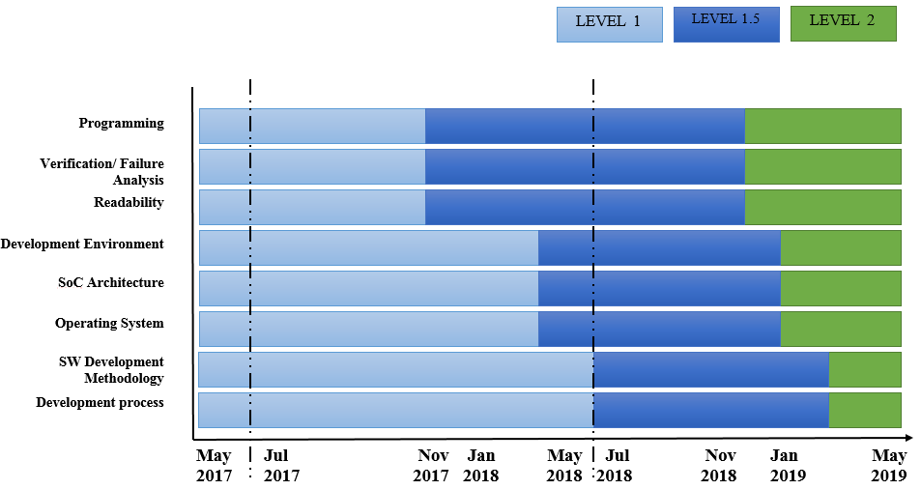
3. TRAINING PLAN (3/3)

Slide 13
Agenda
Target & Current status
Analysis and solution
Training plan
Summary

Slide 14
4. SUMMARY
Target
Achieve role Coding Engineer level 2 by May 2019.
After 2 years
Can do task without any support.
Can manage work and communicate with team effectively.
Action items
Improve technical and soft skills.
Make and keep schedule for assigned task.

Slide 15
www.renesas.com
THANKS FOR YOUR TIME

