Slide 1

25g mentor-mentee
First presentation
Date: JUN 27, 2017
Mentor: ANH TRAN (0406)
Mentee: Tung vo (2013)
Rcar software solution 3 group
Renesas design Vietnam co., ltd

Slide 2
Agenda
Target and Current status
Gap and Analysis
Training plan
Summary

Slide 3
Agenda
Target and Current status
Gap and Analysis
Training plan
Summary

Slide 4
1. TARGET and CURRENT STATUS (1/2)
Skill | Current status | Target | Current Level | Target Level
Software coding | - Basic knowledge of C | -Can create program base on detailed design documents. -Can conduct code review of source code. | 1 | 2
Development environment | - Basic knowledge about Yocto project, GStreamer. | -Understand development, target environments and can create source code with these environments. | 1 | 2
Readability | - Can create program with basic coding style. | -Have technique to improve code readability and perform coding accordingly. | 1 | 2
Software development methodology | - Limited knowledge about object-oriented programming. | -Can make structure analysis/design and object-oriented design. - Learn and apply V-model method | 1 | 2
Verification / Failure analysis | - Can analyze simple bugs. | -Can locate, analyze root causes of bugs. -Can take measure, prevention for bugs | 1 | 2

Slide 5
1. TARGET and CURRENT STATUS (2/2)
Skill | Current status | Target | Current level | Target level
SoC architecture | - Limited knowledge about RZ/G and Rcar series. | - Can refer to hardware manual to find relevant information of a specific SoC. | 1 | 2
Operating System | - Limited knowledge and experience about Linux OS, kernel and device driver | - Understand operating system (Linux kernel, device driver) of RCar, RZ/G | 1 | 2
Development process | - Basic knowledge - No experience in this field | - Can feedback by looking at work result. - Can apply development process. | 1 | 2
Management | - I cannot manage my time at work. | - Can make schedule and manage my time. - Can raise alarm if any. | 1 | 2
Communication | - Can create report on working status | - Can report problem to supervisor clearly. - Can report work status in team. | 1 | 2
Notes:
- Limited knowledge of structure and operation of RCar, RZ/G series.

Slide 6
Agenda
Target and Current status
Gap and Analysis
Training plan
Summary

Slide 7
2. Gap and analysis (1/2)
Skill | Gap | Root cause
Software coding | - Can not create program base on detail document. | - Have no experience in real coding project, reading design document.
Development environment | - Do not understand clearly about Qt, Yocto project | - Never work with Yocto project and Qt environment before
Readability | - Create program with low readability. | - Have little knowledge in coding rules - Have no experience in coding project
Software development methodology | - Can not make structured analysis/design and object-oriented design | - Lack of knowledge and experience in structure analysis and design, object-oriented design
Verification / Failure analysis | - Can not analyze and locate cause of issues - Can not create standard failure analysis report. | - Do not practice in failure analysis. - The method of verification and analysis is not effective.

Slide 8
2. Gap and analysis (2/2)
Skill | Gap | Root cause
SoC architecture | - Do not understand clearly about SoC architecture of Renesas. | - Inefficient hardware manual investigation method.
Operating System | - Do not understand clearly about OS architecture and operation, Linux kernel and device driver. | - Limited knowledge and no experience in working with operating system.
Development process | - Do not know about development process of RZ/G product. - Have not used any development process yet | - Never work with RZ/G products before.
Management | - The plan is not specific enough. | - Poor time and workload estimation.
Communication | - Do not explain clearly about working status and issues in report. | - Lack of experience in real project report

Slide 9
Agenda
Target and Current status
Gap and Analysis
Training plan
Summary

Slide 10
3. TRAINING PLAN (1/3)
Skill | Mentee’s Action | Mentor’s Action | Milestone
Software coding | - Create programs using C in UT, IT and ST tasks. - Investigate source code and practice programming | - Provide materials, train and share experience. - Check outputs and confirm | Nov, 2018
Verification / Failure Analysis | - Analyze bug/issue effect and root cause by investigate documents, source code. - Report analysis result and propose solution for similar problems | - Review results, feedback and confirm mentee’s understanding | Nov, 2018
Readability | - Study and apply C, Script programming coding rules in tasks to create clean code, easy to read | - Check and feedback about coding style | Nov, 2018
Development environment | - Investigate about Yocto project, Qt, GStreamer, Scripting | - Provide materials and support on unclear points. | Jan, 2019
Software development Methodology | - Investigate structure design, practice object-oriented programming with Qt, GStreamer. | - Provide materials, guide and support on unclear points | Apr, 2019

Slide 11
3. TRAINING PLAN (2/3)
Skill | Mentee’s Action | Mentor’s Action | Milestone
SoC architecture | Investigate multimedia module of RZ/G series. Make investigated document | Provide materials, confirm mentee’s understanding | Jan, 2019
Operating System | Investigate system structure and operation of OS, Linux kernel, device driver. Build environment and try on board | Share experience, and confirm the result | Jan, 2019
Development process | - Investigate development process of RZ/G product and apply in tasks. | Provide materials, guide and support mentee on unclear points | Apr, 2019
Management | Make plan for assigned tasks | Check the progress of assigned tasks. | Jul, 2018
Communication | Make weekly report and report working result to mentor. Use English in communication | Check report, feedback and confirm the result | Jul, 2018

Slide 12
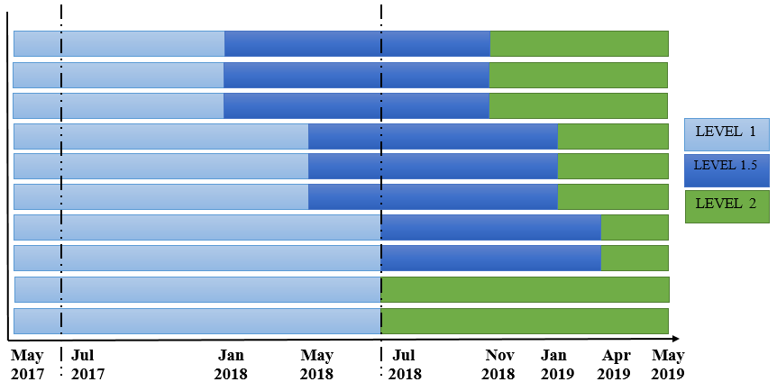
3. TRAINING PLAN (3/3)
Jun 27, 2017
Midterm Presentation
Software coding
Verification/ Failure Analysis
Readability
Development Environment
SoC Architecture
Operating System
SW Development Methodology
Development process
Management
Communication

Slide 13
Agenda
Target and Current status
Gap and Analysis
Training plan
Summary

Slide 14
4. SUMMARY
Target
Achieve role Coding Engineer level 2 by May 2019.
Abilities after 2 years
Can do task without any support.
Can manage work and communicate with team effectively.
Action items
Improve technical and soft skills.
Make and keep schedule for assigned task.

Slide 15
www.renesas.com
THANKS FOR YOUR TIME !

