Slide 1
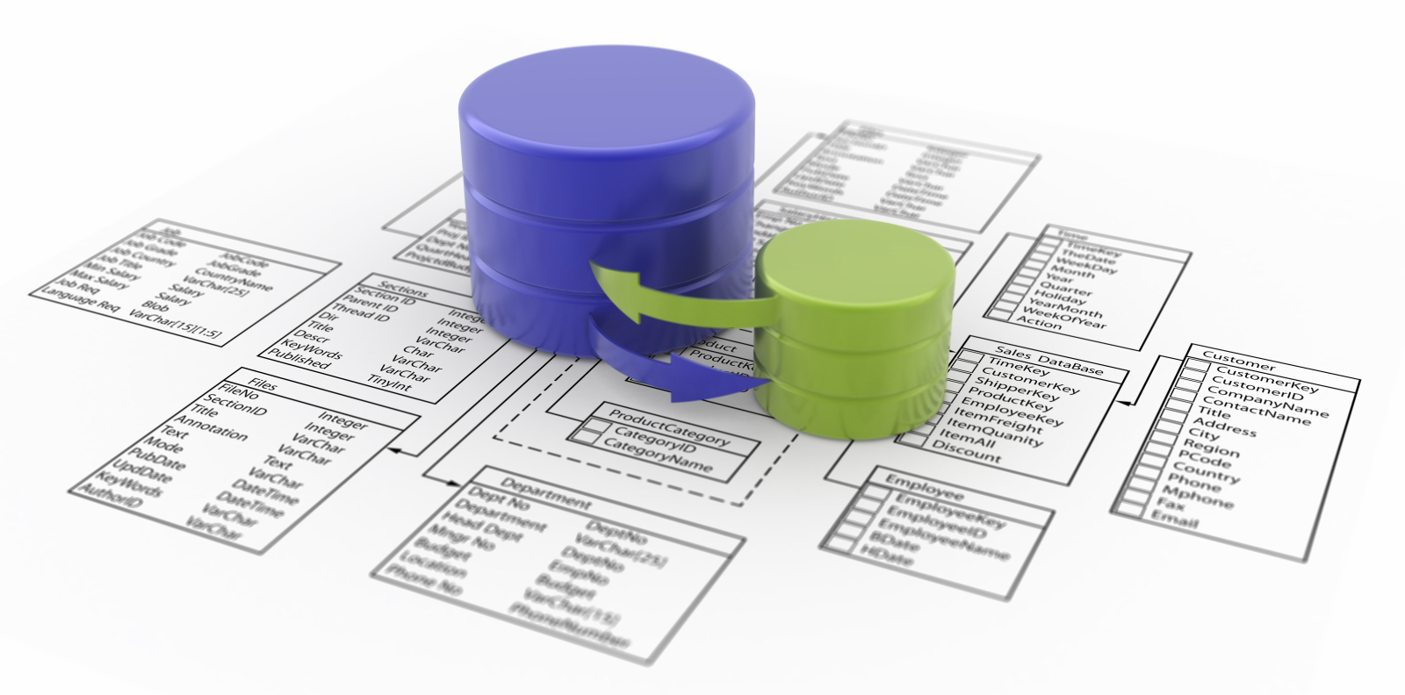
SQL Server 2012 for Business Intelligence
UTS Short Course
Notes:
Click to add notes
Peter Gfader shows SQL Server

Slide 2
Daniel Hyles – SA @ SSW
w: dotnetdan.info | e: DanielHyles@ssw.com.au | t: @danielhyles
Loves C# and .NET
Specializes in
Application architecture and design
SQL Performance Tuning and Optimization
Agile, Scrum
Technology aficionado
ASP.NET
Windows Forms
Mobile Apps
Notes:
Solution Architect

Slide 3
Mehmet Ozdemir – SA @ SSW
w: blog.ozdemir.id.au | e: mehmet@ssw.com.au | t: @mozdemir_au
SQL Server, BI, Infrastructure
Specializes in
Application architecture and design
SQL Performance Tuning and Optimization
HyperV, SCVMM
Technology aficionado
Virtualization
Reporting/BI
Cubes

Slide 4
Admin Stuff
Attendance
You initial sheet
Hands On Lab
You get me to initial sheet
Homework
Certificate
At end of 5 sessions
If I say if you have completed successfully ☺
Notes:
No exam
80% of course (4 days)
Peter Gfader shows SQL Server

Slide 5
Course Website
http://sharepoint.ssw.com.au/Training/UTSSQL/Pages/default.aspx
Course Timetable
Course Materials

Slide 6
Course Overview
Session | Date | Time | Topic
1 | Tuesday 17-Sep-2013 | 18:00 - 21:00 | SSIS and Creating a Data Warehouse
2 | Tuesday 24-Sep-2013 | 18:00 - 21:00 | OLAP – Creating Cubes and Cube Issues
3 | Tuesday 01-Oct-2013 | 18:00 - 21:00 | Reporting Services
4 | Tuesday 08-Oct-2013 | 18:00 - 21:00 | Alternative Cube Browsers
5 | Tuesday 15-Oct-2013 | 18:00 - 21:00 | Data Mining
Notes:
Cube - explain
SSIS - explain

Slide 7
Session 1: Tonight’s Agenda
What is…
Business Intelligence
Data Warehouse / Data Mart
SSIS (DTS)
Steps in Creating a Data warehouse
Analysis of Existing Data
Creating Structures
Clean and Load (Staging)
Notes:
Data Mark - Joke

Slide 8
Introductions
Who are you?
What experience do you have with databases and BI
What are you hoping to gain from this course?

Slide 9
Session 1: Tonight’s Agenda
Automating with SSIS
Creating a Data Warehouse
Hands on Lab - You!

Slide 10
Business Intelligence Defined?
Business intelligence (BI) is a broad category of applications and technologies for gathering, storing, analyzing, and providing access to data to help enterprise users make better business decisions.
Reports + Interactivity

Slide 11
Our traditional data store = OLTP
OLTP - On Line Transaction Processing System
Transactions
Simple & Efficient
Optimized for 1 record at a time
Notes:
OLTP (On-line Transaction Processing)
Example: In a banking System, you withdraw amount through an ATM. Then account Number, ATM PIN Number, Amount you are withdrawing and Balance amount in account are operational data elements.

Slide 12
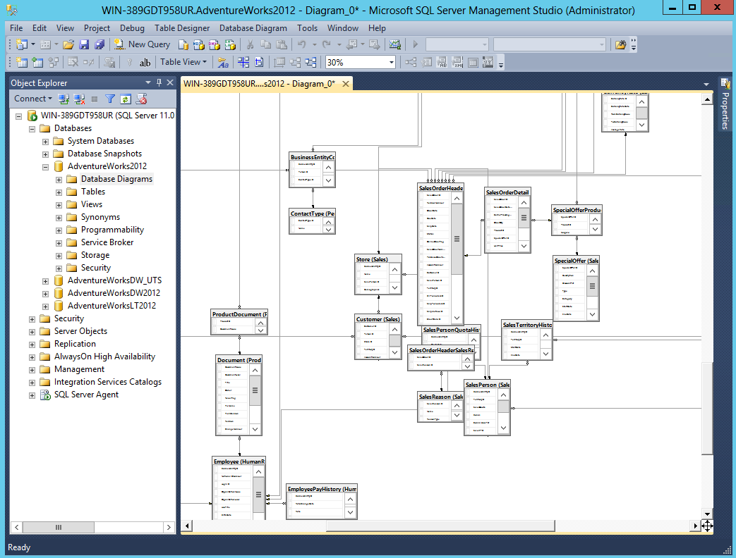
Database

Slide 13
Reports on OLTP database
BI on top of OLTP
OK with little data...
Notes:
BI is for a lot of data

Slide 14
Reports on OLTP database
BI on top of OLTP
OK with little data...
BI with little data???
Notes:
We will be doing it with a little data

Slide 15
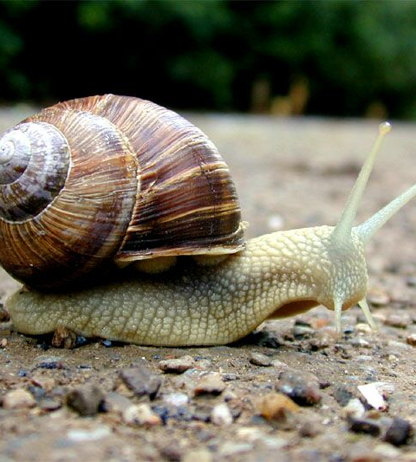
Reports on OLTP database
BI on top of OLTP
OK with little data
BI with little data???
SLOW with huge data

Slide 16
Solution?
A database
The answer is "a database“. The question is irrelevant.

Slide 17
Data warehouse
Database
Cleaned and Restructured for Analysis (normalised schemas)
Notes:
We are going to copy the data from the main DB or other sourses into a data warehouse (DW) database which we will use for reporting
No locking
We can structure data better to make reporting easier
We can also aggregate the data before analysis services gets to it witch will make processing faster

Slide 18
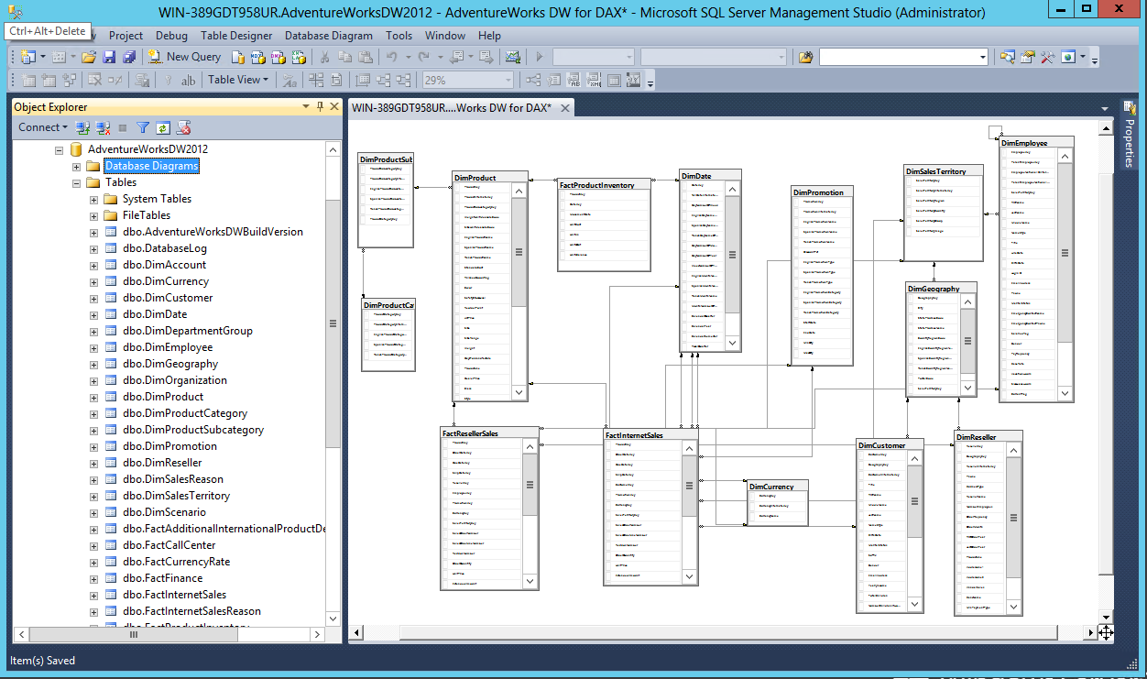
Data Warehouse
Notes:
Here is our structure of our DW.
Less tables, only data we need, less joins

Slide 19
We can go further...
Notes:
It is still in SQL server. We can go a step better

Slide 20
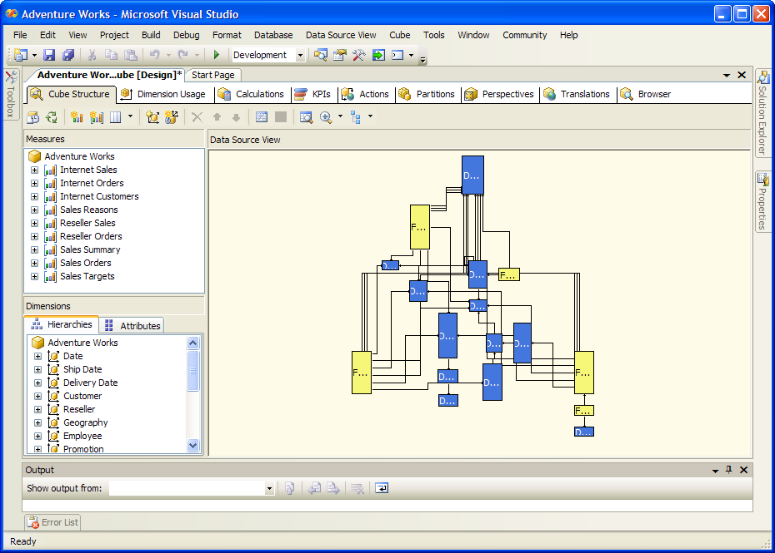
OLAP Cubes
Notes:
Structure data into
Measures – The things you want to report on. Typically numerical data (sales, orders, demoghrapcs) – Things to put into graphs
Dimensions – Filters and Categorys to the data (Axis of the graphs)

Slide 21
OLAP Cubes
Pre calculated Data structure
Fast analysis of data
Dimensions and Measures (aggregations and values)
Dimension Hierarchies (Year, Month, Day)
Slice and Dice Measures by Dimensions
End users can make complex reports themselves
Notes:
OLAP (On-line Analytical Processing)
Example: If we collect last 10 years data about flight reservation, the data can give us much meaningful information such as the trends in reservation. This may give useful information like peak time of travel, and what kinds of people are traveling in the various classes available (Economy/Business).

Slide 22

Let's do it

Slide 23
Steps
Create Data Warehouse
Copy data to data warehouse
Create OLAP Cubes
Create Reports
Do some Data Mining
Discovering a Relationship that was not obvious
Predict future events (e.g. targeting and forecasting)

Slide 24
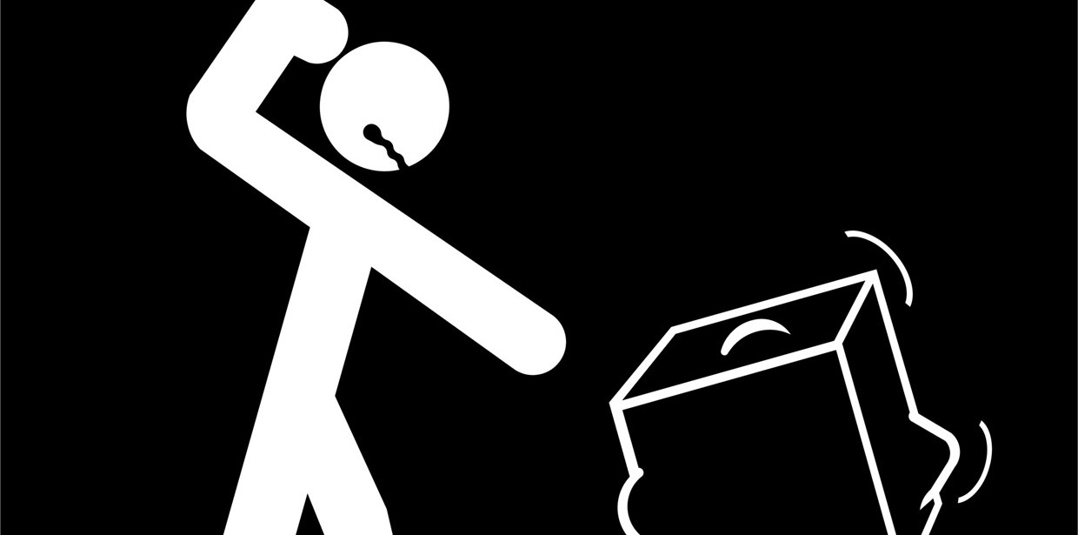
1. Create the Data Warehouse

Slide 25
Creating a Data Warehouse
What do you want to get out of it?
How much stock do we need?
When are our highest sales?
How many bikes did we sell last June?
Identify Candidate Data
Look at the data, see what might be useful
Identify Dimensions and Measures
Year, Product, Employee, etc (Dimensions)
Sales Amount, Quantity, etc (Measures)
Notes:
http://en.wikipedia.org/wiki/Measure_(data_warehouse)
http://en.wikipedia.org/wiki/Dimension_(data_warehouse)
Business don’t always know what they want

Slide 26
Creating a Data Warehouse
Build Structure
Facts (Measures) and Dimensions
Snowflake Schema
Notes:
http://en.wikipedia.org/wiki/Snowflake_schema
http://en.wikipedia.org/wiki/Star_schema
http://en.wikipedia.org/wiki/Gap_analysis
Snowflake – tables related to tables to tables

Slide 27

Theory

Slide 28
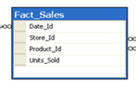
Fact table
2 types of columns
Numeric facts
Foreign keys to dimensions
Contains
Detail-level facts
or
Aggregated facts
Notes:
A fact table typically has two types of columns: those that contain numeric facts (often called measurements), and those that are foreign keys to dimension tables.
A fact table contains either detail-level facts or facts that have been aggregated.

Slide 29

Dimension Tables
Categorizes data
Small in size
Notes:
A dimension is a structure, often composed of one or more hierarchies, that categorises data. Dimensional attributes help to describe the dimensional value. They are normally descriptive, textual values. Dimension tables are generally small in size as compared to fact table.

Slide 30
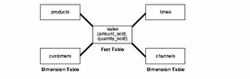
Star schema
Simplest schema for a data warehouse
Center is a fact table
Notes:
The star schema is the simplest data warehouse schema. It is called a star schema because the diagram resembles a star, with points radiating from a center. The center of the star consists of one or more fact tables and the points of the star are the dimension tables, as shown in figure.

Slide 31
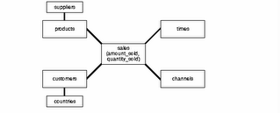
Snowflake schema
Variation of star schema
More complex
Dimensions are normalized
Notes:
The snowflake schema is a variation of the star schema used in a data warehouse. The snowflake schema (sometimes callled snowflake join schema) is a more complex schema than the star schema because the tables which describe the dimensions are normalized.

Slide 32
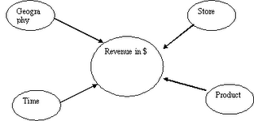
Example: Retail chain
Revenue is fact
Dimensions to see data
Notes:
-To take an example, assume this schema to be of a retail-chain (like woolworths or costco). Fact will be revenue (money).
Now how you want to see data is called a dimension.
In above figure, you can see the fact is revenue and there are many dimensions to see the same data. You may want to look at revenue based on time (what was the revenue last quarter?), or you may want to look at revenue based on a certain product (what was the revenue for chocolates?) and so on. In all these cases, the fact is same, however dimension changes as per the requirement. Note: In an ideal Star schema, all the hierarchies of a dimension are handled within a single table.

Slide 33
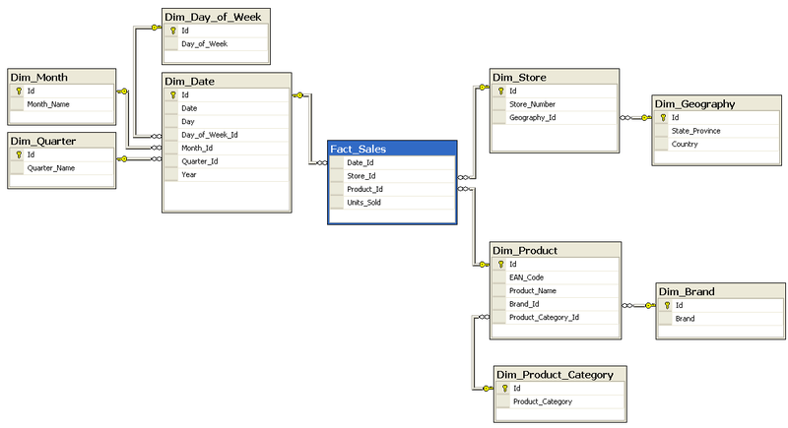
Creating a Data Warehouse - Snowflake schema
Notes:
Cons of "snowflaking" - In a data warehouse, the fact table in which data values (and its associated indexes) are stored, is typically responsible for 90% or more of the storage requirements, so the benefit here is normally insignificant. - Normalization of the dimension tables ("snowflaking") can impair the performance of a data warehouse. Whereas conventional databases can be tuned to match the regular pattern of usage, such patterns rarely exist in a data warehouse. Snowflaking will increase the time taken to perform a query, and the design goals of many data warehouse projects is to minimize these response times. Benefits of "snowflaking"
- If a dimension is very sparse (i.e. most of the possible values for the dimension have no data) and/or a dimension has a very long list of attributes which may be used in a query, the dimension table may occupy a significant proportion of the database and snowflaking may be appropriate. - A multidimensional view is sometimes added to an existing transactional database to aid reporting. In this case, the tables which describe the dimensions will already exist and will typically be normalised. A snowflake schema will hence be easier to implement. - A snowflake schema can sometimes reflect the way in which users think about data. Users may prefer to generate queries using a star schema in some cases, although this may or may not be reflected in the underlying organisation of the database. - Some users may wish to submit queries to the database which, using conventional multidimensional reporting tools, cannot be expressed within a simple star schema. This is particularly common in data mining of customer databases, where a common requirement is to locate common factors between customers who bought products meeting complex criteria. Some snowflaking would typically be required to permit simple query tools such as Cognos Powerplay to form such a query, especially if provision for these forms of query weren't anticpated when the data warehouse was first designed.

Slide 34

SQL Server’s Own Data Warehouse
Notes:
Let do this…….

Slide 35
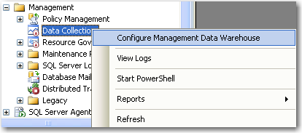
Notes:
This is an example of a implementation of a data warehouse.
SQL has its own inbuilt DW that stores historical database performance metrics

Slide 36
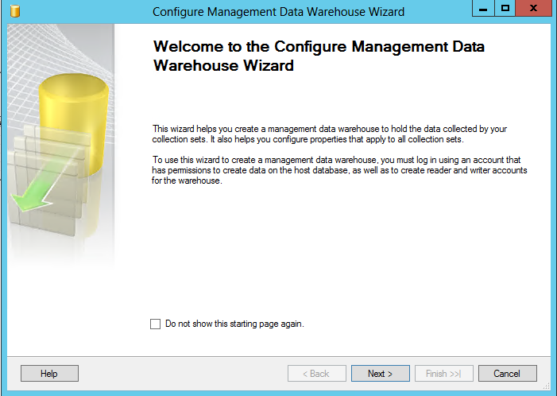

Slide 37
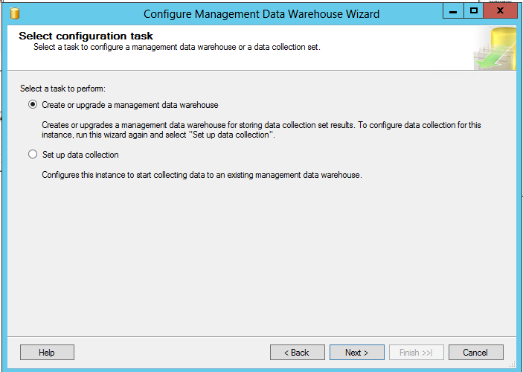

Slide 38
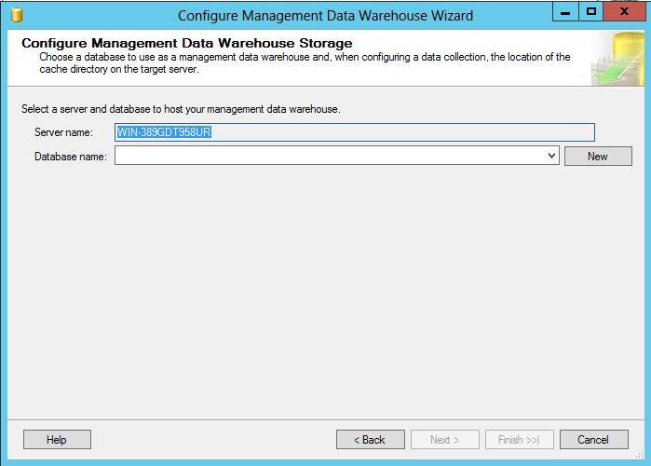
Notes:
Click New

Slide 39
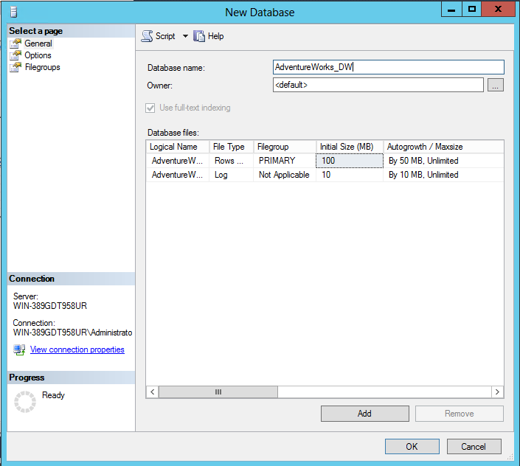
Notes:
DW is a common prefix

Slide 40
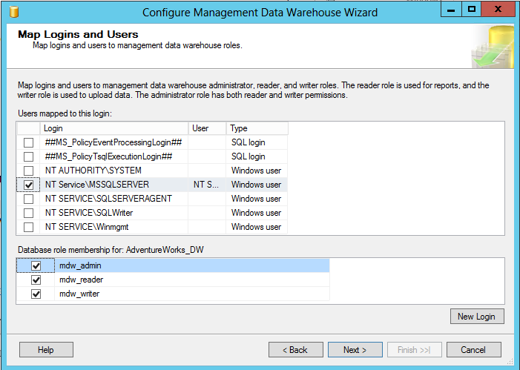
Notes:
Same user as SQL server runs as so it has access to all objects in the database

Slide 41
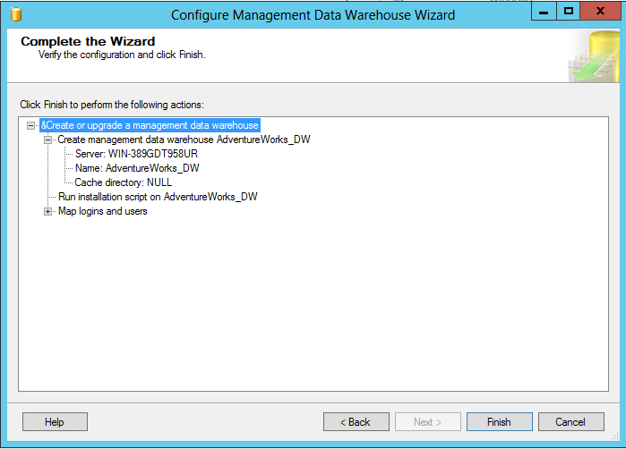

Slide 42
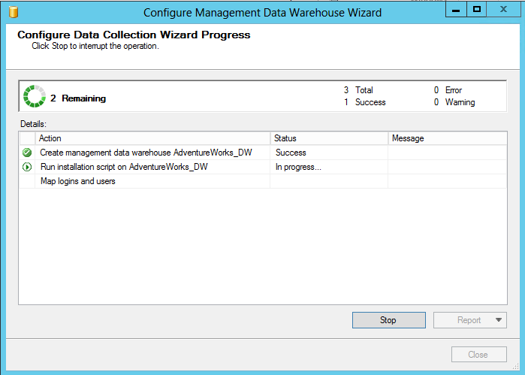

Slide 43
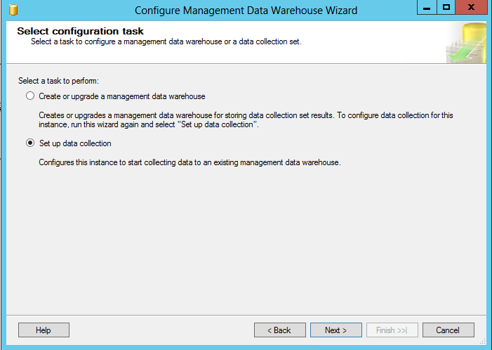
Notes:
Lets go though the wizard again

Slide 44
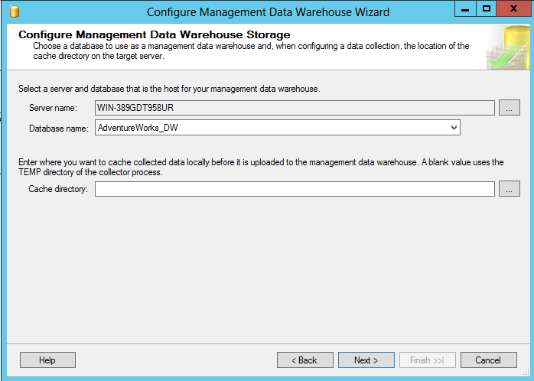

Slide 45
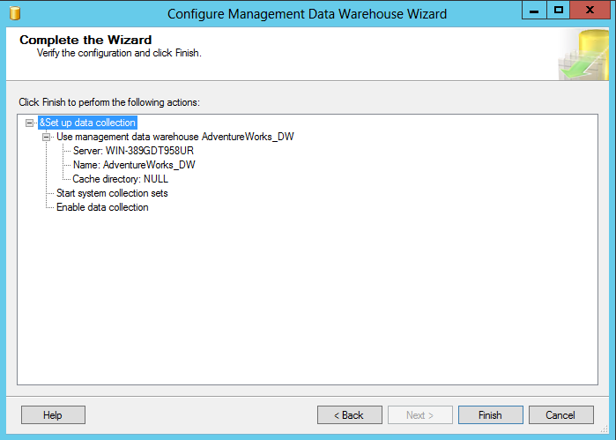

Slide 46
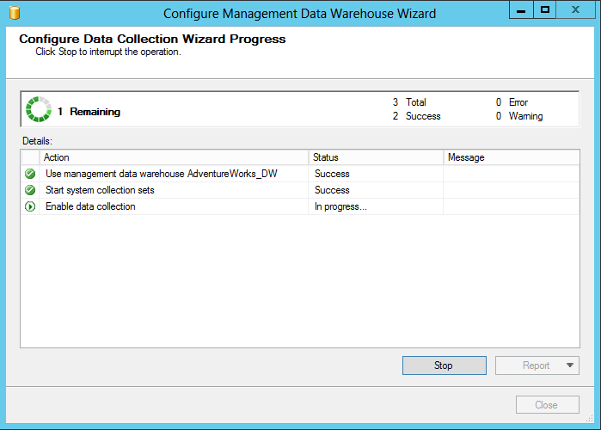
Notes:
Make sure you have SQL agent running (Set to auto)

Slide 47
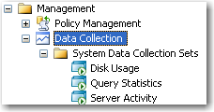
Notes:
Now lets check out some of the reports that it has made for us
OK we can delete this now

Slide 48
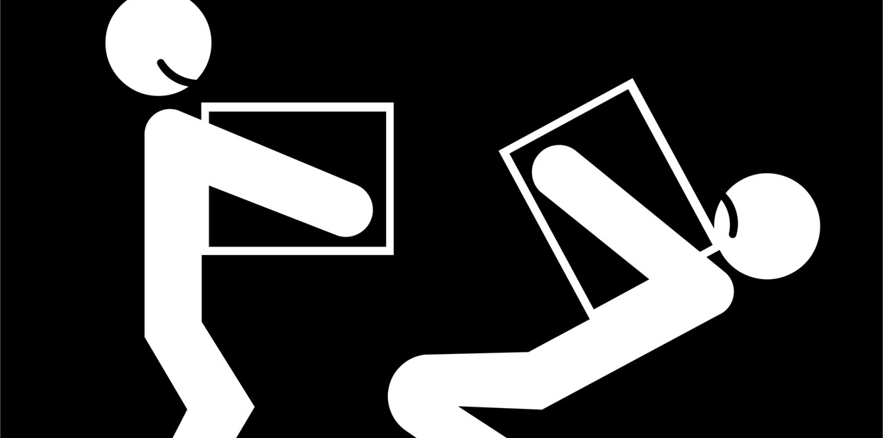
2. Copy data to data warehouse

Slide 49
Copy data to data warehouse
Microsofts answer: SSIS
SQL Server Integration Services
Load Data
Extract, Transform (clean) and Load
Notes:
Adventure works database

Slide 50
What is SSIS?
Replaces DTS (Data Transform Services)
SQL Server Integration Services
Extract, Transform and Load (ETL)
Moving Data Around
Automation
Batch Processing
Advanced error handling and programming control
Notes:
Think of it as a workflow batch file that will perform tasks on a schedule

Slide 51
Automating with SSIS
SQL Tasks
Checking Integrity
Clearing Stage Data
Rebuilding Indexes
Determining Surrogate Keys
Data Flow Tasks (ETL)
Sources
Transformations
Destinations
SSIS
Puts it all together
Controls Sequencing and Conditional Flow
Packages can be run as jobs in SQL Server
Notes:
SQL tasks – maintenance plan

Slide 52
SSIS Designer
What can we do?
What can we import data from?
What can we export data to?
What can we do to the data?

Slide 53
What can we do?
Almost anything you want!
Import data from one database to another
FTP a file to a server
Run SQL commands
Send an email
Call a web service
Perform database maintenance tasks

Slide 54
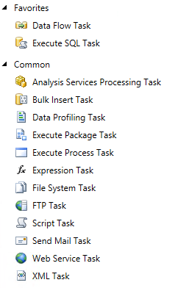
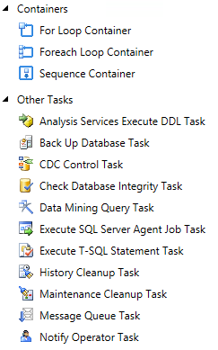
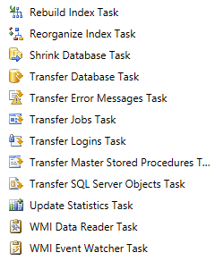
Notes:
Note the Loop containers and the script task.

Slide 55
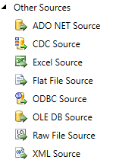
What can we import from?
ADO.NET
Excel
Flat File
OLE DB
Raw File
XML
Web Service

Slide 56
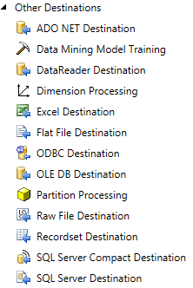
What can we export to?
Same as what we can import from plus:
Data Mining Model Training
Dimension Processing
Partition Processing
SQL Server

Slide 57
What can we do to the data?
Compare
Split
Filter
Convert
Group
Join
Aggregate
Sample
Sort
Pivot

Slide 58
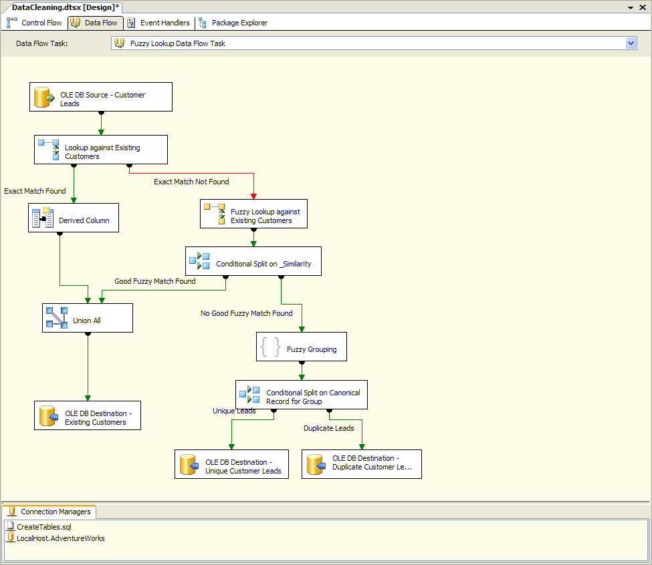
What is SSIS?
Notes:
Add a lead for a new customer

Slide 59
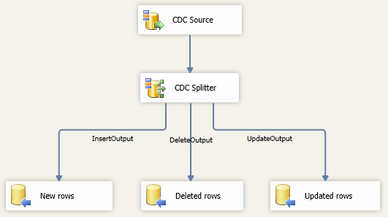
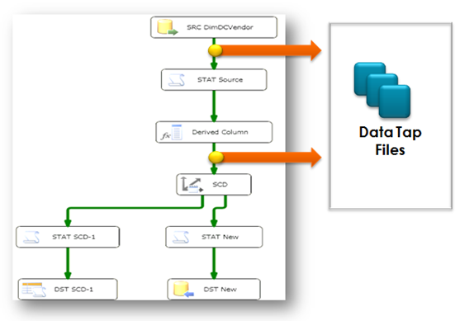
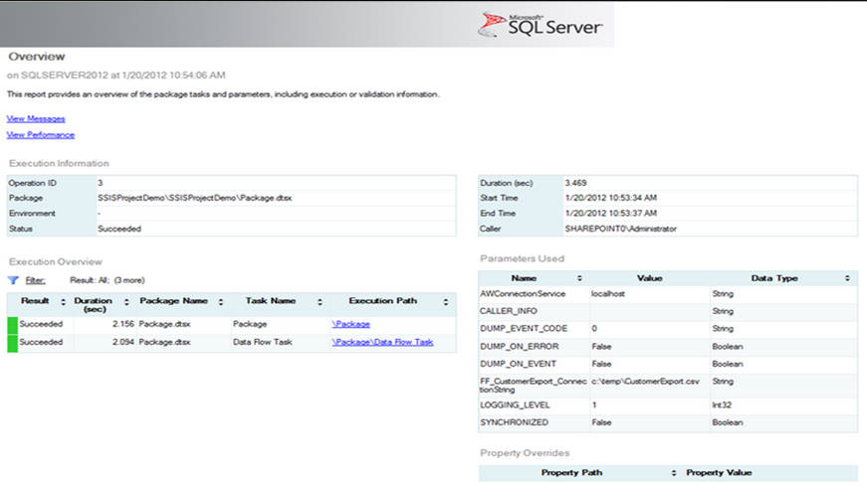
New for SQL 2012
Notes:
** CDC Splitter, Can now easily split changed records into add, edit, delete (http://www.mattmasson.com/2011/12/cdc-in-ssis-for-sql-server-2012-2/)
* Code Debug.. (If your heart is not beating faster by now, then let’s recall how much you struggled to find out why a Script Component does not work as expected? A value, or worse yet,
three are not right?)
** Data taping (http://www.mssqltips.com/sqlservertip/2846/data-tapping-during-ssis-package-execution-in-sql-server-2012/)
* Manage with powershell
** Inbuilt Benchmarking
** UNDO Finally the SSIS surface supports undo
** Deploy to SSIS Catalog (package management) (http://www.mssqltips.com/sqlservertip/2450/ssis-package-deployment-model-in-sql-server-2012-part-1-of-2/) (http://www.mssqltips.com/sqlservertip/2451/ssis-package-deployment-model-in-sql-server-2012-part-2-of-2/)
http://msdn.microsoft.com/en-us/library/bb522534(v=SQL.110).aspx

Slide 60
So what can you do with this?
Use it to gather data from different datasources
Import data from an employee list stored in excel
Export data to XML and mail it to another company for them to use
Pull accounting and salary info from MYOB, performance information from TFS/CRM and use the data to generate KPI reports
Notes:
Demo importing the UTS attendance into a SQL Database
USE Derived columns for FirstName, LastName
FirstName - SUBSTRING([ Name],1,FINDSTRING([ Name]," ",1))
LastName - SUBSTRING([ Name],FINDSTRING([ Name]," ",1),LEN([ Name]) - FINDSTRING([ Name]," ",1))

Slide 61
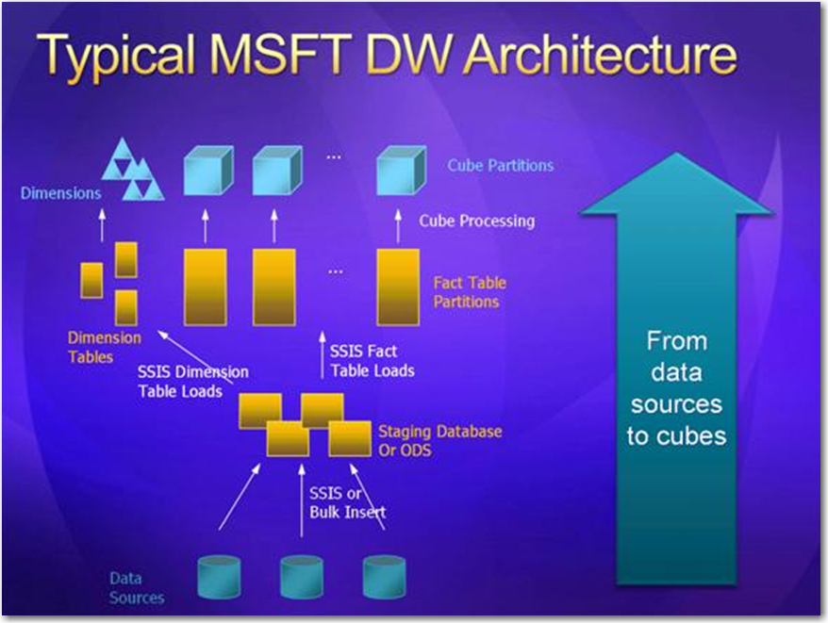
Creating a Data Warehouse – Data Warehouse Architecture
Notes:
Data Warehouse architecture

Slide 62
Current data
Short database transactions
Online update/insert/delete
Normalization is promoted
High volume transactions
Transaction recovery is necessary
Current and historical data
Long database transactions
Batch update/insert/delete
Denormalization is promoted
Low volume transactions
Transaction recovery is not necessary
OLTP
vs
OLAP
Notes:
OLTP (On-line Transaction Processing)
Example: In a banking System, you withdraw amount through an ATM. Then account Number, ATM PIN Number, Amount you are withdrawing and Balance amount in account are operational data elements.
OLAP (On-line Analytical Processing)
Example: If we collect last 10 years data about flight reservation, the data can give us much meaningful information such as the trends in reservation. This may give useful information like peak time of travel, and what kinds of people are traveling in the various classes available (Economy/Business).

Slide 63
Summary
The 5 Sessions
What is…
Business Intelligence
Data Warehouse/Data Mart
SSIS
Steps in Creating a Datawarehouse
Analysis of Existing Data
Creating Structures
Clean and Load (Staging)
Automating with SSIS
Creating a Data Warehouse
Notes:
Go though your labs
Getting data from the adventure works db and extracting orders into a new DW.
Once you have completed your labs,
Assign homework
If they Finnish early then get them to import into another table from a blog (http://www.abc.net.au/bestof/bestofabc.xml)
Peter Gfader shows SQL Server

Slide 64

3 things…
DanielHyles@ssw.com.au
http://dotnetdan.info
twitter.com/danielhyles

Slide 65
3 things…
mehmet@ssw.com.au
http://blog.ozdemir.id.au
twitter.com/mozdemir_au

Slide 66

Thank You!
Gateway Court Suite 10 81 - 91 Military Road Neutral Bay, Sydney NSW 2089 AUSTRALIA
ABN: 21 069 371 900
Phone: + 61 2 9953 3000 Fax: + 61 2 9953 3105
info@ssw.com.au www.ssw.com.au
Notes:
Click to add notes
Peter Gfader shows SQL Server

