Slide 1
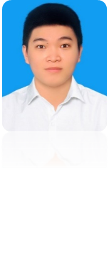










EDUCATION
TON DUC THANG UNIVERSITY SEP 2018 – NOW
Major: Computer Science/Faculty of Information Technology.
GPA: 6.77/10.
TRAN NHAT LONG
PROJECTS
WEB DEVELOPER _ JAVA DEVELOPER
* Design a website with the function of managing employees, adding and deleting accounts, departments, and company tasks
July, 4, 2000
* Design a website with the interface and functionality of an online toy store.(including adding, removing items and paying)
Male
0768025418
* Testing the website of the Faculty of IT
trannhatlong0407@gmail.com
741 DoanVanBo, Quan4,
SKILLS
Ho Chi Minh, Viet Nam
https://www.facebook.com/tran.bii.33046
* HTML
* CSS
* Basic Java
* Basic knowledge in SQL, Testing
* Able to communicate in English.
* Toiec 560
PROFILE
* Hard-working and hopeful to become a better person.
* Interested in Design web
* Willing to learn new technology.
OBJECTIVE
INTERESTS
* Take advantage of knowledge and skills to become a professional person.
* To secure a challenging position in a reputable organization to expand my learnings, knowledge and skills
* Technology, Sports, Music, Game.

