Slide 1
502045
Software Engineering
Chapter 05
Lesson 05: UML

Slide 2
Topics covered
UML
What is the UML?
Ways of Using the UML
Common Diagrams
Use case diagram
Sequence diagram
Activity diagram
Class diagram
Other diagrams

Slide 3
What Is the UML?
The Unified Modeling Language (UML) is a family of graphical notations that help in describing and designing software systems, particularly software systems built using the object-oriented (OO) style
The UML is a relatively open standard, controlled by the Object Management Group (OMG), an open consortium of companies
The UML was born out of the unification^{[thống-nhất]} of the many object-oriented graphical modeling languages that thrived^{[phát-triển-mạnh]} in the late 1980s and early 1990s (its appearance in 1997)

Slide 4
What Is the UML? (Extra)
Phân tích và thiết kế hệ thống theo hƣớng truyền thống
System development life Cycle (SDLC) hoặc Structured Systems Analysis and Design (SSAD)
Mô hình thác nước, ...
Hai vấn đề chính trong việc phát triển hệ thống thông tin đó là các xử lý và dữ liệu được xây dựng độc lập với phương pháp này. (Quy trình: DFD Dữ liệu: ERD)
Phân tích thiết kế hệ thống hướng đối tượng (OOAD)
Dựa trên: abstraction, encapsulation, modularity, hierarchy
Một hệ thống hướng đối tượng sẽ có một số đối tượng, mỗi đối tượng này sẽ kết hợp với các đối tượng khác để hoàn thành một nhiệm vụ.

Slide 5
Ways of Using the UML
At the heart of the role of the UML in software development are the different ways in which people want to use it.
Characterization of the three modes in which people use the UML: sketch, blueprint, and programming language .
By far the most common of the three is UML as sketch. In this usage, developers use the UML to help communicate some aspects of a system. As with blueprints, you can use sketches in a forward-engineering or reverse-engineering direction

Slide 6
UML as Sketches (Self study) (Forward engineering)
The essence of sketching is selectivity. With forward sketching, you rough out some issues in code you are about to write, usually discussing them with a group of people on your team
Your aim is to use the sketches to help communicate ideas and alternatives about what you're about to do . You don't talk about all the code you are going to work on, only important issues that you want to run past your colleagues first or sections of the design that you want to visualize before you begin programming
Sessions like this can be very short

Slide 7
UML as Blueprint (Self Study) (Forward engineering)
In contrast, UML as blueprint is about completeness
The idea is that blueprints are developed by a designer whose job is to build a detailed design for a programmer to code up .
That design should be sufficiently complete in that all design decisions are laid out, and the programmer should be able to follow it as a pretty straightforward activity that requires little thought
The designer may be the same person as the programmer, but usually the designer is a more senior developer who designs for a team of programmers

Slide 8
UML as Programming Language
In this environment, developers draw UML diagrams that are compiled directly to executable code, and the UML becomes the source code.
Obviously, this usage of UML demands particularly sophisticated tooling
One of the interesting questions around the UML as programming language is how to model behavioral logic. UML 2 offers three ways of behavioral modeling : interaction diagrams, state diagrams, and activity diagrams.

Slide 9
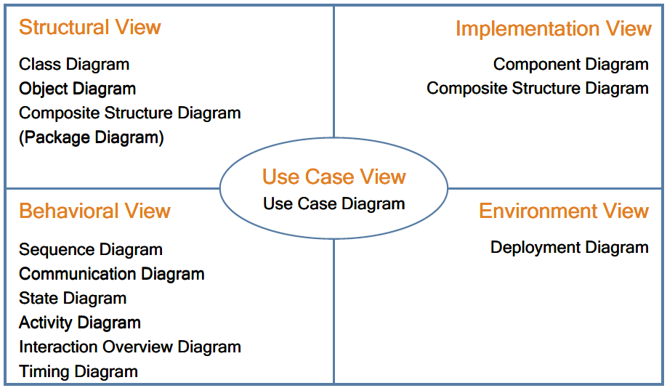
UML Diagrams
UML defines 13 diagrams that describe 4+1 architectural views

Slide 10
UML (Extra)
Các khối của UML
Things
Relationships
Diagrams

Slide 11
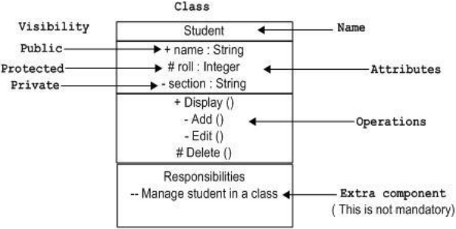
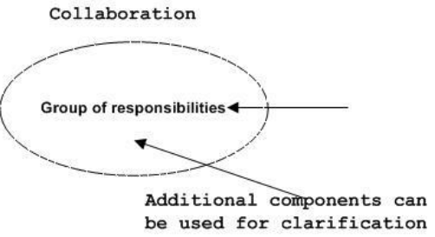
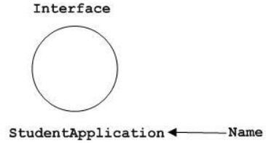
UML (Extra)
Thing
Class
Interface
Collaboration

Slide 12
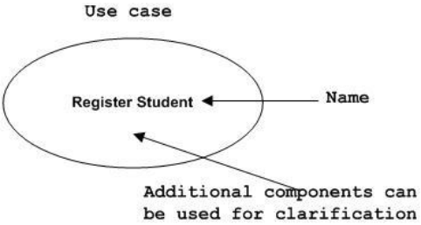
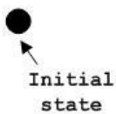

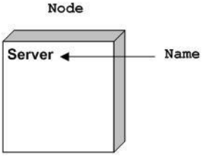

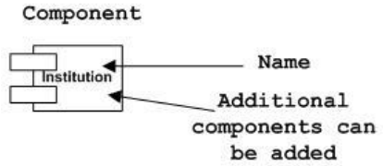
UML (Extra)
Thing
Use case
Actor
Ký hiệu bắt đầu, kết thúc
Component
Node

Slide 13

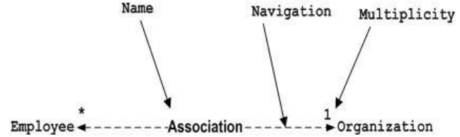
UML (Extra)
Relationship
Dependency
Association
Generalization/Realization

Slide 14
Topics covered
Introduction
What is the UML?
Ways of using the UML
Common diagrams
Use case diagram
Sequence diagram
Activity diagram
Class diagram
Other diagrams

Slide 15
Use Cases
Use cases are a technique for capturing the functional requirements of a System. Use cases work by describing the typical interactions between the users of a system and the system itself, providing a narrative of how a system is used
A scenario: “The customer browses the catalog and adds desired items to the shopping basket. When the customer wishes to pay, the customer describes the shipping and credit card information and confirms the sale. The system checks the authorization an the credit card and confirms the sale both immediately and with a follow-up e-mail”

Slide 16
Use Cases
This scenario is one thing that can happen. However, the credit card authorization might fail, and this would be a separate scenario.
In another case, you may have a regular customer for whom you don't need to capture the shipping and credit card information, and this is a third scenario
In all these three scenarios, the user has the same goal : to buy a product .The user doesn't always succeed, but the goal remains. This user goal is the key to use cases : A use case is a set of scenarios tied together by a common user goal

Slide 17
Actor
Each use case has a primary actor, which calls on the system to deliver a service.
The primary actor is the actor with the goal the use case is trying to satisfy and is usually, but not always, the Initiator of the use case.
There may be other actors which the system communicates while carrying out the use case. These are known as secondary actors

Slide 18
Content of a Use Case
There is no standard way to write the content of a use case, and different formats work well in different cases
You begin by picking one of the scenarios as the main success scenario.
You start the body of the use case by writing the main success scenario as a sequence of numbered steps .
You then take the other scenarios and write them as extensions.

Slide 19
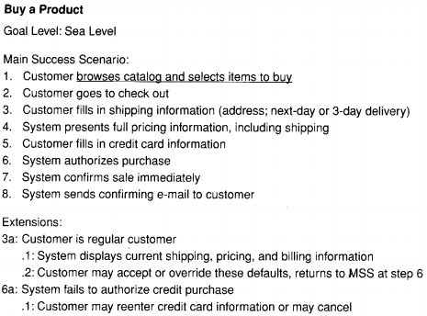
Notes:
Sale: việc bán hàng

Slide 20
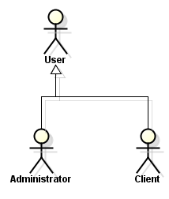
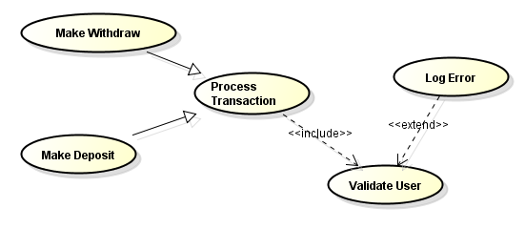
Use case diagram – Relationship
Actor Relationship: Generalization
Used to define overlapping roles between actors
Actor – Use case relationship
Association
Use case Relationship
Include
Extend
Generalization/Specification

Slide 21
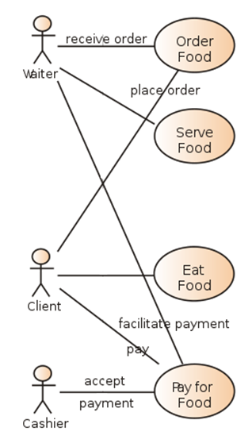
Use case diagram – Association Relationship
Association
Relationship between Actors & use cases
Actor is involved in interaction described by use case
If association line has Arrow head:
Indicate direction of invocation, primary actor
Indicate control flow (not data flow)

Slide 22
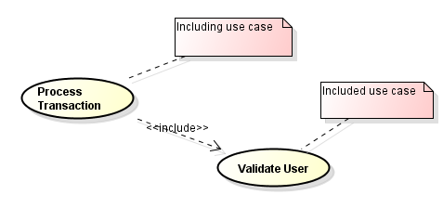
Use case diagram – Include Relationship
Include:
Directed Relationship between 2 use cases

Slide 23
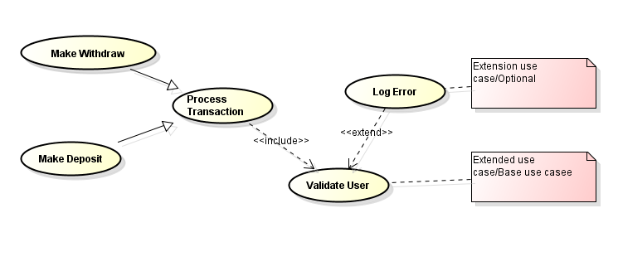
Use case diagram – Extend Relationship
Extends
Behavior of extension use case may be inserted in extended use case under some conditions.

Slide 24
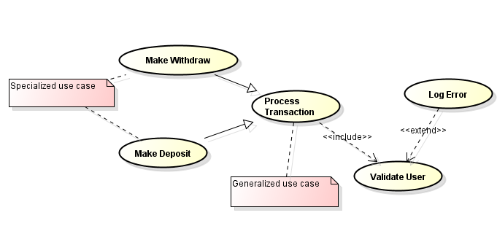
Use case diagram – Generalization Relationship
Generalization/Specialization
Specialized use cases have common behaviors, requirements, constraints, assumptions.

Slide 25
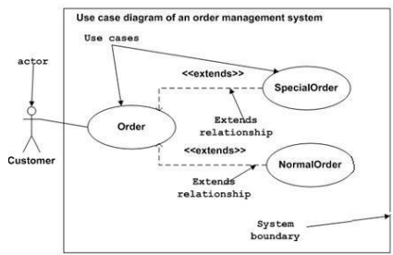
Use Case Diagrams – Other example

Slide 26
Topics covered
Introduction
What is the UML?
Ways of using the UML
Common diagrams
Use case diagram
Sequence diagram
Activity diagram
Class diagram
Other diagrams

Slide 27
Sequence Diagrams
Interaction diagrams describe how groups of objects collaborate in some behavior. The UML defines several forms of interaction diagram, of which the most common is the sequence diagram
Typically, a sequence diagram captures the behavior of a single scenario. The diagram shows a number of example objects and the messages that are passed between these objects within the use case

Slide 28
Sequence Diagrams (Case Study)
We have an order and are going to invoke a command on it to calculate its price
To do that, the order needs to look at all the line items on the order and determine their prices, which are based on the pricing rules of the order line's products. Having done that for all the line items, the order then needs to compute an overall discount, which is based an rules tied to the customer

Slide 29
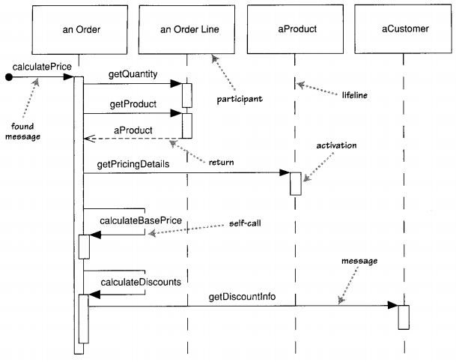
A sequence diagram for centralized control

Slide 30
A sequence diagram for centralized control
Sequence diagrams show the interaction by showing each participant with a lifeline that runs vertically down the page and the ordering of messages by reading down the page
You can see that an instance of order sends getQuantity and getProduct messages to the order line. You can also see how we show the order invoking a method an itself and how that method sends getDiscountInfo to an instance of customer .
Notes:
Participate: tham gia

Slide 31
A sequence diagram for centralized control
Most of the time, you can think of the participants in an interaction diagram as objects, as indeed they were in UML 1. But in UML 2, their roles are much more complicated
I use the term participants, a word that isn't used formally in the UML spec. In UML 1, participants were objects and so their names were underlined, but in UML 2, they should be shown without the underline, as I've done here
In these diagrams, I've named the participants using the style anOrder. This works well most of the time. A fuller Syntax is name : Class, where both the name and the class are optional

Slide 32
A sequence diagram for centralized control
Each lifeline has an activation bar that shows when the participant is active in the interaction. This corresponds to one of the participant's methods being on the stack. Activation bars are optional in UML, but I find them extremely valuable in clarifying the behavior
Naming often is useful to correlate participants an the diagram. The call getProduct is shown returning aProduct, which is the same name, and therefore the same participant.
Some people use returns for all calls, but I prefer to use them only where they add Information

Slide 33
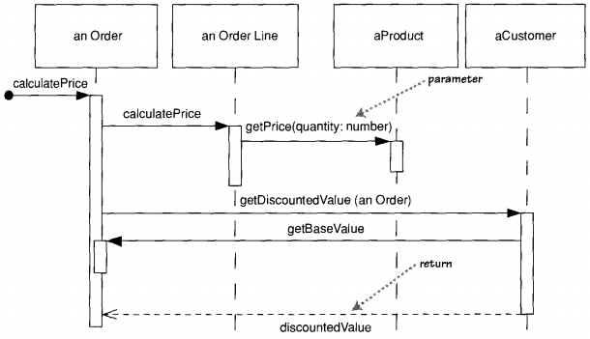
A sequence diagram for distributed control

Slide 34
Centralized vs distributed control
The clear difference in styles between the two interactions. Figure 4 .1 is centralized control, with one participant pretty much doing all the processing and other participants there to supply data. Figure 4 .2 uses distributed control, in which the processing is split among many participants, each one doing a little bit of the algorithm

Slide 35
Centralized vs distributed control
Both styles have their strengths and weaknesses .
Most people, particularly those new to objects, are more used to centralized control. In many ways, it‘s simpler, as all the processing is in one place
With distributed control, in contrast, you have the sensation^{[cảm-giác]} of chasing^{[chạy-theo]} around the objects, trying to find the program

Slide 36
Centralized vs distributed control
One of the main goals of good design is to localize the effects of change. Data and behavior that accesses that data often change together. So putting the data and the behavior that uses it together in one place is the first rule of object-oriented design.
By distributing control, you create more opportunities for using polymorphism rather than using conditional logic . If the algorithms for product pricing are different for different types of product, the distributed control mechanism allows us to use subclasses of product to handle these variations

Slide 37
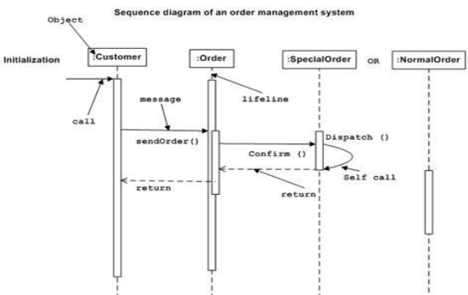
Sequence Diagrams – Another Example
Bài toán hệ thống quản lý đơn đặt hàng

Slide 38
When to Use Sequence Diagrams
You should use sequence diagrams when you want to look at the behavior of several objects within a single use case.
Sequence diagrams are good at showing collaborations among the objects; they are not so good at precise definition of the behavior.
If you want to look at the behavior of a single object across many use cases, use a state diagram
If you want to look at behavior across many use cases or many threads, consider an activity diagram

Slide 39
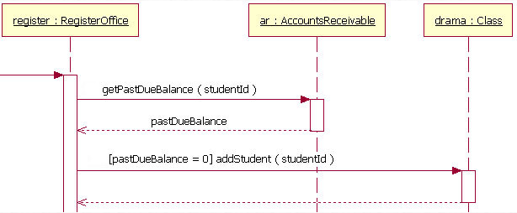
sequence diagram with conditions

