Slide 1


COVID- 19 in Viet Nam Data Visualization
Trần Thị Mai Hương
Trần Thị Huệ
Nguyễn Thế An
Bùi Tuấn Anh

Slide 2
Outline
Introduction
Purpose
Literature review
Data visualization
Algorithm
Dataset
Steps
Members’ role

Slide 3
Purpose
COVID-19 takes responsibility for more than 380.000 deaths in the world and the decline of the economy.
More serious than the disease is the shortage of information.
Not many inforgraphic built to inform Vietnamese people about how our nation working against this pandemic.
=> We decided to collect data and visualize data about Covid-19 in Vietnam.

Slide 4
Literature review
This data taken from the World Health Organization and was posted to the COVID-19 open site there are a lot of researchers wrote about COVID-19 visualization in the world:
World Health Organization (WHO), "Coronavirus disease 2019 (COVID-19) Situation Report - 35," WHO, 2020.
World Health Organization (WHO), "Statement on the second meeting of the International Health Regulations (2005) Emergency Committee regarding the outbreak of novel coronavirus (2019-nCov)," WHO, 2020.
World Health Organization, "Report of the WHO-China Joint Mission on Coronavirus Disease 2019 (COVID-19)," World Health Organization, 2020.
"Coronavirus Disease 2019 (COVID-19)," Centers for Disease Control and Prevention, 2020. [Online].
Available: https://www.cdc.gov/coronavirus/2019- ncov/about/symptoms.html. [Accessed 27 February 2020].
World Health Organization, "Coronavirus disease 2019 (COVID-19) Situation Report- 13," World Health Organization, 2020.
Based on below researches, our team start to study COVID-19 visualization in Vietnam using Python.

Slide 5

Data visualization
Data visualization is the graphical representation of information and data. By using visual elements like charts, graphs, and maps, data visualization tools provide an accessible way to see and understand trends, outliers, and patterns in data.
Use Python packages and libraries to analyze data and draw map, table, chart,..

Slide 6
Data sets
Collected by ourselves
_Sources:
+ Government pages
+ Ministry of Health
_ Contains 328 patients with infected date, gender, age, origin, current condition and status (including confirmed, recovered and death) columns.
Problem | Solution
Lack of data set | Build by ourselves
Missing data | Fill in
Problems

Slide 7
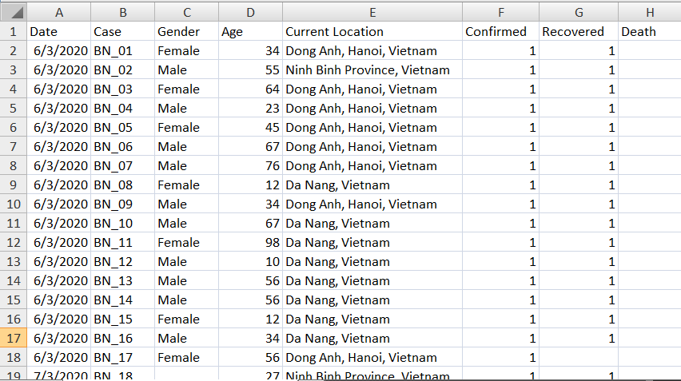
Demo

Slide 8
Method of research
Use these libraries and packages to process data and visualize
Visualize | Data processing
Folium | Numpy
Matplotlib | Pandas
Seaborn | Sklearn
 | Calmap
Best Case : animations
Use Matplotlib

Slide 9
MemberS’role
Work | Members
Collecting data & processing data | The whole team
Draw Viet Nam infection map and Hanoi infection map | Huong
Draw top 5 highest number of patients city graph | Hue
New cases everyday | An
Patient age clustering | Tuan Anh

Slide 10
Steps
Data preparation
1. Collect data and build data set.
2. Create new column “City” which represents states of patients from “Current Location” column.
-e.g: Ha Noi, Ho Chi Minh, Da Nang…
2. Choose columns to use.

Slide 11

Draw National infection map
1. Use folium to display Vietnam map and Hanoi Map
2. Get latitude and longtitude of each city
3. Draw circle in city which has a confirmed not yet recovered patient.
Draw Hanoi infection map
1. Use folium to display Hanoi map
2. Get latitude and longitude of each district
3. Draw circle in districts which has a confirmed not yet recovered patient.

Slide 12

to show the highest confirmed patients in 5 cities in Vietnam
From confirmed column, filtering to top 5 cities which own the highest number of confirmed patients.
Using numpy and matplotlib to draw chart.
Drawing a bar chart
to show the confirmed patients in Hanoi
From current location column, adding a new column to show district
( doing in data re-proccessing step).
2. Counting the sum of confirmed patients in each districts in Hanoi.
3. Using numpy and matplotlib to draw chart.

Slide 13
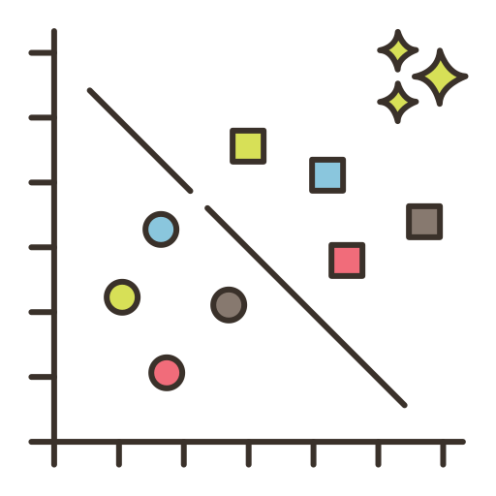
1. Using pandas.dataframe to calculate all new cases everyday
2. Drawing table to show the increase of disease after calculating all new cases
Draw new cases everyday table
1. From the datasets
2. Count sum of sample, feature and cluster
3. Use matplotlib to display clustering graph
Perform an interactive cluster shape
to show number of the confirmed patients’s age in Vietnam.

Slide 14


