Slide 1
Location for new coffee shop
Created by Tran Ngoc Tuyen

Slide 2
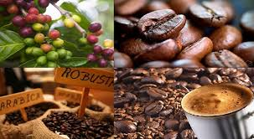
1. Introduction

Slide 3
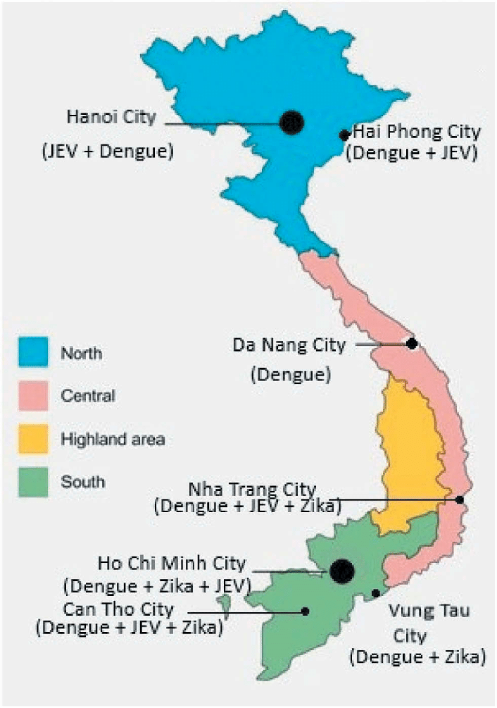
Open new coffee shop
Ha Noi
Da Nang
Ho Chi Minh

Slide 4
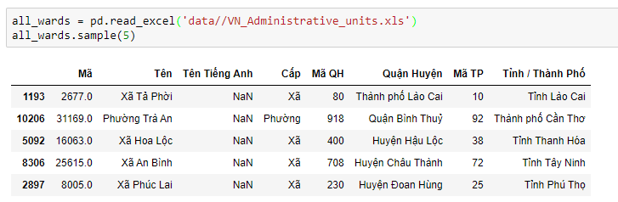
2. Data preparation

Slide 5
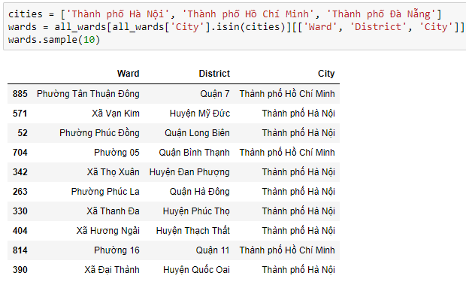
2. Data preparation

Slide 6
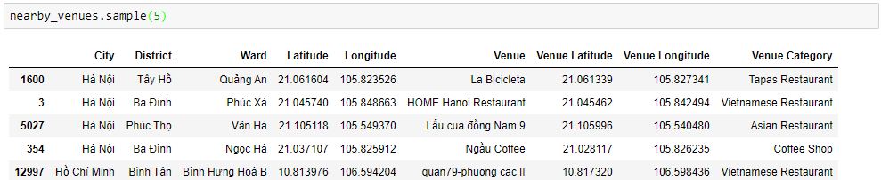
2. Data preparation
Data venues from Foursquare API

Slide 7
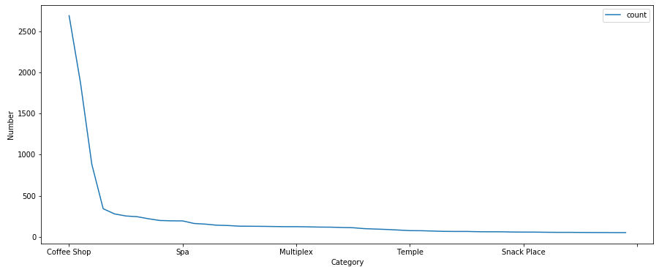
3. Data Exploratory

Slide 8
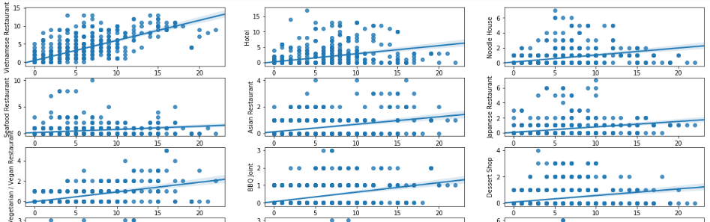
3. Data Exploratory

Slide 9
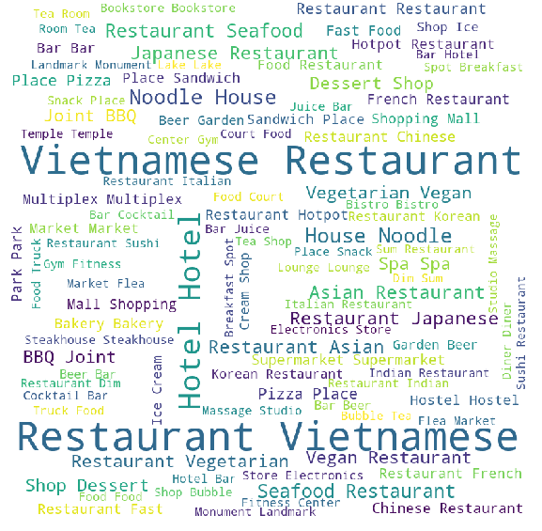
3. Data Exploratory
Categories impact

Slide 10
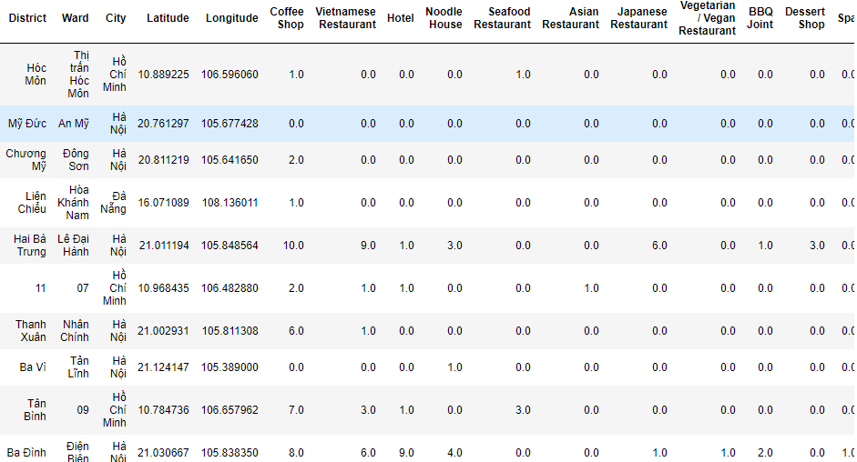
3. Data Exploratory

Slide 11
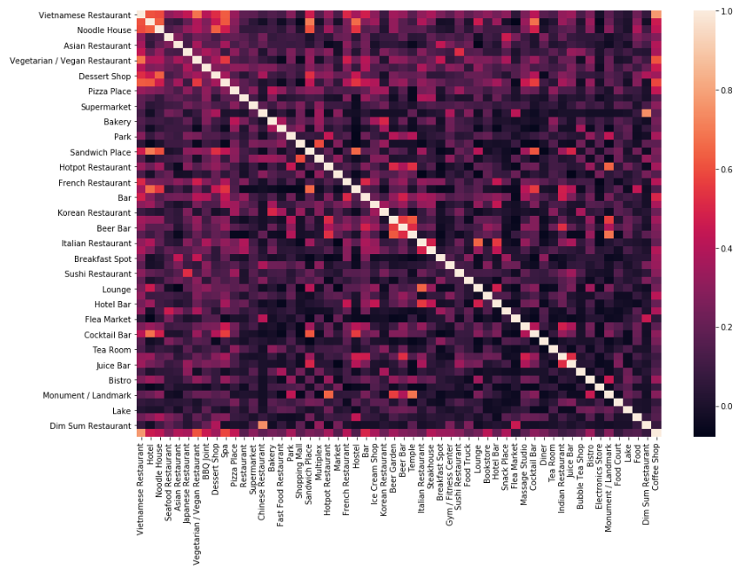
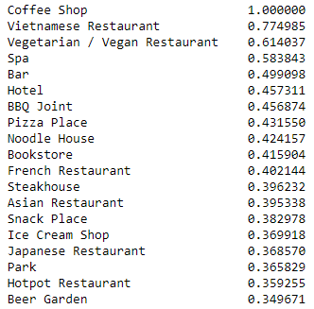
3. Data Exploratory

Slide 12
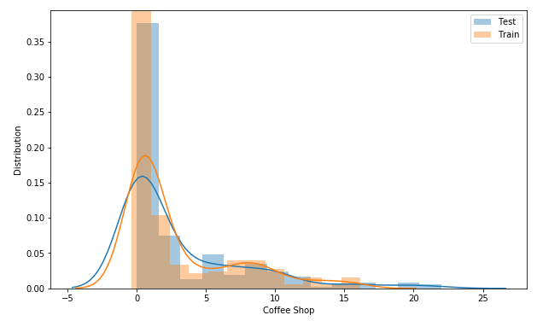
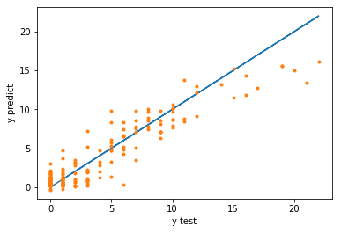
4. Predictive modeling
Linear Regression

Slide 13
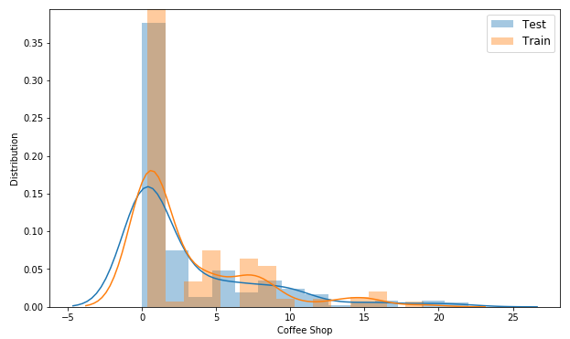
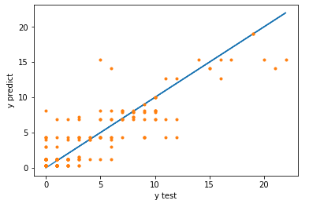
4. Predictive modeling
Decision Tree

Slide 14
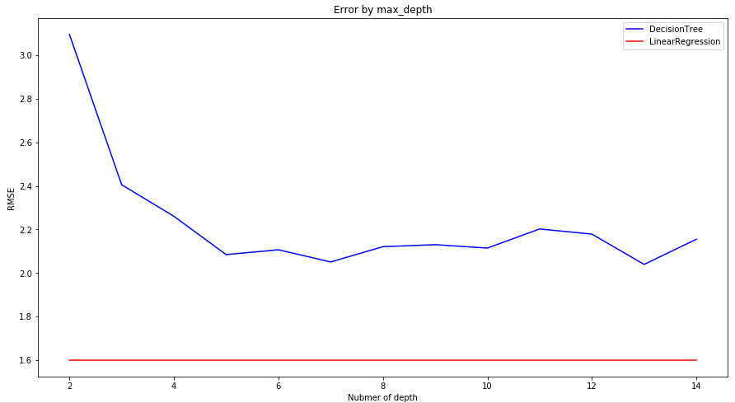
4. Predictive modeling

Slide 15
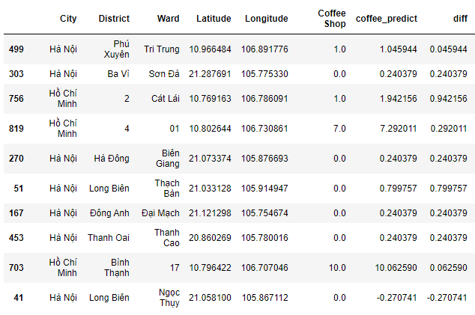
5. Location for new coffee shop

Slide 16
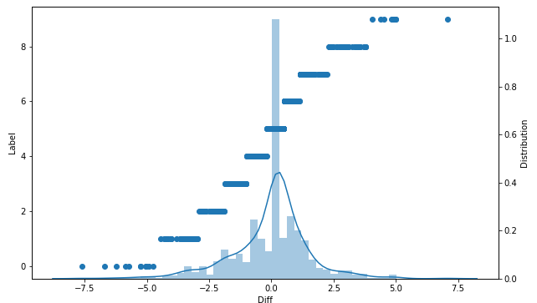
5. Location for new coffee shop

Slide 17
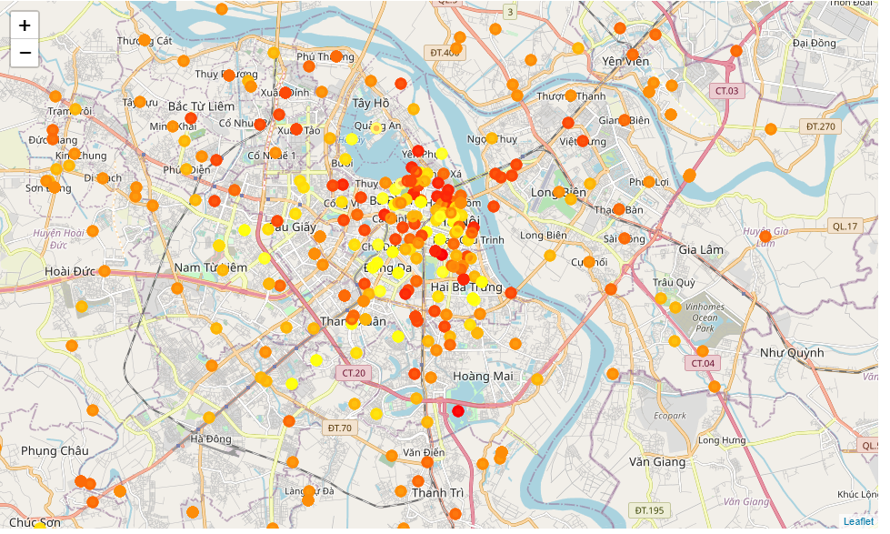
5. Location Ha Noi city

Slide 18
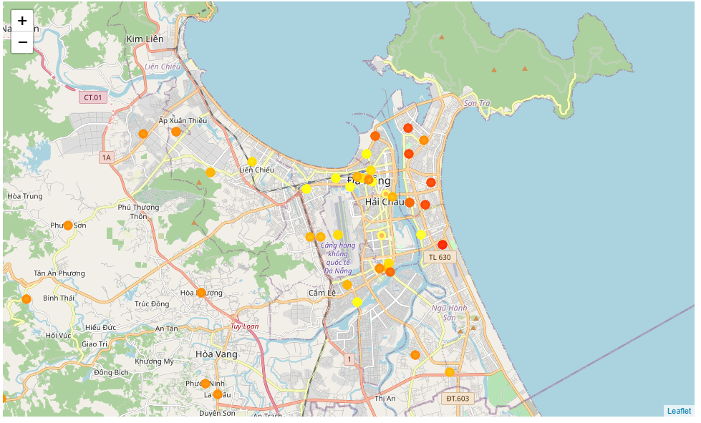
5. Location Da Nang city

Slide 19
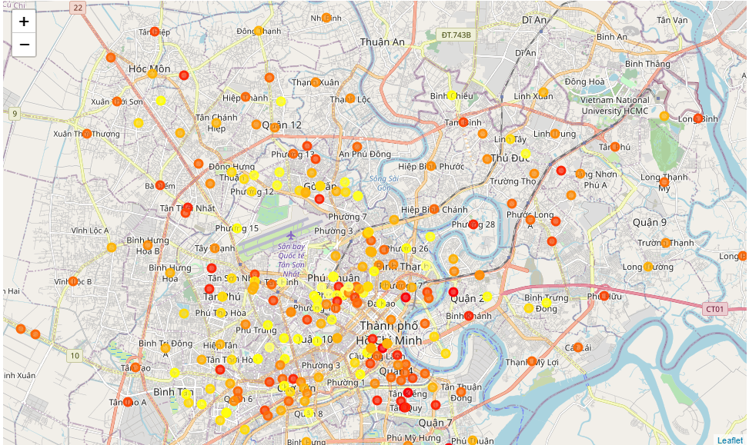
5. Location Ho Chi Minh city

Slide 20
6. Conclusions
In this project, I analyzed the relationship between number of coffee shops and number of other venues. Some category venues have strong impact to appearance of coffee shops or vice versa. They are Vietnamese Restaurant, Bar or Hotel venues. I built models and I optimized them to predict number of coffee shops a Ward should have. From this model, I estimated which area now is shortage of coffee shops and plot them in visualize maps. This information can be useful for the starter, who want to open new coffee shops or for the chain of coffee owners to expand /collapse their business.

Slide 21
7. Future directions
The scope of the study is only 3 cities in Vietnam, I will get more data from many cites over world. In part 2.2, I got venues of 754 / 946 wards, it does not mean that in left 192 wards do not have any venues, I think the problem come from wrong coordinates or unstable Foursquare API. I should find other venues provider to improve this. In the project, I used only 2 algorithm to create model, I think it can be better if I try others like SVM, Random Forest, Gradients Boots ,…
This may be an omission that I predict the shortage of coffee shops only on number of venues. I ignored other factors like the cuisine, the needs, or the living standards of the area. I the future, I will add these in the study and the predictive model would be significantly improved

Slide 22
Thank you

