Slide 1

Chuẩn bị cho buổi trình bày
Các bạn truy cập vào http://mnandnt.com
Đăng nhập bằng mã số sinh viên hoặc họ tên
Vào menu Sharing
Làm theo hướng dẫn để chuẩn bị môi trường thực hành trong buổi hội thảo hôm nay

Slide 2

Distributed lock using Redis
Ensure your business correctness
Notes:
Xin phep bat dau
Loi chao toi tat ca moi nguoi
Gioi thieu ban than, Senior dev o STS
Vinh du duoc thay P va phia FPT da moi minh to chuc buoi hoi thao nay
Fact la cuu sinh vien, ae o day deu la dong mon
Khong ton thoi gian, vao van de chinh cua ngay hom nay

Slide 3
Tables of content
Introduction
Distributed lock: Concepts
Distributed lock manager (DLM)
Redis and Distributed lock
RedLock algorithm
Conclusion
Q&A discussion
Notes:
Noi dung cua buoi hoi thao hom nay
Di tu gioi thieu, qua concept, cach hien thuc mot DLM dung Redis the nao
Red lock la gi, uu nhuoc diem va cach su dung
Thao luan, Q&A
Xuyen suot se co demo de chung ta de hinh dung, co nhung phan tro choi nho nhu hoi dap, tuong tac voi ung dung demo

Slide 4
Prerequisites
Requirements
Basic knowledge in programming
Basic knowledge in software communication mechanisms
Nice to have
Concepts about multi-thread and concurrency
Notes:
Co mot so yeu cau de chung ta co the nam bat tot noi dung
Khong bat buoc
Can ban lap trinh
Co che cac he thong rieng biet giao tiep voi nhau → de hieu noi dung hom nay hon
Tot hon neu biet khai niem multi thread, concurrency truoc do roi (dung winforms)

Slide 5
Contact
Author: Trung Tran
Email: trannamtrung1st@gmail.com
Notes:
Lien he minh thong qua email neu co thac mac, thao luan

Slide 6
1. Introduction
Notes:
Di vao phan 1, gioi thieu

Slide 7
1. Introduction
Software system nowadays
Multiple concurrent users
Multi-thread
Client-Server model
Microservices
Notes:
Noi chut ve boi canh phan mem hien nay
Khong con don gian nhu app win form mot nguoi dung mot may
Nhieu nguoi su dung, ca doanh nghiep, toan quoc, quoc te
Da luong
Client server va microservices cung dang la trend pho bien

Slide 8
1. Introduction
Concurrency problems
Booking system
Ensure that customers cannot book exceed the available tickets number
Football field management system
Ensure that only one customer can successfully book a field at a given time slot
Notes:
Nhung phan mem nay thuong co nhieu yeu cau dac biet, phuc tap
Mot trong so do la concurrency, bai toan xu li dong thoi
Vd he thong booking, dam bao khach ko book qua so ve con lai
He thong quan li dat san, dam bao trong 1 khung gio chi co 1 khach dat san thanh cong
Tuong chung de, nhung da ai thu test cho nhieu nguoi dung cung thuc hien thao tac cung mot luc va xem co loi gi xay ra hay khong chua??
—
Nhung truong hop nay thuong ko len ke hoach, xu li truoc thi rat de gay loi, vd dan den hai khach hang co the dat san cung mot khung gio
Cai van de cua bai toan dong thoi → van cho phep su dung dong thoi nhung phai dam bao tinh dung dan cua he thong

Slide 9
1. Introduction
Concurrency problems
Booking system
Ensure that customers cannot book exceed the available tickets number
Football field management system
Ensure that only one customer can successfully book a field at a given time slot → To be discussed
Notes:
Vay chung ta phai giai quyet bai toan nay the nao?
Se lay bai toan duoi lam topic hom nay
Co app demo, dung topic nay lam business domain de de hinh dung thuc te

Slide 10
1. Introduction
Demo application
Technical
Programming: Visual Studio, C# / .NET 3.1: https://dotnet.microsoft.com/en-us/download/dotnet/3.1
Softwares: Redis, SQL Server, Docker (optional)
Source code
Simple version: https://github.com/trannamtrung1st/SimpleDLock
Advanced: https://github.com/trannamtrung1st/DLock
Notes:
Minh co mot ung dung demo
Technical stack
Resource code de tren github

Slide 11
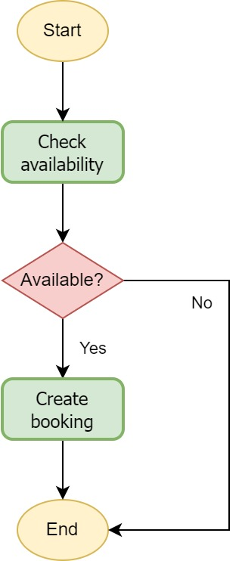
1. Introduction
Demo application
Field booking flow

Slide 12
2. Distributed lock: Concepts
Notes:
Chung ta se di qua cac khai niem ve topic hom nay

Slide 13
2. Distributed lock: Concepts
Resources
An entity that we should control the shared access to it.
Resources in a database system:
Database, table, record, field
Resources in an ordering application might be:
Orders, products, carts, etc
Notes:
Resource: nhung tai nguyen, du lieu ma chung ta can quan li access của cac ben toi no

Slide 14
2. Distributed lock: Concepts
Race condition
"A race condition or race hazard is the condition of an electronics, software, or other system where the system's substantive behavior is dependent on the sequence or timing of other uncontrollable events. It becomes a bug when one or more of the possible behaviors is undesirable"
Reference: https://en.wikipedia.org/wiki/Race_condition
Notes:
Dinh nghia nhu nay da noi

Slide 15
2. Distributed lock: Concepts
Race condition
Read-modify-write process
Process 1 | Process 2 | Memory value
Read |  | 0
 | Read | 0
Increase 1 |  | 1
 | Increase 1 | 1
Notes:
Se co vi du cu the hon
Expected 2, nhung do viec do du lieu cung luc => actual 1

Slide 16
2. Distributed lock: Concepts
What is a "lock"?
"In computer science, a lock or mutex (from mutual exclusion) is a synchronization primitive: a mechanism that enforces limits on access to a resource when there are many threads of execution."
Reference: https://en.wikipedia.org/wiki/Lock_(computer_science)
Notes:
Se dung lock de giai quyet
Vay lock la gi?

Slide 17
2. Distributed lock: Concepts
What is a "lock"?
Process 1 | Process 2 | Memory value
Lock read (acquired) |  | 0
 | Lock read (waiting)
Increase 1 |  | 1
Release lock
 | Lock read (acquired) | 1
 | Increase 1 | 2
 | Release lock
Notes:
Giai thich

Slide 18
2. Distributed lock: Concepts
Lock modes
Null (NL)
Concurrent Read (CR)
Concurrent Write (CW)
Protected Read (PR)
Protected Write (PW)
Exclusive (EX): a traditional exclusive lock, allow the client that acquired and is holding the lock to read/update resource while preventing the others to access it. → To be discussed
Notes:
Cac mode thong dung,
Mode exclusive la nghiem nhat do ko cho ai truy cap (Doc va Ghi)
Cac mode khac sẽ dễ hơn, mode protected write se cho phep multiple readers, 1 writers de danh nhung truong hop chi muon lock resource khi update, con doc thi van cho su dung để tang performance → nang cao

Slide 19
3. Distributed lock manager (DLM)
Notes:
Di sau hon vao component nay

Slide 20
3. Distributed lock manager (DLM)
Why distributed lock
Modern softwares requirements
Lock is shared in distributed environment
Ensure correctness between systems
Control shared access to many types of resources
Local lock cannot be shared
Notes:
[TODO] demo application, local lock but multiple servers
Phu hop voi phan mem hien dai
Lock shared trong moi truong phan tan
Co the dam bao tinh dung dan giua nhieu system
Quan li duoc shared access cua nhieu loai resource khac nhau
—
Local lock cannot be shared

Slide 21
3. Distributed lock manager (DLM)
Lock mechanism at a glance
4 basic steps here:
Wait for a lock
Acquire the lock
Access the resource
Release the lock
Notes:
Nhin chung lock gồm các step co ban nhu sau

Slide 22
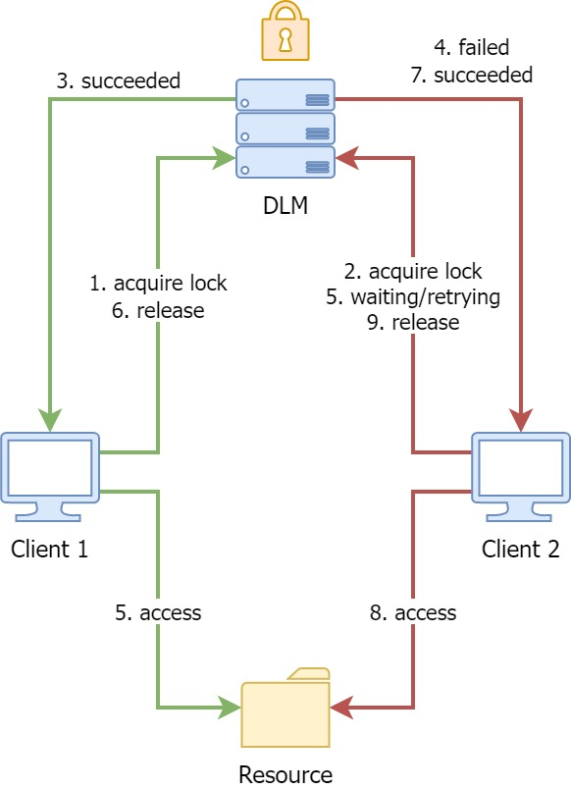
3. Distributed lock manager (DLM)
How DLM works
Client-Server model
Notes:
Day la so do mot DLM se work nhu the nao
Chung ta se co resource, 2 client cung muon truy cap
De dam bao tinh dung dan thi ca 2 phai request acquire lock cua DLM
Neu lock trao thanh cong cho ben nao thi ben do duoc quyen access truoc, ben con lai phai doi
Cho toi khi ben 1 nha lock ra thi ben 2 se thanh cong acquire lock va access resource
Do la tong quan cach 1 DLM hoat dong

Slide 23
4. Redis and Distributed lock
Notes:
Vay lam the nao de implement mot DLM, co nhieu cach
Su dung redis la mot cach nhanh, hieu qua va de su dung

Slide 24
4. Redis and Distributed lock
Introduction to Redis
"An open-source, in-memory data store used by millions of developers as a database, cache, streaming engine, and message broker" https://redis.io/
Notes:
Redis la mot in memory data store
Co the dung lam cache, db, streaming engine hay message broker

Slide 25
4. Redis and Distributed lock
Redis and Distributed lock
Redis can be used as a DLM and is also well-known for that.
Redis does not support built-in lock management mechanisms. However, various projects use Redis features for their distributed lock implementation.
Note: For the rest of this presentation, many concepts and discussions are referenced from the original documentation here: https://redis.io/docs/reference/patterns/distributed-locks/#implementations
Notes:
Chinh tac gia Redis cung da neu len Distributed lock la mot use case cua Redis
Redis ko ho tro quan li distributed lock mac dinh, nhung nhung gi redis cung cap co the khien no thanh mot DLM:
Performance cao
De su dung
Hieu qua tot

Slide 26
4. Redis and Distributed lock
Redis features & use cases
Features
In-memory data structures
Programmability, Extensibility
Clustering
High availability
Persistence
Use cases
Real-time data store
Caching & session storage
Streaming & messaging
Notes:
Mot so tinh nang va ung dung cua Redis

Slide 27
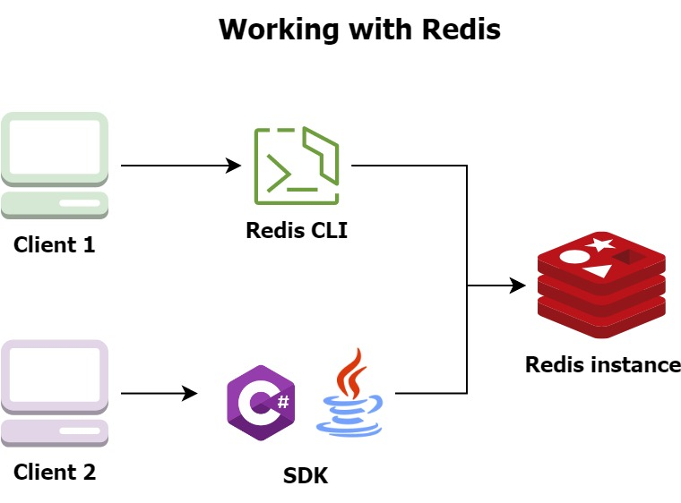
4. Redis and Distributed lock
Working with Redis
Install using Docker, packages or port project (Windows): https://github.com/tporadowski/redis/releases
Using Redis CLI
Using Client SDKs
Notes:
[TODO] diagram: CLI, SDK, Redis instances
Demo application, basic operations using Redis
Dung Redis thong qa CLI, hoac SDK client
Theo mo hinh client-server, Redis co the la mot instance hoac nhieu instance tren nhieu may khac nhau

Slide 28
4. Redis and Distributed lock
Characteristics of a good locking algorithm
From Redis’ point of view, there are three properties that must be at least satisfied to guarantee we used distributed locks effectively.
Safety property: Mutual exclusion
Liveness property A: Deadlock free
Liveness property B: Fault tolerance
For more details: https://redis.io/docs/manual/patterns/distributed-locks/#safety-and-liveness-guarantees
Notes:
Safety property: Mutual exclusion
Liveness property A: Deadlock free, which means eventually, a lock is always available for acquisition, even if it is not released explicitly by the client (due to crashing or partitioning).
Liveness property B: Fault tolerance. Clients can acquire and release the locks as long as major DLM instances are up and running.

Slide 29
4. Redis and Distributed lock
Deadlock
"In concurrent computing, deadlock is any situation in which no member of some group of entities can proceed because each waits for another member, including itself, to take action, such as sending a message or, more commonly, releasing a lock."
Reference: https://en.wikipedia.org/wiki/Deadlock
Notes:
Deadlock la truong hop cac ben cho doi, phu thuoc lan nhau de co the tiep tuc
Vd 2 dua di an, dua nay doi dua kia bao thi moi di => ko đi duoc luon =))

Slide 30
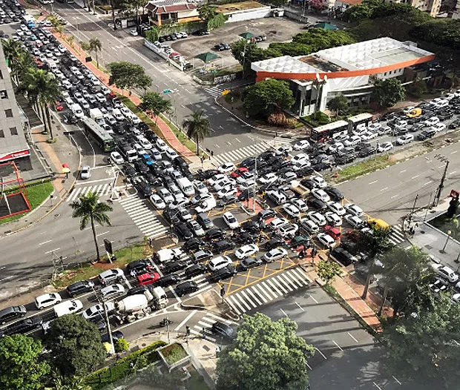
4. Redis and Distributed lock
Deadlock
Notes:
Trong thuc te giao thong

Slide 31
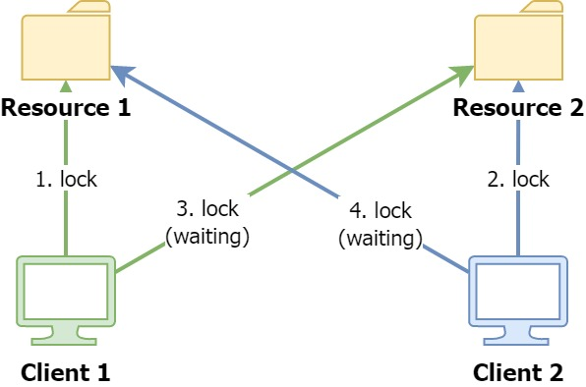
4. Redis and Distributed lock
Deadlock
Notes:
Trong phan mem, client 1 lock resource 1 va doi resource 2, client 2 nguoc lai => ko client nao co the di tiep

Slide 32
4. Redis and Distributed lock
Using a single Redis instance as a DLM
To acquire the lock, execute the following command:
SET resource_name a_random_value NX PX 10000
NX: set the key only if it does not already exist → mutex lock
PX: expiration time (TTL) of 10000 milliseconds → avoid deadlock
a_random_value: unique value across all clients and all lock requests. → Release the lock in a safe way: if current lock has similar value when acquiring that lock, we can avoid releasing the lock acquired by other clients.
Notes:
Truoc do chung ta da xem so cach su dung Redis
Bay gio chung ta se di vao phan code mot chut de xem co the ung dung Redis nhu nao
De tao ra mot lock cho client, dung cau lenh tren

Slide 33
4. Redis and Distributed lock
Using a single Redis instance as a DLM
See the following Lua script for releasing a lock:
if redis.call("get",KEYS[1]) == ARGV[1] then
return redis.call("del",KEYS[1])
else
return 0
end
Now, we already have two core operations: acquiring and releasing locks. It’s our responsibility to implement the complete DLM to support blocking, retrying acquiring locks, lock requests queue, etc.
Notes:
De release lock, execute đoạn script sau.
Redis se execute doan script nhu la mot command, ko command nao khac co the execute trong luc script thuc thi
Chung ta da co 2 operation quan trong, cac chuc nang con lai phai duoc tu implement

Slide 34
4. Redis and Distributed lock
Using a single Redis instance as a DLM
Pros
Simple
High performance
Easy to manage
Cons
Lack of Liveness guarantee
Single point of failure
Require additional implementation
Notes:
Loi va hai

Slide 35
5. RedLock algorithm
Notes:
Voi nhung bat loi cua viec su dung 1 instance Redis, nguoi ta da nghi ra giai thuat RedLock de khac phuc

Slide 36
5. RedLock algorithm
Algorithm
To remove single point of failure, assume we have N DLM masters (which are Redis master nodes in our case).
Those masters nodes are totally independent, no replication or coordination system is used
Notes:
De loai bo single point of failure, gia su chung ta co N Redis master
Cac redis master nay doc lap khong co lien he voi nhau

Slide 37
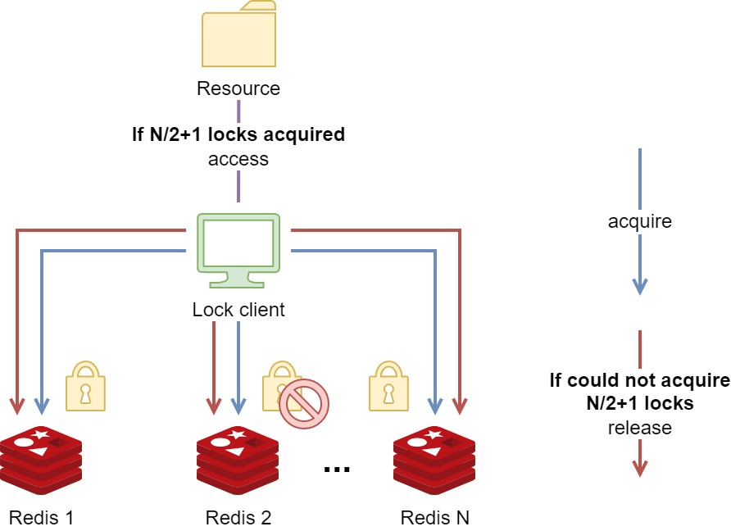
5. RedLock algorithm
Algorithm
More details in: https://redis.io/docs/manual/patterns/distributed-locks/#the-redlock-algorithm
Notes:
Day la so do overview thuat toan Red lock
Truoc khi client access resource, no se co gang lien lac toi N redis master,
Su dung cach da lam voi 1 redis instance, lap lai N lan
Neu client thanh cong lay duoc N/2+1 (major, da so) locks, no se access vao resource, cuoi cung se release tat ca lock
Cac client khac cung truy cap ko lay duoc, se tu dong release het tat ca cac lock ma no da co thu ve o tat ca cac instances (vi co the luc no lay duoc thi valid time da het)

Slide 38
5. RedLock algorithm
RedLock using Redis
Various open source projects for different programming languages: https://redis.io/docs/manual/patterns/distributed-locks/#implementations
See the DEMO
Notes:
[TODO] demo application
Co rat nhieu project open source implement RedLock su dung Redis

Slide 39
5. RedLock algorithm
Discussion on RedLock
Pros
Satisfy Liveness guarantee
Many existing implementations
Simple integration
Cons
There are still discussions around it
Not every project implements lock request queue, clients that come later can acquire locks faster than early-waiting clients.
Notes:
Loi va hai
Co 3 client, client 1 acquire lock, xong toi client 2 doi truoc, sau do la client 3. Se co truong hop client 3 acquire duoc lock truoc client 2 sau khi client 1 release lock, do hien tai co che cua project la retry chu ko phai la lock request queue

Slide 40
5. RedLock algorithm
Discussion on RedLock
Redis is fine for a reliable distributed lock manager.
However, if consistency and correctness are important factors in your system, you should review and plan the following points carefully:
Using fencing tokens
Redis is not using a single clock for the expiration mechanism. A wall-clock shift may result in multiple clients can acquire a single lock
Consider using a single instance approach
Use the heartbeat pattern to extend the lock TTL
More details in: https://redis.io/docs/reference/patterns/distributed-locks/#disclaimer-about-consistency
Notes:
Redis co the dung de dang va hieu qua nhu mot DLM
Tuy nhien, van co vai han che o mot so truong hop hi huu
Nen can phai chu y them neu tinh dung dan la mot yeu to quan trong
Fencing tokens
Redis dua vao thoi gian, neu lech time giua cac server/ client se de gay loi
Neu ko co nhieu yeu cau, single instance se don gian va de su dung, quan li hon nhieu
Dung heartbeat pattern de extend lock TTL neu process chay qa lau

Slide 41
6. Conclusion
Notes:
Truoc khi chung ta den voi phan hoi dap, hay cung xem demo

Slide 42
6. Conclusion
Demonstration

Slide 43
6. Conclusion
Some good practices
Use other lock modes for better performance in some cases: Readers-writers, etc.
Avoid blocking user interactions
Use async communication instead to avoid long waiting time
Use database mechanism if possible
Should plan for concurrency problems early
Notes:
Sau day la mot so good practices khi ap dung lock va distributed lock

Slide 44
7. Q&A discussion

Slide 45
References
Implement Distributed Lock For a Microservices Software System | Careers Saigon Technology
Race condition: https://en.wikipedia.org/wiki/Race_condition
Distributed lock manager: https://en.wikipedia.org/wiki/Distributed_lock_manager
Distributed lock manager by Oracle: https://docs.oracle.com/cd/A57673_01/DOC/server/doc/SPS73/chap8.htm

Slide 46
References
Distributed lock with Redis: https://redis.io/docs/reference/patterns/distributed-locks/
Analysis of RedLock with Redis: https://martin.kleppmann.com/2016/02/08/how-to-do-distributed-locking.html
Deadlock: https://en.wikipedia.org/wiki/Deadlock

Slide 47
THE END
Thank you for your attention

