Slide 1
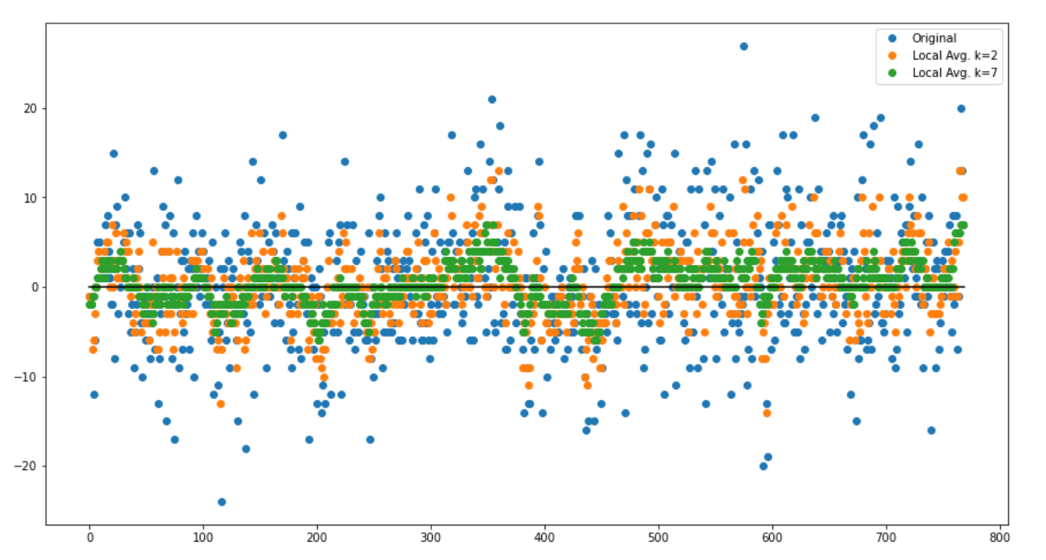
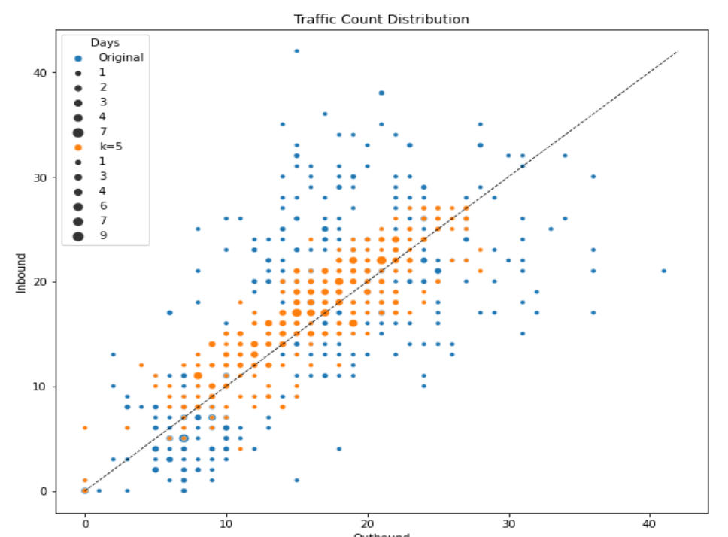
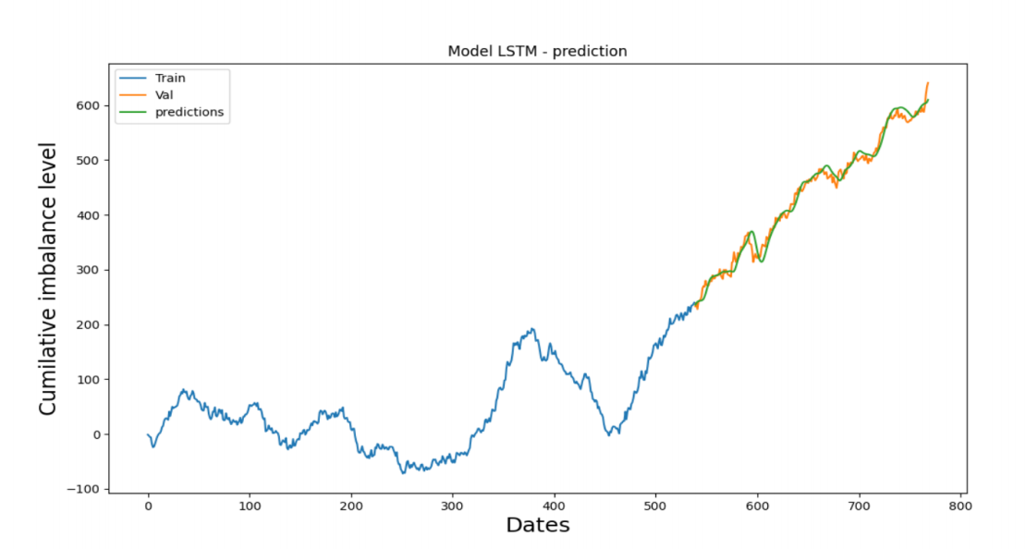
NEXUS CHALLENGE 2021 ADDRESSING NETWORK IMBALANCES REPORT
Qi Wen, Jason Tran, Daniel Mai Department of Computer Science University of Manitoba, Winnipeg, Canada
2. Optimization algorithm (k-local algorithm)
We propose a method to improve the balance level of the current schedule. The idea being, “given a number k, the algorithm will go through every group of k consecutive days in the schedule and try to even out the imbalances of each and every day”, hence the name k-local greedy algorithm.
Optimization:
3. Evaluation and Visualization
We separate 768 days of records to 70% of training (538 days) and 30% of testing (230 days)
We define three main cases/trends for cumulative imbalance level (CIL): big growth, big reduction, stable
The goal of the prediction is whether we can detect all the cases/trends accurately. Our prediction accuracy is roughly 96% when N = 10, 82% when N= 5.
Introduction
The challenge offered by Bison Transport Company is about how we balance the inbound and outbound of current days and predict what would be the inbound and outbound freights for the future.
In response, we design a novel optimization algorithm--called k-local greedy algorithm--to minimize the daily/weekly imbalance based on the prediction output.
Our goal of this project is to predict the future traffic trend of a certain region (e.g., Quebec) in terms of inbound freight and outbound freight.
Prediction:
Methodology
1 . Prediction model
We apply the LSTM model to predict the cumulative imbalance level of the future N numbers of days.
Parameters used in the model:
Observation of the sample: 60
Sequential() method to build model
Dropout 0.2 regularisation
Epochs: 50 – 100
-
Conclusions(answer and future work)

