Slide 1



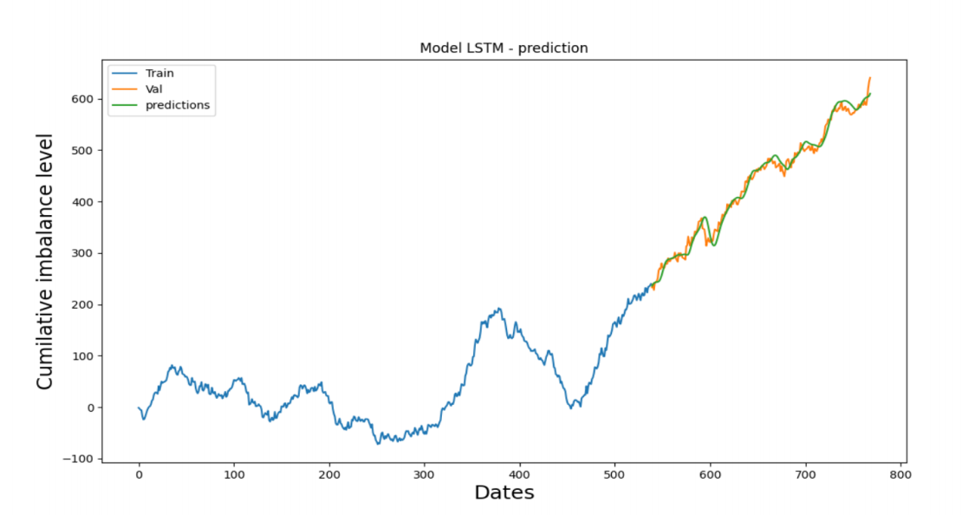
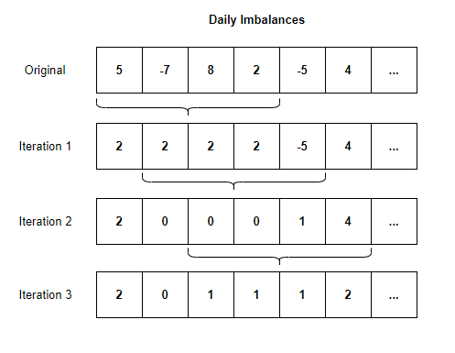
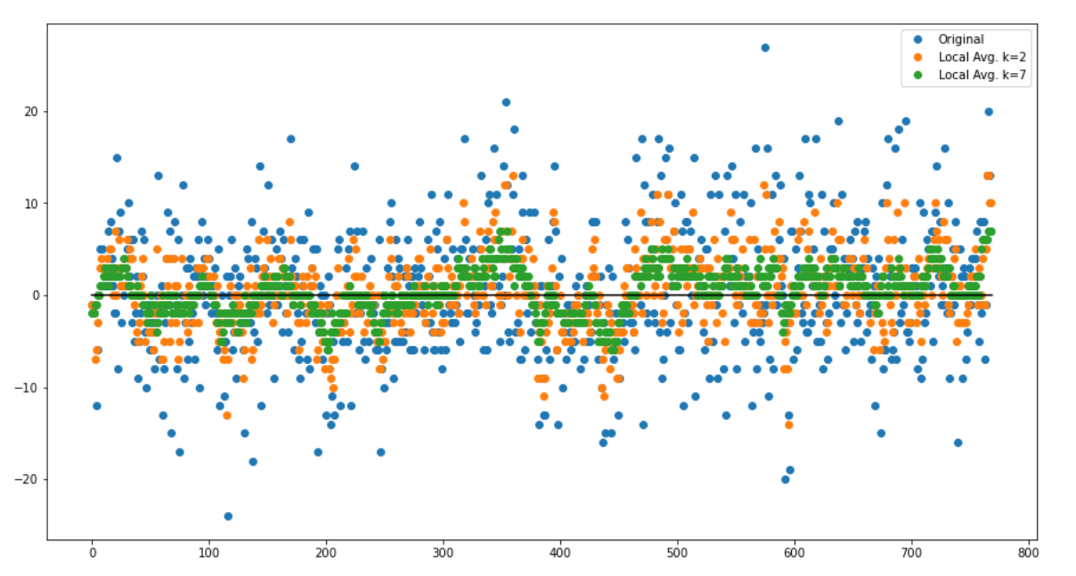
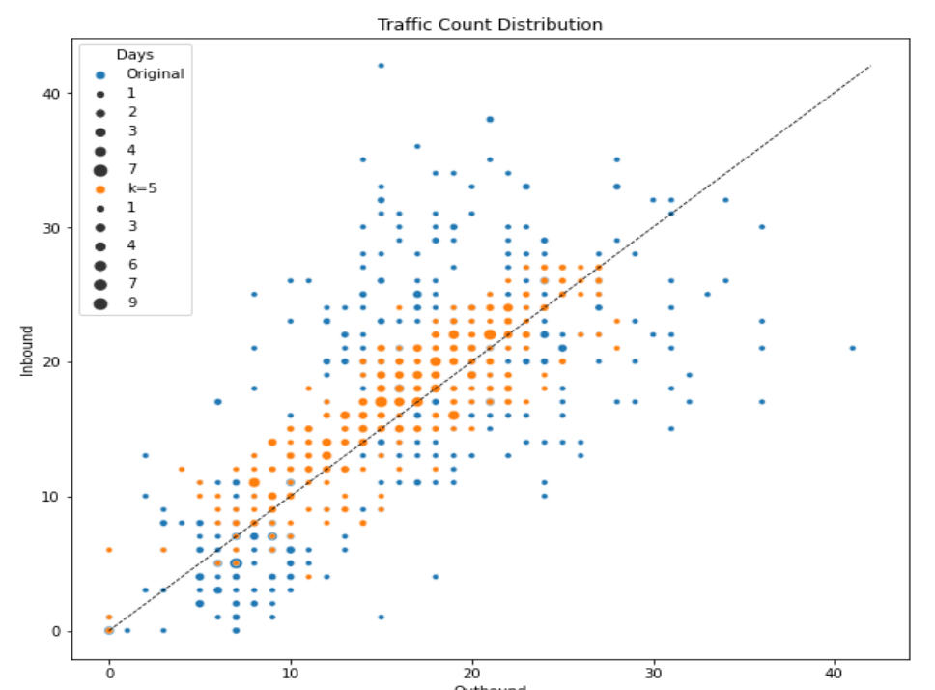
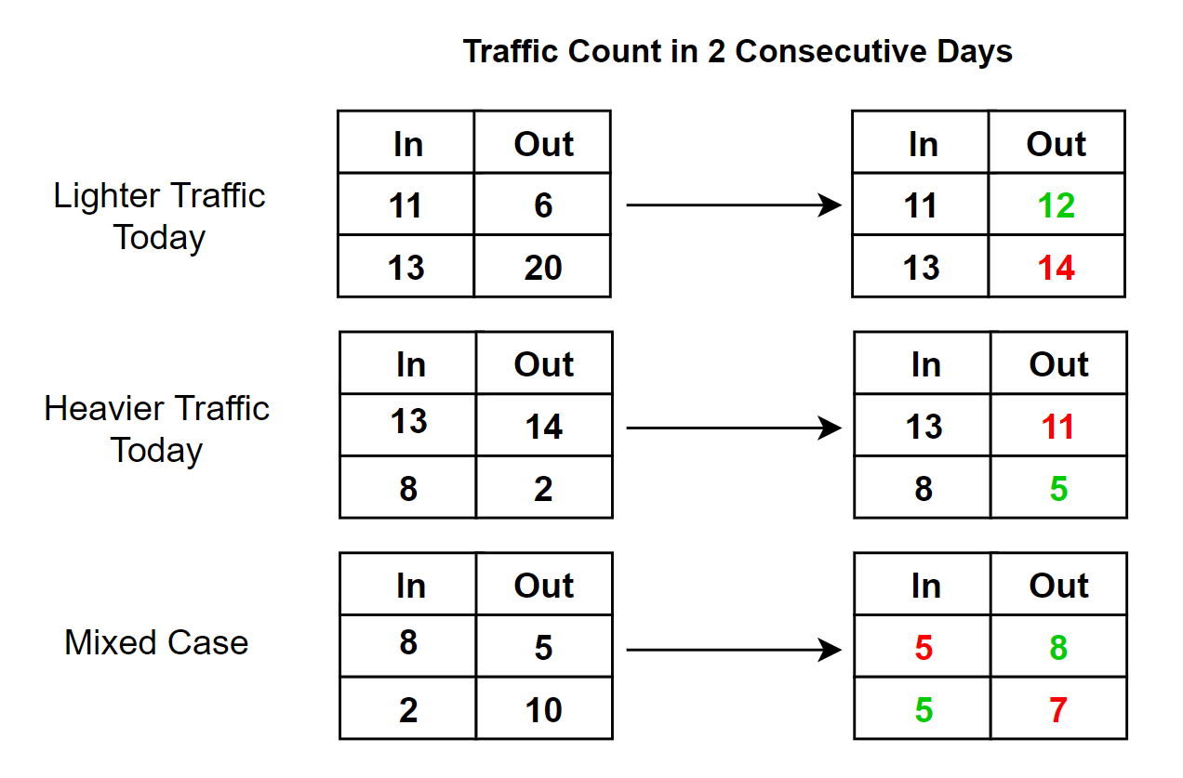
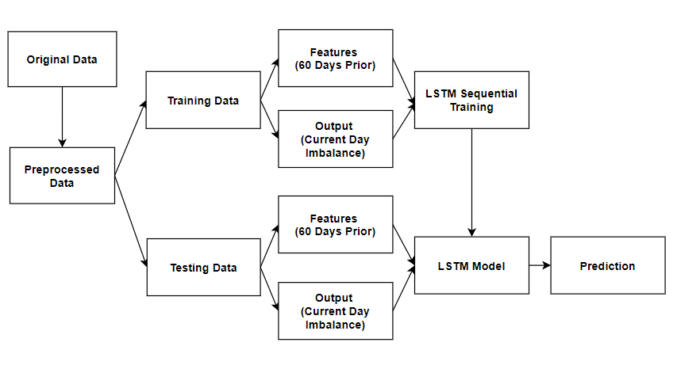
ADDRESSING NETWORK IMBALANCES REPORT
Qi Wen, Jason Tran, Daniel Mai
Department of Computer Science University of Manitoba, Winnipeg, Canada
Introduction
The challenge offered by Bison Transport Company is about how we balance the inbound and outbound of current days and predict what would be the inbound and outbound freights for the future.
In response, we created a Long Short-Term Memory (LSTM) model to predict the future traffic trend of a certain region (e.g., Quebec) in terms of inbound freight and outbound freight.
We also designed a novel optimization algorithm--called k-local greedy algorithm--to minimize the daily/weekly imbalance based on the prediction output.
2. Optimization:
To improve the imbalance level of a given schedule, we propose a greedy algorithm: “given a number k, go through every group of k consecutive days and try to even out the imbalances in each of the k days.”
Evaluation and Visualization
1. LSTM Model
We separate the records to 70% training (538 days) and 30% testing (230 days)
Our goal: verify that the algorithm can detect 3 important trends (big growth, big reduction, stable) accurately, using a margin of error N.
Result: Our prediction accuracy is ~96% when N = ±10, ~82% when N= ± 5.
2. K local greedy Algorithm
We use standard deviation as a metric for the imbalance and found that the original dataset’s standard deviation reduce from 7.2039 to 2.4310 when k=7.
We also observe that the new inbound - outbound traffic pairs (orange) are closer to the balance line and form a cohesive cluster, signaling fewer extreme variations than the original data set (blue).
Methodology
We define imbalance level as:
Imbalance level = No. Inbound – No. Outbound (Trailers)
1. Prediction:
We apply the LSTM model to predict the cumulative imbalance level of the future .
We use the prior 60 days as the feature for predicting the output of a specific day.
We balance any given day by exchanging inbound/outbound orders with the next day, in such a way that it reduces the load of the day with heavier traffic.
Future Work
Proving our k local greedy algorithm is near-optimal
Integrate the 2 methods used to develop a comprehensive solution to the imbalance problem
Conclusions
Our LSTM prediction model was able to predict the important future trends in cumulative imbalance level
Our k-local greedy algorithm could improve the daily imbalance level of a given schedule

