Slide 1
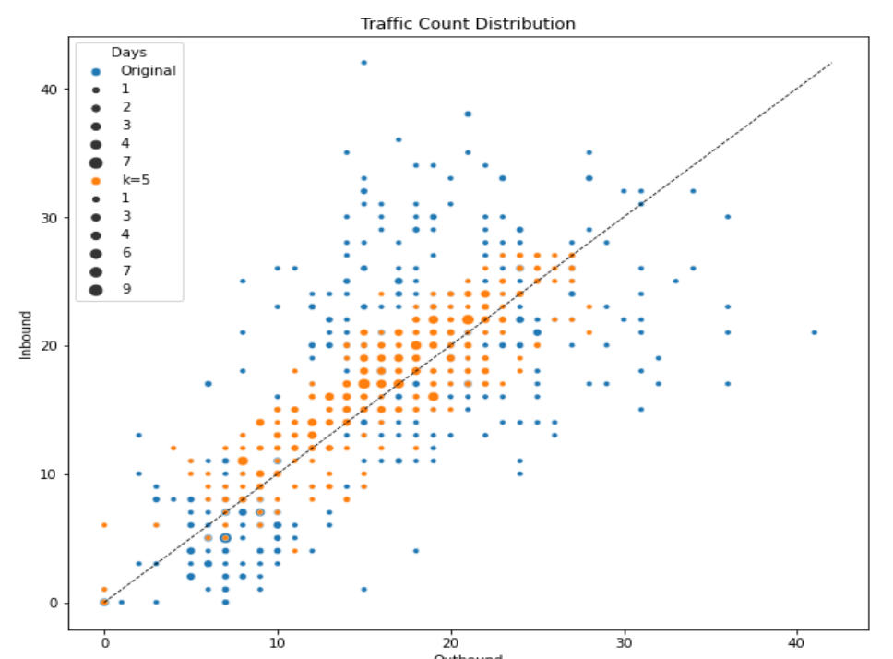
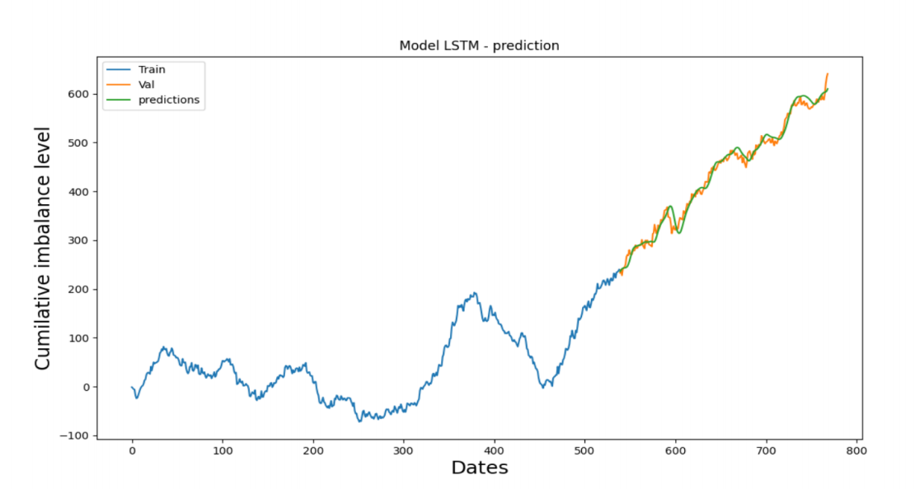
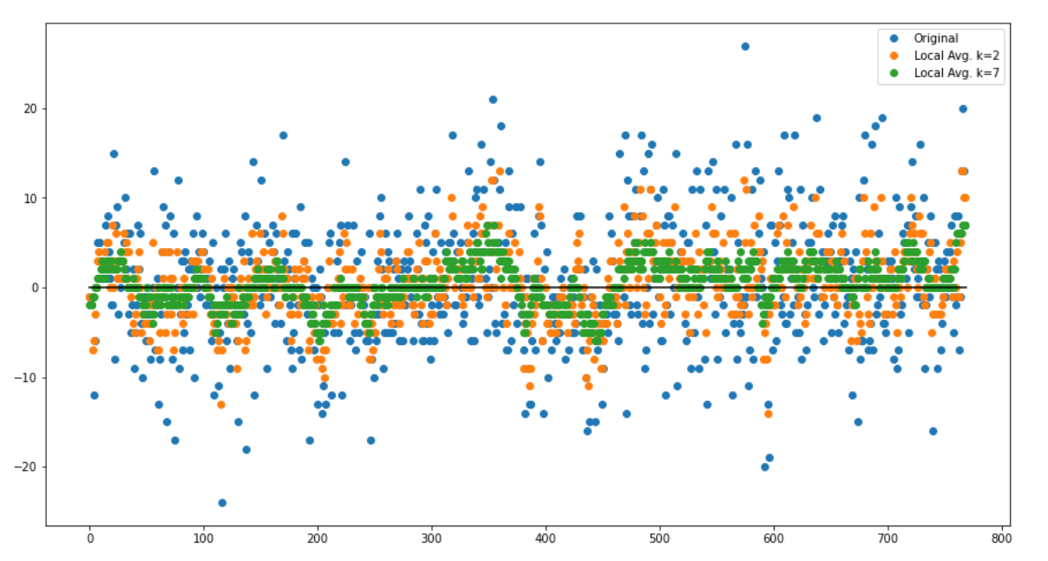
NEXUS CHALLENGE 2021 ADDRESSING NETWORK IMBALANCES REPORT Qi Wen, Jason Tran, Daniel Mai Department of Computer Science University of Manitoba Winnipeg, Canada
Result
We propose a method to improve the balance level of the current schedule. The idea being, “given a number k, the algorithm will go through every group of k consecutive days in the schedule and try to even out the imbalances of each and every day”, hence the name k-local greedy algorithm. In detail, as we go through each day in the original schedule, we will look ahead at the next k-days forecast and then re-tune the inbound and outbound schedule so that we achieve the k-days average balance level for our current day and then iteratively to all the other days in k-days group. To achieve the desired balance level for any particular day, say May 1st, we will be looking to move certain inbound or outbound orders between itself and the very next day (within 24 hours)
2. Optimization algorithm
We propose a method to improve the balance level of the current schedule. The idea being, “given a number k, the algorithm will go through every group of k consecutive days in the schedule and try to even out the imbalances of each and every day”, hence the name k-local greedy algorithm. In detail, as we go through each day in the original schedule, we will look ahead at the next k-days forecast and then re-tune the inbound and outbound schedule so that we achieve the k-days average balance level for our current day and then iteratively to all the other days in k-days group. To achieve the desired balance level for any particular day, say May 1st, we will be looking to move certain inbound or outbound orders between itself and the very next day (within 24 hours)
Introduction
In response, we design a novel optimization algorithm--called k-local greedy algorithm--to minimize the daily/weekly imbalance based on the prediction output.
Our goal of this project is to predict the future traffic trend of a certain region (e.g. Quebec) in terms of inbound freight and outbound freight.
The challenge offered by Bison Transport Company is about how we balance the inbound and outbound of current days and predict what would be the inbound and outbound freights for the future.
III. Conclusions
Conclusion1
Conclusion 2
Conclusion 3
III. Conclusions
Conclusion1
Conclusion 2
Conclusion 3
II. Methodology
1 . Prediction model
- We apply the LSTM model for the time series forecasting, i.e., predict the future trend of the traffic. In particular, we predict the cumulative imbalance level of the future N numbers of days. Parameters used in the model: - Observation of the sample: 60 - Sequential() method to build model - Dropout 0.2 regularisation - Epochs: 50 – 100 In general, our prediction accuracy is around 90% (as explained in Section 4) depending on how the users define the fluctuation range (N). After obtaining the predicted trend, we apply a k-local greedy algorithm to balance the inbound and outbound for each day.
III. Conclusions
Conclusion1
Conclusion 2
Conclusion 3

