Slide 1
SOFTWARE TESTING
Applied Software Project Management

Slide 2
QUALITY
Quality means “conformance to requirements”
  The best testers can only catch defects that are contrary to specification.
  Testing does not make the software perfect.
  If an organization does not have good requirements engineering practices then it will be very hard to deliver software that fills the users’ needs, because the product team does not really know what those needs are.

Slide 3
TEST PLANS
The goal of test planning is to establish the list of tasks which, if performed, will identify all of the requirements that have not been met in the software. The main work product is the test plan.
  The test plan documents the overall approach to the test. In many ways, the test plan serves as a summary of the test activities that will be performed.
  It shows how the tests will be organized, and outlines all of the testers’ needs which must be met in order to properly carry out the test.
  The test plan should be inspected by members of the engineering team and senior managers.

Slide 4
TEST PLAN OUTLINE
Purpose
  A description of the purpose of the application under test.
Features to be tested
  A list of the features in the software that will be tested. It is a catalog of all of the test cases (including a test case number and title) that will be conducted, as well as all of the base states.
Features not to be tested
  A list of any areas of the software that will be excluded from the test, as well as any test cases that were written but will not be run.
Approach
  A description of the strategies that will be used to perform the test.
Suspension criteria and resumption requirements
  Suspension criteria are the conditions that, if satisfied, require that the test be halted. Resumption requirements are the conditions that are required in order to restart a suspended test.

Slide 5
TEST PLAN OUTLINE
Environmental Needs
  A complete description of the test environment or environments. This should include a description of hardware, networking, databases, software, operating systems, and any other attribute of the environment that could affect the test.
Schedule
  An estimated schedule for performing the test. This should include milestones with specific dates.
Acceptance criteria
  Any objective quality standards that the software must meet, in order to be considered ready for release. This may include things like stakeholder sign-off and consensus, requirements that the software must have been tested under certain environments, minimum defect counts at various priority and severity levels, minimum test coverage numbers, etc.
Roles and responsibilities
  A list of the specific roles that will be required for people in the organization, in order to carry out the test. This list can indicate specific people who will be testing the software and what they are responsible for.

Slide 6
TEST CASES
A test case is a description of a specific interaction that a tester will have in order to test a single behavior of the software. Test cases are very similar to use cases, in that they are step-by-step narratives which define a specific interaction between the user and the software.
  A typical test case is laid out in a table, and includes:
    A unique name and number
    A requirement which this test case is exercising
    Preconditions which describe the state of the software before the test case (which is often a previous test case that must always be run before the current test case)
    Steps that describe the specific steps which make up the interaction
    Expected Results which describe the expected state of the software after the test case is executed
Test cases must be repeatable.
  Good test cases are data-specific, and describe each interaction necessary to repeat the test exactly.

Slide 7
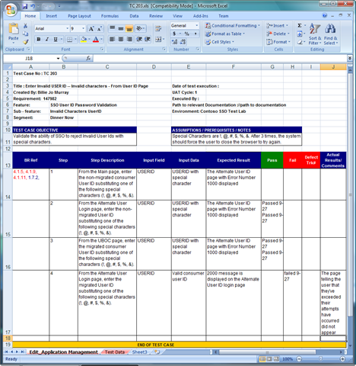

Slide 8
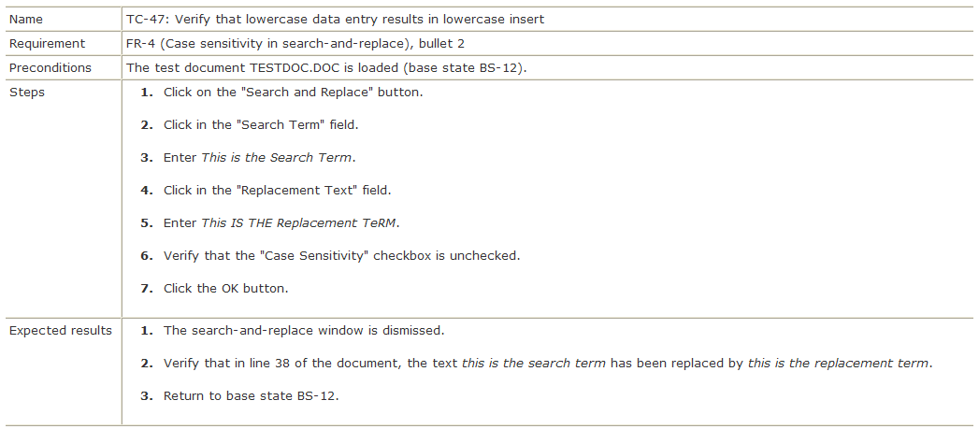

Slide 9
TEST EXECUTION
The software testers begin executing the test plan after the programmers deliver the alpha build, or a build that they feel is feature complete.
  The alpha should be of high quality—the programmers should feel that it is ready for release, and as good as they can get it.
There are typically several iterations of test execution.
  The first iteration focuses on new functionality that has been added since the last round of testing.
  A regression test is a test designed to make sure that a change to one area of the software has not caused any other part of the software which had previously passed its tests to stop working.
  Regression testing usually involves executing all test cases which have previously been executed.
  There are typically at least two regression tests for any software project.

Slide 10
DEFECT TRACKING
The defect tracking system is a program that testers use to record and track defects. It routes each defect between testers, developers, the project manager and others, following a workflow designed to ensure that the defect is verified and repaired.
  Every defect encountered in the test run is recorded and entered into a defect tracking system so that it can be prioritized.
  The defect workflow should track the interaction between the testers who find the defect and the programmers who fix it. It should ensure that every defect can be properly prioritized and reviewed by all of the stakeholders to determine whether or not it should be repaired. This process of review and prioritization referred to as triage.

Slide 11
SMOKE TESTS
A smoke test is a subset of the test cases that is typically representative of the overall test plan.
  Smoke tests are good for verifying proper deployment or other non invasive changes.
  They are also useful for verifying a build is ready to send to test.
  Smoke tests are not substitute for actual functional testing.

Slide 12
TEST AUTOMATION
Test automation is a practice in which testers employ a software tool to reduce or eliminate repetitive tasks.
  Testers either write scripts or use record-and-playback to capture user interactions with the software being tested.
  This can save the testers a lot of time if many iterations of testing will be required.
  It costs a lot to develop and maintain automated test suites, so it is generally not worth developing them for tests that will executed only a few times.

Slide 13
POSTMORTEM REPORTS
The postmortem report is an overall account of the team’s experience in building the software, and of the experience of the users and stakeholders in working with the team.
  The report should contain an honest assessment of how the team members, users, and stakeholders perceived the end product, and assessed the decisions made throughout the project.
  The purpose of the post-mortem report is to highlight the team’s successes and identify any problems which should be fixed in future releases.

