Slide 1
Lesson 3: Estimation ước lượng
Applied Software Project Management

Slide 2
Review
Stakeholder(liên quan tới dịch vụ, thiết kế)
Project manager
team of software engineers
  Business analysts or requirements analysts
  Designers and architects
  Programmers
  Testers

Slide 3
Vision and Scope Document( PHẠM VI VÀ HÌNH DUNG BAN ĐẦU)
  Problem Statement
    Project background
    Stakeholders
    Users
    Risks
    Assumptions
  Vision of the Solution
    Vision statement
    List of features
    Scope of phased release (optional)
    Features that will not be developed

Slide 4
What is estimation?
The project manager must set expectations about the time required to complete the software among the stakeholders, the team, and the organization’s management.
If those expectations are not realistic from the beginning of the project, the stakeholders will not trust the team or the project manager.

Slide 5
Elements of a Sound Estimate(bảng cấu trúc công việc)
To generate a sound estimate, a project manager must have:
  A work breakdown structure (WBS), or a list of tasks which, if completed, will produce the final product
  An effort estimate for each task
  A list of assumptions which were necessary for making the estimate
  Consensus among the project team that the estimate is accurate

Slide 6
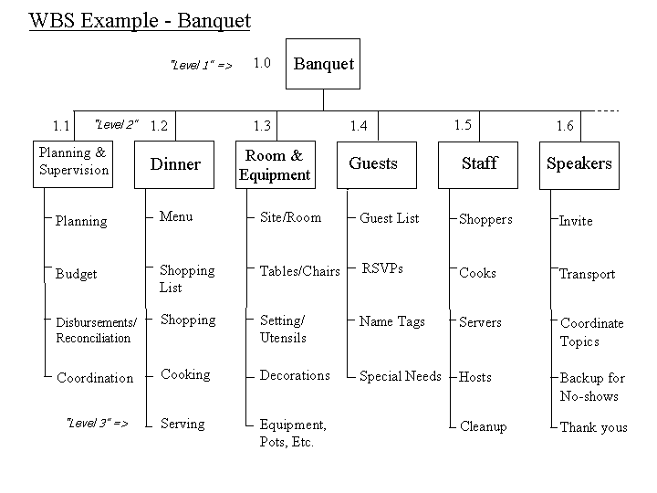
Notes:
banquet

Slide 7
Work Breakdown Structure
Define project scope by listing all of major sub-projects or deliverables on a project
The decomposition of a WBS
  Represent unique work
  Clearly defined duration or a total effort
  Discrete enough
  Responsibility can be assigned to a person or group

Slide 8
WBS
WBS family tree diagram
Tracking cost
8/80 rule
  No work package should be fewer than 8 labor hours or more than 80 labor hours

Slide 9
Assumptions Make Estimates More Accurate
Team members make assumptions about the work to be done in order to deal with incomplete information
  Any time an estimate must be based on a decision that has not yet been made, team members can assume the answer for the sake of the estimate
  Assumptions must be written down so that if they prove to be incorrect and cause the estimate to be inaccurate, everyone understands what happened
  Assumptions bring the team together very early on in the project so they can make progress on important decisions that will affect development

Slide 10
Effort Estimation Models
A software estimation model defines the project characteristics whose values (or their estimates) it needs and the ways these values are used to compute the effort.
the estimation model will require values of characteristics that can be measured at that stage.
The size of the software is the predominant factor in determining how much effort is needed to build it.
Many models have been proposed that use this top-down approach to estimation,
  COCOMO model being the most famous.
  Models using function points (instead of LOC) as size units have also been built.
you can accommodate other factors that affect the effort by refining the estimates based on these factors.

Slide 11
In the bottom-up approach, on the other hand, you obtain the estimates first for parts of the project and then for the overall estimate.
The bottom-up approach lends itself to direct estimation of effort; once the project is partitioned into smaller tasks, it is possible to directly estimate the effort required for them.
a key advantage of this approach is that it does not require explicit size estimates for the software. Instead, it requires a list of project tasks.

Slide 12
Both the top-down and the bottom-up approaches require information about the project: size (for top-down approaches) and a list of tasks (for bottom-up approaches).
In many ways, these approaches are complementary.
Both types of estimates are more accurate if more information about the project is available or as the project proceeds.
  For example, estimating the size is much more difficult when very high level requirements are given but becomes considerably easier when design is finished, and even easier and more accurate when code is developed.

Slide 13
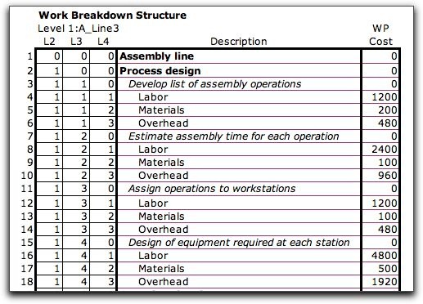
The Bottom-up Estimation Approach

Slide 14
1. Identify programs in the system and classify them as simple, medium, or complex (S/M/C).
2. If a project-specific baseline exists, get the average build effort for S/M/C programs from the baseline.
3. If a project-specific baseline does not exist, use project type, technology, language, and other attributes to look for similar projects in the process database. Use data from these projects to define the build effort of S/M/C programs.
4. If no similar project exists in the process database and no project-specific baseline exists, use the average build effort for S/M/C programs from the general process capability baseline.
5. Use project-specific factors to refine the build effort for S/M/C programs.
6. Get the total build effort using the build effort of S/M/C programs and the counts for them.
7. Using the effort distribution given in the capability baseline or for similar projects given in the process database, estimate the effort for other tasks and the total effort.
8. Refine the estimates based on project-specific factors.

Slide 15
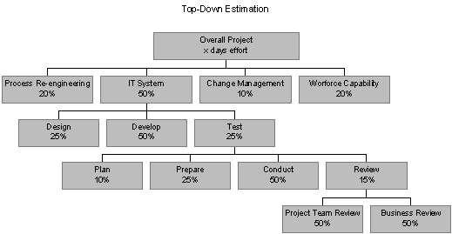
Top-Down Estimation

Slide 16
1. Get the estimate of the total size of the software in function points.
2. Using the productivity data from the project-specific capability baseline, from the general process capability baseline, or from similar projects, fix the productivity level for the project.
3. Obtain the overall effort estimate from the productivity and size estimates.
4. Use effort distribution data from the process capability baselines or similar projects to estimate the effort for the various phases.
5. Refine the estimates, taking project-specific factors into consideration.

Slide 17
Wideband Delphi
Wideband Delphi is a process that a team can use to generate an estimate
  The project manager chooses an estimation team, and gains consensus among that team on the results
  Wideband Delphi is a repeatable estimation process because it consists of a straightforward set of steps that can be performed the same way each time

Slide 18
The Wideband Delphi Process
Step 1: Choose the team
  The project manager selects the estimation team and a moderator. The team should consist of 3 to 7 project team members.
    The moderator should be familiar with the Delphi process, but should not have a stake in the outcome of the session if possible.
    If possible, the project manager should not be the moderator because he should ideally be part of the estimation team.

Slide 19
The Wideband Delphi Process
Step 2: Kickoff Meeting
  The project manager must make sure that each team member understands the Delphi process, has read the vision and scope document and any other documentation, and is familiar with the project background and needs.
  The team brainstorms and writes down assumptions.
  The team generates a WBS with 10-20 tasks.
  The team agrees on a unit of estimation.

Slide 20
The Wideband Delphi Process
Step 3: Individual Preparation
  Each team member independently generates a set of preparation results.
  For each task, the team member writes down an estimate for the effort required to complete the task, and any additional assumptions he needed to make in order to generate the estimate.

Slide 21
The Wideband Delphi Process
Step 4: Estimation Session
  During the estimation session, the team comes to a consensus on the effort required for each task in the WBS.
  Each team member fills out an estimation form which contains his estimates.
  The rest of the estimation session is divided into rounds during which each estimation team member revises her estimates based on a group discussion. Individual numbers are not dicsussed.

Slide 22
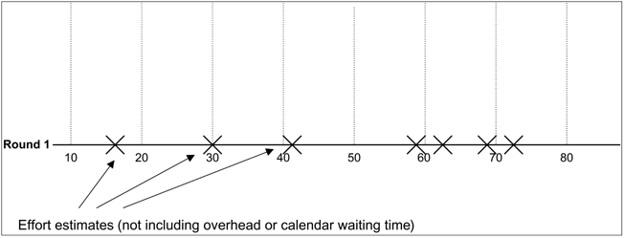
The Wideband Delphi Process
Step 4: Estimation Session (continued)
  The moderator collects the estimation forms and plots the sum of the effort from each form on a line:

Slide 23
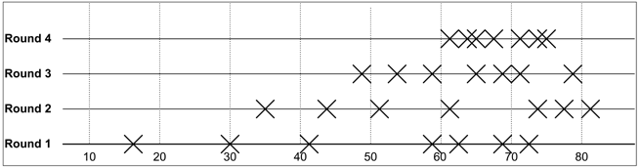
The Wideband Delphi Process
Step 4: Estimation Session (continued)
  The team resolves any issues or disagreements that are brought up.
    Individual estimate times are not discussed. These disagreements are usually about the tasks themselves. Disagreements are often resolved by adding assumptions.
  The estimators all revise their individual estimates. The moderator updates the plot with the new total:

Slide 24
The Wideband Delphi Process
Step 4: Estimation Session (continued):
  The moderator leads the team through several rounds of estimates to gain consensus on the estimates. The estimation session continues until the estimates converge or the team is unwilling to revise estimates.
Step 5: Assemble Tasks
  The project manager works with the team to collect the estimates from the team members at the end of the meeting and compiles the final task list, estimates and assumptions.
Step 6: Review Results
  The project manager reviews the final task list with the estimation team.

Slide 25
Other Estimation Techniques
PROBE, or Proxy Based Estimating
  PROBE is based on the idea that if an engineer is building a component similar to one he built previously, then it will take about the same effort as it did in the past.
  Individual engineers use a database to maintain a history of the effort they have put into their past projects.
  A formula based on linear regression is used to calculate the estimate for each task from this history.
COCOMO II
  In Constructive Cost Model, or COCOMO, projects are summarized using a set of variables that must be provided as input for a model that is based on the results of a large number of projects across the industry.
  The output of the model is a set of size and effort estimates that can be developed into a project schedule.

Slide 26
Other Estimation Techniques
The Planning Game
  The Planning Game is the software project planning method from Extreme Programming (XP), a lightweight development methodology developed by Kent Beck in the 1990s at Chrysler.
  It is a full planning process that combines estimation with identifying the scope of the project and the tasks required to complete the software.
  The Planning Game is highly iterative. The scope is established by having Development and Business work together to interactively write “user stories” written on index cards to describe the scope. Each story is given an estimate of 1, 2 or 3 weeks. This process is repeated continuously throughout the project.

Slide 27
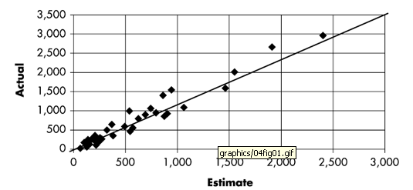
Actual versus estimated effort

Slide 28
ACIC
ACIC Corporation is a multibillion-dollar financial institution. To keep up with the times, several years ago it started slowly Web-enabling its applications, and it wanted to start an on-line service for opening and tracking accounts. Because Infosys had successfully built some e-services for ACIC earlier in a project called Synergy (name changed), ACIC employed Infosys to analyze the problem. This work was executed in time and material (T&M) mode—that is, the customer paid for the effort spent by Infosys in doing the analysis. Based on the analysis output, Infosys made a successful bid for the Web project, giving rise to the ACIC case study. The project successfully released the new service in time, and the software has been in operation without any problem.

Slide 29
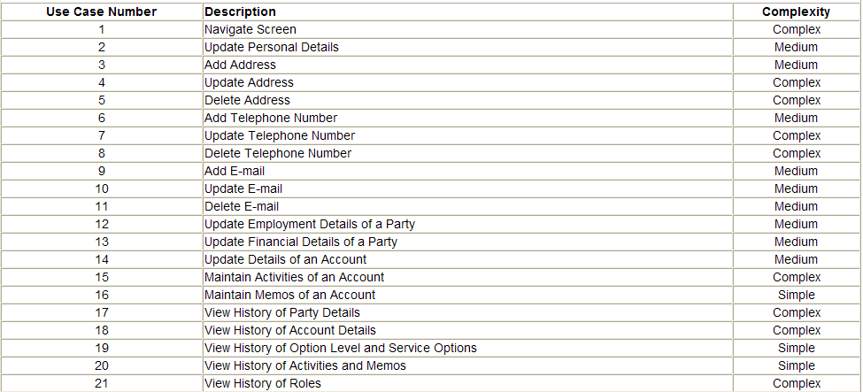
CASE STUDY: Effort Estimate of the ACIC Project(giai đoạn thiết kế)

Slide 30
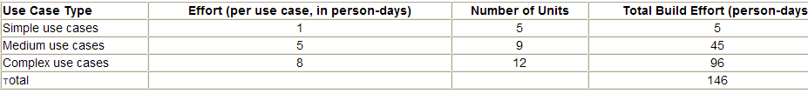
Build Effort for the ACIC Project

Slide 31
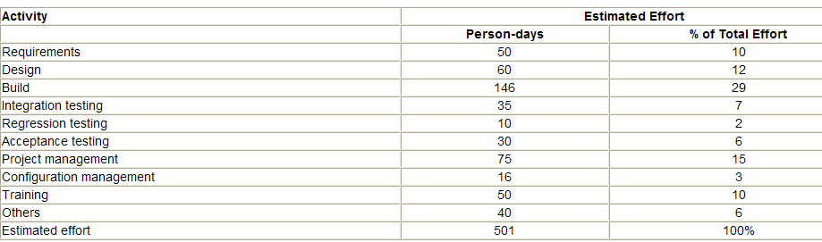
Estimated Effort for the ACIC Project

Slide 32
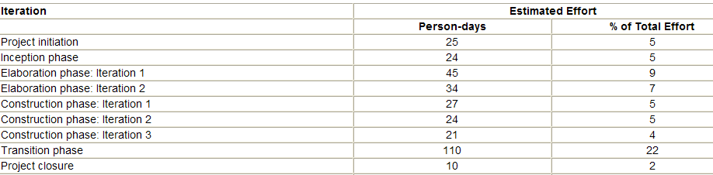
Distribution of Effort by Iterations in the ACIC Project

Slide 33
Case study

