Slide 1
Project Schedules
Applied Software Project Management

Slide 2
What is a project schedule?
The project schedule is a calendar that links the tasks to be done with the resources that will do them.
  Before a project schedule can be created, the project manager must have a work breakdown structure (WBS) and estimates.
  The schedule is part of the project plan.

Slide 3
Scheduling concepts: Effort vs. Duration
Effort represents the work required to perform a task.
  Effort is measured in person-hours (or person-days, person-weeks, etc.)
  It represents the total number of hours that each person spent working on the task.
Duration is amount of time that elapses between the time the task is started and the time it is completed.
  Duration is measured in hours (or days, weeks, etc.)
  It does not take into account the number of people performing the task

Slide 4
Scheduling concepts:
Slack and Overhead
Slack is the amount of time which any of the tasks can be delayed without causing the due date of the final task in the sequence to be delayed as well.
  A tight schedule has very little slack; a delay in any task will cause a delay in the due date
  Parkinson’s Law: “Work expands so as to fill the time available for its completion.”
  Float
Overhead is any effort that does not go to the core activities of the task but is still required in order for the people to perform it—a sort of “real world” cost of actually doing the work.
  Two people performing a task will require more effort than one person doing the same task
  Assigning two people to the task requires more effort, but the task has a shorter duration
  if the duration of a task is 12 days, it may require 7 days for 2 people to finish it

Slide 5
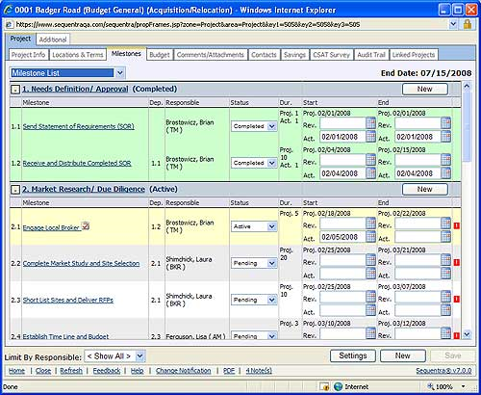
Milestones

Slide 6
Milestones
A control point event in the project, usually the completion of a key deliverable, that triggers a reporting requirement or that requires sponsor or customer approval before proceeding with project.

Slide 7
Building the project schedule
Allocate resources
  For each task in the WBS, one or more resources must be assigned
  Choose person or people for each task based on qualifications, familiarity and availability
  Take overhead into account when calculating the duration of each task

Slide 8
Building the project schedule
Identify dependencies
  A task has a dependency if it involves an activity, resource or work product which is subsequently required by another task
  Tasks may have dependencies because they require the same resource

Slide 9
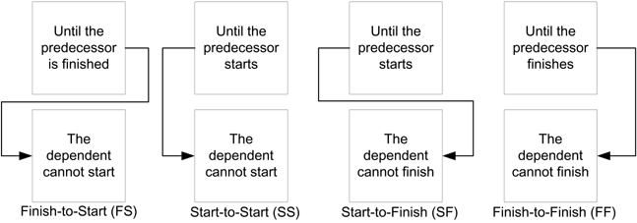
Building the project schedule
Identify dependencies (continued)
  Every dependency has a predecessor, or a task that must be begun, in progress, or completed, for another task to begin
  Identify the type of predecessor for each dependency

Slide 10
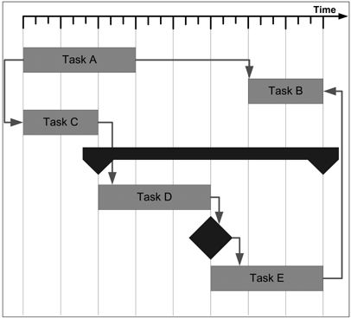
Building the project schedule
Create the schedule
  Most project schedules are represented using a Gantt chart
  The Gantt chart shows tasks, dependencies and milestones using different shapes
Notes:
Milestones(phần màu đen)

Slide 11
Building the project schedule
The most common form for the schedule to take is a Gantt chart. This is a type of bar chart developed by Henry Laurence Gantt, an American engineer who was prominent during the first two decades of the 20th century.
Over the past century, Gantt charts have been used on major civil engineering projects (including the Hoover Dam and the U.S. interstate highway system), and it is now the standard way to document software project schedules

Slide 12
Scheduling Techniques
PERT
CPM

Slide 13
PERT
Program Evaluation and Review Technique, commonly abbreviated PERT
a graphic representation of a project’s schedule, showing the sequence of tasks,
  which tasks can be performed simultaneously,
  the critical path of tasks that must be completed on time in order for the project to meet its completion deadline.
The chart can be constructed with a variety of attributes, such as earliest and latest start dates for each task, earliest and latest finish dates for each task, and slack time between tasks.
A PERT chart can document an entire project or a key phase of a project.
The chart allows a team to avoid unrealistic timetables and schedule expectations, to help identify and shorten tasks that are bottlenecks, and to focus attention on most critical tasks.
It is commonly used in conjunction with the critical path method or CPM.

Slide 14
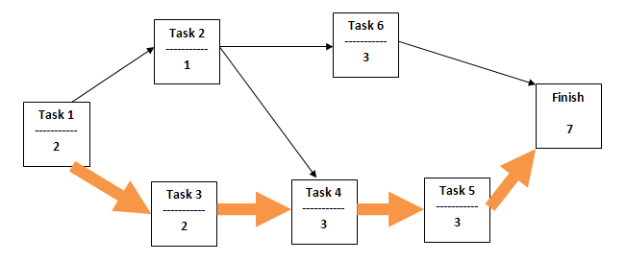
Task #1: 2 days duration, Task #2,…
Dependency: Task #2, #3 must be completed before Task #4
..
Notes:
Công việc trên đường tới hạn không duowcjdj phép trễ.(mũi tên lớn)

Slide 15
Work package dependency relationships
Relationship | Description
Finish-to-Start | Preceding activity must finish before the succeeding activity can start
Finish-to-Finish | Preceding activity must finish before the succeeding activity can finish
Start-to-Start | Preceding activity must start before the succeeding activity can start
Start-to-Finish | Preceding activity must finish before the succeeding activity can finish

Slide 16
PERT
PERT is networking technique that has four defining characteristics
  All WBS must be placed in a network diagram
  Show all of the dependencies and paths to completion
  3 time estimates must be made for each work package
    F=Optimistic + 4 x Most Likely + Pessimistic/6
  Slack of float for each work package must be calculated and the critical path determined

Slide 17
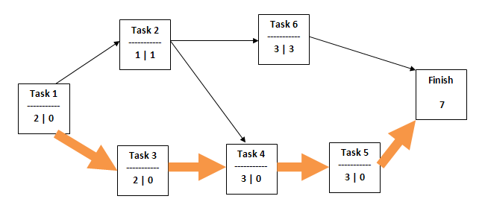

Slide 18
CPM
In 1957, DuPont developed a project management method designed. Given the complexity of the process, they developed the Critical Path Method (CPM) for managing projects.
CPM provides the following benefits:
  Provides a graphical view of the project.
  Predicts the time required to complete the project.
  Shows which activities are critical to maintaining the schedule and which are not.
CPM models the activities and events of a project as a network. Activities are depicted as nodes on the network and events that signify the beginning or ending of activities are depicted as arcs or lines between the nodes.

Slide 19
Identify and Analyze the critical path
The critical path is the longest-duration path through the network. The significance of the critical path is that the activities that lie on it cannot be delayed without delaying the project. Because of its impact on the entire project, critical path analysis is an important aspect of project planning.

Slide 20
Identify and Analyze the critical path
The critical path can be identified by determining the following four parameters for each activity:
  ES - earliest start time: the earliest time at which the activity can start given that its precedent activities must be completed first.
  EF - earliest finish time, equal to the earliest start time for the activity plus the time required to complete the activity.
  LF - latest finish time: the latest time at which the activity can be completed without delaying the project.
  LS - latest start time, equal to the latest finish time minus the time required to complete the activity.

Slide 21
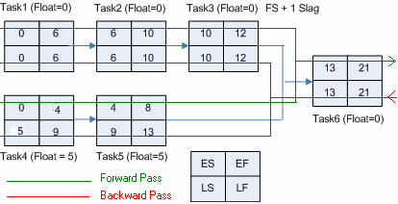

Slide 22
Identify and Analyze the critical path
The slack time
The critical path is the path through the project network in which none of the activities have slack, that is, the path for which ES=LS and EF=LF for all activities in the path. A delay in the critical path delays the project. Similarly, to accelerate the project it is necessary to reduce the total time required for the activities in the critical path.

Slide 23
The forward pass: calculate the Early Start (ES), Early Finish (EF)
  Start with the first activity
  ES for the first activity = 0
  EF for the first activity is its duration
  ES = latest EF of any of its predecessor activities
  EF = latest EF of any of its predecessor activities + duration
  Move forward
The backward pass: calculate the Late Start (LS) and the Late Finish (LF).
  Start with last activity
  LF for the last activity equals its EF time
  LS for the last activity equals its EF-its duration
  LF for any predecessor activity equals the earliest LS of any of its successors
  LS for any predecessor activity equals its LF minus duration
  Move backward
Float = LF-EF

Slide 24
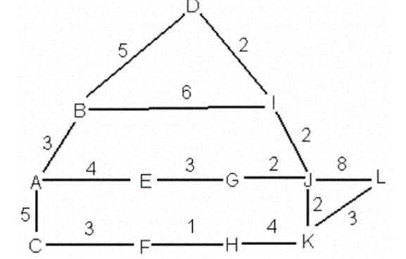

Slide 25
How long from start (A) to finish (L)?
What would happen if AE takes 8 days?
An activity is critical if:
  a delay in it delays the entire project
What activities are critical in the fig.?

Slide 26
Building the project schedule
Reconcile the schedule with the organization’s needs
  Once resources are allocated to each task, a final date can be calculated
  If this date is unacceptable, the project plan must change
  Either additional resources must be allocated to the project or the scope must be cut down
  Brooks’ Law: “Nine women cannot have a baby in one month.”
    In other words, some tasks can only be done by one person, no matter how critical they are.

Slide 27
Building the project schedule
Add review meetings to the schedule
  Progress reviews are meetings held regularly to check the progress of a project versus it's scheduled progress.
  Milestone reviews are meetings which the project manager schedules in advance to coincide with project events.
    The most common way for project managers to handle milestone reviews is to schedule them to occur after the last task in a project phase (such as the end of design or programming).

Slide 28
Building the project schedule
Step 4: Optimize the schedule
  The critical path is the sequence of tasks that represent the minimum time required to complete the project.
    If a task is only on the critical path when delaying that task will delay the project.
    Allocating resources to tasks on the critical path will reduce the project schedule; allocating them to other tasks will have less effect.
  A resource is over-allocated if more than 100% allocated to multiple tasks simultaneously
    If any resource is over-allocated, it means that there is a dependency between two tasks which was not discovered.
    When this happens, the schedule is guaranteed to be inaccurate. Find and fix over-allocated resources.

Slide 29
Don’t abuse buffers
A buffer is a task added to the schedule with no specific purpose except to account for unexpected delays.
  This practice involves either adding extra tasks or padding existing tasks at strategic points in the schedule where overruns are “expected”.
  Buffers can be useful:
    On a year-long project, every programmer will take two weeks of vacation
    Buffers can be used to account for this known delay
  Buffers are often abused
    The idea that overruns are expected means that there is an implicit assumption that the estimate is incorrect.
    Buffers should not be used to add time to compensate for an inaccurate estimate.

Slide 30
Project metrics
The baseline is the version of the schedule that has been approved
  The schedule will change based on the actual work done by the project team.
  When the deadline of the revised schedule is later than that of the baseline, the project has slipped.
Variance is the difference between the estimated effort in the baseline and the actual effort performed by the team.

Slide 31
Project metrics
Earned value management tracks the project by considering effort “earned” against a budget only after it has actually been performed
  The budgeted cost for work scheduled (BCWS) is the estimated effort of the actual tasks that appear on the schedule to date.
  The actual cost of work performed (ACWP) is the effort spent on the tasks in the schedule that have actually been completed by the development team members.
  Variance = BCWS – ACWP

Slide 32
Project metrics
The cost performance index is used to compare projects with each other or to compare phases within a project
  CPI is calculated by dividing BCWS / ACWP (budgeted cost for work scheduled/actual cost for work performed) and multiplying by 100 to express it as a percentage.
  A CPI of 100% means that the estimated cost was exactly right and the project came in exactly on budget.
  A CPI under 100%, the work cost less effort than planned; a CPI greater than 100% means that the estimate was not adequate for the work involved.
    For example, if the programming tasks took twice as long as estimated but every other type of task in the project took less time than estimated, the total variance for the project might still be low. However, the problem can still be pinpointed by calculating the CPI for each phase of development.

