Slide 1
Reviews
Applied Software Project Management

Slide 2
When are reviews needed?
A review is any activity in which a work product is distributed to reviewers who examine it and give feedback.
  Reviews are useful not only for finding and eliminating defects, but also for gaining consensus among the project team, securing approval from stakeholders, and aiding in professional development for team members.
  Reviews help teams find defects soon after they are injected making them cost less to fix than they would cost if they were found in test.
  All work products in a software project should be either reviewed or tested.
    Software requirements specifications, schedules, design documents, code, test plans, test cases, and defect reports should all be reviewed.

Slide 3
Types of Review:
Inspections
Inspections are moderated meetings in which reviewers list all issues and defects they have found in the document and log them so that they can be addressed by the author.
The goal of the inspection is to repair all of the defects so that everyone on the inspection team can approve the work product.
  Commonly inspected work products include software requirements specifications and test plans.

Slide 4
Types of Review: Inspections
Running an inspection meeting:
  A work product is selected for review and a team is gathered for an inspection meeting to review the work product.
  A moderator is chosen to moderate the meeting.
  Each inspector prepares for the meeting by reading the work product and noting each defect.
  In an inspection, a defect is any part of the work product that will keep an inspector from approving it.
  Discussion is focused on each defect, and coming up with a specific resolution.
    It’s the job of the inspection team to do more than just identify the problems; they must also come up with the solutions.
  The moderator compiles all of the defect resolutions into an inspection log

Slide 5
Choose the Inspection Team
The job of the inspection team is to work with the author of the document in order to identify any defects. Once a problem is identified, the inspection team must work to come up with a solution that will fix the problem -> solutions to the defects that they find.
  This means that each inspector needs to have enough familiarity with the project and the way the work product will be used to understand its problems and propose changes.
The project manager must choose a team of 3 to 10 inspectors. Ideally, each inspector should represent a different perspective on the work product. This is critical for catching all of the defects.
During the inspection, the team works to identify any defects in the work product. They are expected to evaluate it from two perspectives.
  the perspective of their own expertise, where the inspectors identify any issues that will interfere with the development of the project. For this role, they must draw on their engineering skills and experience with past software projects.
  evaluate the work product from a common sense perspective.

Slide 6
Select a Moderator
This person must be able to objectively evaluate the work product being inspected and understand any issues that are raised during the inspection.
The project manager should be an inspector
The hardest part of the moderator's job is to prepare the inspectors and the author for criticism of the work product
  the moderator must help the author understand the benefit of the criticism

Slide 7
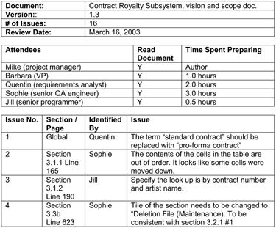
Inspection Log Example

Slide 8
Inspect the Work Product
During the inspection meeting, a moderator leads the team page by page through a printed copy of the work product. The purpose of the meeting is to identify and fix any defects.

Slide 9
Preparation
  Each inspector reviews the printed copy of the work product individually, prior to the inspection meeting.
Overview
  The moderator verifies that each inspection team member has read the printed copy of the work product. If any team member has not prepared, the inspection is aborted and rescheduled for a later date.
Page-by-page review
  The moderator turns to the first page of the work product and asks if anyone found any issues on that page.
  actual text that will be inserted into the document in order to fix the defect; the moderator should add this fix to the inspection log.
  Once all issues for the page are discussed, the moderator moves to the next page in the work product.

Slide 10
Rework
  When the changes are complete, the author turns the updated work product over to the moderator.
Follow-up
  The moderator distributes the updated work product to the inspection team.
  Approval
  If any inspector feels that there are still further issues raised by the corrections to the work product, another inspection meeting can be held;
  The moderator adds a signature page to the work product and distributes a printed version for signature approval. The signed work product is archived.

Slide 11
Manage the Author's Expectations
Many people who have implemented inspections have found that it is very difficult for authors to sit through an inspection meeting without defending their work
A major challenge of the moderator role is keeping the author from altering the understanding of the document through discussion
Each inspector should keep in mind the fact that if he did not understand something after reading a document, then it is probably the document's fault, not the reader's.
The author should be prepared to listen to the inspection team discuss defects

Slide 12
Help Others in the Organization Accept Inspections
spending the time inspecting the work products up front will save the team from having to fix the software later
"Inspections take too long.“
  The project manager should explain that a typical inspection meeting will take less than two hours
"I don't like people criticizing my work.“
"I built it, and only I can say when it's done."

Slide 13
Types of Review: Deskchecks
A deskcheck is a simple review in which the author of a work product distributes it to one or more reviewers.
  The author sends a copy of the work product to selected project team members. The team members read it, and then write up defects and comments to send back to the author.
    vision and scope documents
    discussion summaries

Slide 14
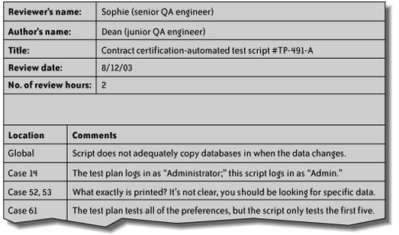

Slide 15
Types of Review:
Deskchecks
Unlike an inspection, a deskcheck does not produce written logs which can be archived with the document for later reference.
Deskchecks can be used as predecessors to inspections.
  In many cases, having an author of a work product pass his work to a peer for an informal review will significantly reduce the amount of effort involved in the inspection.

Slide 16
Types of Review:
Walkthroughs
A walkthrough is an informal way of presenting a technical document in a meeting.
  Unlike other kinds of reviews, the author runs the walkthrough: calling the meeting, inviting the reviewers, soliciting comments and ensuring that everyone present understands the work product.
  Walkthroughs are used when the author of a work product needs to take into account the perspective of someone who does not have the technical expertise to review the document.
  After the meeting, the author should follow up with individual attendees who may have had additional information or insights. The document should then be corrected to reflect any issues that were raised.

Slide 17
Types of Review:
Code Review
A code review is a special kind of inspection in which the team examines a sample of code and fixes any defects in it.
  In a code review, a defect is a block of code which does not properly implement its requirements, which does not function as the programmer intended, or which is not incorrect but could be improved
    For example, it could be made more readable or its performance could be improved

Slide 18
Types of Review:
Code Review
  It’s important to review the code which is most likely to have defects. This will generally be the most complex, tricky or involved code.
  Good candidates for code review include:
    A portion of the software that only one person has the expertise to maintain
    Code that implements a highly abstract or tricky algorithm
    An object, library or API that is particularly difficult to work with
    Code written by someone who is inexperienced or has not written that kind of code before, or written in an unfamiliar language
    Code which employs a new programming technique
    An area of the code that will be especially catastrophic if there are defects

Slide 19
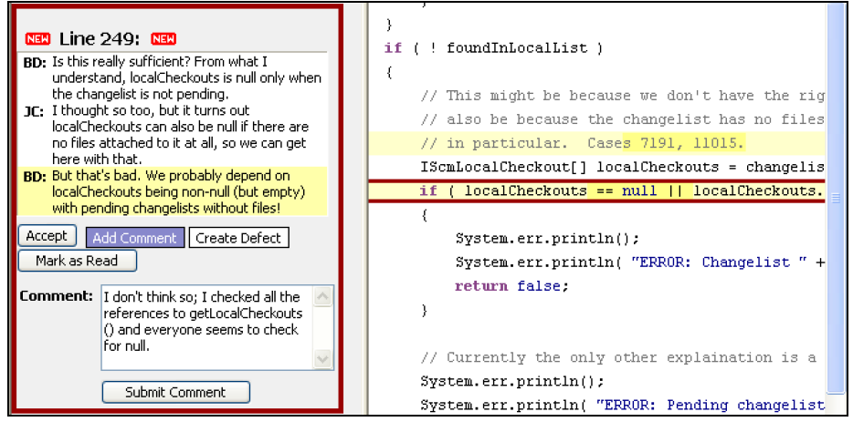

Slide 20
Types of Review:
Pair Programming
Pair programming is a technique in which two programmers work simultaneously at a single computer and continuously review each others’ work.
Although many programmers were introduced to pair programming as a part of Extreme Programming, it is a practice that can be valuable in any development environment.
Pair programming improves the organization by ensuring that at least two programmers are able to maintain any piece of the software.

Slide 21
Types of Review:
Pair Programming
In pair programming, two programmers sit at one computer to write code. Generally, one programmer will take control and write code, while the other watches and advises.
  Some teams have found that pair programming works best for them if the pairs are constantly rotated; this helps diffuse the shared knowledge throughout the organization. Others prefer to pair a more junior person with a more senior for knowledge sharing.
The project manager should not try to force pair programming on the team; it helps to introduce the change slowly, and where it will meet the least resistance.
  It is difficult to implement pair programming in an organization where the programmers do not share the same nine-to-five (or ten-to-six) work schedule.
  Some people do not work well in pairs, and some pairs do not work well together.

