Slide 1
Requirements các yêu cầu pm
Applied Software Project Management

Slide 2
Software Requirements
Software requirements are documentation that completely describes the behavior that is required of the software-before the software is designed built and tested.
  Requirements analysts (or business analysts) build software requirements specifications through requirements elicitation.
    Interviews with the users, stakeholders and anyone else whose perspective needs to be taken into account during the design, development and testing of the software
    Observation of the users at work
    Distribution of discussion summaries to verify the data gathered in interviews

Slide 3
Discussion Summary
A requirements analyst can use a discussion summary to summarize information gathered during elicitation and validate it through a review.
Notes gathered during the elicitation should fit into the discussion summary template
The discussion summary outline can serve as a guide for a novice requirements analyst in leading interviews and meetings
  Discussion Summary outline
  Project background
    Purpose of project
    Scope of project
    Other background information
  Perspectives
    Who will use the system?
    Who can provide input about the system?
  Project Objectives
    Known business rules
    System information and/or diagrams
    Assumptions and dependencies
    Design and implementation constraints
  Risks
  Known future enhancements
  References
  Open, unresolved or TBD issues

Slide 4
Use Cases
A use case is a description of a specific interaction that a user may have with the system.
Use cases are deceptively simple tools for describing the functionality of the software.
  Use cases do not describe any internal workings of the software, nor do they explain how that software will be implemented.
  They simply show how the steps that the user follows to use the software to do his work.
  All of the ways that the users interact with the software can be described in this manner.

Slide 5
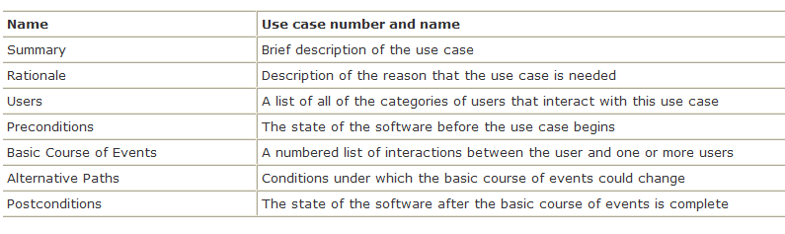

Slide 6
Functional Requirements
Functional requirements define the outward behavior required of the software project.
  The goal of the requirement is to communicate the needed behavior in as clear and unambiguous a manner as possible.
  The behavior in the requirement can contain lists, bullets, equations, pictures, references to external documents, and any other material that will help the reader understand what needs to be implemented.

Slide 7
Nonfunctional Requirements
Nonfunctional requirements define characteristics of the software which do not change its behavior.
  Users have implicit expectations about how well the software will work.
  These characteristics include how easy the software is to use, how quickly it executes, how reliable it is, and how well it behaves when unexpected conditions arise.
  The nonfunctional requirements define these aspects about the system.
    The nonfunctional requirements are sometimes referred to as “non-behavioral requirements” or “software quality attributes”

Slide 8
Software Requirements Specification
The software requirements specification (SRS) represents a complete description of the behavior of the software to be developed.
The SRS includes:
  A set of use cases that describe all of the interactions that the users will have with the software.
  All of the functional requirements necessary to define the internal workings of the software: calculations, technical details, data manipulation and processing, and other specific functionality that shows how the use cases are to be satisfied
  Nonfunctional requirements, which impose constraints on the design or implementation (such as performance requirements, quality standards or design constraints).

Slide 9
Requirements vs. Design
Many people have difficulty understanding the difference between scope, requirements and design.
  Scope demonstrates the needs of the organization, and is documented in a vision and scope document
  Requirements document the behavior of the software that will satisfy those needs
  Design shows how those requirements will be implemented technically

Slide 10
Change Control
Change control is a method for implementing only those changes that are worth pursuing, and for preventing unnecessary or overly costly changes from derailing the project.
  Change control is an agreement between the project team and the managers that are responsible for decision-making on the project to evaluate the impact of a change before implementing it.
  Many changes that initially sound like good ideas will get thrown out once the true cost of the change is known.

Slide 11
Change Control
A change control board (CCB) is made up of the decision-makers, project manager, stakeholder or user representatives, and selected team members.
  The CCB analyzes the impact of all requested changes to the software and has the authority to approve or deny any change requests once development is underway.
  Before the project begins, the list of CCB members should be written down and agreed upon, and each CCB member should understand why the change control process is needed and what their role will be in it.

Slide 12
Change Control
Whenever a change is needed, the CCB follows the change control process to evaluate the change:
  The potential benefit of the change is written down, and the project manager works with the team to estimate the potential impact that the change will have on the project.
  If the benefit of the change is worth the cost, the project manager updates the plan to reflect the new estimates. Otherwise, the change is thrown out and the team continues with the original plan.
  The CCB either accepts or rejects the change.

