Slide 1
Presentation Topic

Slide 2
COCOMO ESTIMATION

Slide 3
Cocomo estimation
COCOMO (COnstructive COst MOdel) Boehm: group of models
In the late 1970s, 63 projects (7)
effort = c(size)^{k}
  Effort was measured in pm (person month)
  Size was measured in kdsi, thousands of delivered source code instructions
  C, k

Slide 4
COCOMO
  COCOMO (COnstructive COst MOdel)
    Developed by Boehm in 1981
    Became one of the most popular and most transparent cost model
    Mathematical model based on the data from 63 historical software project
  COCOMO II
    Published in 1995
    To address issue on non-sequential and rapid development process models, reengineering, reuse driven approaches, object oriented approach etc
    Has three sub-models – application composition, early design and post-architecture

Slide 5
COCOMO 81
COCOMO stands for COnstructive COst MOdel
It is an open system First published by Dr Barry Bohem in 1981
Worked quite well for projects in the 80’s and early 90’s

Slide 6
COCOMO 81
COCOMO has three different models (each one increasing with detail and accuracy):
  Basic, applied early in a project
  Intermediate, applied after requirements are specified.
  Advanced, applied after design is complete
COCOMO has three different modes:
  Organic – “relatively small software teams develop software in a highly familiar, in-house environment” [Bohem]
  Embedded – operate within tight constraints, product is strongly tied to “complex of hardware, software, regulations, and operational procedures” [Bohem]
  Semi-detached – intermediate stage somewhere between organic and embedded. Usually up to 300 KDSI

Slide 7
COCOMO 81
COCOMO uses two equations to calculate effort in man months (MM) and the number on months estimated for project (TDEV)
MM is based on the number of thousand lines of delivered instructions/source (KDSI)
  MM = a(KDSI)^{b} * EAF
  TDEV = c(MM)^{d}
EAF is the Effort Adjustment Factor derived from the Cost Drivers, EAF for the basic model is 1
The values for a, b, c, and d differ depending on which mode you are using
Mode | a | b | c | d
Organic | 2.4 | 1.05 | 2.5 | 0.38
Semi-detached | 3.0 | 1.12 | 2.5 | 0.35
Embedded | 3.6 | 1.20 | 2.5 | 0.32

Slide 8
COCOMO 81
A simple example:
Project is a flight control system (mission critical) with 310,000 DSI in embedded mode
Reliability must be very high (RELY=1.40). So we can calculate:
Effort = 1.40*3.6*(319)^{1.20} = 5093 MM
Schedule = 2.5*(5093)^{0.32} = 38.4 months
Average Staffing = 5093 MM/38.4 months = 133 FSP
( Full time equivalent Software Personnel )

Slide 9
COCOMO II
Main objectives of COCOMO II:
  To develop a software cost and schedule estimation model tuned to the life cycle practices of the 1990’s and 2000’s
  To develop software cost database and tool support capabilities for continuous model improvement

Slide 10
COCOMO II
Has three different models:
The Application Composition Model
  Good for projects built using rapid application development tools (GUI-builders etc)
The Early Design Model
  This model can get rough estimates before the entire architecture has been decided
The Post-Architecture Model
  Most detailed model, used after overall architecture has been decided on

Slide 11
COCOMO II Differences
The exponent value b in the effort equation is replaced with a variable value based on five scale factors rather then constants
Size of project can be listed as object points, function points or source lines of code (SLOC).
EAF is calculated from seventeen cost drivers better suited for today's methods, COCOMO81 has fifteen
A breakage rating has been added to address volatility of system

Slide 12
COCOMO II Calibration
For COCOMO II results to be accurate the model must be calibrated
Calibration requires that all cost driver parameters be adjusted
Requires lots of data, usually more then one company has
The plan was to release calibrations each year but so far only two calibrations have been done (II.1997, II.1998)
Users can submit data from their own projects to be used in future calibrations

Slide 13
Importance of Calibration
Proper calibration is very important
The original COCOMO II.1997 could estimate within 20% of the actual values 46% of the time. This was based on 83 data points.
The recalibration for COCOMO II.1998 could estimate within 30% of the actual values 75% of the time. This was based on 161 data points.

Slide 14
Is COCOMO the Best?
COCOMO is the most popular method however for any software cost estimation you should really use more then one method
Best to use another method that differs significantly from COCOMO so your project is examined from more then one angle
Even companies that sell COCOMO based products recommend using more then one method. Softstar (creators of Costar) will even provide you with contact information for their competitor’s products

Slide 15
COCOMO Conclusions
COCOMO is the most popular software cost estimation method
Easy to do, small estimates can be done by hand
USC has a free graphical version available for download
Many different commercial version based on COCOMO – they supply support and more data, but at a price

Slide 16
AGILE Project Management

Slide 17
What are Agile approaches?
Dealing with project management problems
  Late project completion
  Poor customer satisfaction
  Being able to react to changing requirements
Focussing on delivering software
Creative approaches, trying out new techniques
The new ‘thing’ in software engineering

Slide 18
Agile Manifesto
We are uncovering better ways of developing software by doing it and helping others do it. Through this work we have come to value:
Individuals and interactions over processes and tools
Working software over comprehensive documentation
Customer collaboration over contract negotiation
Responding to change over following a plan
The Agile Alliance
http://www.agilealliance.org/home

Slide 19
The 80/20 Approach
Fundamental Assumption:
Nothing is built perfectly first time
80% of the solution can be produced in 20% of the time it would take to produce the total solution

Slide 20
Flexing Requirements
Functionality Time Resources
TRAD
fixed
AGILE
vary
Time Resources Functionality

Slide 21
Agile methods
DSDM (Dynamic Systems Development Method)
Scrum
XP
Crystal
Feature-driven development
Lean Project Development
Agile Unified Process

Slide 22
Extreme Programming
“A deliberate and disciplined approach to software development”
Devised by Kent Beck in the 1990s
Really focused on the software development part of the project .. Does not deal with some of the wider project management issues
See http://www.extremeprogramming.org
Also: http://xprogramming.com/index.php

Slide 23

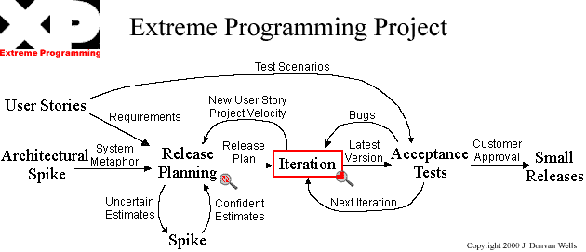

Slide 24
Planning
User stories are written (by users)
Release planning creates the schedule
Make frequent small releases
The project velocity is measured (how fast are you working)
The project is divided into iterations
Iteration planning starts each iteration
Move people around (to avoid knowledge loss and coding bottlenecks)
Each day starts with a stand-up meeting
Fix XP when it breaks

Slide 25
Designing
Simplicity
Choose a system metaphor
Use CRC cards for design sessions (Class, Responsibility, Collaboration – an OO approach)
Create spike solutions to reduce risk (throw-away code to explore difficult bits of functionality)
No functionality is added early
Refactor whenever and wherever possible (remove redundancy, eliminate unused functionality, and rejuvenate obsolete designs )

Slide 26
Coding
The customer is always available
Code must be written to agreed standards
Create the unit test first
All production code is pair programmed
Only one pair integrates code at a time
Integrate often
Use collective code ownership
Leave optimization till last
No overtime

Slide 27
Testing
All code must have unit tests
All code must pass all unit tests before it can be released
When a bug is found tests are created
Acceptance tests are run often and the score is published

Slide 28
Process Improvement with CMMI

Slide 29
Capability Maturity Model
The Capability Maturity Model (CMM) is a method for evaluating and measuring the maturity of the software development process of organizations on a scale of 1 to 5.
The CMM was developed by the Software Engineering Institute (SEI) at Carnegie Mellon University in Pittsburgh. It has been used extensively for avionics software and for government projects since it was created in the mid-1980s.
The SEI has subsequently released a revised version known as the Capability Maturity Model Integration (CMMI).

Slide 30
Process capability assessment
Intended as a means to assess the extent to which an organisation’s processes follow best practice.
By providing a means for assessment, it is possible to identify areas of weakness for process improvement.
There have been various process assessment and improvement models but the SEI work has been most influential.

Slide 31
Capability Maturity Levels
5
Focus on continuous software improvement
Optimising
4
Process measured and controlled
Quantitatively
Managed
3
Process designed for organisation
and is proactive
Defined
2
Process designed for projects and is reactive
Managed
1
Process unpredictable, uncontrolled and reactive
Initial

Slide 32
Problems with the CMM
Practices associated with model levels
  Companies could be using practices from different levels at the same time but if all practices from a lower level were not used, it was not possible to move beyond that level
Discrete rather than continuous
  Did not recognise distinctions between the top and the bottom of levels
Practice-oriented
  Concerned with how things were done (the practices) rather than the goals to be achieved.

Slide 33
The CMMI model
An integrated capability model that includes software and systems engineering capability assessment.
The model has two instantiations
  Staged where the model is expressed in terms of capability levels;
  Continuous where a capability rating is computed.

Slide 34
CMMI model components
Process areas
  24 process areas that are relevant to process capability and improvement are identified. These are organised into 4 groups.
Goals
  Goals are descriptions of desirable organisational states. Each process area has associated goals.
Practices
  Practices are ways of achieving a goal - however, they are advisory and other approaches to achieve the goal may be used.

Slide 35
CMMI Process Areas
CAR | Causal Analysis and Resolution | Support | 5
CM | Configuration Management | Support | 2
DAR | Decision Analysis and Resolution | Support | 3
IPM | Integrated Project Management | Project Man | 3
MA | Measurement and Analysis | Support | 2
OPD | Organizational Process Definition | Process Man | 3
OPF | Organizational Process Focus | Process Man | 3
OPM | Org. Performance Management | Process Man | 5
OPP | Organizational Process Performance | Process Man | 4
OT | Organizational Training | Process Man | 3
PMC | Project Monitoring and Control | Project Man | 2
PP | Project Planning | Project Man | 2
PPQA | Process and Product Qual Ass | Support | 2
QPM | Quantitative Project Management | Project Man | 4
REQM | Requirements Management | Project Man | 2
RSKM | Risk Management | Project Man | 3

Slide 36
CMMI assessment
Examines the processes used in an organisation and assesses their maturity in each process area.
Based on a 6-point scale:
  Not performed;
  Performed;
  Managed;
  Defined;
  Quantitatively managed;
  Optimizing.

Slide 37
The staged CMMI model
Each maturity level has process areas and goals. For example, the process area associated with the managed level include:
  Requirements management;
  Project planning;
  Project monitoring and control;
  Supplier agreement management;
  Measurement and analysis;
  Process and product quality assurance.

Slide 38
ISO 12207

Slide 39
ISO 12207
Software lifecycle processes

Slide 40
Context and Purpose
Domain : software engineering
Focus : software lifecycle processes
Purpose : to establish a common framework for the life cycle of software
  -> to foster mutual understanding among business parties
  -> to acquire, supply, develop, operate and maintain software

Slide 41
Scope
Stakeholders: acquirers, suppliers, users etc
Application: corporate processes related to project products and project services
ISO 12207 covers process definitions and descriptions

Slide 42
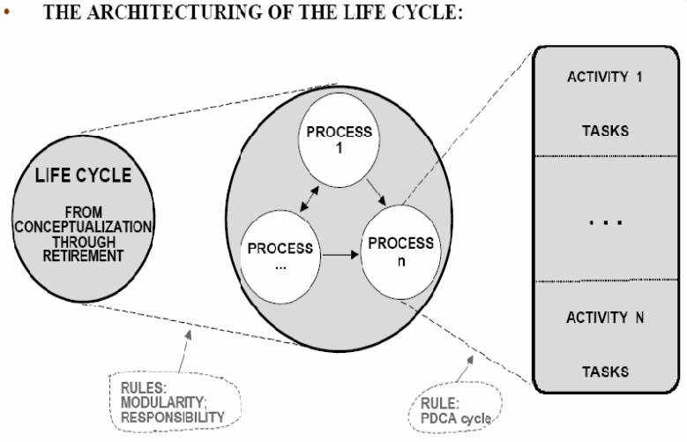
Basic Concepts – Life cycle and architecture

Slide 43
Basic Concepts – Rules for partitioning the life cycle
Modularity
  Cohesion (Functional): Tasks in a process must be functionally related
  Coupling (Internal): Links between processes must be minimal
Association
  If a function is used by more than one process, then the function becomes a process in itself
  If Process X is invoked by Process A and Process A only, then Process X belongs to Process A
Responsibility
  Each process is under a responsibility
  A function with parts under different responsibilities shall not be a process

Slide 44
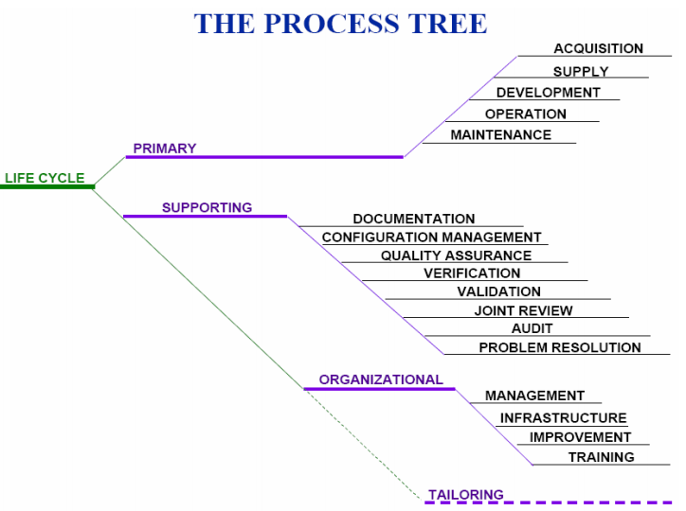
Basic Concepts – The Process Tree

Slide 45
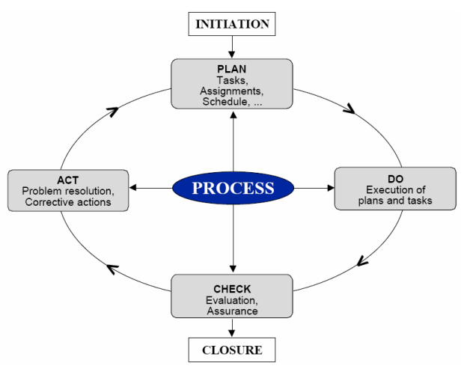
Basic Concepts - Rules for partitioning a process
A process is partitioned into PDCA activities based on the PDCA-
cycle principles

Slide 46
Basic Concepts - Activity and
Tasks
An activity is divided into tasks, which are grouped into similar actions
Based on TQM Principles (Total Quality Management Principles)
  Each party/participant has appropriate responsibility

Slide 47
Basic Concepts -What 12207 is not
Not certifying
Not prescriptive, no how-tos
Not a standard for methods, techniques & models
  does not prescribe management and engineering methods
  does not prescribe computer languages
  Etc
Not a standard for metrics
  many tasks need metrics and indicators
  but prescribes no specific metrics/indicators
  references ISO/IEC 9126 for guidance

