Slide 1
CUDA RADIX SORT
1512211 - Trần Quang Huy
1412235 - Võ Xuân Khang

Slide 2
I. BASELINE (Thời gian trung bình trong 5 lần chạy)
N = 2^14 | Code (ms) | Thrust (ms)
Tuần tự | 2.394 | 2.1956
Song song hist và scan | 2.8978 | 2.1956
Song song 1 bit (n =512) | 1.5086 | 0.2378
Satish tuần tự | 355.004 | 2.1956

Slide 3
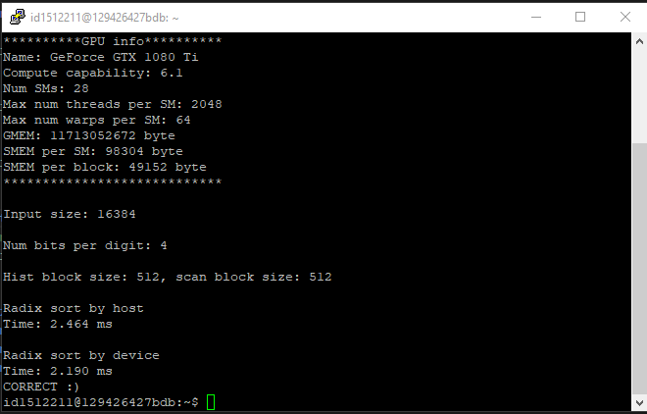
1. Tuần tự

Slide 4
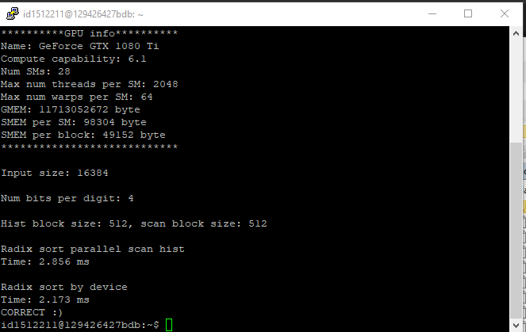
2. Song song hist và scan

Slide 5
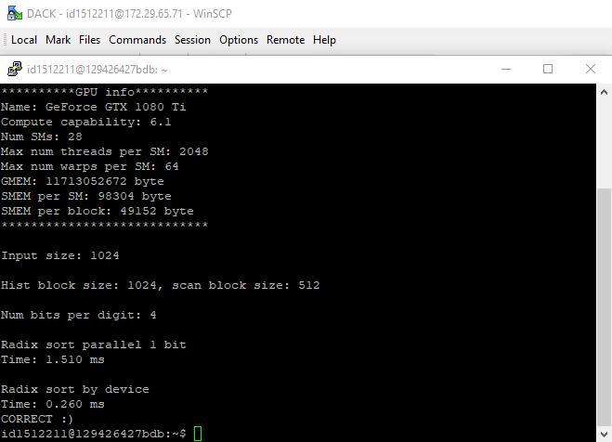
3. Song song 1 bit

Slide 6
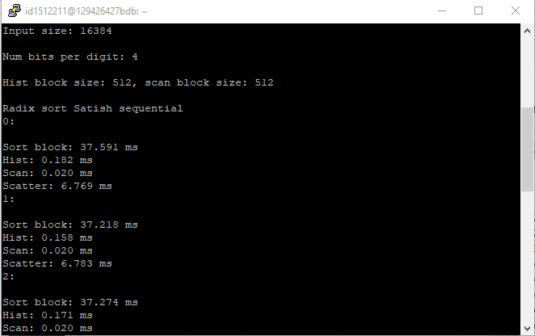
4. Radix sort by Satish tuần tự

Slide 7
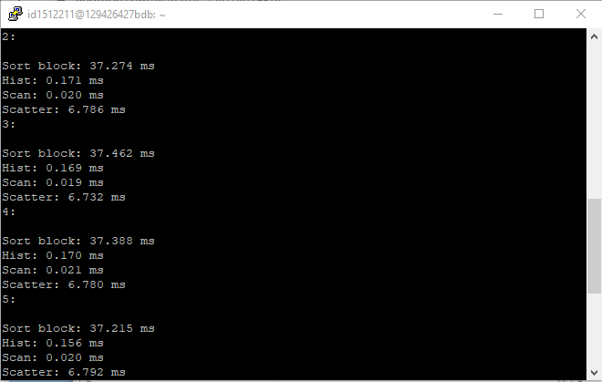

Slide 8
II. Cải tiến
1. Song song các hàm sort bit, hist, scan, scatter và tuần tự sort digit (1 block): 9.9628 ms
2. Song song các hàm sort bit, hist, scan, scatter và tuần tự sort digit (Nhiều block): 32.9526 ms
3. Sử dụng smem vào histogram: 32.9918 ms
4. Song song hàm sort digit: 11.6814 ms
5. Sử dụng luồng CUDA: 10.9792 ms

Slide 9
Thời gian trung bình (5 lần chạy)
Version (N = 2^14) | Code (ms) | Thrust (ms)
1 | 9.9628 | 0.2378
2 | 32.9526 | 2.1956
3 | 32.9918 | 2.1956
4 | 11.6814 | 2.1956
5 | 10.9792 | 2.1956

Slide 10
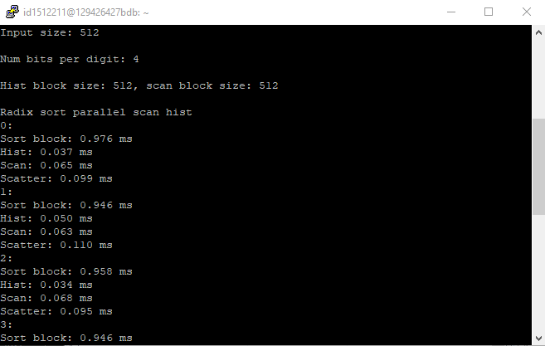
Version 1

Slide 11
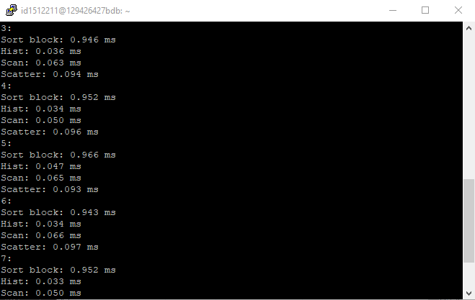

Slide 12
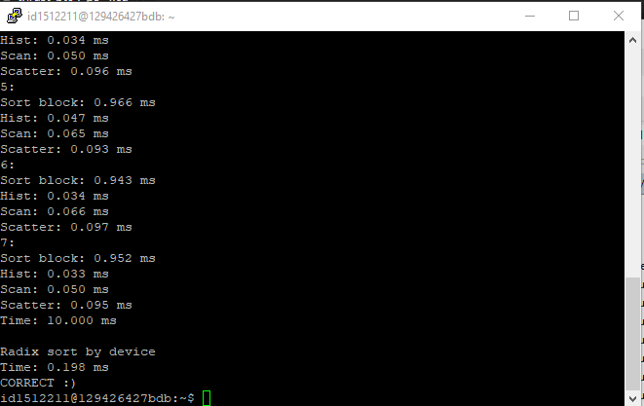

Slide 13

Version 2

Slide 14
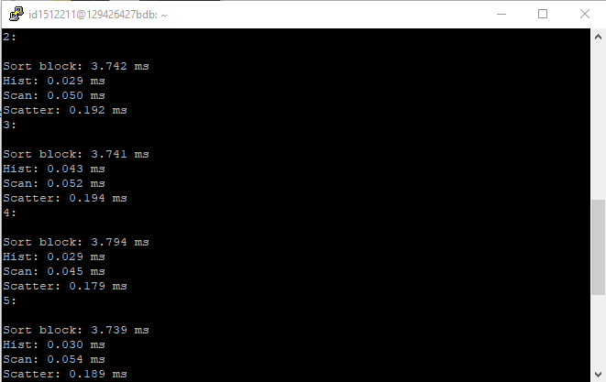

Slide 15
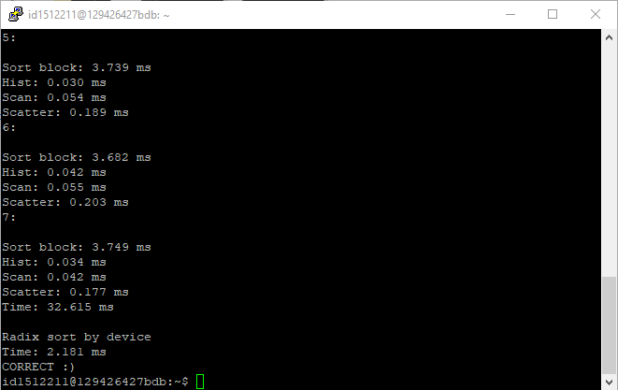

Slide 16

Version 3

Slide 17
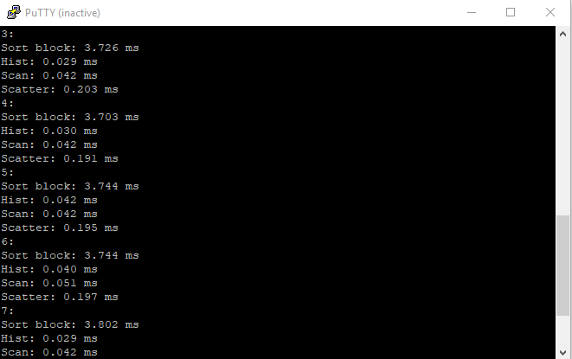

Slide 18
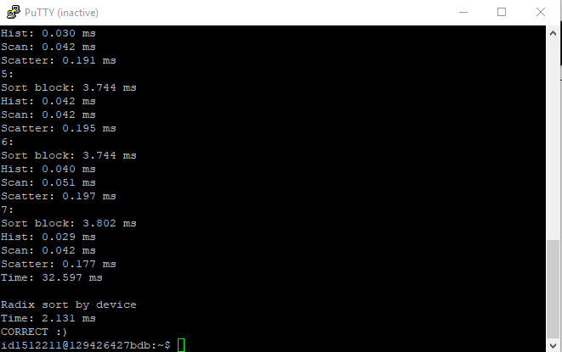

Slide 19

Version 4

Slide 20
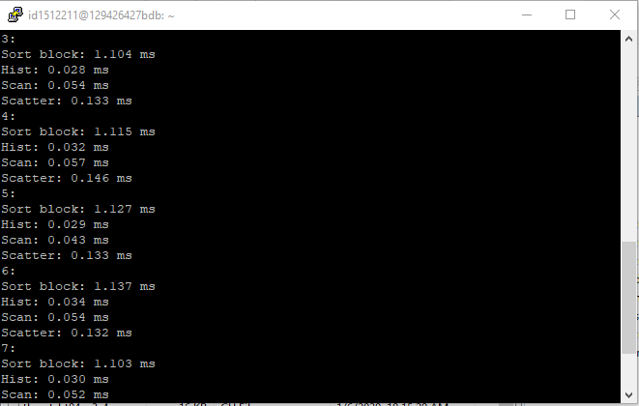

Slide 21
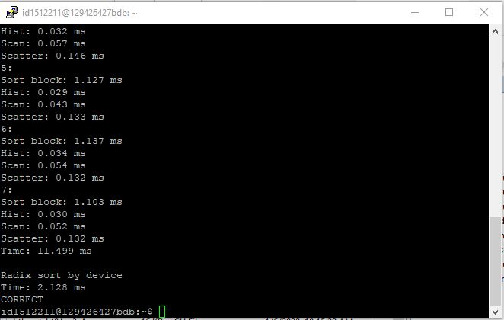

Slide 22

Version 5

Slide 23


Slide 24


Slide 25
Tổng quát

Slide 26
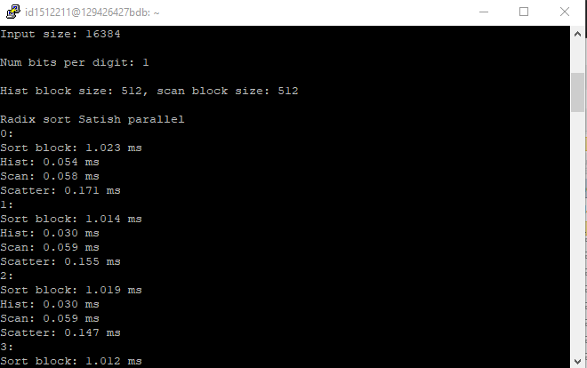
K = 1

Slide 27
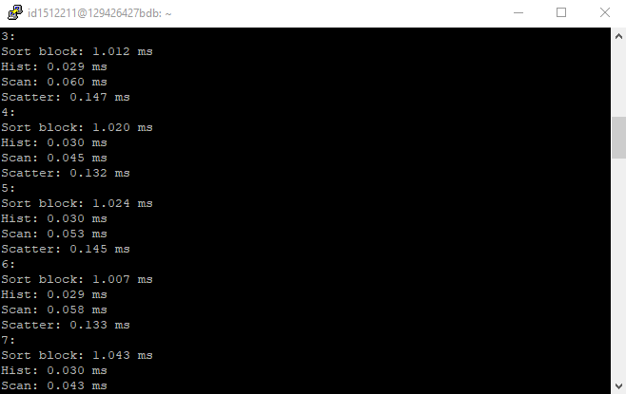

Slide 28
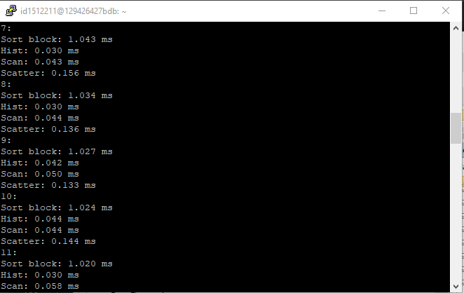

Slide 29
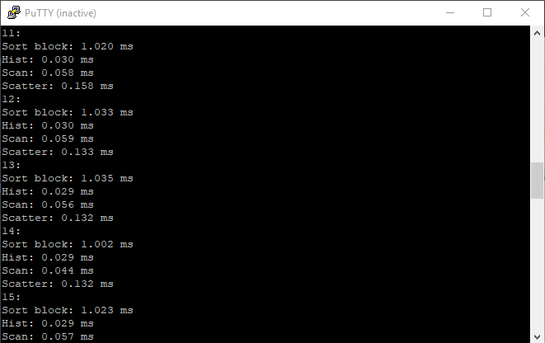

Slide 30
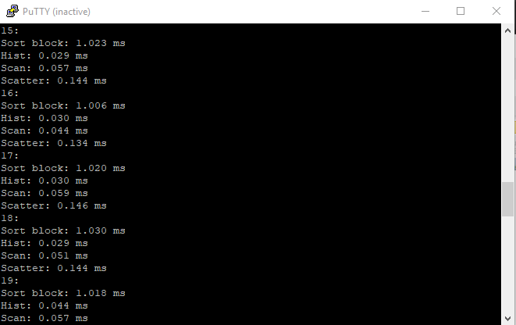

Slide 31
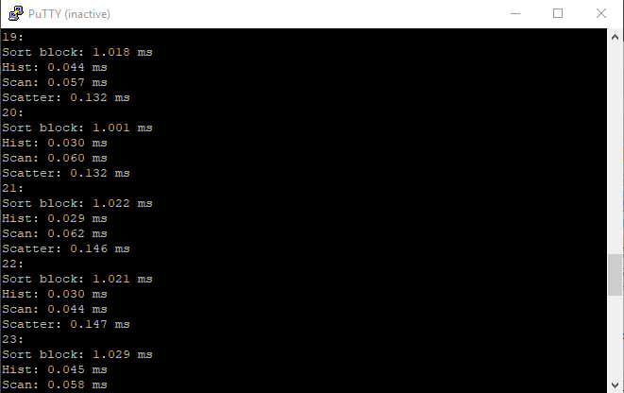

Slide 32
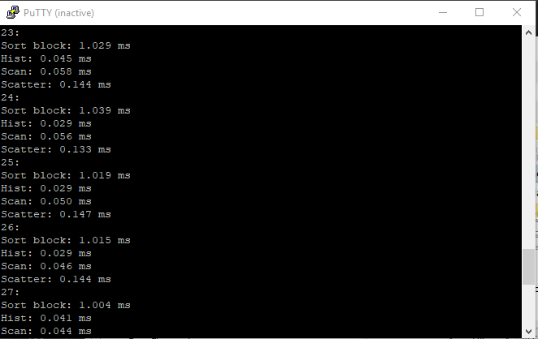

Slide 33
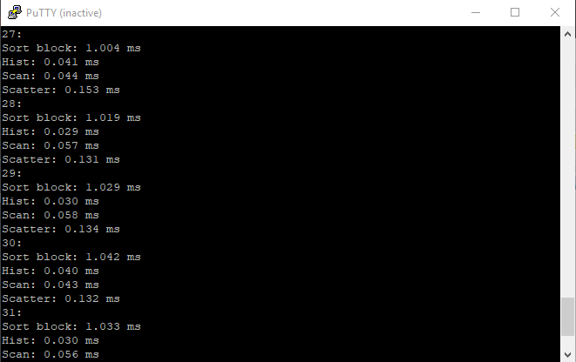

Slide 34
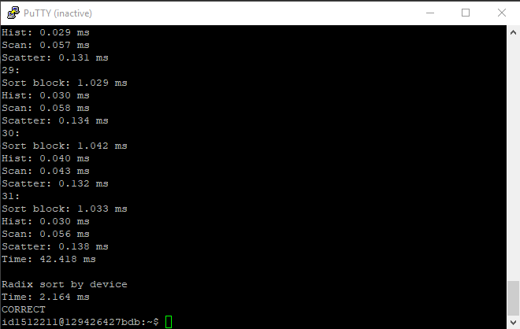

Slide 35
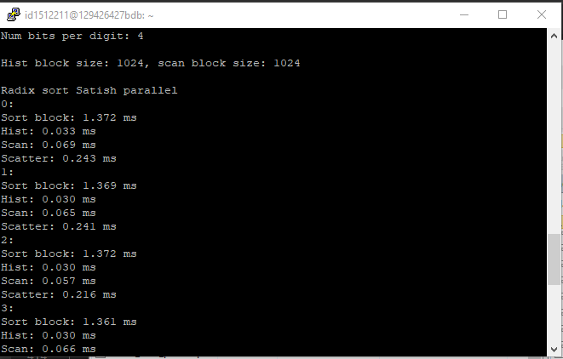
Block Size = 1024

Slide 36
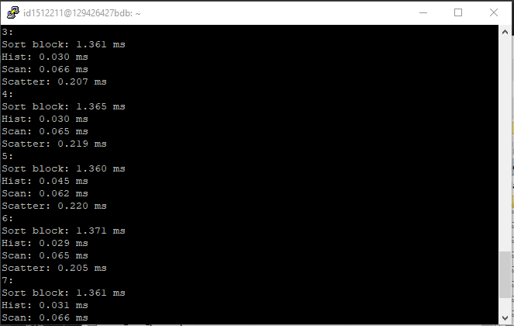

Slide 37
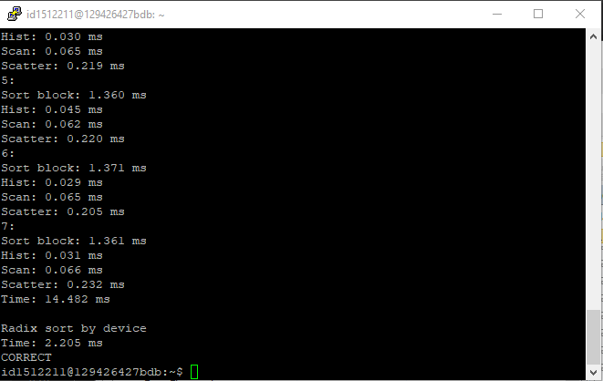

Slide 38


