Slide 1
CUDA RADIX SORT
1512211 - Trần Quang Huy
1412235 - Võ Xuân Khang

Slide 2
Baseline (Cập nhật n = 2^20)
N = 2^20 | Code | Thrust
Tuần tự | 145.1666 | 7.222
Song Song Hist | 97.3824 | 7.222
Satish Tuần Tự | 15731.52 | 7.222

Slide 3
(Cập nhật) Các phần trong Satish tuần tự
N = 2^20 | Time(ms)
Sort Local | 12232.22
Hist | 54.8102
Scan | 0.9562
Scatter | 3420.141

Slide 4
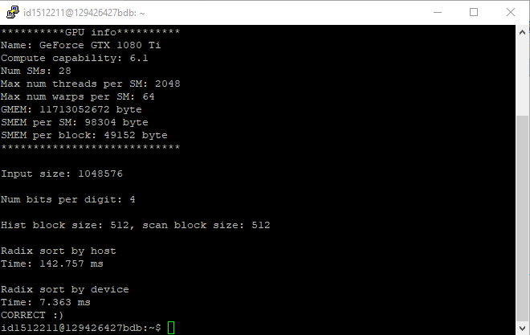
1. Tuần tự (Cập nhật n = 2^20)

Slide 5
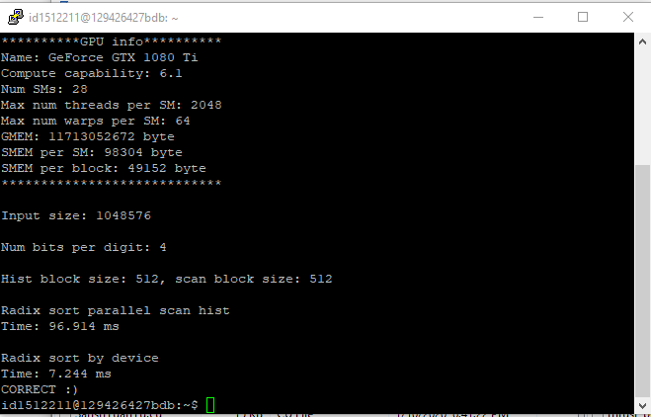
2. Song song hist (Cập nhật n = 2^20)

Slide 6
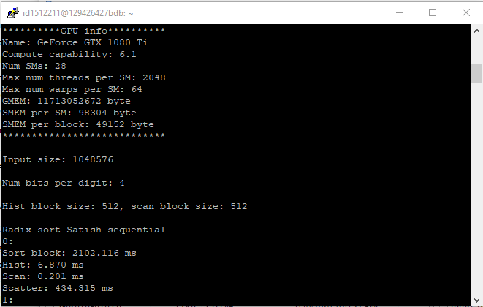
3. Radix sort by Satish tuần tư (Cập nhật n = 2^20) ̣

Slide 7
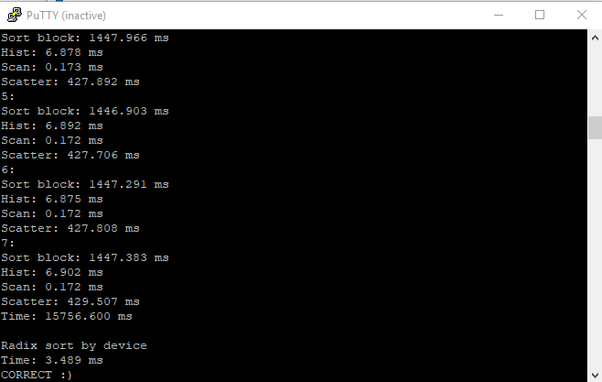

Slide 8
II. Cải tiến (Cập nhật với n = 2^20)
1. Song song các hàm sort bit, hist, scan, scatter và tuần tự sort digit (Nhiều block): 1576.948 ms
2. Sử dụng smem vào histogram: 1577.046 ms
3. Song song hàm sort digit: 268.6356 ms
4. Sử dụng luồng CUDA: 267.8074 ms

Slide 9
Thời gian trung bình (5 lần chạy) (Cập nhật với n = 2^20)
N = 2^20 | Code | Thrust
Version 1 | 1576.948 | 7.222
Version 2 | 1577.046 | 7.222
Version 3 | 268.6356 | 7.222
Version 4 | 267.8074 | 7.222

Slide 10
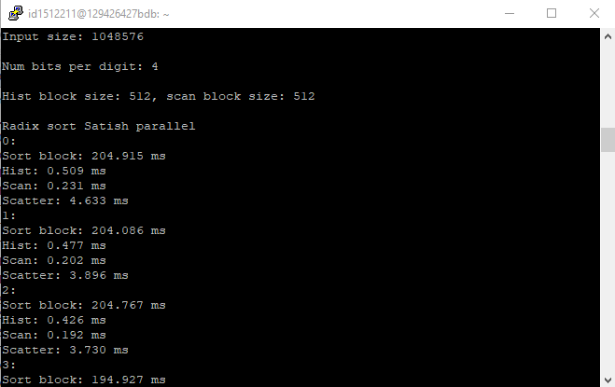
Version 1 (Cập nhật với n = 2^20)

Slide 11
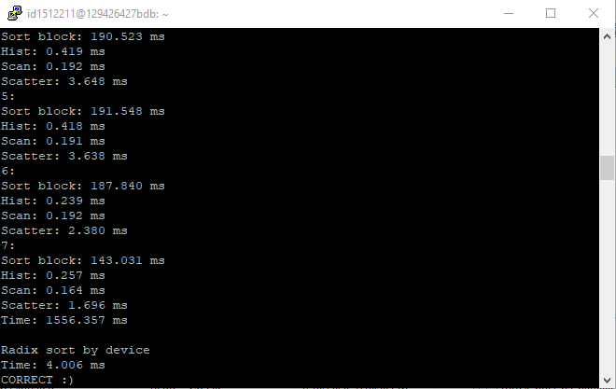

Slide 12
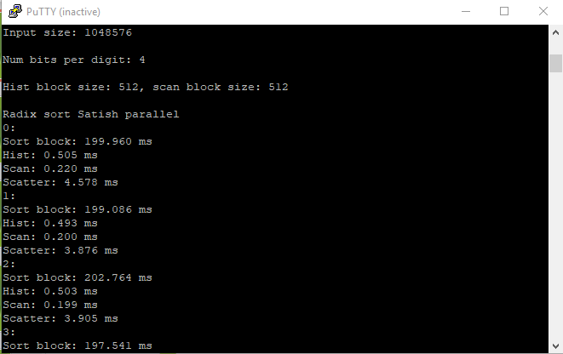
Version 2 (Cập nhật với n = 2^20)

Slide 13
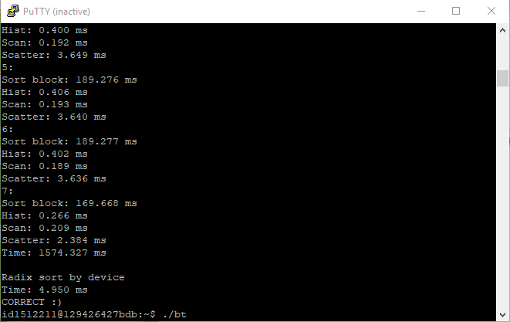

Slide 14
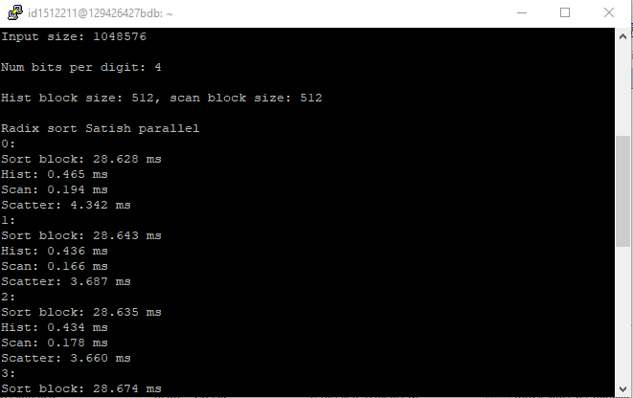
Version 3

Slide 15
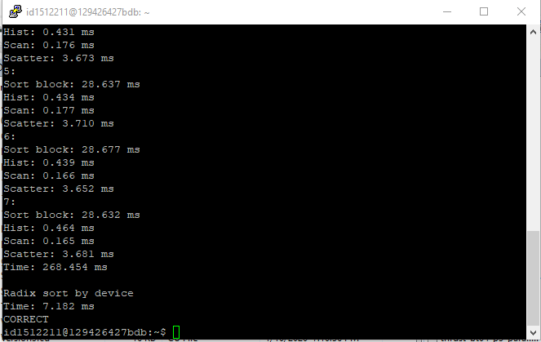

Slide 16
Version 4

Slide 18
Tổng quát (Cập nhật với n = 2^20)

Slide 19
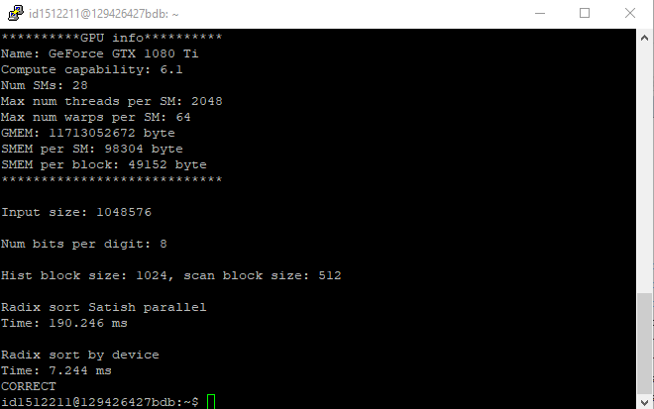
K = 8 bit (Cập nhật với n = 2^20)

Slide 20
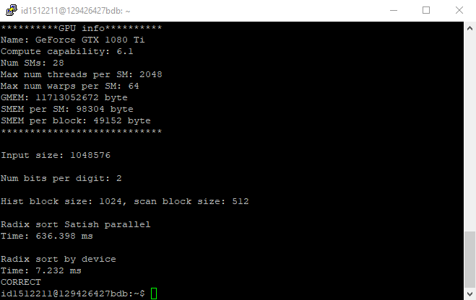
K = 2 bit (Cập nhật với n = 2^20)

Slide 21

Block Size = 256 (Cập nhật với n = 2^20)

Slide 22
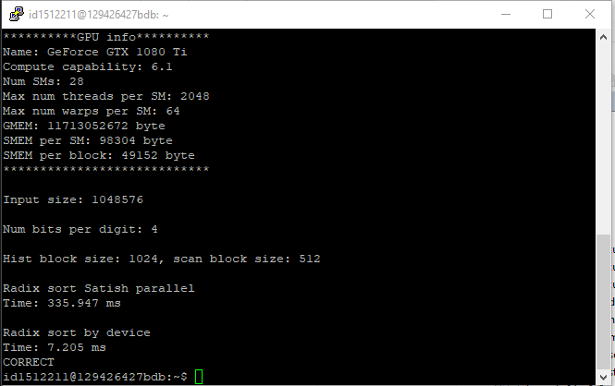
Block Size = 1024 (Cập nhật với n = 2^20)

Slide 23


