Slide 1
Dynamic Load Balancer
with Auto-Scaling and Performance Monitoring
Name: Mahmudul Hasan Efaz
Roll:1741
Supervisor’s name: Prof. Dr. Naushin Nower
Midterm Presentation

Slide 2
Project Overview
A load balancer that grows and shrinks its server pool on its own
1
Multiple Backends
2
Load-Balancing Algorithms
Backend servers talking over TCP sockets
Round Robin, Random, Least Connections
3
Auto-Scaling
4
Monitoring & Evaluation
Servers added or removed based on workload
Metrics, load tests, performance report

Slide 3
Methodology
Nine phases in two milestones
PHASE 1
PHASE 2
PHASE 3
Networking Basics
Multiple Backends
Basic Load Balancer
PHASE 4
PHASE 5
PHASE 6
Server Management
Health Monitoring
Metrics Collection
PHASE 7
PHASE 8
PHASE 9
Auto-Scaling Algorithm
Scaling Integration
Performance Evaluation
● Milestone 1: Functional Load Balancer (Phases 1–4) — COMPLETE
● Milestone 2: Intelligent Load Balancer (Phases 5–9)

Slide 4
System Architecture
How the components fit together
Client
Load Balancer
ServerManager
Backends
➜
➜
➜
Sends requests
Port 8080 • selects backend
fork / exec / kill
Ports 8081, 8082, 8083…
Admin commands at runtime: add • remove <port> • list • quit
Run with: ./loadbalancer roundrobin (algorithm chosen at startup)

Slide 5
Implementation Progress
Milestone 1 — Functional Load Balancer ✔
✔
Phase 1
TCP server/client, bind, listen, accept, send/receive
✔
Phase 2
Configurable-port backends (8081–8083) that identify themselves
✔
Phase 3
Load balancer on port 8080 forwarding requests; algorithm selectable at start
✔
Phase 4
Server / ServerManager classes, dynamic add & remove, status tracking, PID/port assignment

Slide 6
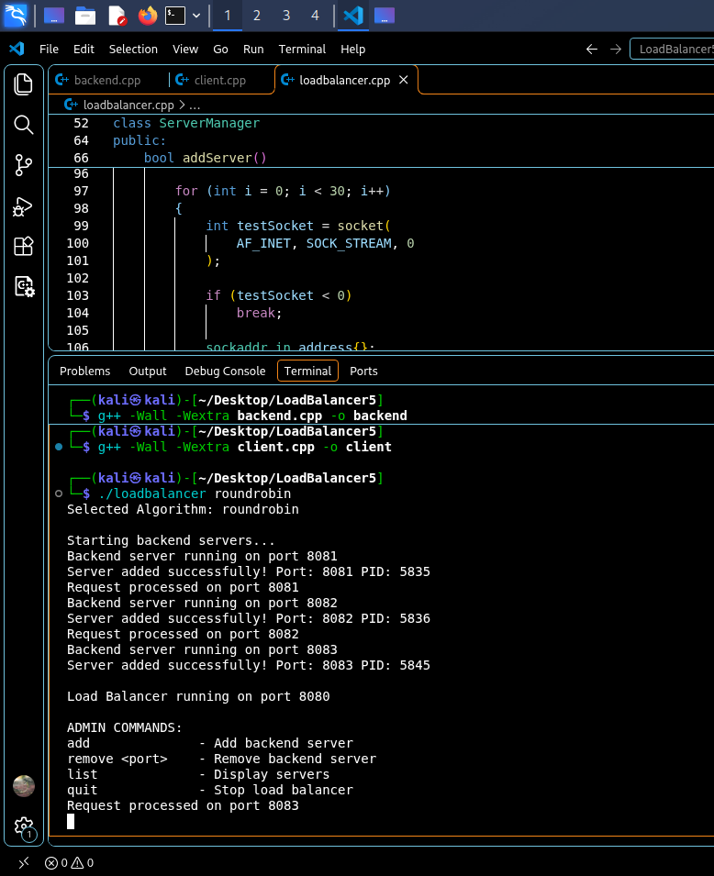
Demo 1: Startup
Compile, launch with Round Robin, three backends spawn automatically
g++ -Wall -Wextra builds backend and client
1
Backends start on 8081, 8082, 8083 with PIDs registered
2
Load balancer listens on 8080 and shows admin commands
3

Slide 7
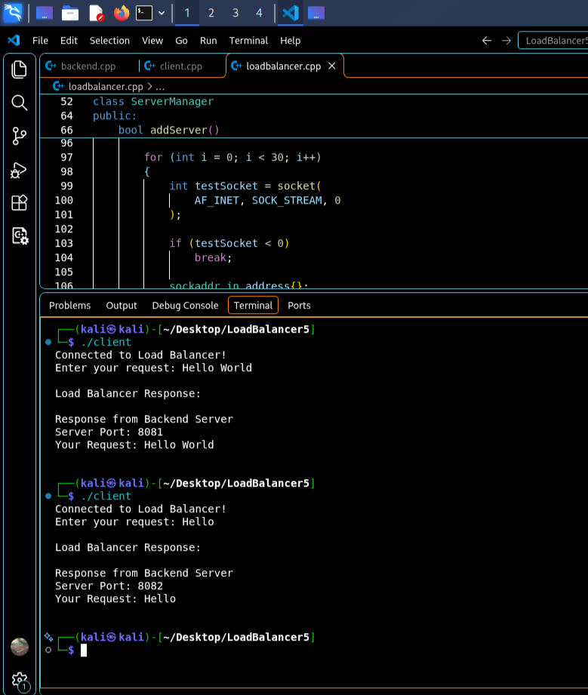
Demo 2: Round Robin in Action
Two client requests, two different backends
Client connects to the load balancer
1
"Hello World" is answered by port 8081
2
Next request "Hello" goes to port 8082
3

Slide 8
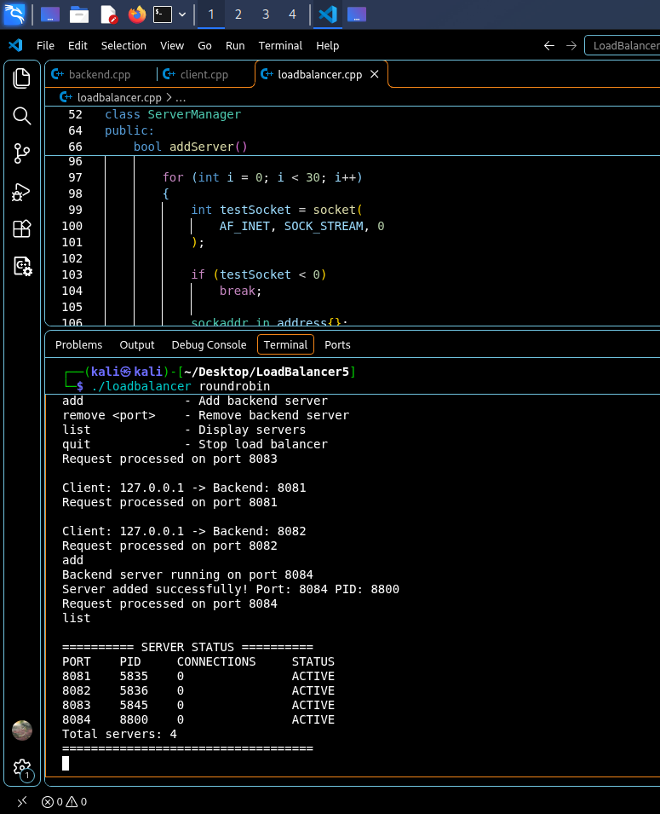
Demo 3: Dynamic Server Management
Adding a server while the load balancer is running
"add" starts a new backend on port 8084 (PID 8800)
1
Next request is served by the new server
2
"list" shows 4 ACTIVE servers with PID and connections
3

Slide 9
Remaining Work
Milestone 2 — Intelligent Load Balancer (Phases 5–9)
Phase 5
Health Monitoring
HealthMonitor class; detect dead or unresponsive backends; exclude unhealthy servers
Phase 6
Metrics Collection
Per-server and pool utilization U = C/Cmax × 100; throughput; response time
Phase 7
Auto-Scaling Algorithm
Thresholds 80% / 30%, 3 consecutive checks, cooldown, min 2 / max 10 servers
Phase 8
Integration
Connect metrics, scaler, manager and balancer without breaking live connections
Phase 9
Performance Evaluation
Load-testing client; throughput, avg and p95 latency, error rate; scaling on vs off

Slide 10
Auto-Scaling Plan
Parameters and safeguards planned for Milestone 2
2
10
80%
30%
5 s
Min servers
Max servers
Scale-up
Scale-down
Interval
Cooldown period between scaling actions
Three consecutive high/low checks before acting
Never go below min or above max servers
Never remove an unhealthy server as a normal scale-down

Slide 11
Thank You
Questions?

