Slide 1
Formal Verification of Multipliers by Computer Algebra brief Summary
By Chen Tang

Slide 2
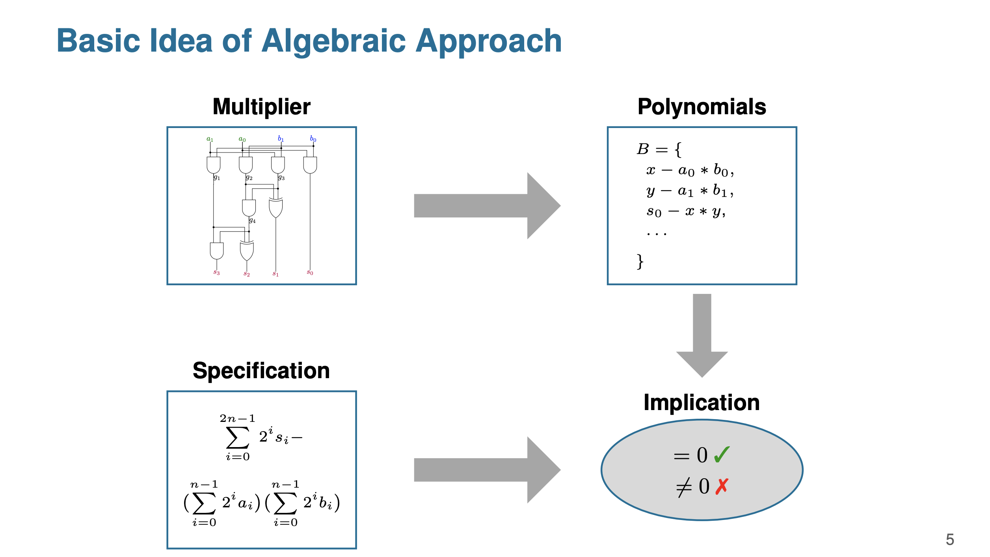

Slide 3
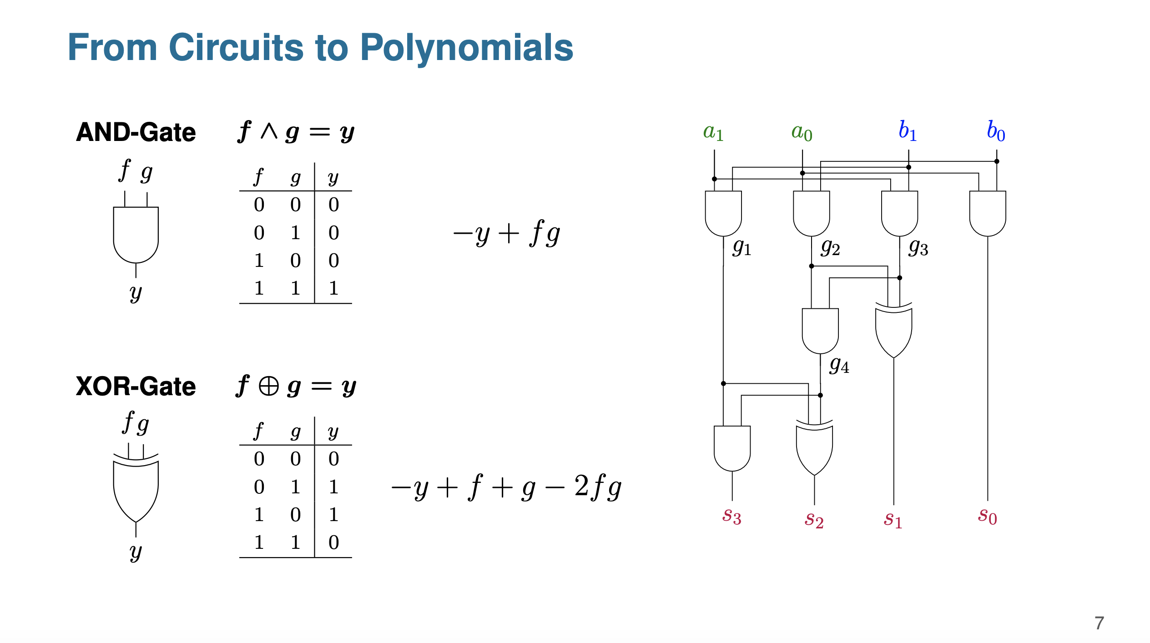

Slide 4
The polynomials of basic Boolean gates
z=¬a =⇒ g:=−z+1−a
z=a∧b =⇒ g:=−z+ab
z=a∨b =⇒ g:=−z+a+b−ab
z=a⊕b =⇒ g:=−z+a+b−2ab.

Slide 5
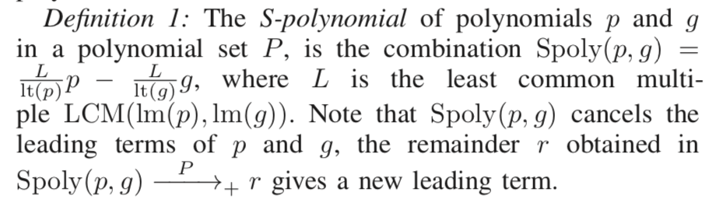
An Important Algorithm to Understand
The Spoly(p,g) is nothing more than a simplified algorithm to get the remainder of p/g (polynomial division)
Explanation:
Suppose p:= x4x3 + x1 and a polynomial g := −x4 + x2x1,
Then Spoly(p, g) = x4x3 p − x4x3 g = x3x2x1 + x1
Doing polynomial division provides the same result: suppose we do p/g
(x4x3+x1)/(-x4+x2x1)=-x3(Quotient) ……x1+x3x2x1(Remainer)
Conclusion: Spoly(p,g) means the remainder of dividing p by g.

Slide 6
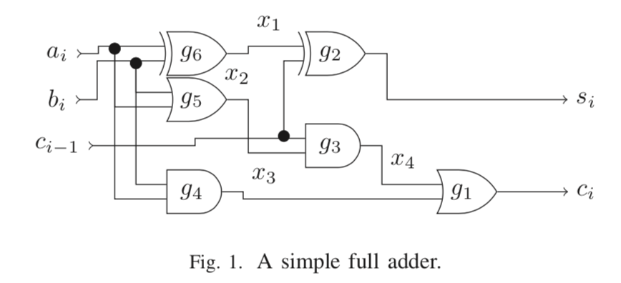

An example:
Implementing

Slide 7
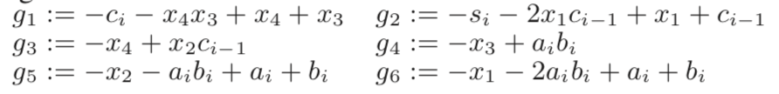
Function:
Pspec :=- si - 2ci + ai + bi + ci-1
First, we convert the circuit to algebraic model:
Then, we reduce Pspec by g1 to g6 sequentially.
Following such (topological) order of polynomial variable: ci >si >x4 >x3 >x2 >x1 > ci−1 > bi > ai.

Slide 8
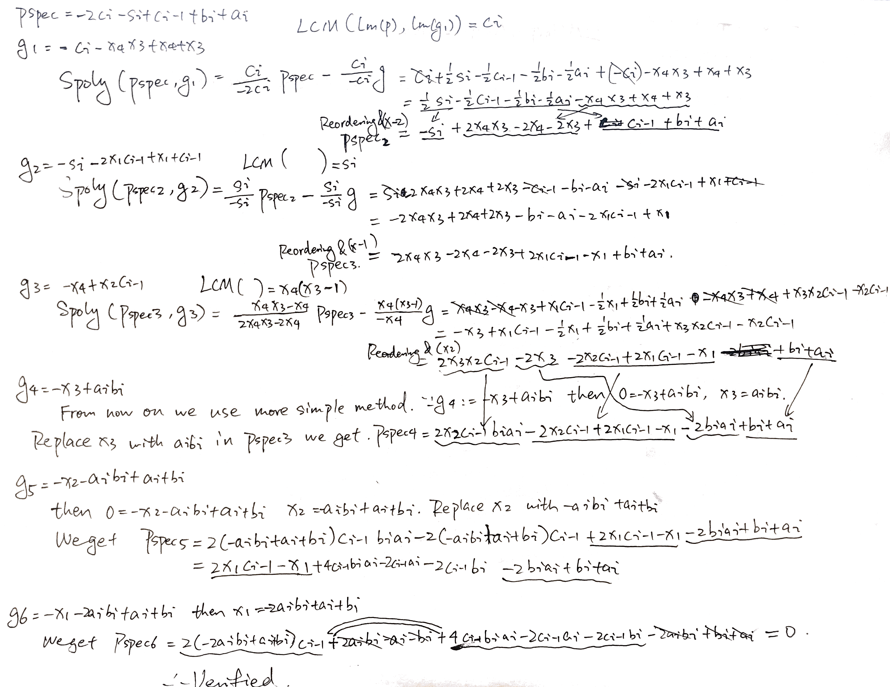
Process:

Slide 9
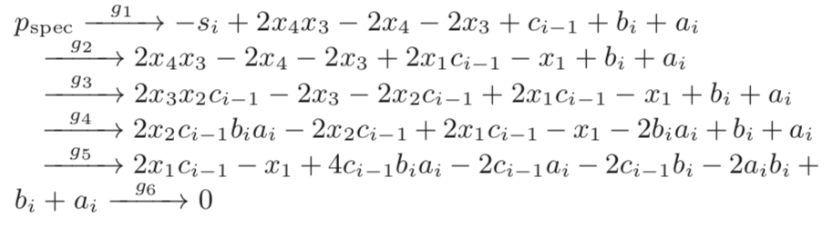
To Summarize the process:
Because the result is 0, therefore, it is verified!

Slide 10
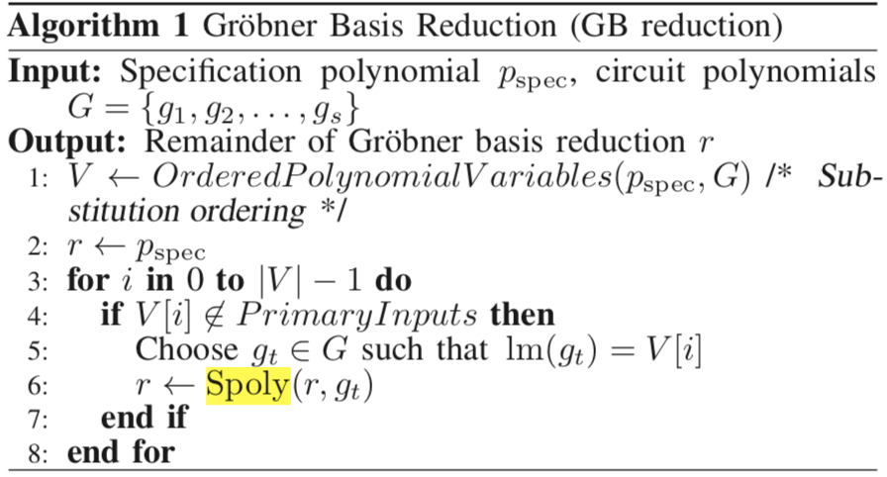
The formal way of writing the reduction process

Slide 11
AMULET
Amulet is a tool developed based on such ideology of verification.
Licensed under MIT.
Trying to improve the runtime by applying the idea of parallel programing.
Is there a way to break the reduction progress into independent processes?

Slide 12
Simple idea on simple example
g1 is consisted by the combination of x4 and x3. x4 is consisted by x2 ci-1. However, x3 is only consisted of ai and bi.
Therefore the reduction process can be divided into two relatively independent processes: reduce x3 and reduce x4.

Slide 13
Thanks for Listening

