Slide 1

BEGINNER PROGRAMMING LESSON
Custom Images and Sounds

Slide 2
LESSON OBJECTIVES
Learn to use the Display Block and Sound Block to add your custom images and sounds to the EV3

Slide 3
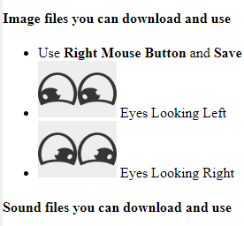
Download the Eyesleft and eyesright images
From the website https://transfer99.github.io/blog/2019/03/01/Lego-NXT
Download the 2 pictures with eyes left and right
These are under LESSON 5
Note where they were downloaded to

Slide 4
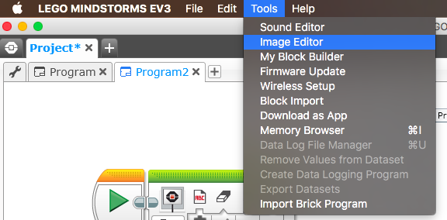
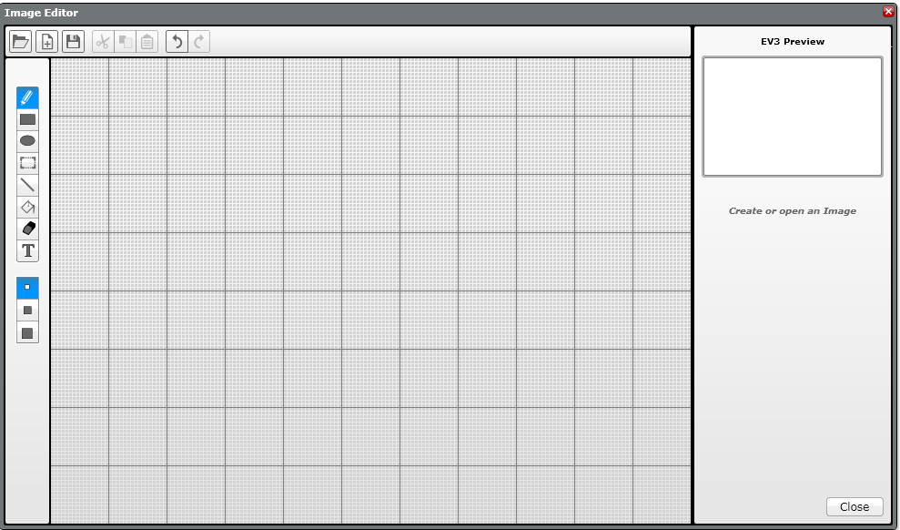
ADDING CUSTOM IMAGES
STEP 1: Select Image Editor from the EV3 Menu Note:
The Image Editor can open .rgf, .jpg, .png, and .bmp files. Color images are automatically converted to monochrome images. The .rgf file extension is what LEGO uses.
STEP 2: Open your image

Slide 5
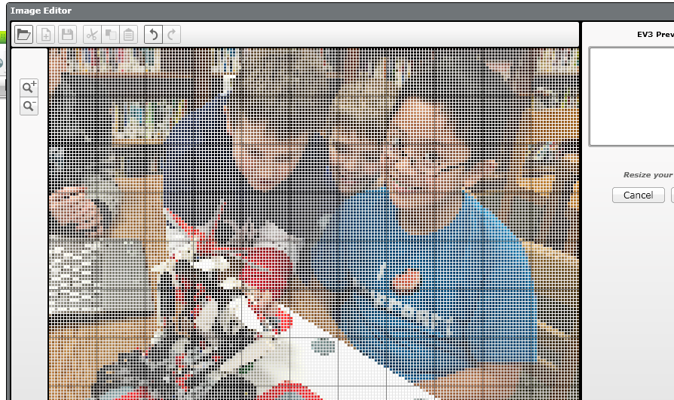
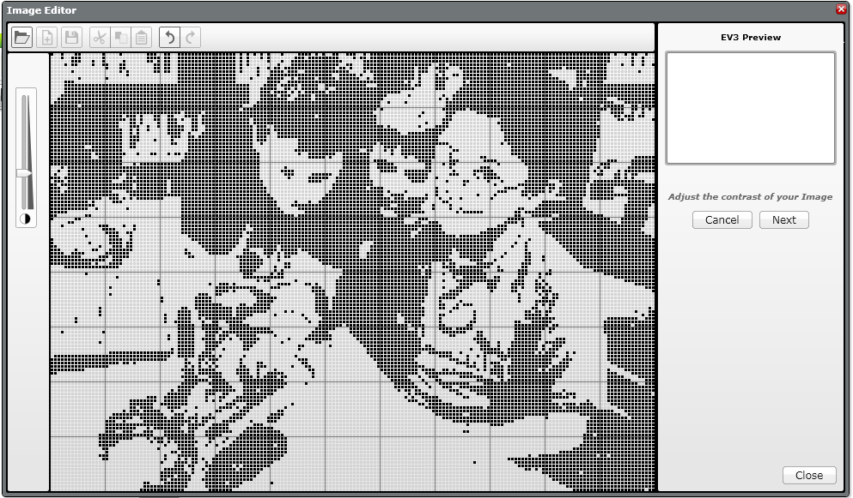
ADDING CUSTOM IMAGES
STEP 3: Change its size using the buttons and change the placement by selecting and moving the entire image around
STEP 4: Adjust the contrast

Slide 6
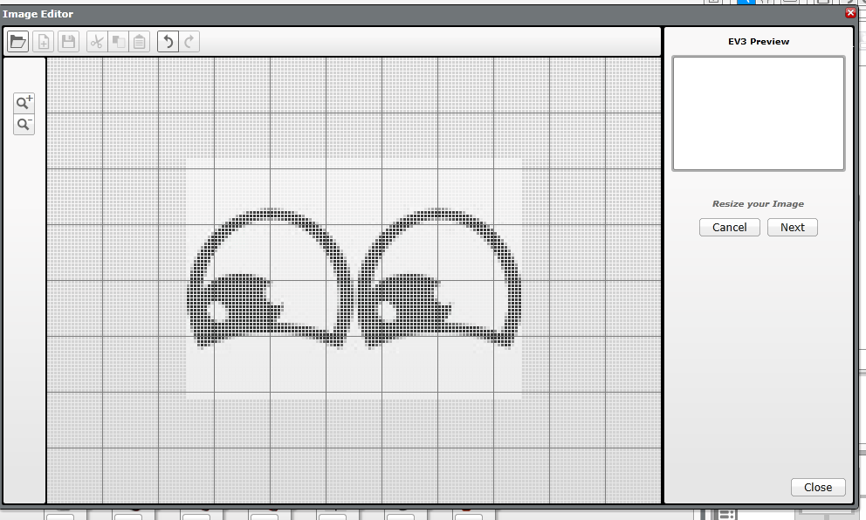
Using the eyes left and right images
Open the “eyes left” image
Reduce the size to about half using this zoom button
Position eyes in middle of screen
Press NEXT

Slide 7
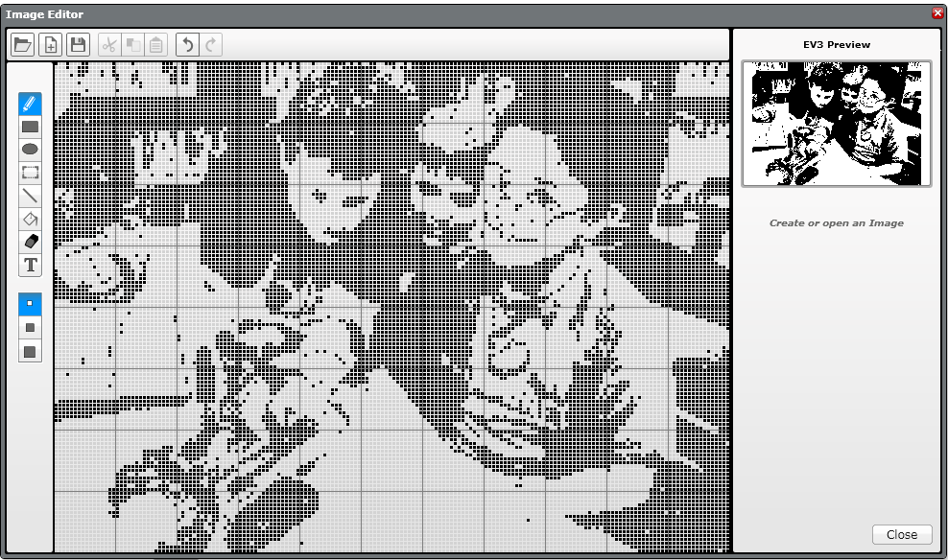
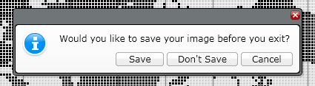
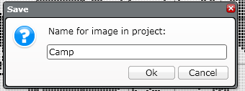
Adding CUSTOM IMAGES
STEP 5: Edit the image, using the tool palette to the left of the editing screen.
STEP 6: Save the image

Slide 8
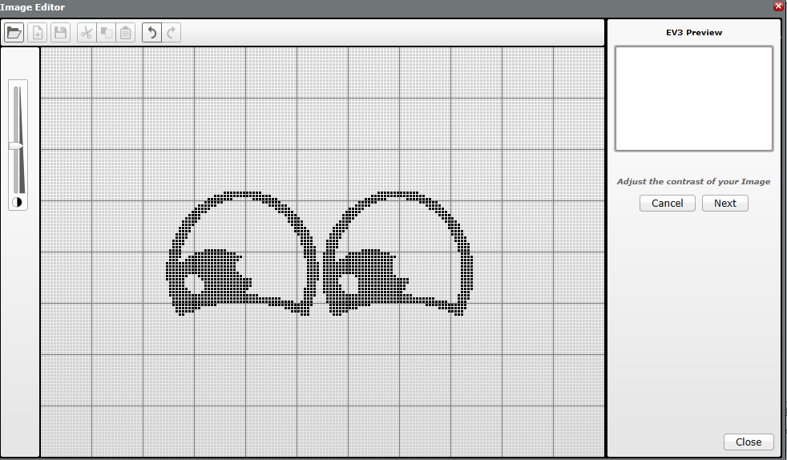
Using the eyes left and right images
Open the “eyes left” image
Fine tune the contrast using this slider
Press NEXT

Slide 9
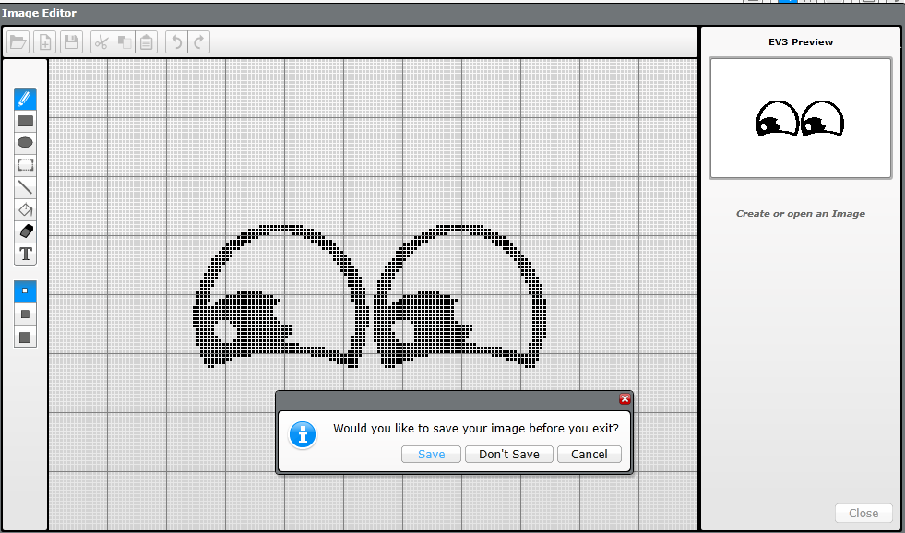
Using the eyes left and right images
Press the CLOSE button
Select Save
Save the image with a sensible name suck as “EyesLeft”

Slide 10
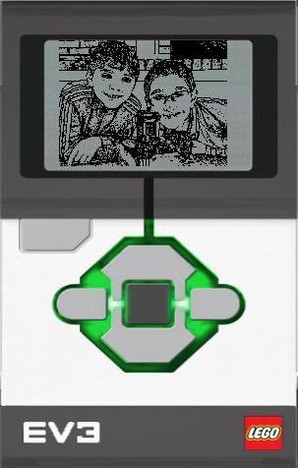
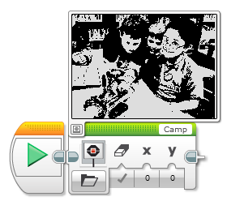
Adding CUSTOM IMAGES
STEP 7: This image is now ready to use in your display block

Slide 11
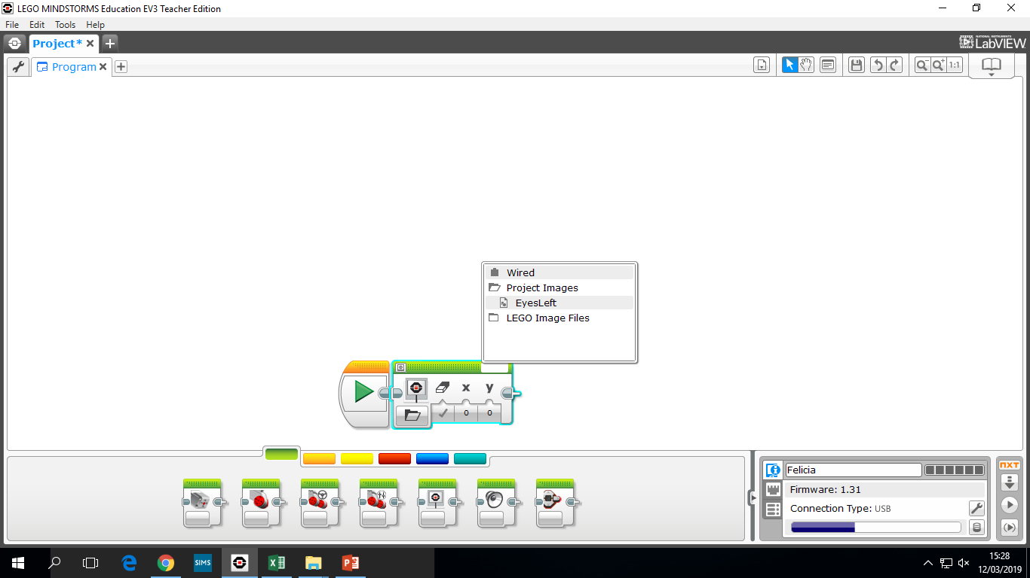
Using the eyes left and right images
Select the display block
Press in the name area
Select the image to display
After selecting the image press the preview button
Adjust x and y position so image in centre of preview

Slide 12
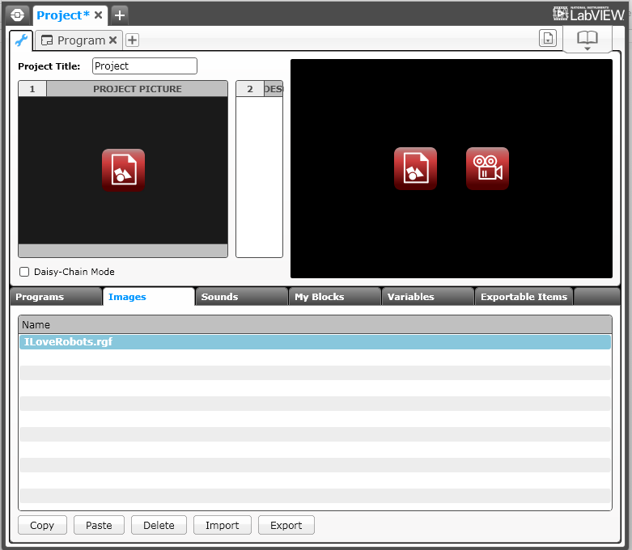
Sharing your RGF FILE
Click on the wrench tool in your project
Select the Images Tab
Click on the .rgf file
Click on Export and save the file
You can now send this file to anyone you want to
If you want to add a .rgf file sent to you to your project, simply choose Import instead

Slide 13
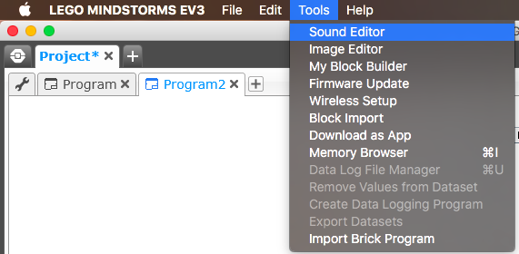
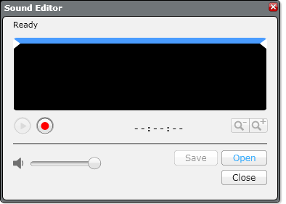

ADDING CUSTOM SOUNDS
STEP 1: Select Sound Editor from the Tools Menu
STEP 2: Click on Open and select a sound file or record your own using the red button

Slide 14
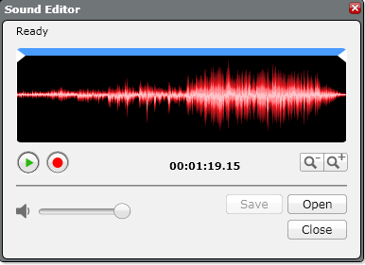
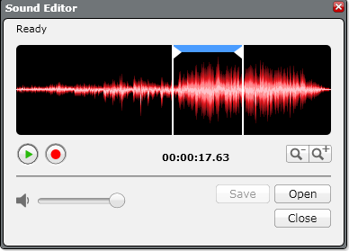
ADDING CUSTOM SOUNDS
STEP 3: The sound you selected will appear in the editor
STEP 4: Move the blue bar to change the size of the clip

Slide 15

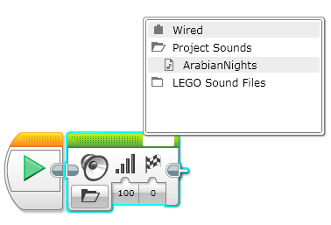
ADDING CUSTOM SOUNDS
STEP 5: Save the file
STEP 6: The sound will appear in the sound block

Slide 16
CREDITS
This tutorial was created by Sanjay Seshan and Arvind Seshan
More lessons are available at www.ev3lessons.com
This work is licensed under a Creative Commons Attribution-NonCommercial-ShareAlike 4.0 International License.

