Slide 1
Pseudo to Python example
2 Adder Program
Select a line of pseudo code
Using the pseudo code to python cross reference table determine the target python code
Pseudo code Lesson 2 Notebook
Add that line to the program
May have to change variable name(s)
May have to add some suitable python syntax
Worked example follows

Slide 2
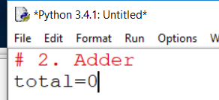
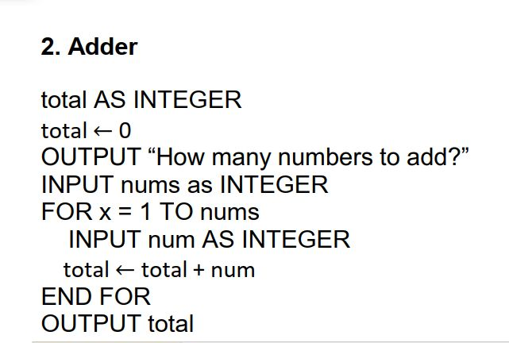
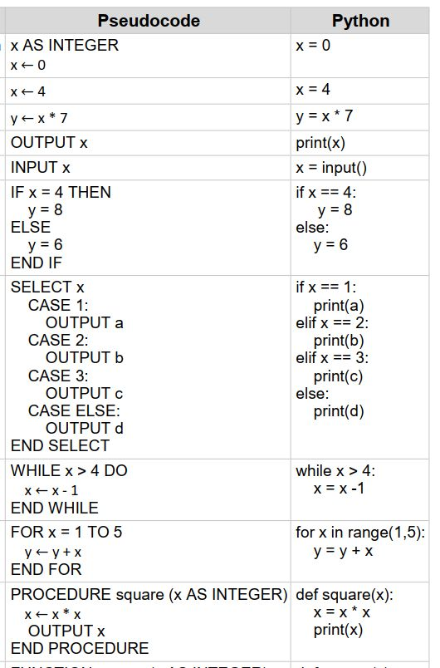

Slide 3
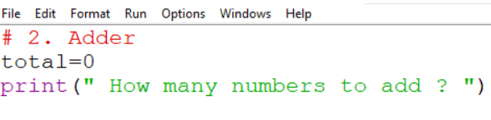

Slide 4
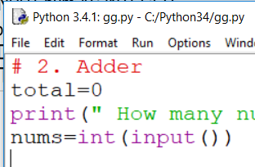

Slide 5
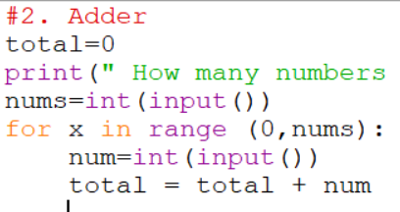

Slide 7
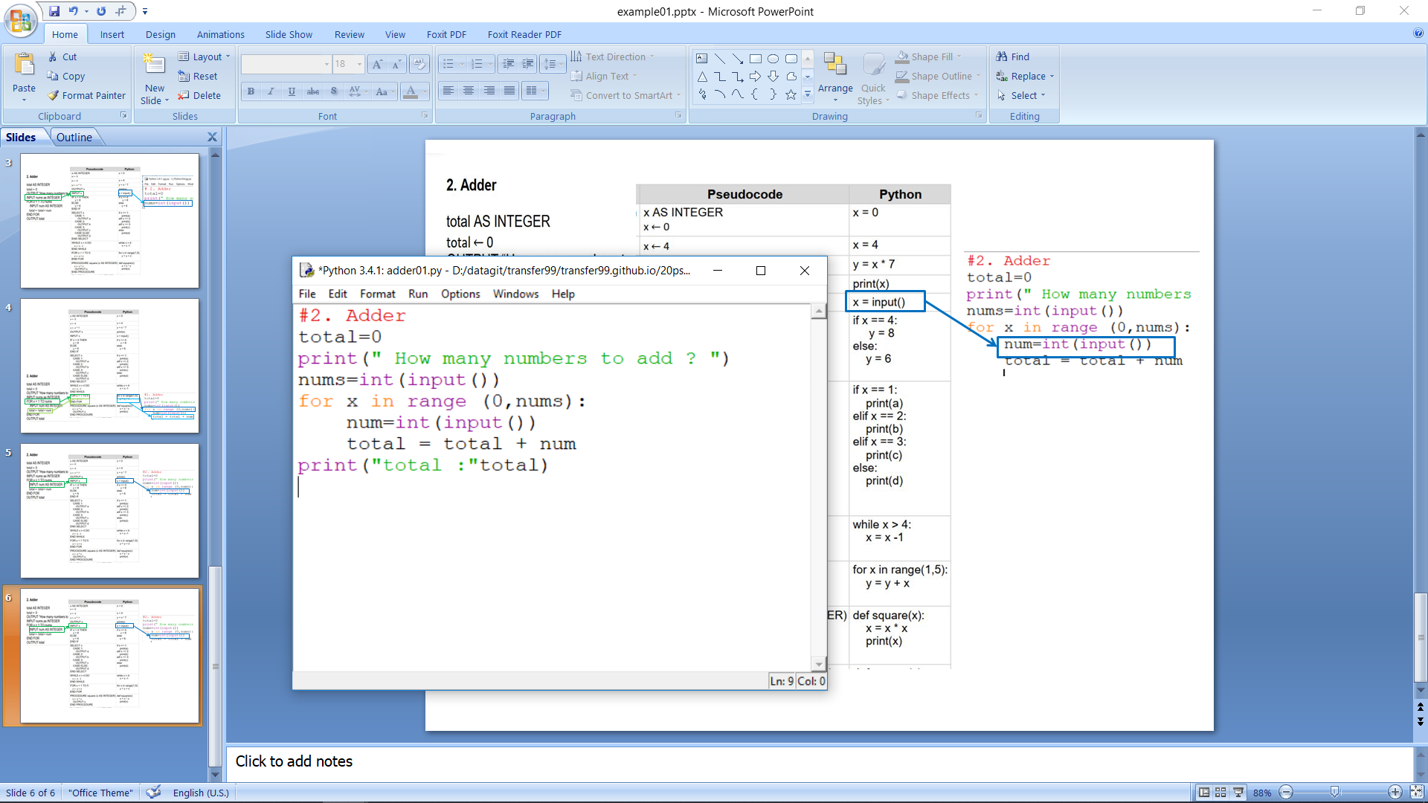

Slide 8
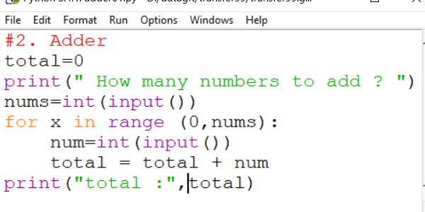
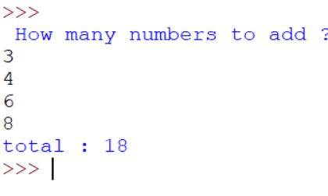
Completed Adder Program
Python Program
Example running the program for adding 3 numbers

